Slide 1
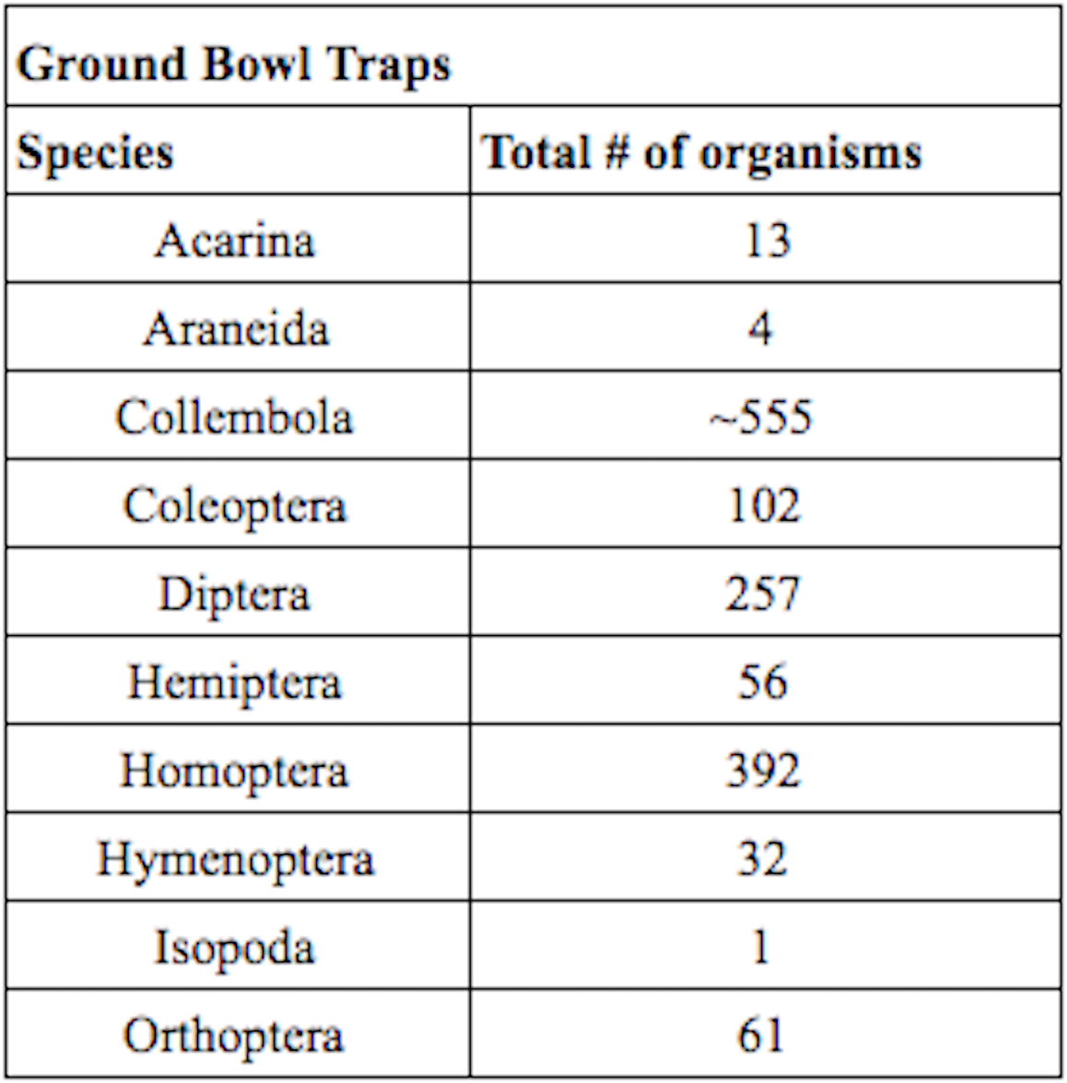
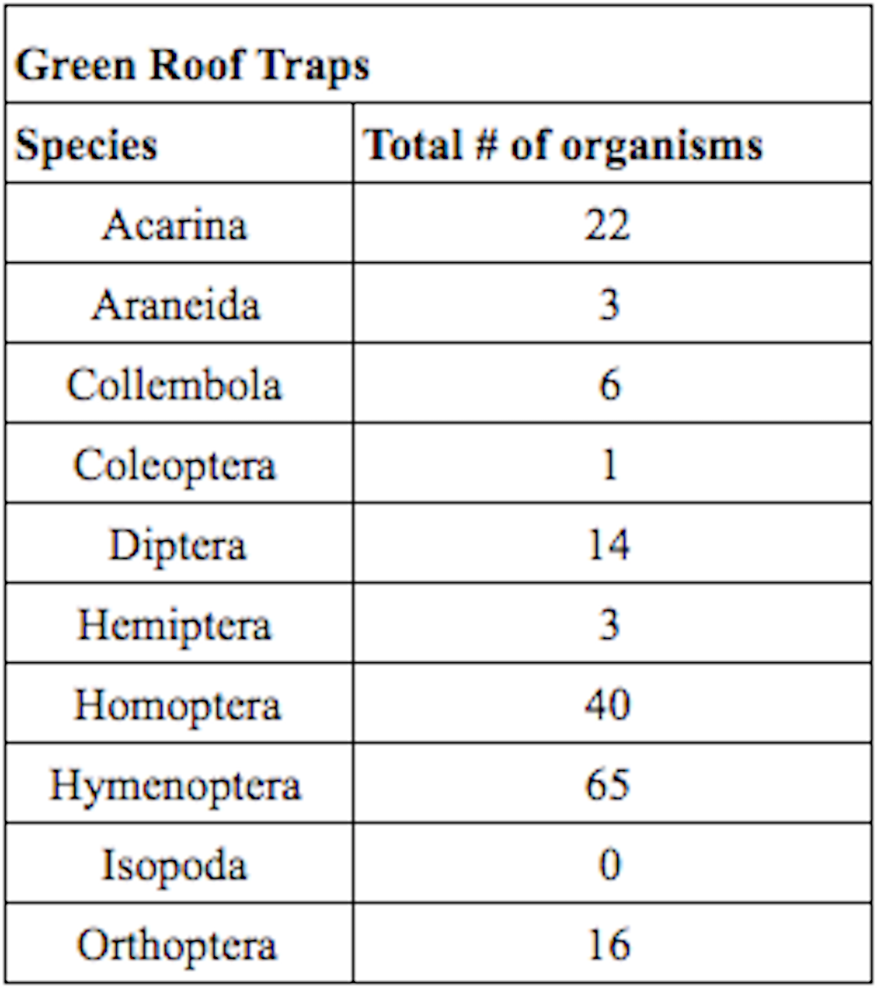
Using DNA Barcoding to Identify Biodiversity: A Comparative Study of the Invertebrate Fauna of an Urban Green Roof and the Ground Level
Ella Ezratty, Sasha Gérard & Ayse Aydemir, PhD
Bard High School Early College Manhattan
Abstract
Results
Biodiversity is a measure of the diversity and abundance of organisms in a habitat or ecosystem. In this study, the soil invertebrate biodiversity of a green roof and the ground level in East River Park, New York City were compared to each other. In addition, the invertebrate fauna at both sites were identified by DNA barcoding. The species abundance of the soil invertebrates was nearly ten times higher on the ground than on the green roof. Using DNA barcoding, invertebrates that belong to Diptera and Hymenoptera were correctly identified at the species-level and matched with the taxonomic identification at the order-level. At least three of the orders identified could not be barcoded due to unsuccessful DNA amplification. Future studies should continue to collect baseline information about the biodiversity of the greenroof to determine if they successfully promote biodiversity.
A total of four collections were made from the two sites from May-October 2016 (Table 1).
DNA barcoding and taxonomic identification were the same for two (Diptera and Hymenoptera) of the eight classes identified, but the other six did not yield successful PCR products.
Table 1. Taxonomic Identification of Organisms
From Four Sets of Dates
References
Table 2. Shannon-Wiener Index Calculations for the Green Roof and the Ground-Level
1. Cain M.L., Jackson R.B., Minorsky P.V., Reece J.B., Urry L.A., Wasserman S.A. 2014. AP Edition Campbell Biology textbook. United States of America: Pearson Education, inc. 2. Möhring, Caroline. 2008. “Deutsche Forschungsgemeinschaft Biodiversity Research.” German Research Foundation. 3. “Green Infrastructure.” [Internet] Lower East Side Ecology Center. 4.“John V. Lindsay East River Park.” [Internet] NYC Parks. 5. Kraft, Amy. 2013. Scientific American. 6. 2015. “Soil Ecosystems.” [Internet] The Environmental Literacy Council. 7. Cyverse. “DNA Subway”. Cold Spring Harbor Laboratory. 8. “Illustrated Guide to Major Groups of Soil Invertebrates.” Available:tiee.esa.org/vol/v3/experiments/soil/pdf/soil[Invertebrate_Key].pdf
Introduction
Biodiversity is a measure of the variety of organisms in a particular environment, and is based on species richness and abundance¹. Understanding biodiversity holds great importance in the conservation of endangered species, and in studying the restoration of ecosystems. Soil is a complex ecosystem that exhibits the significance of biodiversity. Soil plays a role in the ecological cycles, including the water and carbon cycle, and also houses a diversity and abundance of life greater than any other ecosystem⁶. Soil invertebrates are ecosystem engineers that contribute to the health of the soil community, through processes including soil aeration, nutrition, and decomposition⁶.
Green roof projects are being implemented in urban settings to help to mitigate the impacts of climate change, and provide space to conserve biodiversity. Green roofs also have economical and ecological benefits such as lowering energy usage for heating and cooling, reducing rainwater runoff, and increasing the amount of green space in cities⁵. Little is known about the biodiversity of urban green roofs. This study aims to investigate and identify the changing invertebrate fauna of a greenroof and the adjacent ground level.
These studies are helpful to determine if green roofs are meeting their promise to promote urban biodiversity.
Figure 1. DNA barcoding results for the Diptera and Hymenoptera collected, respectively.
Materials and Methods
Acknowledgements
Soil invertebrates were collected at GPS coordinates (40.712991,-73.976045) and (40.712824, -73.976194). Two sets of pitfall traps were set up in both locations every few weeks from May to October 2016. The pitfall traps included a bowl trap and a cup trap, each containing 10% detergent- salt water solutions. These traps were collected two days after being placed. In total, four dates of samples were collected on both the ground and green roof.
The samples were counted and identified taxonomically⁹. Soil invertebrates were also identified using DNA barcoding. DNA was isolated from the 8 different taxa using the Qiagen Dneasy Blood and Tissue Kit. PCR reactions were set up using PuReTaq Ready-To-Go PCR Beads and NEB Taq Master Mix with the Invertebrate CO1 primers. PCR products were confirmed with 2% gel electrophoresis and submitted for sequencing at Genewiz Inc. (South Plainfield, NJ). The sequences were analyzed using the DNA Subway program Blue Line⁷.From the two sites, data from different collection dates were pooled together and the the Shannon-Wiener biodiversity index was calculated, followed by a Kolmogorov-Smirnov (K-S) test (K=0.05).
Discussion
We would like to thank Kaitlyn Parkins (Lower East Side Ecology Center) for helping us collect specimens from the LESEC greenroof and for guidance and support during the course of the project. We also would like to thank Cold Spring Harbor Laboratory, DNALC for their support. Financial support for this project was provided by the Pinkerton Foundation (UBRP). Research permit for East River Park was approved by the NY City Parks Department.
The purpose of this project was to use DNA barcoding to identify invertebrates and to compare the biodiversity of the ground and green roof in East River Park. In addition to identification, the abundance of invertebrates collected in each location could be counted, and used to compare their biodiversity. Species abundance was higher at the ground-level than the green roof (Table 1). The biodiversity index calculations revealed that there is a difference between the biodiversity of the two sites (Table 2). One possible reason for this difference might that the greenroof is only a few years old and the invertebrate community composition is still undergoing change.
Using DNA barcoding, two of the eight species, Diptera and Hymenoptera, were correctly identified. One of the problems found with using taxonomic identification is the use of a guide that may have unclear illustrations that are hard to compare to real-life specimens. In addition, comparison of similar features can be difficult to conduct without prior information about the size of the organisms.
This study supports that DNA barcoding is a reliable method to identify invertebrates. It was used successfully in this project to compare the invertebrate biodiversity in two different sites. In the future, DNA Barcoding can be helpful in citizen science projects where invertebrate surveys are being conducted. Participating students can be initially trained using a similar outline to what the authors completed in this study.

