Slide 1








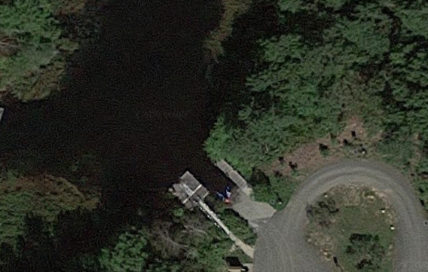
Peconic River Estuary: A Time Series Analysis of Biodiversity
Azizi, A., Balzano, V., Bogdan, J., Brylewski, J., Callahan, S., Cluff, C., Cortes, J., D'Gracia, A., Gayer, C., Giacolone, G., Godlewski, L., Gonzales, B., Hack, R.,
Hogan, S., Isaacson, B., Lavallee, T., McDonald, A., Nouicer, A., Parente, J., Patel, D., Perez, N., Rodrigues, E., Safian, M., Sbaschnik, M., Schlegel, F., Schlendorf, J., Sheludenko, K., Talamini, I., Thorley, L., Voorhees, D., Votteler, A., Wynne, A., Young, A., Zeltmann, K.
Eastport South Manor Junior-Senior High School • Teacher: Mr. Robert Bolen
Abstract
Over the last 4 years, students collected and document specimens of both aquatic and terrestrial organisms to assess the biodiversity of the Peconic River Estuary. These collections took place at the same location, the NYS DEC Boat Ramp on South River Road, on or about October 18 each year from 2015 through 2018. We report here the totality of organisms collected which illustrates the great biodiversity within the Peconic Estuary at this location.
Results
Methods and Materials
The Barcode Long Island Sample Database was used to develop a complete list of all organisms positively identified using DNA Barcoding.
Samples with high quality sequences wee selected as the samples have confirmed positive matches
Samples were verified by checking the FASTA sequences using a BLAST search to confirm the identification of the organisms
Table 1: Most abundant organisms collected from the Peconic River Estuary from 2015 through 2019
Table 2: Least abundant organisms collected from the Peconic River Estuary from 2015 through 2019
Table 3: Specimens that are designated as invasive species in New York State
Organism | Approximate Number Collected
Amphipod | Over 100
Beetle | 40-50
Damselfly | 60-70
Dragonfly | 80-90
Isopod | Over 100
Snail | 20-30
Water Boatman | 20-30
Organism | Approximate Number Collected
Caddisfly | 5
Crayfish | 8
Hellgrammite | 2
Spring Fishfly | 2
Moth | 1
Water Flea | 2
Wood Roach | 1
Organism | Invasive Species
Asian Clam | Corbicula fluminea
Banded Mystery Snail | Viviparus georgianus
Introduction
All samples were prepared, and documented by previous year’s teams
The goal of each team each year was to identify organisms, determine if any were invasive or disease carrying, and determine if and how these impacted human health.
All DNA sequences were obtained from previously extracted, sequenced, and analyzed mitochondrial CO1-gene sequences.
Location of sampling site
Discussion
Dragonfly and damselfly larvae make up a large portion of the organisms sampled. Both organisms are excellent biological controls of mosquitoes. Amphipods are a major food source for fish, as are beetles, and other insects.
Water quality
Questionable due to the presence of many
poor water quality indicators such as leeches
and snails and absence of crayfish
Human Health Impacts
                Direct Effects: Snails and leeches can impact
                human health negatively; they can transmit
                disease directly to humans.
Indirect Effects: Crayfish that can reduce
dragonfly populations which result in
increased mosquitoes
Table 4: Species diversity of most abundant organisms collected from the Peconic River Estuary from 2015 through 2019. Names in red are most abundant.
Wood Roach
Organism | Number of Different Species | Species Identified
Amphipod | 2 | Gammarus gammarus, Ampithoe helleri
Beetle | 8 | Peltodytes tortulosus, Peltodytes edentulous, Harpalus affinis, Pelocoris femoratus, Anomala orientalis, Melanotus morosus, Sacarbidae species, Halipdae species
Damselfly | 4 | Enallagma geminatum, Enallagma signatum, Ischnura verticalis, Lestes inaequalis
Dragonfly | 7 | Erythemis simplicicollis, Anax junius, Basiaeschna Janata, Tetragoneuria canis, Tetragoneuria cynosure, Pachydiplax longipennis
Isopod | 2 | Caecidotea communis, Asellidae species
Snail | 6 | Viviparus georgianus, Tritia obsoleta, Menetus dilatatus, Physella acuta, Pseudosuccinea columella, Amnicola limosus
Water Boatman | 2 | Notonecta triguttata, Corixidae species
Acknowledgements
Thank you to the teachers at ESM who mentored over 100 students the last 5 years: Mr. Bolen, Mr. Ostensen, and Dr. Spata.
We are grateful to the scientists who provided open labs space: Dr. Moloney at SUNY Stony Brook and Dr. Perez at Brookhaven National Laboratory.
Thank you to Sharon Pepenella at the DNALC for picking up and dropping off samples and coordinating the whole barcode program.
Table 4: Organisms whose abundance has decreased
Table 5: Organisms indicative of water quality and frequency observed
Table 6: Organisms that may transmit disease (viruses or bacteria)
Resources
The NCBI BLAST website was used to verify the identify of samples
The Barcode Data Base was the source for all confrimed sequenced samples
NYS DEC Invasive Species List https://www.dec.ny.gov/animals/265.html.
Organism | Year Last Observed
Caddisfly | 2016
Crayfish | 2017
Hellgrammite | 2016
Spring Fishfly | 2016
Water Flea | 2016
Organism | Water Quality Indicators
Leech | Poor (every year)
Crayfish | Good (2017)
Dragonfly | Good (every year)
Hellgrammite | Very Good (2016)
Caddisfly | Very Good (2016)
Organism | Pathogen Transmitted or Effect on Ecosystem
Amphipods | Carry viruses, some may be parasitic
Crayfish | Can reduce dragonfly population which increases mosquito population
Leech | Potential vector of blood-borne pathogens
Snails | Parasitic flatworms (Schistosomes)

