Slide 1
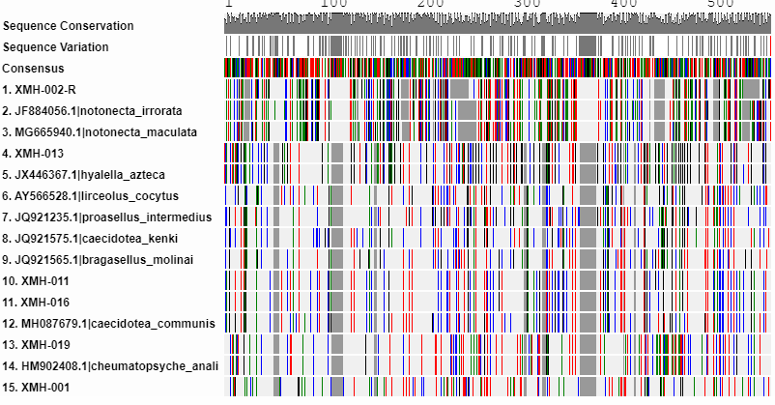
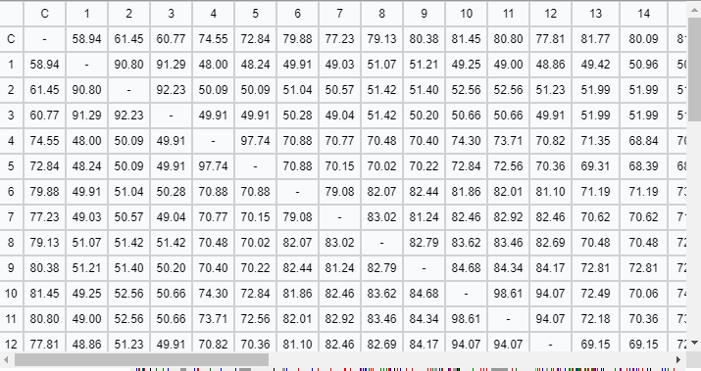
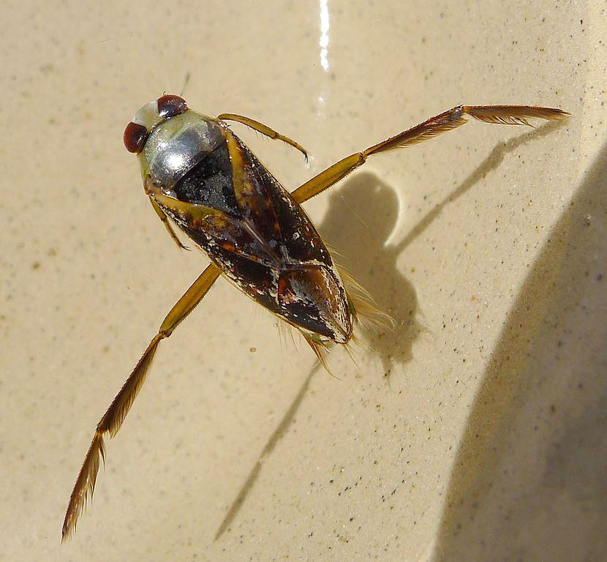
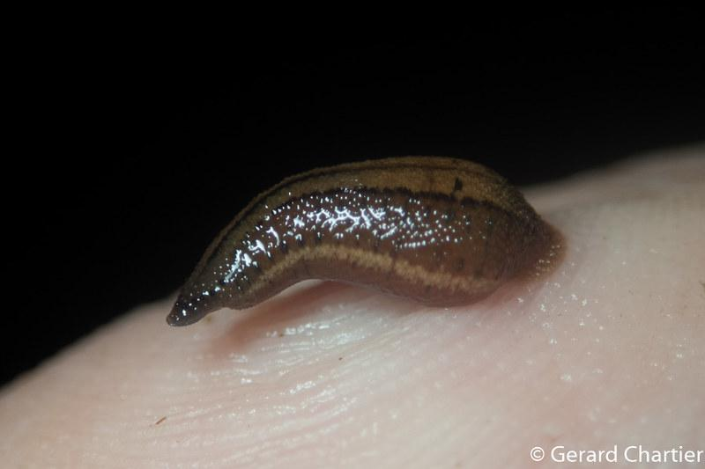
DNA Barcoding
Fallon McKenna, Scarlett Melia, Sophie Rambelle, Natalie Reid
Abstract
Human activities have impacted the Peconic Estuary significantly by increasing the amount of nitrogen, introducing non-native species, and reducing oxygen levels due to algal blooms which contributed to a loss of biodiversity. Some of these impacts may have a negative effect on humans if they promote the survival of organisms that carry disease, are non-native, and interfere with the survival of native beneficial species. This will harm that ecosystem overall, and could potentially lead to diminished biodiversity. Due to COVID 19 we are not able to collect the samples ourselves, and observe first-hand all the microorganisms living in the river. Fortunately, we were able to use the samples from last year that were not sequenced and send them out for DNA sequencing. The gene that we are barcoding is the COI gene. We use the COI gene for barcoding because it can be used to identify animal species. This gene sequence is suitable for this role because its mutation rate is fast enough to resolve differences between species. This will allow us to measure the biodiversity within the Peconic Estuary by determining the overall diversity within the samples we obtained.
Mentor: Dr. Spata
Eastport South Manor Jr-Sr High School
Discussion
The majority of the organisms found in the DNA sequencing is backswimmers. The organisms are from North America. Many of these organisms happen to be a form of crustacean as well. In the process of barcoding the DNA, our samples looked to be very similar to one another and when doing the muscle, we had seen that one was 100% similar to the other sample. The Hylallea Azteca organism was the most abundant organism. The Hylallea Azteca is a form of crustacean. Another abundant organism is a form of Leech in the Erpobdellidae family.
Materials & Methods- Seining and dip nets were used to collect specimens from the river.
Samples were separated by visual inspection as amphipods, dragonfly larvae, beetles, and “other invertebrates”.
Samples were placed in glass vials at the school and photos taken from four different sides (top, bottom, front, and rear) to document the organisms.
Samples were then stored in 99% ethanol in a non-defrosting freezer until they were needed for tissue and DNA extraction.
References
1)https://www.peconicestuary.org/peconic-estuary/the-peconic-estuary-story/
2)https://www.onthewater.com/multi-agency-study-finds-sources-fish-kills-peconic-river
3)https://southoldlocal.com/2016/05/11/peconic-river-turning-brown-dense-mahogany-tide-algae-bloom-blamed-last-years-massive-fish-turtle-kills/
4)https://www.nature.org/en-us/get-involved/how-to-help/places-we-protect/long-island-peconic-estuary/
Introduction
Macroinvertebrates,are organisms that are large (macro) enough to be seen with the naked eye and lack a backbone. They inhabit all types of running waters, from fast flowing mountain streams to slow moving muddy rivers. Aquatic macroinvertebrates include crayfish, clams, snails, and worms, dragonfly and stonefly larvae, snails, worms, and beetles. In the past years, efforts had been made to improve water quality, likely resulting in an increased diversity of certain macroinvertebrates. Our goals for this project are to work as a team to successfully sequence our samples and measure the biodiversity of macroinvertebrates collected, comparing the samples to previous years collections. Our hypothesis: An increase in macroinvertebrate diversity within the Peconic River is expected as a result of the improvement to water quality. CV
Suggestions For Future Research
How does climate change affect fish kills and extinction in a peconic estruary? How do these fish kills affect other species in a peconic estruary?
Acknowledgements
Thank you to Cold spring Harbor for giving us the materials to make this research happen. We also want to thank Mr. Bolen and Dr. Spata for helping us through the process of this project.

