Slide 1
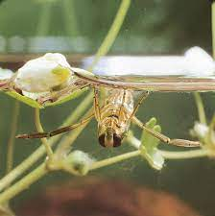
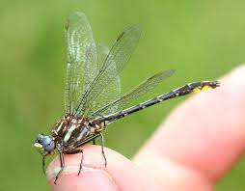
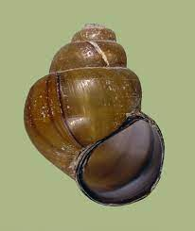
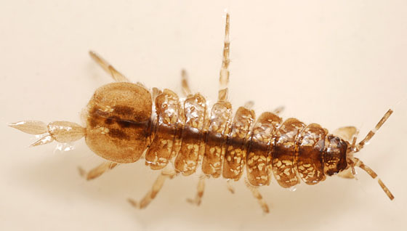
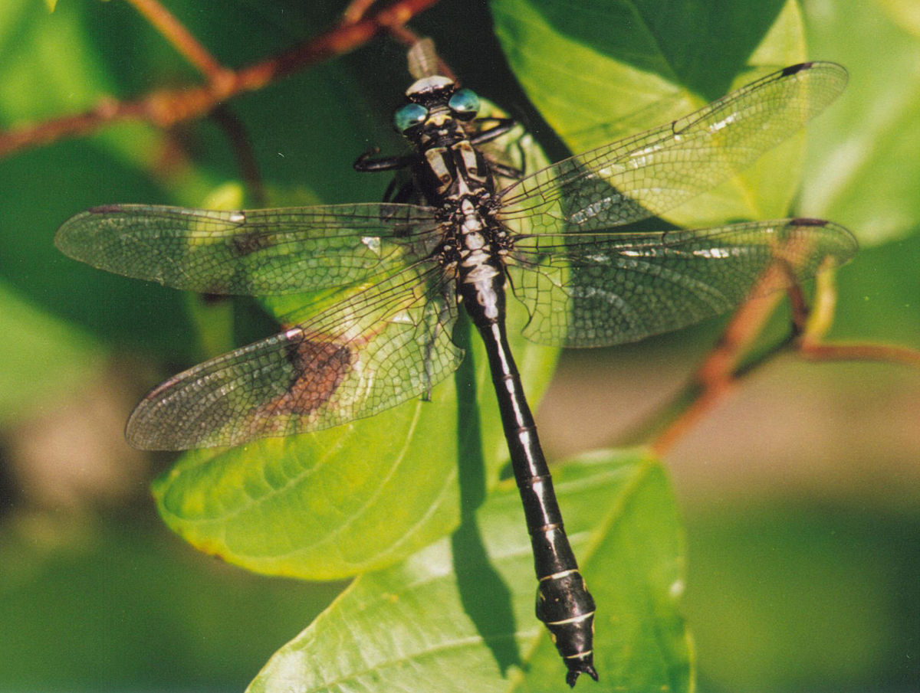
Peconic River DNA Barcoding
Julian Vinch, Preston Vinch, Jillian Warsaw, Layla Warsaw
Mentors: Dr. Spata, Mr. Bolen
Eastport South Manor Junior-Senior High School
Abstract
Results
The Peconic River had many mass depletions in its fish population. These depletions resulted from an inadequate amount of oxygen in the water for a long time, which suffocated the fish. Studies show that the scarce oxygen levels were affected by rising water temperatures, algal blooms, and excessive nitrogen, biochemical oxygen demand (BOD), and sediment oxygen demand (SOD). Mass kills that happened in the river are now known as “fish kills”, which has occurred repeatedly during the life of the river. The last fish kill was in 2015. In this study, the CO1 gene which is found in nucleotide pairs 5904 to 7444 in sections of mtDNA is compared to a database of gene sequences to determine the identity of each sample. Using data from last year, our goal is to observe how the presence of aquatic macroinvertebrates act as indicators of overall water quality. We expect to observe a stable or slight rise in biodiversity of invertebrates due to reduced damage caused by human impacts.
The results show that the Peconic River accommodates various species of insects , such as backswimmers and lancet clubtails. The presence of these different species of insects provides evidence of poor water conditions. Poor water quality has detrimental effects on entire ecosystems, since many different species rely on clean water for survival. Poor water quality also increases the likelihood of algal blooms being present in a river. These algal blooms are significant to the fish kills in Peconic River, their increase in population leaving scarce oxygen for other species, suffocating them over time.
Discussion
Some species that were identified from our barcode data were martarega bentois, achyla oligacanthas, cipangopaludina chinesis’, caecidotea communis’, and gomphus exilis’. Further investigation is required for a concrete basis due to the age of the dna samples provided. Nevertheless the species observed provide adequate evidence that the water quality in the Peconic River is deficient.
Introduction
By observing the information from last year's DNA barcoding, we predict that since the most recent fish kill occuring in 2015, there has been an increase in the number and variety of organisms and species that inhabit the Peconic River compared to previous years. We expect that our hypothesis will be supported by the DNA data we collect and analyze, indicating an increase in the diversity of organisms.
References
Materials and Methods
Seining and dip nets were used to collect specimens from the river. These samples were then separated visually by species.
Tomarken, James L., Marc Gerstman, and C. J. Gobler. "Investigation of fish kills occurring in the Peconic River-Riverhead, NY Spring 2015." Suffolk County Department of Health Services, New York (2016).
“Back Swimmers”
“Lancet Club Tails”
Samples were placed in glass vials at the school, which were later photographed from several angles.
Acknowledgements
Thank you to Dr. Spata, Mr Bolen, and Cold Spring Laboratories for helping us throughout this researching process!
Samples were then stored in 99% ethanol in a non-defrosting freezer until they were needed for tissue and DNA extraction.
“cipangopaludina chinensis”
“caecidotea communis”
“gomphus exilis”

