Slide 1
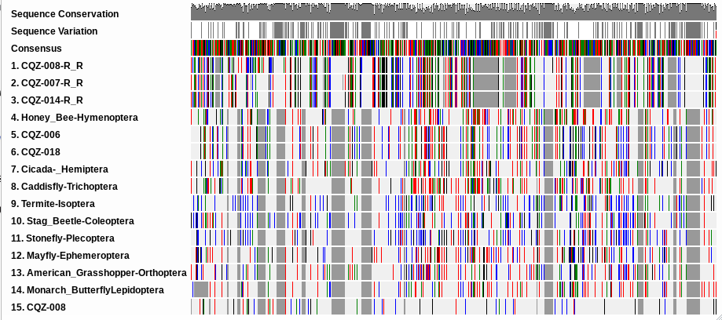
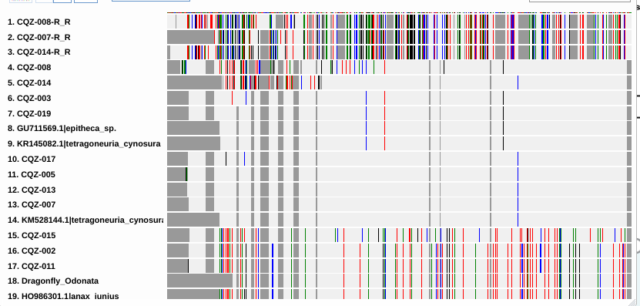
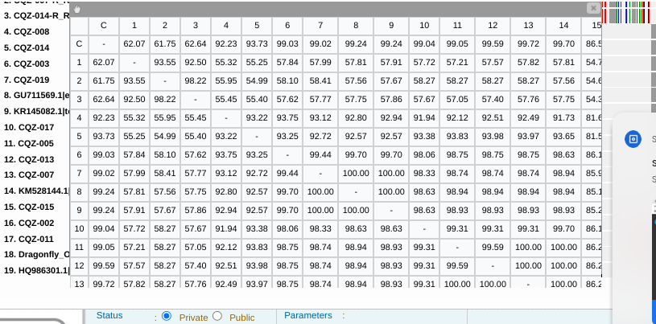
Studying Species of the Peconic River
Abstract
What is harming our ecosystem and native species? There is mahogany tide, and invasive species that are hurting our ecosystem and native species. Our hypothesis is that finding issues earlier will make it easier to help keep an ecosystem safe and promote our native species. We selected the Peconic River as it is close by and affects the ecosystem that we live near, so we find that keeping this ecosystem healthy will be just the start of keep many more safe and healthy.
Alex Silbert, Logan Silbert
Eastport South Manor Junior-Senior High School
Mentor: Mr. Robert Bolen
Methods and Materials
The samples will be collected with 0.5 meter dip nets and with the 6 x 1.5 meter seine net to collect more samples at a time. They will be transported within buckets filled with water from the Peconic to make sure they survived. There will be 4 photos of each sample taken on an Iphone 14 pro, a stereomicroscope will be used to get better images of certain specimens. The samples will be preserved within small vials that will be filled with 1 ml of Ethanol and then put within a freezer.
Introduction
Barcoding allows us to determine the taxonomy of species along with learning which species on Long Island are native and invasive. DNA barcodes can be used for biodiversity studies in many ways. Firstly we can compare the DNA bases to see if a sample is a certain species. Second, this process can even uncover novel species or DNA sequences. We are using the mitochondrial CO1 gene because it evolves quickly and can show diversity even among closely related species. CO1 is one of the best genes for barcoding because of this, and because it has a large number of sequences in databases for a wide range of taxonomic groups.
Biodiversity is important for the environment; biodiversity means greater strength for an ecosystem because if one species dies there are still other species to take over the niche of which it held.
We plan to collect Dragonfly nymphs which are a biological control species that limits the mosquito levels. An adult dragonfly can eat hundreds of mosquitoes a day.. We also have leech samples which could indicate pollution and low oxygen conditions.
The Mahogany Tide is a harmful algae that plagued the river from 1985-1998. Nitrogen Loading , pollutants and toxic contaminants affect the river ecosystem. Poor water quality in the Peconic River caused by nitrogen loading, algae blooms, and toxic contaminants. This can lead to low dissolved oxygen, which with the contaminants could cause the fish to be inedible.
We are planning to measure the biodiversity and compare species diversity observed this year to that of years prior. We plan to compare the species that were found and see which species are invasive and if the biodiversity has changed over the past few years. We are collecting the species that are found in the Peconic river to better study the biodiversity of the Peconic. We collected 11 dragonfly nymphs and 1 leech.
Our final goal is to determine which species are native, non-native, and which, if any, species pose a threat to the ecosystem stability. Invasive species affect ecosystems by out competing the native species, and because they have no natural predators they ultimately go uncontrolled and end up taking over and hurting the ecosystem.
Discussion
Out of our 20 samples, we had samples 002, 003, 005, 006, 007, 008, 011, 013, 014, 015, 017, 018, 019. Sadly we have not gotten any new or novel species from any of our samples. Samples 006 and 018 are new to the program, the name of the specimen is Erpobdella mexicana
Our results are showing us that there isn't much diversity in the peconic, as we have many of the same species. This isn't saying that it isn't diverse, but our results show a recurring species without much diversity.
If we had Information that shows the water quality in recent years, animal populations and growth of these populations. We would be able to use these pieces of data to to see if the river system is improving or reverting to an unstable environment for the species.
References
23rd, C. P. on A. (2021, April 7). 8 indigenous species that live in the Peconic Estuary. Northforker. https://northforker.com/2015/08/8-indigenous-species-live-peconic-estuary/
Department of Environmental Conservation. (n.d.). Peconic River Ludwigia Control Project. Dec.ny.gov. https://www.dec.ny.gov/animals/122333.html#:~:text=Background&text=Ludwigia%20peploides%20is%20an%20aquatic,freshwater%20part%20of%20the%20river
Environmental Protection Agency. (n.d.). EPA. https://www.epa.gov/nep/basic-information-about-estuaries
Flora & Fauna. Peconic Estuary Program. (n.d.-a). https://www.peconicestuary.org/peconic-estuary/peconic-natural-history/
Water quality. Peconic Estuary Program. (n.d.-b). https://www.peconicestuary.org/projects/clean-waters-2/
Images of the samples you successfully identified Include the sample number and the scientific name (genus species). These could be the newest, novel, or unique, never been seen before organisms
Acknowledgements
Thank you Day in the Life of a River Program
Field Experts Mr. Scott Bronson, Dr. Aleida Perez, Mr. Bob Moser
BNL for open lab space
Sharon Pepenella and the DNALC for assisting with DNA samples and technical supprt
NXC-011
Top Hit;
Stylaria fossularis

