Slide 1
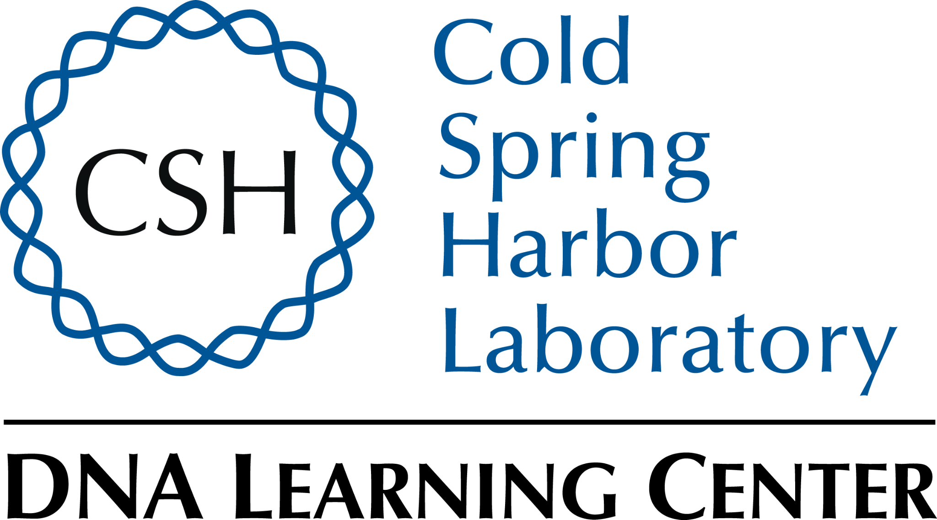
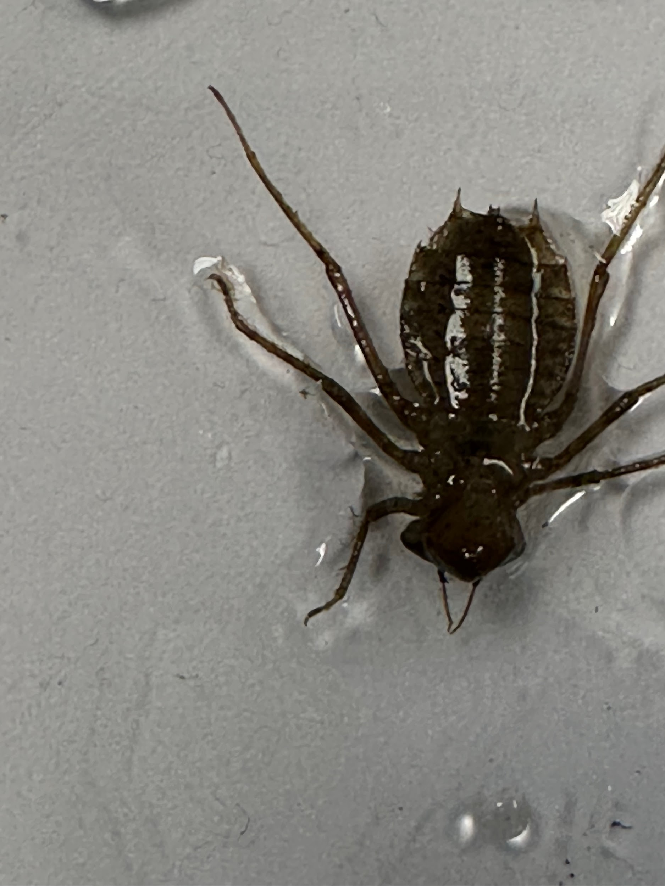
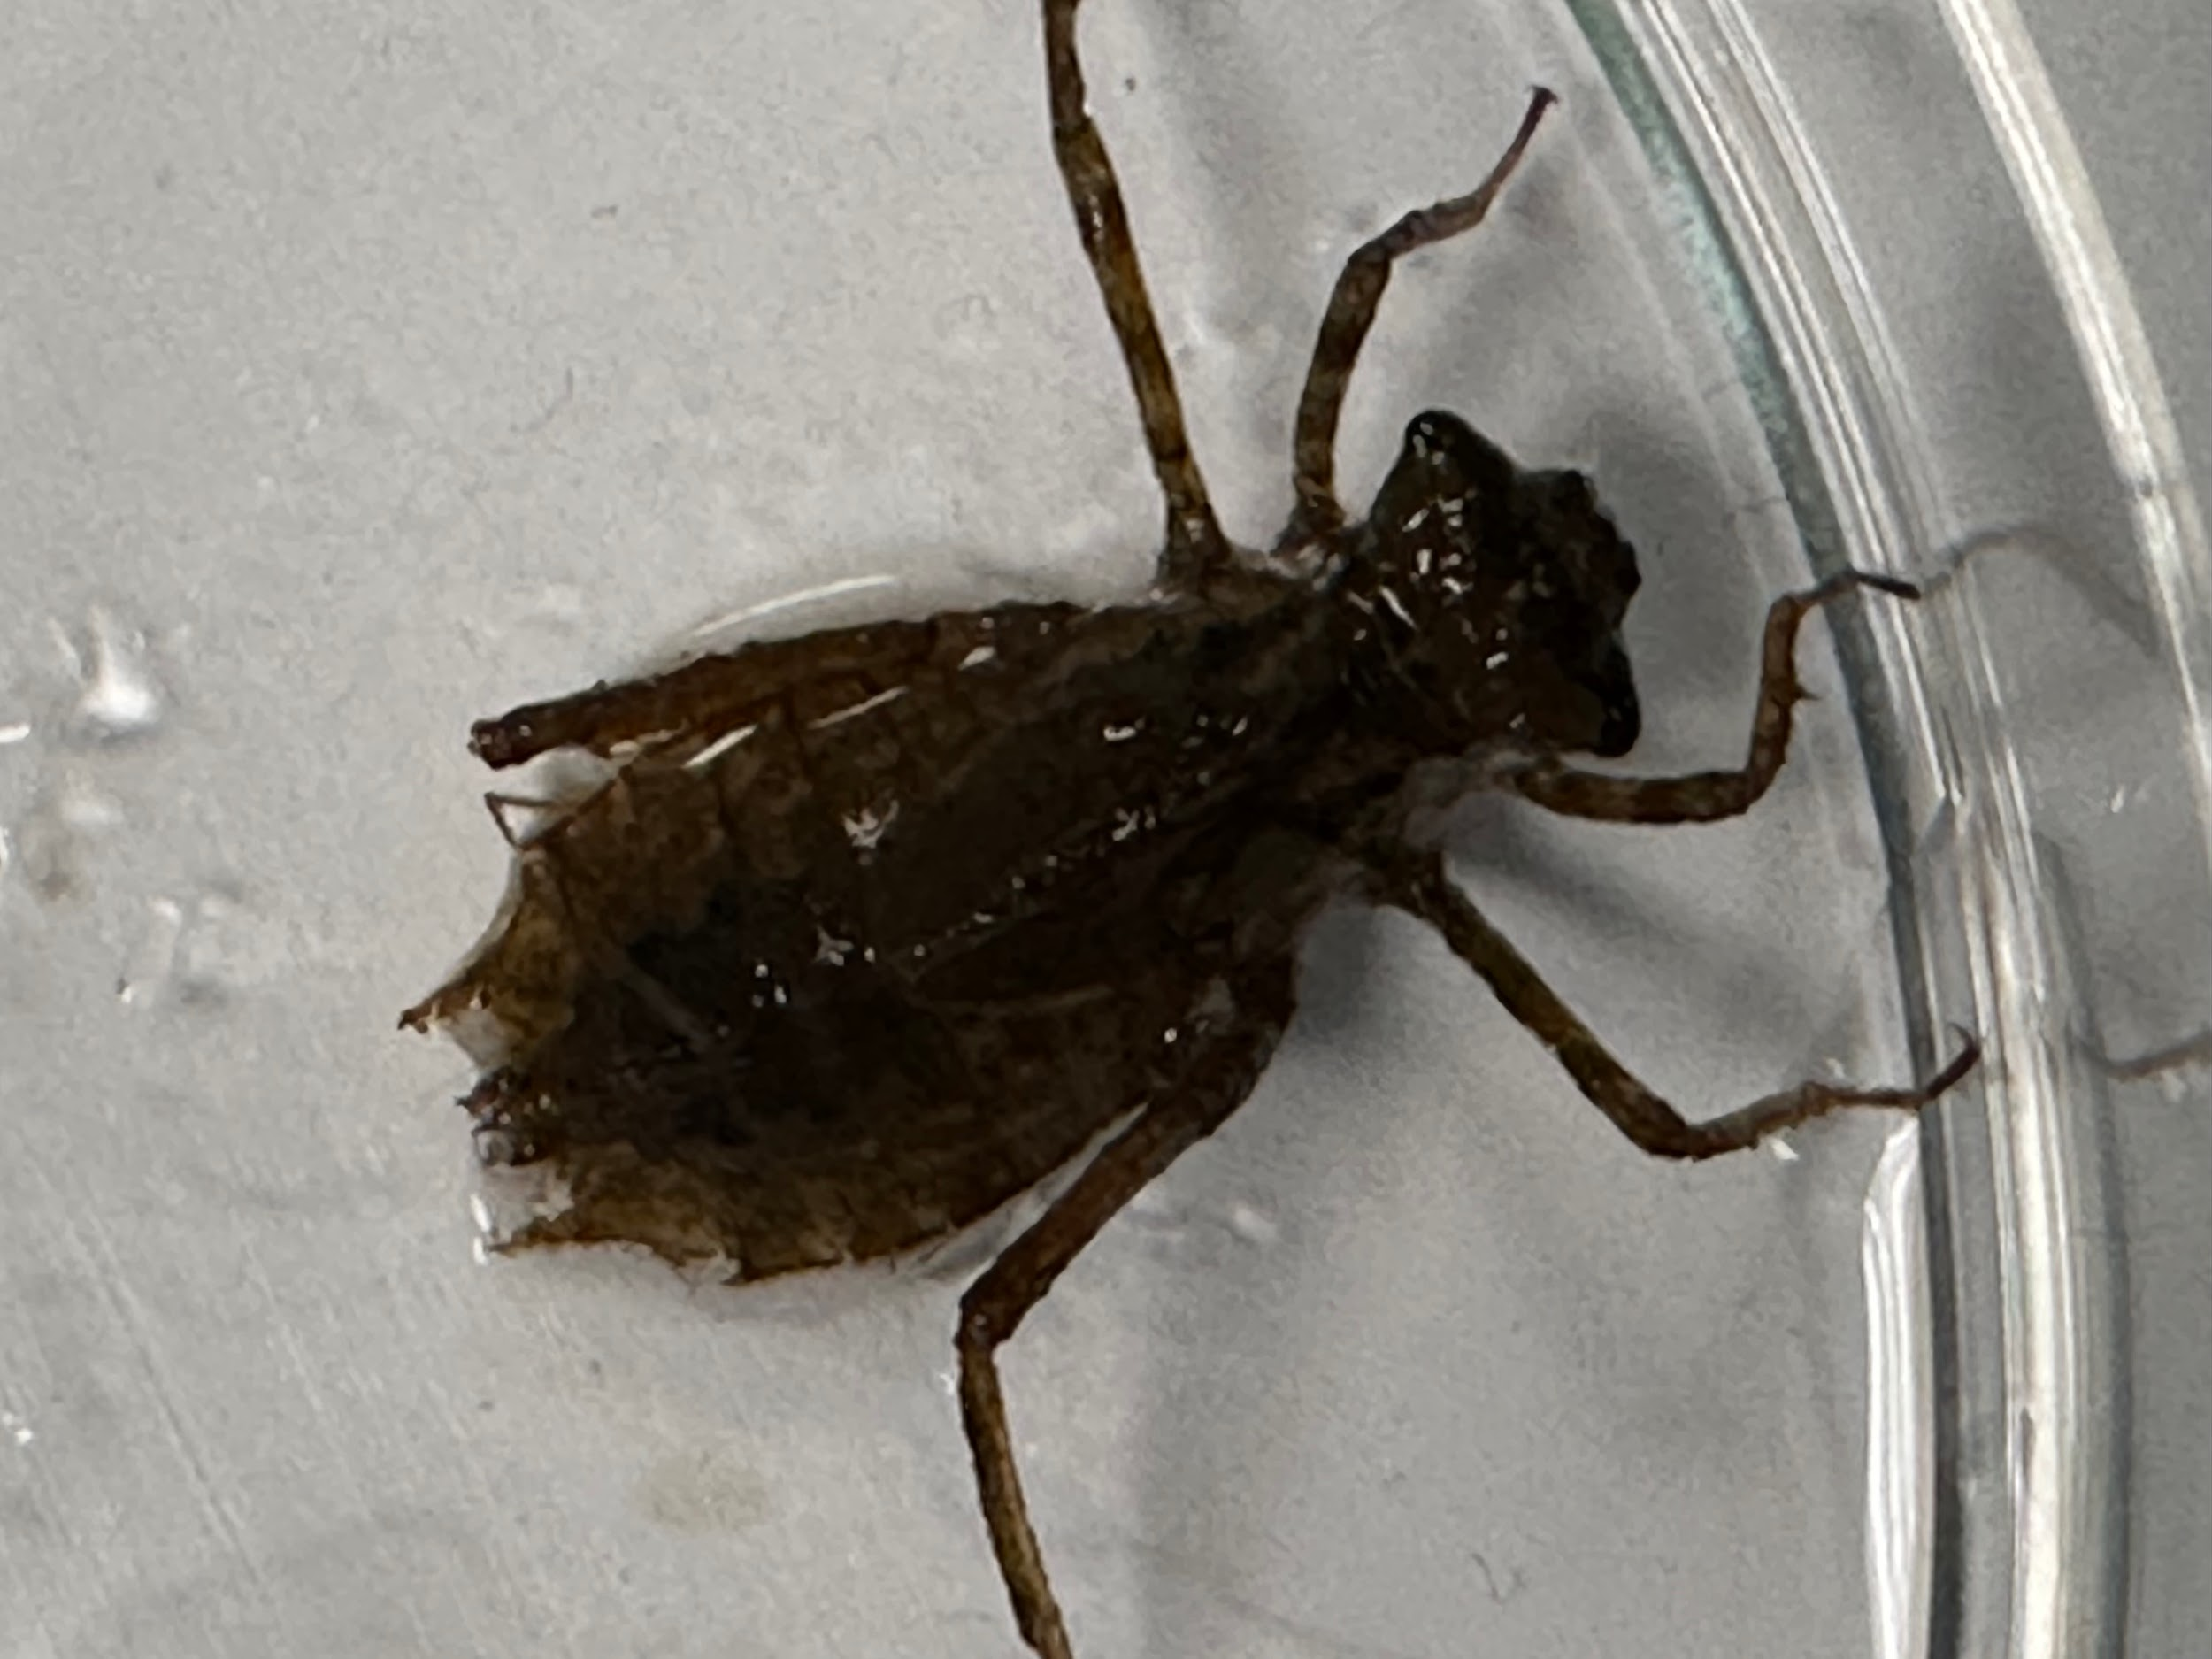
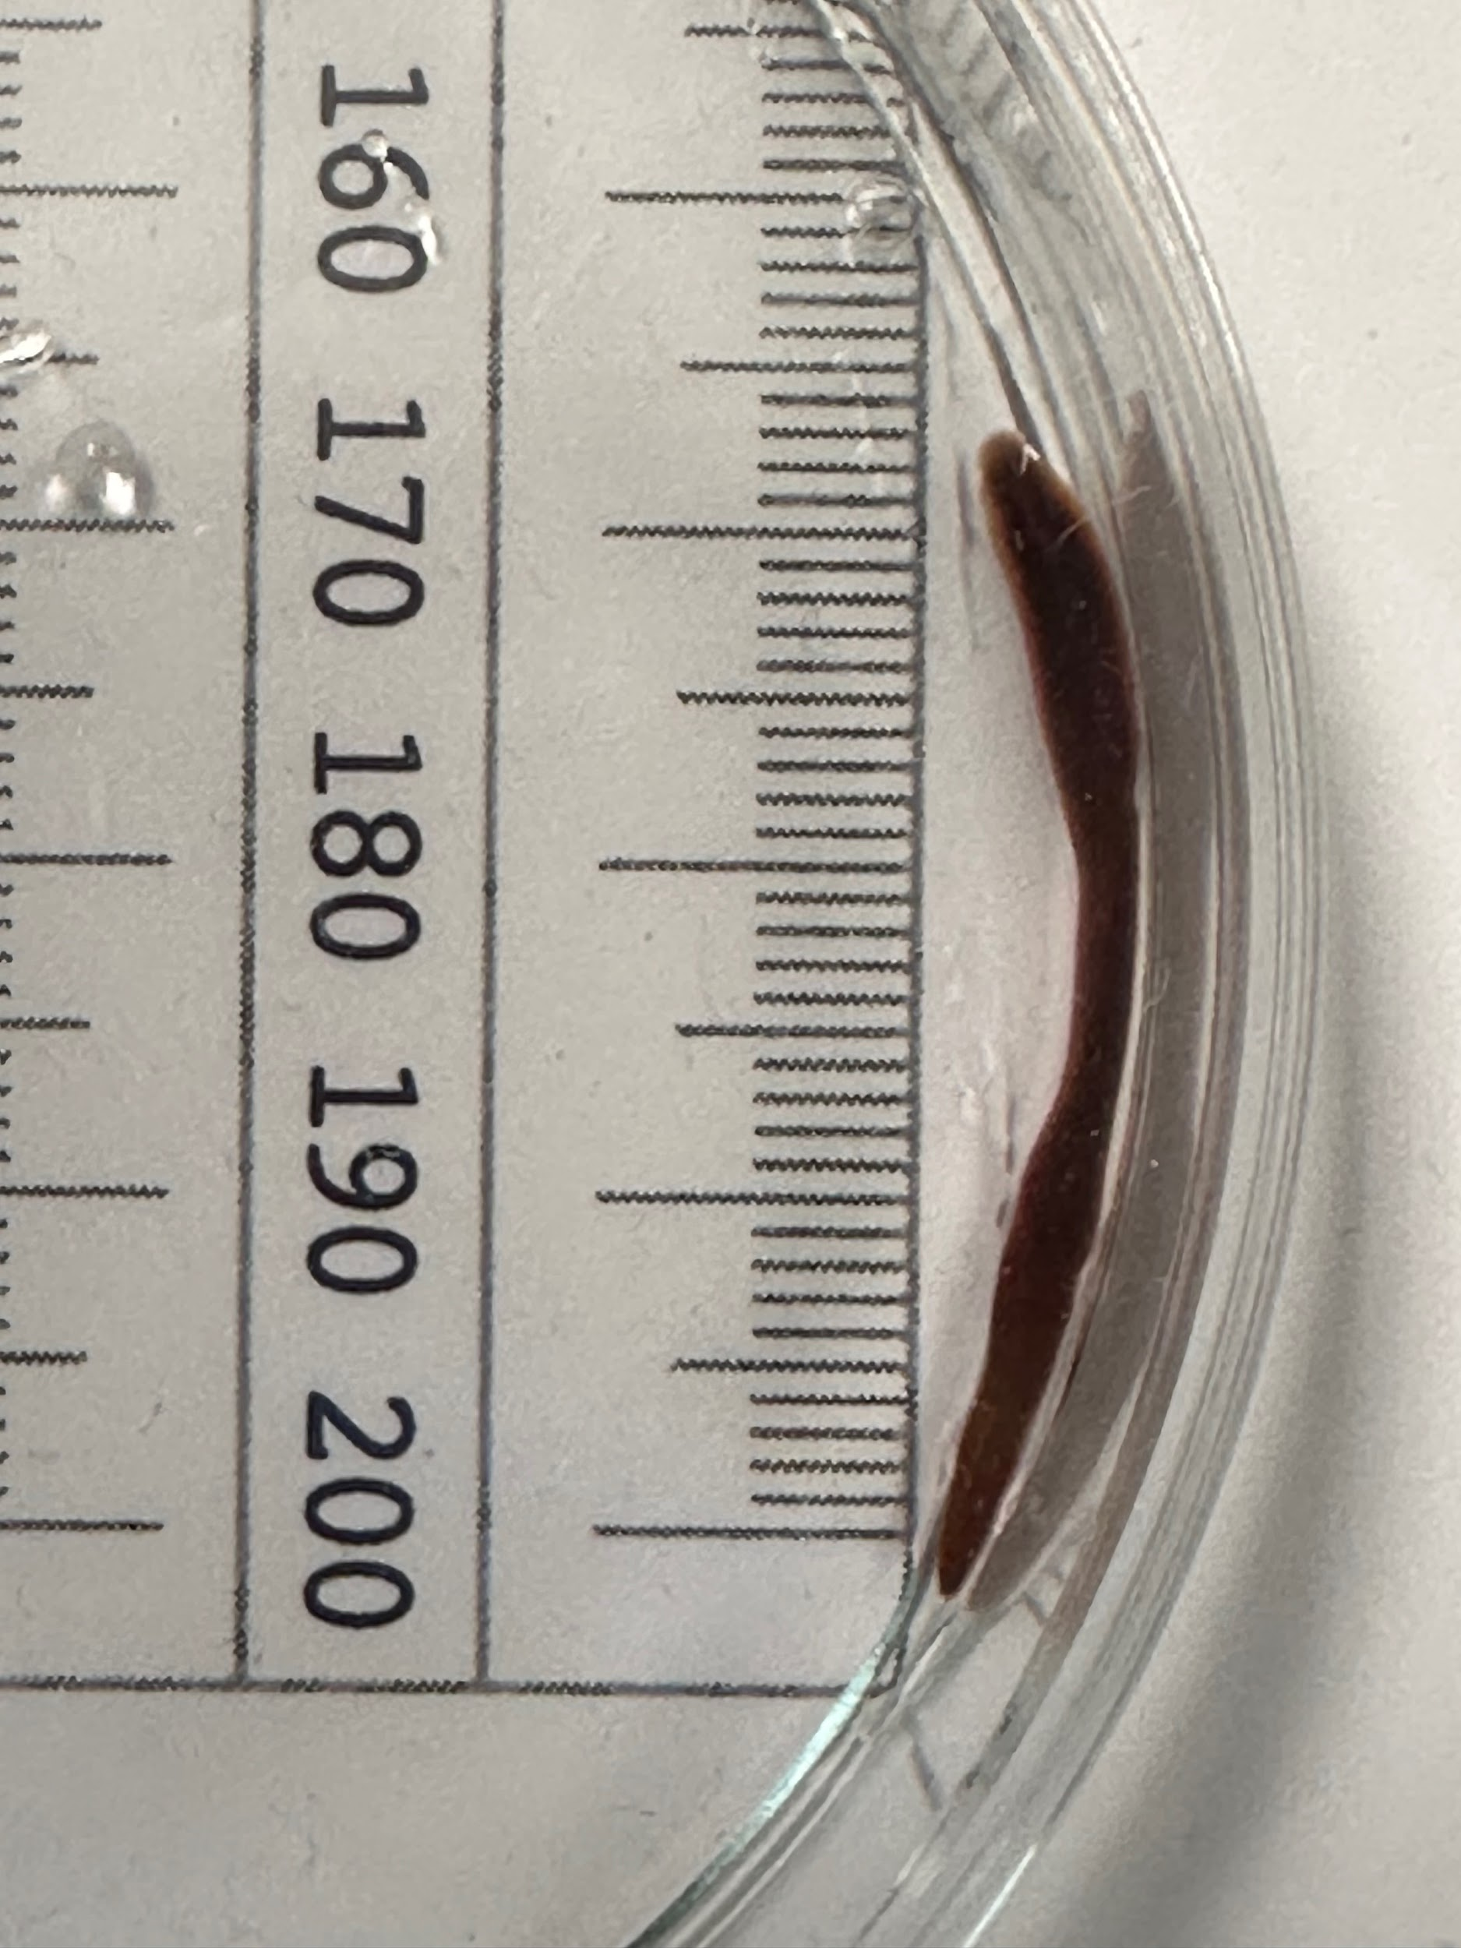
Abstract:
Our team collected several different samples from the Peconic River for barcoding. We wanted to see how many different species lived in the river. With this information we could see the biodiversity of the river and determine its stability. We barcoded the samples and found many diverse soecies of dragonfly nymphs.
Long Island Barcoding
Kevin Ackerman | Sean Doherty | Bennett Leselrod | Alex Madlinger
Eastport South Manor Junior-Senior High School
Teacher: Mr. Bolen
Discussion:
Several of our samples were successfully identified. The Tetragoneuria cynosura or the common baskettail, the Anax Junius or green darner, and two Basiaeschna janata or the springtime darner had a total of zero mismatches. This means that there were no errors or unforeseen issues with the DNA extraction process for this specific sample.
Almost all of the species collected in the Peconic were dragonfly nymphs. However, a few different species of fish (fish were not barcoded) and one leech specimen was found.
Our results suggest that the biodiversity of the Peconic is large enough to be functional. There are several different species of prey and predator to keep the ecosystem flowing. However, in order to determine if the ecosystem is stabilizing or destabilizing we need more information. To see if biodiversity is increasing we could go back next year and barcode some samples and see if we get any new samples. We could also search for some invasive species and signs of pollution around the Peconic.
Introduction:
This project was constructed to discover several things about the Peconic River. One of the main things however was to see how large the biodiversity (number of different species) of the area is.
The Peconic River is unfortunately under threat from many different things. Large amounts of pollution can find their way into the water. Many different invasive species such as creeping water primrose are outcompeting and killing native species. Proper funding is also necessary for the protection of this ecosystem we are apart of.
Biodiversity is of large importance to an ecosystem. The more species that are a part of the ecosystem the more stable it is. This is because if something bad were to happen in the ecosystem it would have more things that could survive from such an event. Also, different species can provide us different things. We would be limited to specific food items if the World's biodiversity decreased. Different species also provide other species with their own means for survival.
References:
Hebert, P. D., Cywinska, A., Ball, S. L., & deWaard, J. R. (2003). Biological identifications through DNA barcodes. Proceedings of the Royal Society of London. Series B: Biological Sciences, 270(1512), 313-321.
Meier, R., Zhang, G., & Ali, F. (2008). The use of mean instead of smallest interspecific distances exaggerates the size of the "barcoding gap" and leads to misidentification. Systematic biology, 57(5), 809-813.
Rubinoff, D., Cameron, S., & Will, K. (2006). A genomic perspective on the shortcomings of mitochondrial DNA for “barcoding” identification. Journal of Heredity, 97(6), 581-594.
Methods & Materials:
• First we traveled to a spot by the Peconic River and collected
several different samples. We also took recording of the
environment.
• Second we took let the samples soak in alcohol for a day and then
we took limbs from each sample and put them in test tubes.
• Third we harvest the DNA from each sample by pestering it. We put the DNA through electrophoresis.
• Finally we used the Information from the DNA extraction process
to barcode the samples
Samples
XPE002
XPE004
XPE007
XPE008
XPE009
XPE012
XPE013
XPE016
Top Blast Scores
Anax junius
Tetragoneuria cynosura
Arhynchobdellida / Erpobdella Mexicana Isolate
Anax junius
Tetragoneuria cynosura
Basiaeschna janata
Basiaeschna janata
Bit Score
1114
807
649
1164
933
1180
1168
1119
2
0
11
0
15
0
0
2
Number Of Mismatches
Acknowledgements:
Thanks to all the people who allowed us to conduct this research. Thanks to the Day in the Life of a River Program. Thanks to the field experts who helped us along the way. Mr. Scott Bronson, Dr. Aleida Perez, and Mr. Bob Moser. Thanks to BNL for the open lab space which came in handy. Big thanks to Dr. Sharon Pepenella and the DNALC for assistance with DNA samples and for teaching us some things about DNA barcoding. Finally, thanks to Mr. Bolen for taking us all on many fun field trips and teaching us about DNA.

