Slide 1
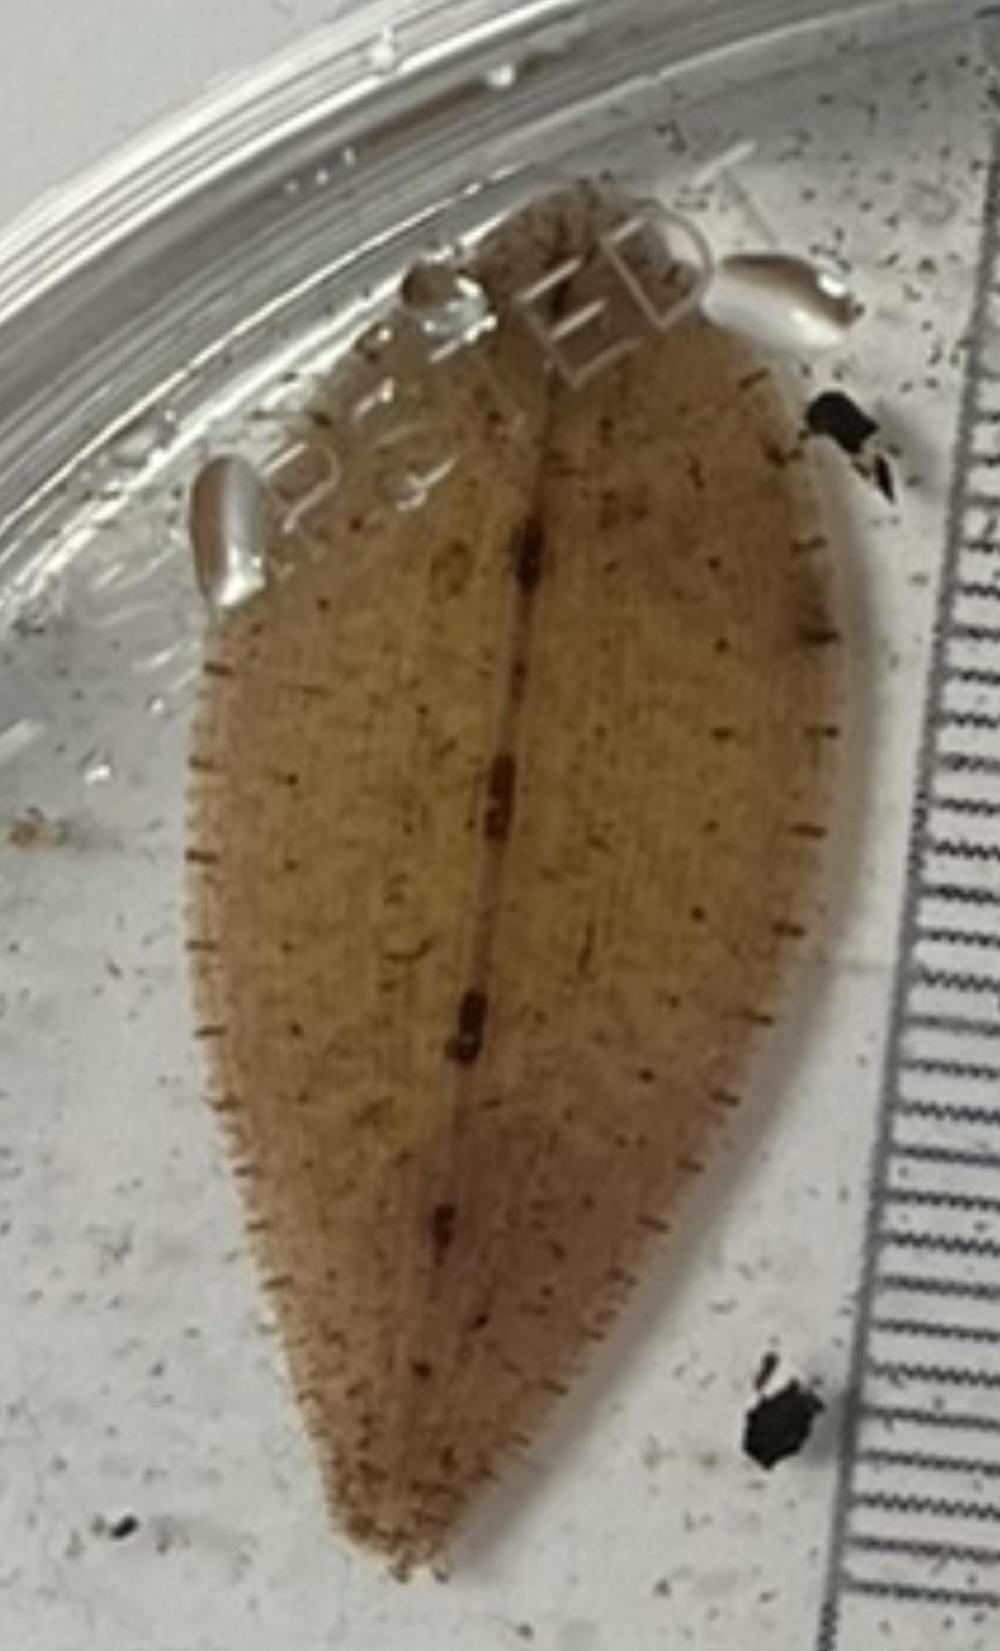
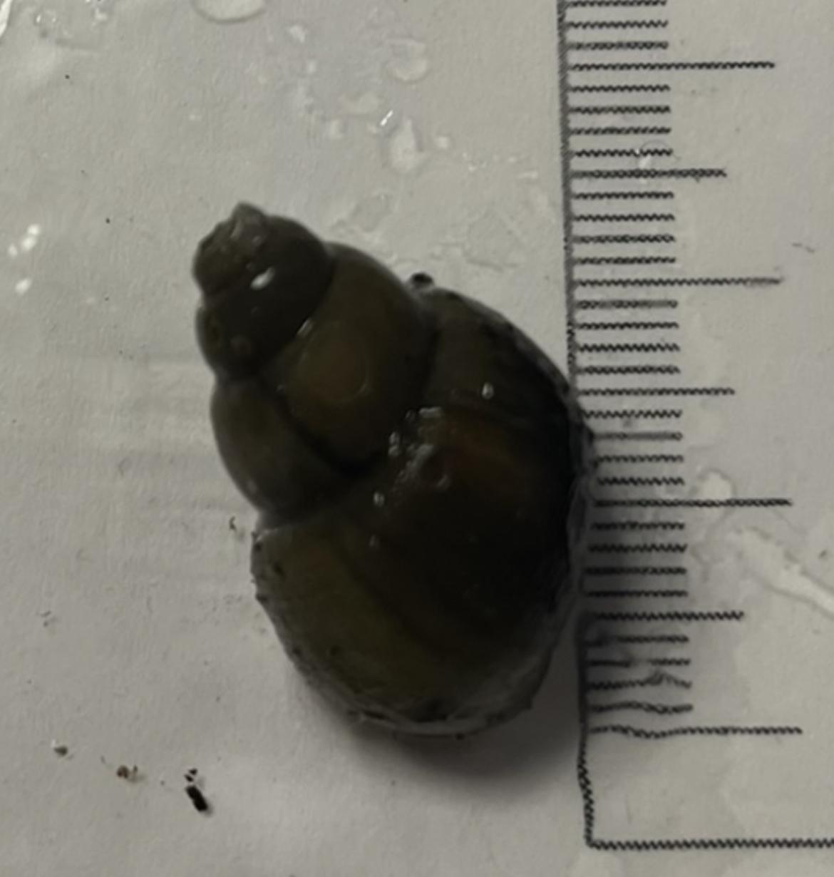
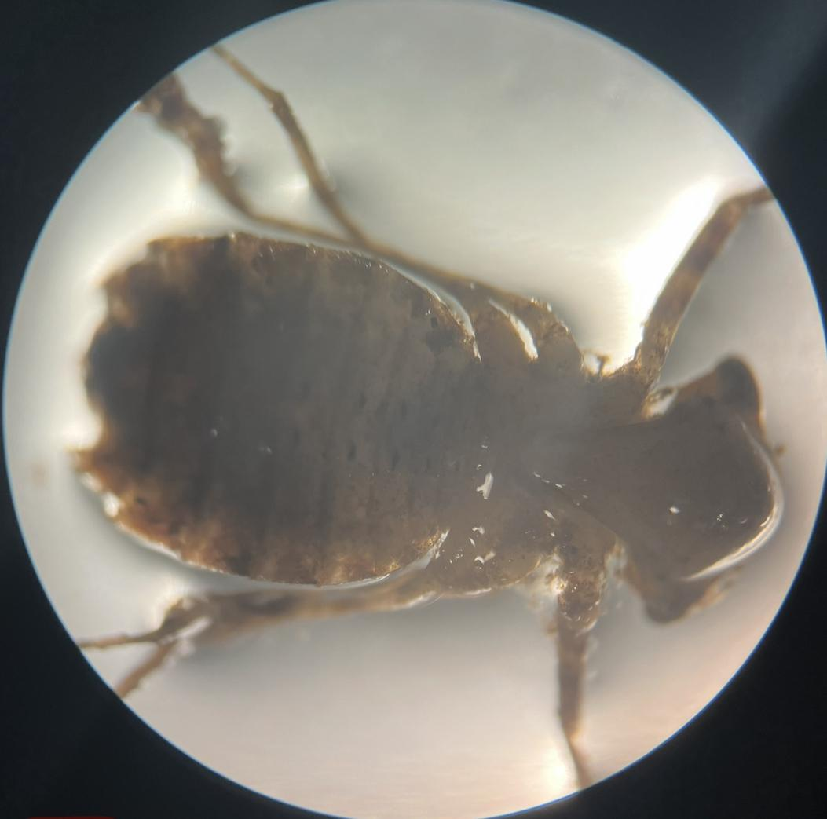
DNA Barcoding of Aquatic Macroinvertebrates
Abstract
The most commonly used gene for DNA barcoding is the mitochondrial gene for the CO1 gene which can evolve quickly and be used for biodiversity and taxonomic identification studies. We planned to measure biodiversity by comparing this year's results to results of prior years. By doing this, we can look for changes in biodiversity. We collected many dragonfly nymphs, 1 amphipod, 1 leech, 3 snails, 4 snail nymphs (these snails were within a larger snail). The goal was to determine the identity of all samples, and which samples are native, invasive, and if they pose a threat to the ecosystem. Contrary to what had been found prior, we discovered a leech which is not native to the area, in fact, this leech made its debut in America in 2017 in Mississippi. Due to DNA barcoding, we were able to uncover this rare species.
Ava DiDonna, Szonja Gabor, Makena Wood, Pasha Wray
Eastport South Manor Junior-Senior High School
Mentor: Mr. Robert Bolen
Discussion
Our results show us the genus of one of the species we have sampled is not commonly found. This is seen in sample 2 and is known as Placobdella ali. Placobdella ali is a type of blood feeding leech from the family Glossiphoniidae. Sample 2 is a novel sequence. It has only been discovered three other times. Once in Connecticut and twice in New York. Sample 3 is from the genus Caenis, and is a type mayfly. Sample 5 is Cipangopaludina chinen and is known as the Chinese mystery snail and is a freshwater snail. This snail is an invasive species that competes with native snails for food and may also transmit diseases and parasites to fish and other wildlife. Our results are important because discovering this novel sequence gives scientists more insight on this species. We also learn that there is more biodiversity in the Peconic River. When looking for our DNA for our results we had some issues with getting samples sequenced. Not all of our sequences came back with results so we sent them back to resequenced. We got the majority of our results back afterwards. rIn future studies we should look at what the family name of our species is and see where they are commonly found and species related to them.
Introduction
The Peconic Ecosystem is an important channel with significant benefits. This estuary provides a feeding habitat as well as spawning and nursery grounds to a wide variety of aquatic species. A major problem of the Peconic River is excess nitrogen loading, which can cause harmful algae blooms, low dissolved oxygen, and degraded aquatic habitats. Humans are impacted by the pollution of the Peconic River because toxic algae blooms cause foul odors, and poisoned fish and shellfish affect fisheries. A high mortality rate of fish and habitat imbalance reduces biodiversity. Biodiversity is essential for the processes that support all life on Earth, including humans. Without a wide range of animals, plants and microorganisms, we cannot have the healthy ecosystems that we rely on.
DNA barcoding can be used to study biodiversity because it can document and identify different species. We are using the CO1 gene because it has high variability. DNA barcoding can be used to monitor the state, geographical spread, and genetic diversity of distinct species.
References
Fast track to gene annotation and genome analysis - DNA subway. Fast Track to Gene Annotation and Genome Analysis - DNA Subway. (n.d.). https://dnasubway.cyverse.org/
Richardson, D. J., Moser, W. E., Hammond, C. I., Shevchenko, A. C., & Lazo-Wasem, E. (n.d.). New Geographic Distribution Records and host specificity of Placobdella Ali (Hirudinida: Glossiphoniidae). BioOne Complete. https://bioone.org/journals/Comparative-Parasitology/volume-77/issue-2/4456.1/New-Geographic-Distribution-Records-and-Host-Specificity-of-Placobdella-ali/10.1654/4456.1.short
CMX-005 Identified as Campeloma decisum and mostly in Eastern North America.
CMX-002Identified as Placobdella ali and is a novel sequence to the Peconic Estuary
Methods and Materials
Collected 12 samples from the Peconic River Estuary by pulling a large seining net in the same specific area. All the samples were stored and frozen at ESM Jr.-Sr. High School
DNA samples were taken and processed using the standard DNA extraction using equipment from Cold Spring Hardor
In January 2023, PCR was used to amplify the gene sequence at BNL
The results were then compared to our sequences to the Genebank in DNA Subway
Sample Number | Top Blast Hits | Bit Score | Number of mismatches
CMX-001 | Caenis amica | 1137 | 6
CMX-002 | Placobdella ali | 1147 | 2
CMX-003 | Caenis sp. | 932 | 42
Acknowledgements
Field Experts Mr. Scott Bronson, Dr. Aleida Perez, Mr. Bob Moser
BNL for open lab space
Sharon Pepenella and the DNALC for assisting with DNA samples and technical support
CMX-004 | Epitheca sp. | 819 | 18
CMX-005 | Campeloma decisum | 1108 | 4
CMX-007 | Callinina georgiana | 1148 | 4
CMX-008 | Viviparus georgianus | 1125 | 1
CMX-003 Identified as Caenis sp. And is mostly located in bottoms of lakes and bottom of decaying leaves.

