Slide 1
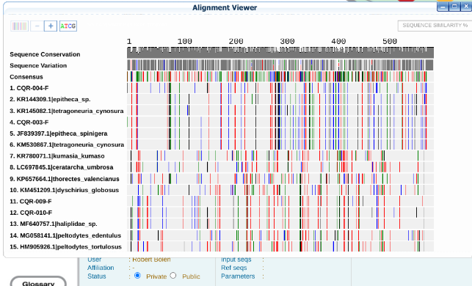
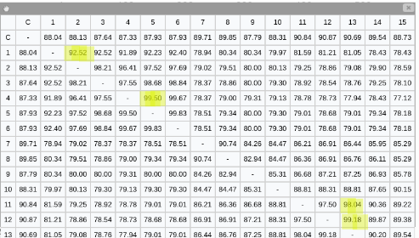
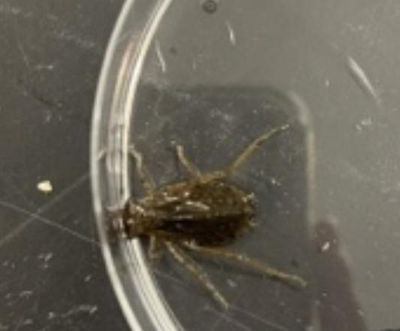
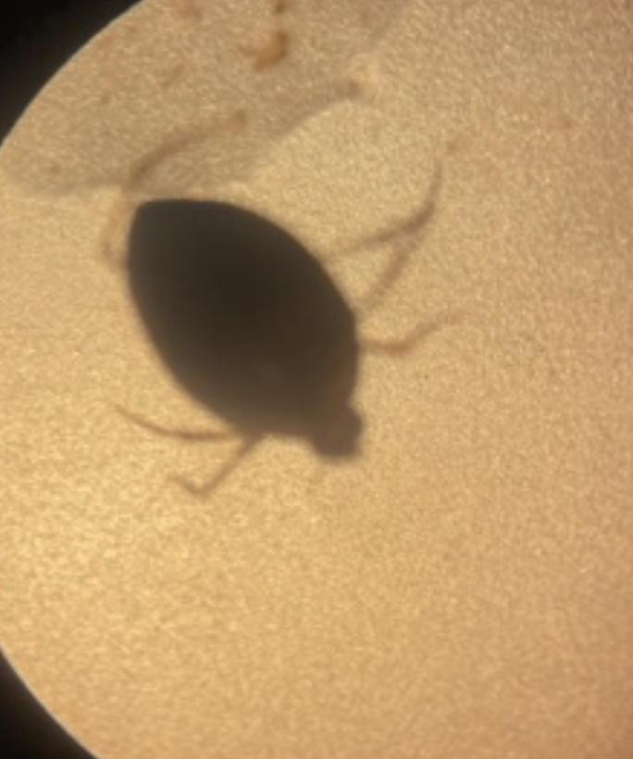
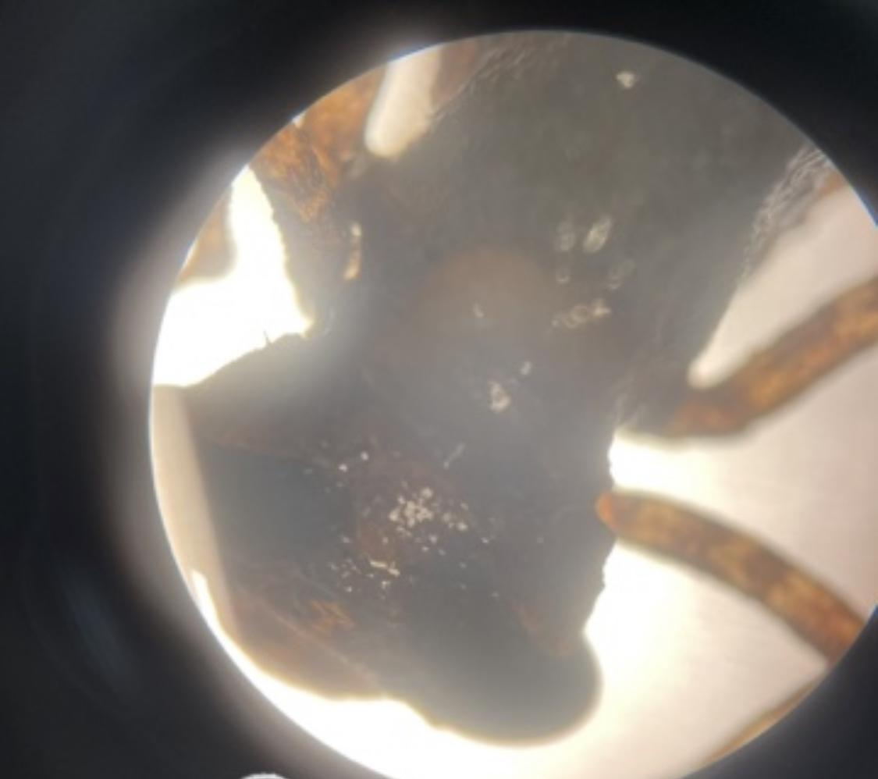
Gang Barcode Poster
Abstract
DNA barcoding is used for identifying genomes. DNA barcoding can also be used to track the biodiversity of an ecosystem. Our hypothesis is that DNA barcoding invertebrate organisms will permit the taxonomic identification of the samples collected which will contribute to documenting the biodiversity of the Peconic River ecosystem at this location. The DNA barcoding process will allow us to identify invasive species as well as species that may carry diseases that can negatively affect the native species in the river system. DNA barcoding involves sequencing a short fragment of the mitochondrial cytochrome c oxidase subunit I gene (CO1). We used the DNA barcoding results to measure the biodiversity of the organisms we collected compared to the organisms collected in prior years. We compared the results of both as well., using DNA Subway to compare the sample sequences to the DNA database of CO1 genes. We identified the following species tetragoneuria cynosura, haliplidae sp., cipangopaludina chinesis, and basiaeschna janata.
Gabriella Cerase,Jillian Gmelch,Madison Heaney
Eastport South Manor Junior-Senior High School
Mentor: Mr. Robert Bolen
Methods and Materials
1.)We went to the Peconic River and collect our samples using a net and then putting them into a jar with some water. After we put them in the refrigerator to slow them down making the organisms easier to handle. We took photos under microscopes and cover them in ethanol.
2.)The samples were collected by the seine net and hand-help dip nets. The seine net is 6 meters long and 1.2 meters deep. These nets were used to collect dragonfly nymphs . We also used dip nets for beetle leeches and worms that were 0.5 meters wide and 0.3 meters deep.
Samples were photographed and numbered and stored in a small glass vial with 1 ml of ethanol to be preserved.
3.)We used an iPhone 12 pro max and a stereomicroscope at 3x-10x magnification to take 4 photos for each specimen. Photos were taken from the top, bottom, anterior, and posterior regions.
Samples were preserved by putting them in a non-defrosting freezer in individual glass vials with 1ml of ethanol.
Discussion
Samples 003, 004, 009, 010, 012, and 013 were successfully identified. None of the samples were novel samples.
None of the samples are new samples.
No, all of our samples were identified in previous years.
The results suggest that the Peconic River is a diverse environment. It has a lot of dragon flys but different types of them as well many other organisms
The river system is important because there is an increase in biodiversity in the Peconic River.
Introduction
In our project we used barcoding dna to identify different types of species. Around the world, rivers have increasingly come under assault from poorly planned dams, pollution, habitat loss, sand mining, climate change, and the introduction of invasive species. As a result, they have become the most degraded in the world. Pollution is greatly affecting the Peconic River in a negative way.
The growth of the human population and the development of the land threatens to damage the water quality and the health of these economically important resources and habitats. The poor quality of the water is affected by people’s actions on land. In the Peconic Estuary, pollution often comes from sources such as septic systems and residential and agricultural fertilizer. The pollution enters the groundwater or surface waters, and these waters carry the pollution to the estuary. One of the most serious issues affecting water quality in the Peconic Estuary is excess nitrogen loading, which can cause harmful algae blooms, low dissolved oxygen, and degraded aquatic habitats. Some of the cause of this excess of nitrogen is residential septic systems, pesticides and fertilizers.
DNA barcoding can also be used to track the biodiversity of an ecosystem by identifying the genomes of different organisms correctly. DNA barcoding involves sequencing a short fragment of the mitochondrial cytochrome c oxidase subunit I gene (CO1). The CO1 gene can be used to identify individuals belonging to the same species, as well as to distinguish between individuals from different species. That being said, it would make identification quicker and not take as long to differentiate between two different species. We are comparing the sequences of different species which are located in the peconic river estuary. We are using the DNA subway website to compare the DNA base sequences match up with the base sequences in the program.
References
-Overview - Peconic Estuary. (n.d.-a). https://www.peconicestuary.org/wp-content/uploads/2017/05/CCMP_Chpt1.intro_.pdf
-Peconic Estuary. The Nature Conservancy. (n.d.). https://www.nature.org/en-us/get-involved/how-to-help/places-we-protect/long-island-peconic-estuary/
-Estuaries 101. Peconic Estuary Program. (n.d.). https://www.peconicestuary.org/peconic-estuary/estuaries-101/
-The Peconic Estuary Story. Peconic Estuary Program. (n.d.-b). https://www.peconicestuary.org/peconic-estuary/the-peconic-estuary-story/
~
CQR-003
Top hit;
Tetragoneuria cynosura
CQR-010
Top Hit;
Haliplidae sp.
CQR-013
Top hit;
Basiaeschna janata
SAMPLE NUMBER | TOP BLAST HIT | BIT SCORE | NUMBER OF MISMATCHES
CQR-003 | Tetragoneuria cynosura | 1187 | 0
CQR-004 | Tetragoneuria cynosura | 983 | 45
CQR-009 | Haliplidae sp. | 1107 | 15
CQR-010 | Haliplidae sp. | 1165 | 5
CQR-012 | Cipangopaludina chinensis | 1170 | 2
CQR-013 | Basiaeschna janata | 1191 | 0
NXC-011
Top Hit;
Stylaria fossularis
Acknowledgements
Thank your teacher!
Day in the Life of a River Program
Field Experts Mr. Scott Bronson, Dr. Aleida Perez, Mr. Bob Moser
BNL for open lab space
Sharon Pepenella and the DNALC for assisting with DNA samples and technical supprt

