Slide 1
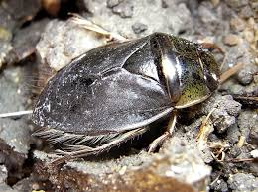
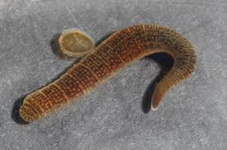
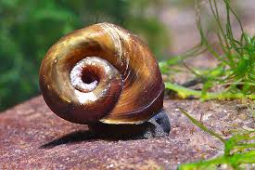
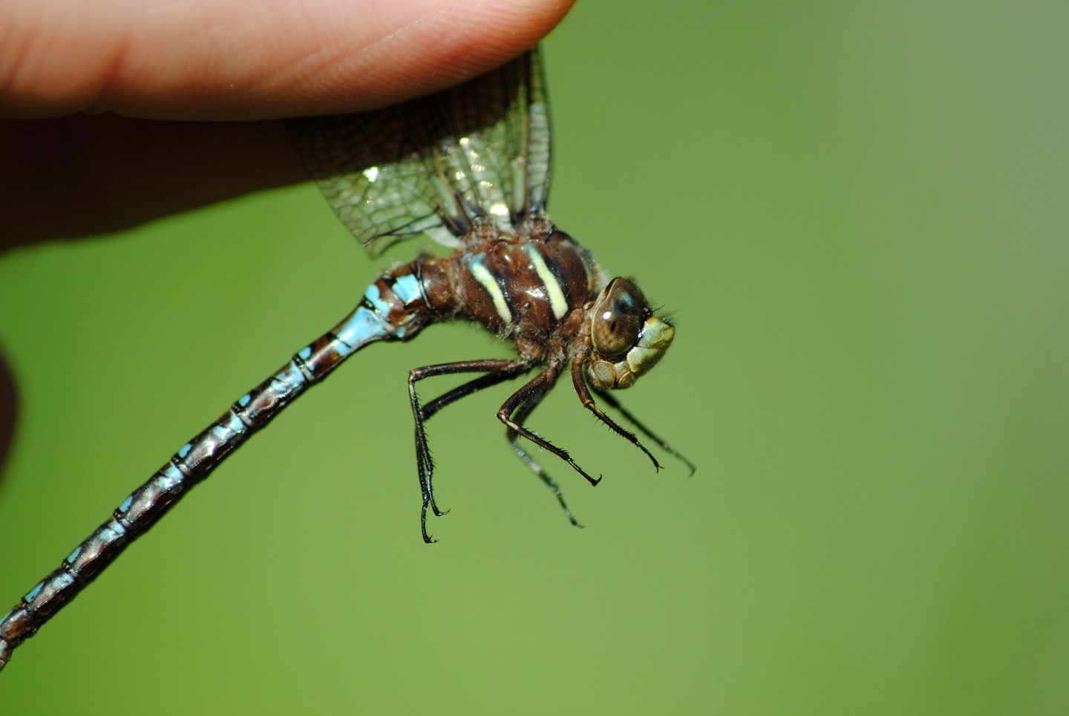
Peconic Biodiversity
Through The Eyes of The Klammers
Kainoa Bosch, Matthew Keller, John Palina, and Jeffrey Smith
Eastport South Manor Junior-Senior High School
Mentors: Mr. Robert Bolen, Mrs. Megan Murray
Abstract
This study is meant to help the Peconic Estuary, which is under threat from invasive species and Brown Tide algae blooms. We conducted the study in order to figure out whether the biodiversity in the Estuary has risen or decreased. We collected samples and barcoded their DNA in order to find this. Our goal was to identify the species that reside in the Estuary currently. Our results show that biodiversity has stayed the same, or at the very least decreased slightly.
Discussion
Samples 9, 4, 11, 13, and 14 were successfully identified. Sample 004 is Helisoma anceps and is also known as a river snail, it is not invasive, it is not an indicator of anything, they do not carry any diseases, they eat algae. Sample 009 is Basiaeschana janta which is also known as a springtime darner, they are not invasive, do not carry diseases, and they eat insect on stream lines. Sample 011 is Erpobdellidae and is also known as a leech, invasive species, they are parasites, they might carry diseases and are and indicator for low dissolved oxygen in streams. Sample 013 is Erpobdellidae which is also known as a leech, invasive species, they are parasites, they might carry diseases and are and indicator for low dissolved oxygen in streams. Sample 014 is Naucoridaeis and is also known as a water beetle, not invasive, they capture nutrients and release it back to the ecosystem, purify water and if bitten M.ulcerans may be transmitted. Unfortunately, we did not obtain any novel sequences or discover any new species. Also, we have no species that haven’t been previously identified. Our results suggest that the biodiversity in the Estuary has stayed constant, if anything decreased slightly. Multiple of one types of species so that must mean that biodiversity is decreasing in the Peconic River. In order to identify if the river’s ecosystem has been increasing or not we would need to take chemical data from inside the river. We would also need to find out if our levels of oxygen is increasing, as well as levels of pH and nitrates.
Introduction
The Peconic Estuary houses many different plants, animals, and insects. These organisms are in danger because of multiple threats like: Brown tide algae blooms, nitrate levels, contamination (or runoff) of the water and invasive species. Humans depend heavily on the estuary, as it is important for the local economy and recreation. An ecosystem's stability depends on its biodiversity. The greater the biodiversity, the more stable the ecosystem. DNA barcoding can help identify the invertebrate aquatic organisms found in the estuary based upon genetic differences in the mitochondrial CO1 gene. This gene can evolve rapidly, allowing scientists to see differences in organisms. Using DNA Subway the DNA sequences of the collected specimens are compared to those inside a worldwide database to identify matching species. The information that DNA Subway has in their database shows us genus’ that could be the correct match to our found organism.
References
Fast Track to Gene Annotation and Genome Analysis - DNA Subway. (n.d.). Dnasubway.cyverse.org. https://dnasubway.cyverse.org/
Invasive Species – Peconic Estuary Partnership. (n.d.). https://www.peconicestuary.org/projects/healthy-ecosystem-with-abundant-diverse-wildlife-2/invasive-species/
Peconic Estuary Program. (n.d.). Blasl, K. (2016, May 11). “Mahogany tide” turns Peconic River brown in Riverhead, same algae that caused last year’s fish and turtle kills.. https://southoldlocal.com/2016/05/11/peconic-river-turning-brown-dense-mahogany-tide-algae-bloom-blamed-last-years-massive-fish-turtle-kills/
https://www.suffolkcountyny.gov/Departments/Health-Services/Environmental-Quality/Ecology/Peconic-Estuary-
Methods and Materials
Invertebrate organisms were collected from Forge Pond, Peconic River.
The samples were stored in vials with 5 milliliters of ethanol to preserve their DNA.
DNA was extracted using Chelex and amplified using PCR.
Gel electrophoresis was used to see if the certain gene was amplified, then it was sent out to be barcoded.
The organisms with the gene present were used in DNA subway to identify the taxonomy of each sample
Sample 014 Samples 011, 013 Sample 004 Sample 009
Naucridacis Erpobdellidae Helisoma anceps Basiaeschana janata
Acknowledgements
We thank Mr. Bolen and Mrs. Murray, as well as the Day in the Life of a River Program. Dr Cristina Fernandez-Marco and the DNALC for assisting with DNA samples and technical support.

