Slide 1
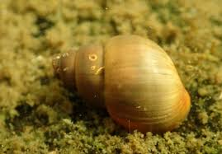
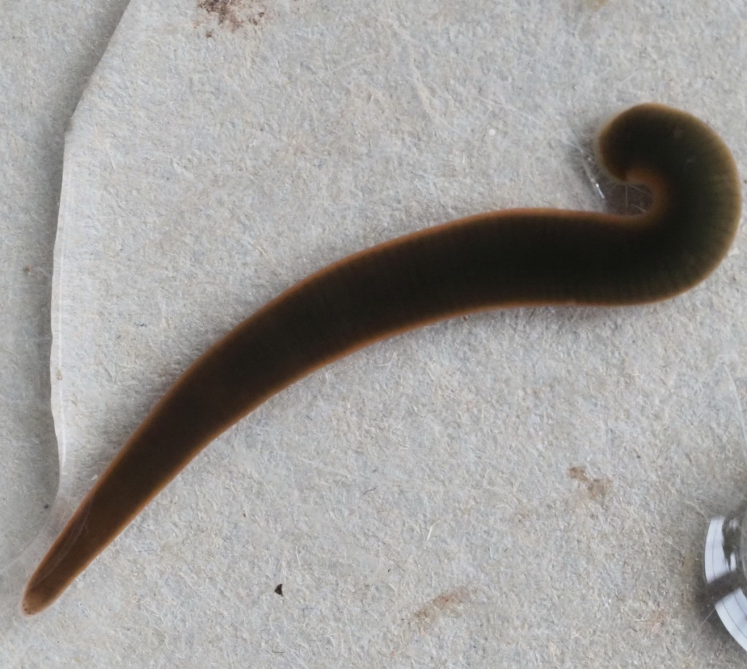
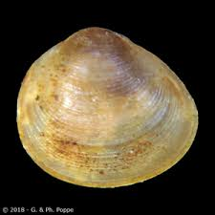
Using DNA Barcoding to Assess the Biodiversity of Macroinvertebrates in the Peconic River
Abstract
Eleven different species were collected in the Peconic Bay Estuary in order to measure biodiversity. In order to determine what these species are, DNA Barcoding was used. Biodiversity is important because it keeps a stable balance within an ecosystem. Pollution is a major issue within the river. Nitrates are abundant in its water and the water quality is suffering because of all of the pollution in the river. Fertilizers are in runoff that ends up in the river. Nitrates decrease the amount of oxygen in the water which makes it harder for the animals to survive which causes a decrease in biodiversity. Invasive species need to be dealt with so that they do not disturb biodiversity.
Olivia Marx, Olivia Pfeffer, Sophia Rivera, Lucille Romaine
Eastport-South Manor Junior-Senior High School
Methods and Materials
15 specimens were collected from the Peconic River using different forms of nets and buckets. They were then organized, placed in ethanol, and frozen.
DNA was extracted from the sample using the Chelex protocol from the DNALC and amplified using PCR. Then DNA barcoding was used to be able to identify the species that were collected. PCR was used to start the replication process. Gel electrophoresis was also used to identify DNA samples that amplified well.
Gel electrophoresis was used to identify at which sequences amplified well
DNA amplicons were sent for sequencing
Samples were analyzed using DNA subway. They were processed with DNA Subway, and compared to other sequences to identify the taxonomy of each species and determine if any of them were invasive or native.
The specimens that obtained good sequences are CTM-004, CTM-005, CTM-007, CTM-008, and CTM-010. The CTM-007 sequence matches up with the cipangopaludina chinensis sequence, as well as the campeloma moitessierianum sequence. The CTM-004 and CTM-005 sequences both match up with the erpobdellidae sequence. The CTM-008 sequence matches up with the helisoma anceps sequence. The CTM-010 sequence matches the pisidium moitessierianum sequence.
Introduction
DNA Barcoding is the process of collecting DNA from different species and running their DNA in the DNA Subway to compare it to the DNA of other species. The gene used for DNA Barcoding is CO1, since it is commonly found in species. The DNA Subway database then works to identify what species a specimen is. This process helps to monitor the biodiversity of different areas, in this case, the Peconic Bay River. Biodiversity is the variety of life in a specific area. It is important to track and maintain biodiversity because it helps keep the ecosystem in check. One of the problems with the Peconic Bay River is the high nitrogen levels. Many invertebrates are good indicators of how much nitrogen there is in the water. By tracking these specimens, one can see the nitrogen levels of an area.
Discussion
The Helisoma anceps, Campeloma decisum, and Cipangopaludina chinensis are freshwater snails that were collected, and reproduce asexually. The moitessierianum, Helisoma, and the Campeloma are all non-invasive to Long Island. But the Cipangopaludina is an invasive species on Long Island and originally came from China.
The Erpobdillidaes’ we identified in the Peconic estuary are freshwater leeches. They are not invasive to Long Island and reproduce sexually by laying eggs. This type of leech is special since it is not a parasite but rather a predatory species.
The Psidium moitessierianum we collected is a freshwater clam. They are non invasive to Long Island and reproduce asexually. Their niche in the ecosystem is that they remove suspended organic material from water. They inhabit places with sandy substrates, ponds, lakes, swamps, or aquatic plants.
Campeloma decisum
CTM - 007
Erpobdellidae
CTM - 004 & 005
Psidium moitessierianum
CTM-010
Resources
Mulcrone, R. (n.d.). Campeloma decisum. Animal Diversity Web. Retrieved March 12, 2024, from https://animaldiversity.org/accounts/Campeloma_decisum/#physical_description
NatureServe Explorer 2.0. (n.d.). Explorer.natureserve.org. Retrieved March 12, 2024, from https://explorer.natureserve.org/Taxon/ELEMENT_GLOBAL.2.108947/
Helisoma_anceps Chinese Mystery Snail (Cipangopaludina chinensis). (n.d.). Minnesota Department of Natural Resources.https://www.dnr.state.mn.us/invasives/aquaticanimals/chinese-mystery-snail/index.html
https://invasions.si.edu/nemesis/species_summary/70329#:~:text=Cipangopaludina%2520chinensis%2520is%2520commonly%2520known. (n.d.). Invasions.si.edu. Retrieved March 14, 2024, fromhttps://invasions.si.edu/nemesis/species_summary/70329#:~:text=Cipangopaludina%20chinensis%20is%20commonly%20known
Acknowledgements
We would like to acknowledge and thank Robert Bolen and Megan Murray for their endless support and help throughout this process along with Dr. Cristina Fernandez-Marco from Cold Spring Harbor lab for giving us feedback on our work along with sending us materials.

