Slide 1
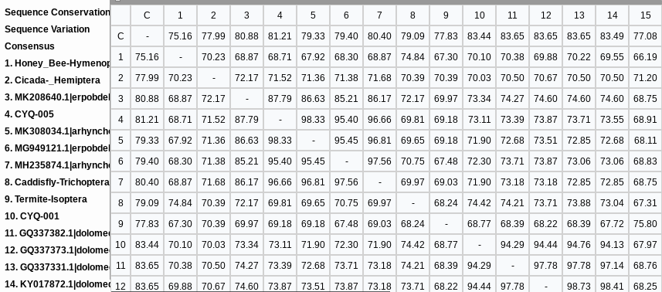
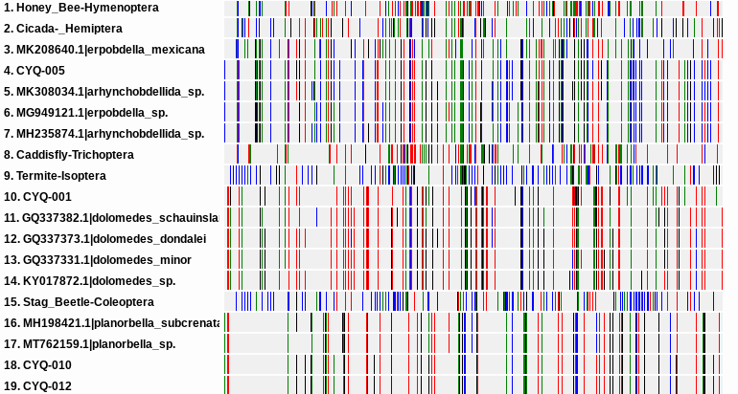
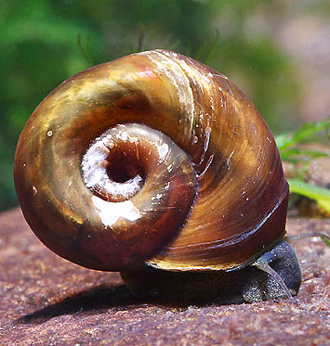
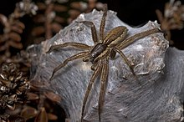
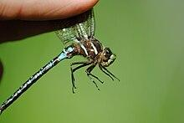
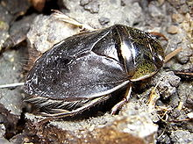
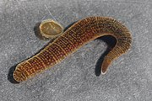
Exploring Biodiversity in the Peconic
Anthony Bruno, Brendan Fabian, Benjamin Grausso, Aidan Lee
Eastport South Manor Junior-Senior High School
Mentors: Mr. Robert Bolen, Mrs. Megan Murray
Abstract
DNA Barcoding is used to identify a novel species using a specific DNA sequence. We were able to collect a variety of different species as shown using many different tools such as seining nets and smaller hand-held nets. Our results allowed us to identify all of our samples that are as shown and even helped us identify a species of spider that was native to New Zealand and has never been identified in New York. These sequences have helped us to gain a better perspective on biodiversity in this section of the Peconic River Estuary.
Discussion
The samples that were successfully identified were 2 snails, one leech, and one spider. The spider we found was endemic to New Zealand. It was called A Dolomedes Minor. It is a aquatic spider that is nocturnal. Its prey consists of locusts, other spiders, dobsonfly larvae, earthworms, bees and other small insects. But the dolomedes minor will also eat deceases animals. The two snails that were identified are very similar. They have the same genus (helisoma) with their niche being eating algae and other decaying organisms this helps control the overpopulation of algae and recycles energy back into the ecosystem.
Introduction
The Peconic River is home to over 600 species. These species vary from vertebrates to invertebrates. This extensive biodiversity of species allows the Peconic to be a stable and thriving ecosystem. Some of these species include sponges, jellyfish, freshwater mussels, insects, and spiders. It is located between the north and south fork of Long Island. The river is made up of both salt and freshwater saltwater creates a perfect habitat for significant biodiversity. Biodiversity is the variation of living things in an environment and that is what we will be studying in this project.
Acknowledgements
We would like to express our gratitude towards our mentors Mr. Robert Bolen and Mrs. Megan Murray and Dr. Cristina Fernandez-Marco at the DNA Learning Center in Cold Spring Harbor for providing us with the resources needed to conduct this experiment.
The chart above illustrates the percentages of matching DNA from the species found compared to the known species in the Peconic.
References
“A “Summer of Discontent” in Long Island Waters |
the Peconic Bathtub.” The Peconic Bathtub | on the
Water, between the Forks, 15 Oct. 2022,
www.peconicbathtub.com/a-summer-of-
discontent-in-long-island-waters/.
Blue Water Task Force Water Quality Monitoring Program – Peconic Baykeeper. peconicbaykeeper.org/programs/blue-water-task-force/.
3. “Peconic Estuary Partnership – Protecting &
Restoring Long Island’s Peconic Bays.”
www.peconicestuary.org, www.peconicestuary.org/.
4. “Peconic Estuary Program.”
www.suffolkcountyny.gov/Departments/Health-
Services/Environmental-Quality/Ecology/Peconic-
Estuary-Program. Accessed 30 Apr. 2024.
“Peconic Estuary Water Quality Report – Peconic
Estuary Partnership.” Www.peconicestuary.org,
www.peconicestuary.org/peconic-estuary-water-
quality-report/.
Methods And Materials
Many invertebrate species were collected using seining nets, and smaller dip nets
Samples were organized into different buckets.
Pictures of each sample were taken, and samples were placed in vials that contain 0.5 mL of 95% ethanol, labeled and stored them in a non-defrosting freezer.
DNA Extraction: a small piece of tissue approximately 1-2 mm in size and put into different vials with the Chelex solution.
Samples were amplified using PCR and amplicons were sent for sequencing
Sequences were analyzed using DNA Subway to generate the barcodes and comparing sequences to the BLAST database.
The barcode chart above image shows all of our species from our blast hits and their relationships between them.
Sample #006, 010 ,012
Planorbella anceps
two-ridge rams-horn snails
Sample #001
Dolomedes minor Nursery Web spider
NOT NATIVE
Sample #013
Odonata genus
Dragonfly
Sample #009
Naucoridae genus
Water Beetle
Sample #011
Hirudo medicinalis
Medicinal leech
The above images depict all of the closest species to the BLAST hits acquired

