Slide 1
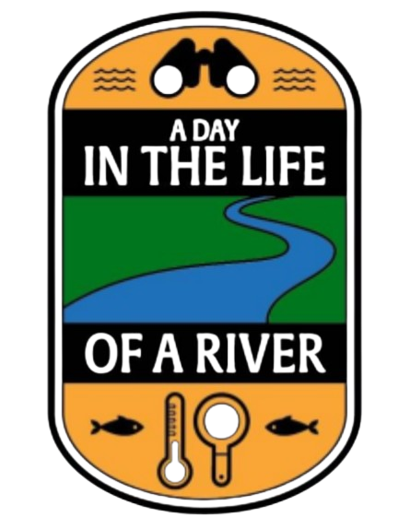
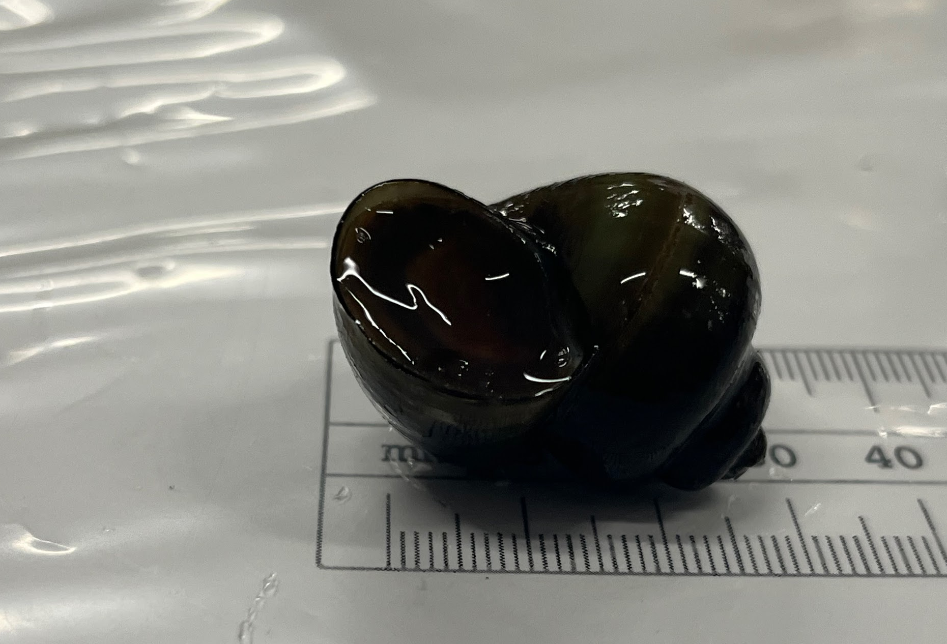
Peconic Estuary Aquatic Invertebrate Sample Collection and Analysis for DNA Barcoding
Sarah Benson, Brooke Stimpson, Serenity Wiegman
Eastport-South Manor Jr-Sr High School
Abstract
The focus of this study is to compare the results to prior years and identify any changes in biodiversity. 20 aquatic invertebrate samples of various species were collected and DNA barcoding was used to identify these organisms. DNA was extracted from the samples and processed through PCR to isolate the CO1 gene. Amplifed sampled were then processed through DNA subway to analyze the sequences. DNA sequences were successfully collected for the four species barcoded which were Callinina georgiana, Naucoridae, Mooreobdella melanostoma, and Chaetogaster limnaei (snail). The snail was determiend to be invasive while all the others are native.
Discussion
Six samples out of eighteen collected samples came back as identifiable sequences The leech is potentially of the Mooreobdella genus. Unlike most leeches, Mooreobdella is a predator and scavenger species, not parasitic. It is native to freshwater and it reproduces sexually. This species will aerate the sediment at the floor of the body of water that they are in.
The snail belongs to the Callinina genus with a thin, smooth shell and can have bands along their shell. They are often referred to as the banded mystery snail. This genus is marked as an invasive species of concern.
The aquatic oligochaete worm was identified in either the Chaetogaster genus or the Allonais genus. Both genera are segmented worms and are in the family of sludge worms. The Chaetogaster limnaei is a parasite of freshwater snails and mussels. Neither the Chaetogaster nor the Allonais genus are invasive species.
The water bug was identified as several different genera , but the top one was the Naucoridae genus, followed by the Micronectidae genus. They feed on small invertebrates and are considered to be predators. The Naucoridae is suspected of carrying bacteria and transferring it through biting mice. Micronectidae are described as pygmy water boatmen and is an indicator of water quality.
Three samples were identified as the Springtime Darner Basiaeschna janta. This species is native to freshwater and are not an invasive species. Dragonflies are beneficial in reducing mosquitoes and other biting insects that can be blood-borne disease vectors.
RESULTS
CXR-001 Basiaeschna janata
CXR-002 Basiaeschna janata
CXR-004 Basiaeschna janata
CXR-007 Naucoridae
Introduction
To measure biodiversity, DNA barcoding is used to identify samples
The CO1 gene is found in the mitochondria and is used to barcode organisms, it is used because the gene sequence rate of change is slow enough to be almost identical in the same species, but fast enough to differentiate small DNA changes between species
The samples were collected from the Peconic river, an essential part of the Long Island ecosystem
The Peconic river provides habitats for a variety of species and has been susceptible to invasive species
In the past, the Peconic river has suffered from high nitrate levels that resulted in changes of biodiversity Measuring biodiversity will help determine if these problems still exist
CXR-017
Callinina georgiana
CXR-018
Mooreobdella melanostoma
CXR-019
Chaetogaster limnaei
Methods and Materials
20 different invertebrate samples were collected using one meter by half meter dip nets for small organisms.
A seine net measuring one meter deep and four meters long attached to wooden poles on either end was used to collect larger organisms.
Samples were individually photographed and measured, then stored in 0.5mL of 95% ethanol in a freezer.
DNA was extracted using the DNALC Chelex protocol.
DNA was amplified using PCR and the CO1 gene presence was verified using gel electrophoresis
Amplified samples were sequenced and then identified using BLAST and DNA Subway to generate DNA barcodes.
Resources
Muñiz-Pareja, F., & Iturbe-Espinoza, P. (2018). Effectiveness of Chaetogaster limnaei as a controller of Fasciola hepatica in experimental infections of Galba truncatula. Tropical Parasitology, 8(2), 88. https://doi.org/10.4103/tp.tp_24_15
Stoll, S., Hormel, N., Früh, D., & Tonkin, J. D. (2016). Effects of Chaetogaster limnaei limnaei (Oligochaeta, Tubificidae) on freshwater snail communities. Hydrobiologia, 785(1), 101–113. https://doi.org/10.1007/s10750-016-2909-1
Smythe, A. B., Forgrave, K., Patti, A., Hochberg, R., & Litvaitis, M. K. (2015). Untangling the Ecology, Taxonomy, and Evolution of Chaetogaster limnaei (Oligochaeta: Naididae) Species Complex. The Journal of Parasitology, 101(3), 320–326. https://doi.org/10.1645/13-465.1
Kathman, R. D., Kathman, R. D., & Wetzel, M. J. (2003). Allonais inaequalis (Annelida: Oligochaeta: Tubificidae) in North America. Proceedings of the Biological
Society of Washington, 116, 548–-556. https://www.biodiversitylibrary.org/part/44492
Acknowledgements
We would like to thank Mr.Bolen and Ms.Murray for their continued support in the classroom. We would also like to thank Dr. Cristina Fernandez-Marco for her help and support from Cold Spring Harbor Laboratory..

