Slide 1


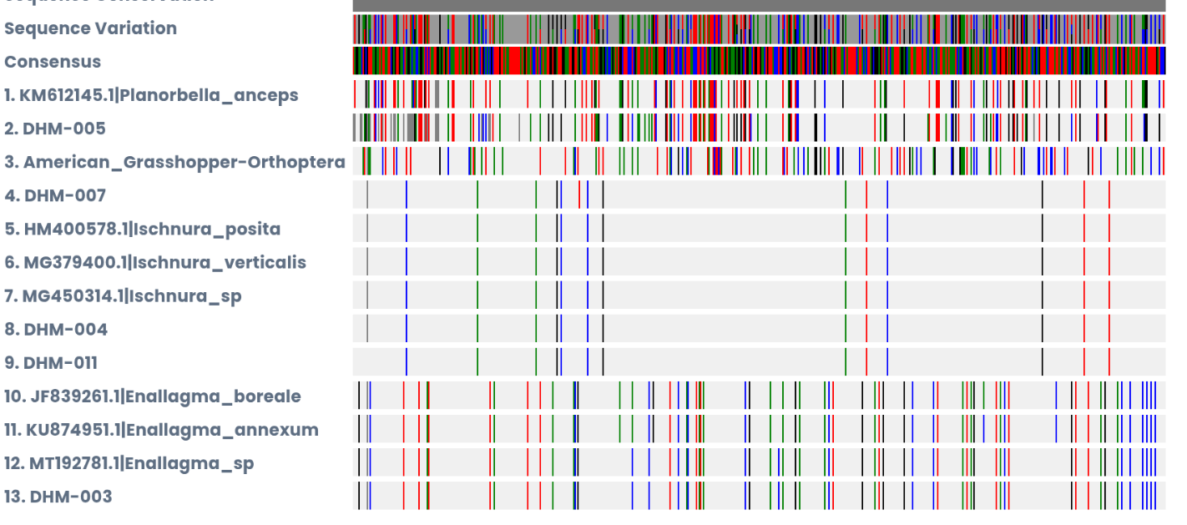
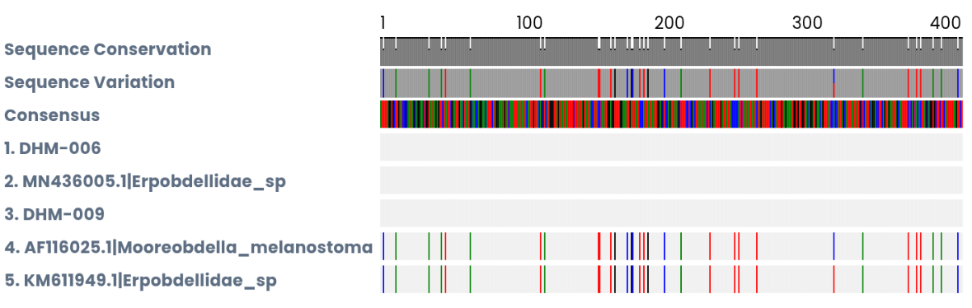
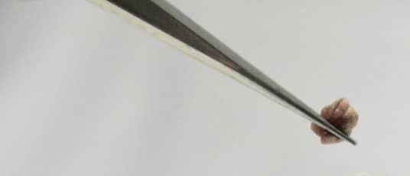
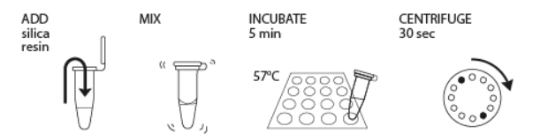
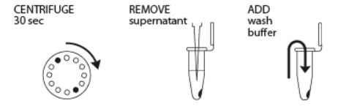
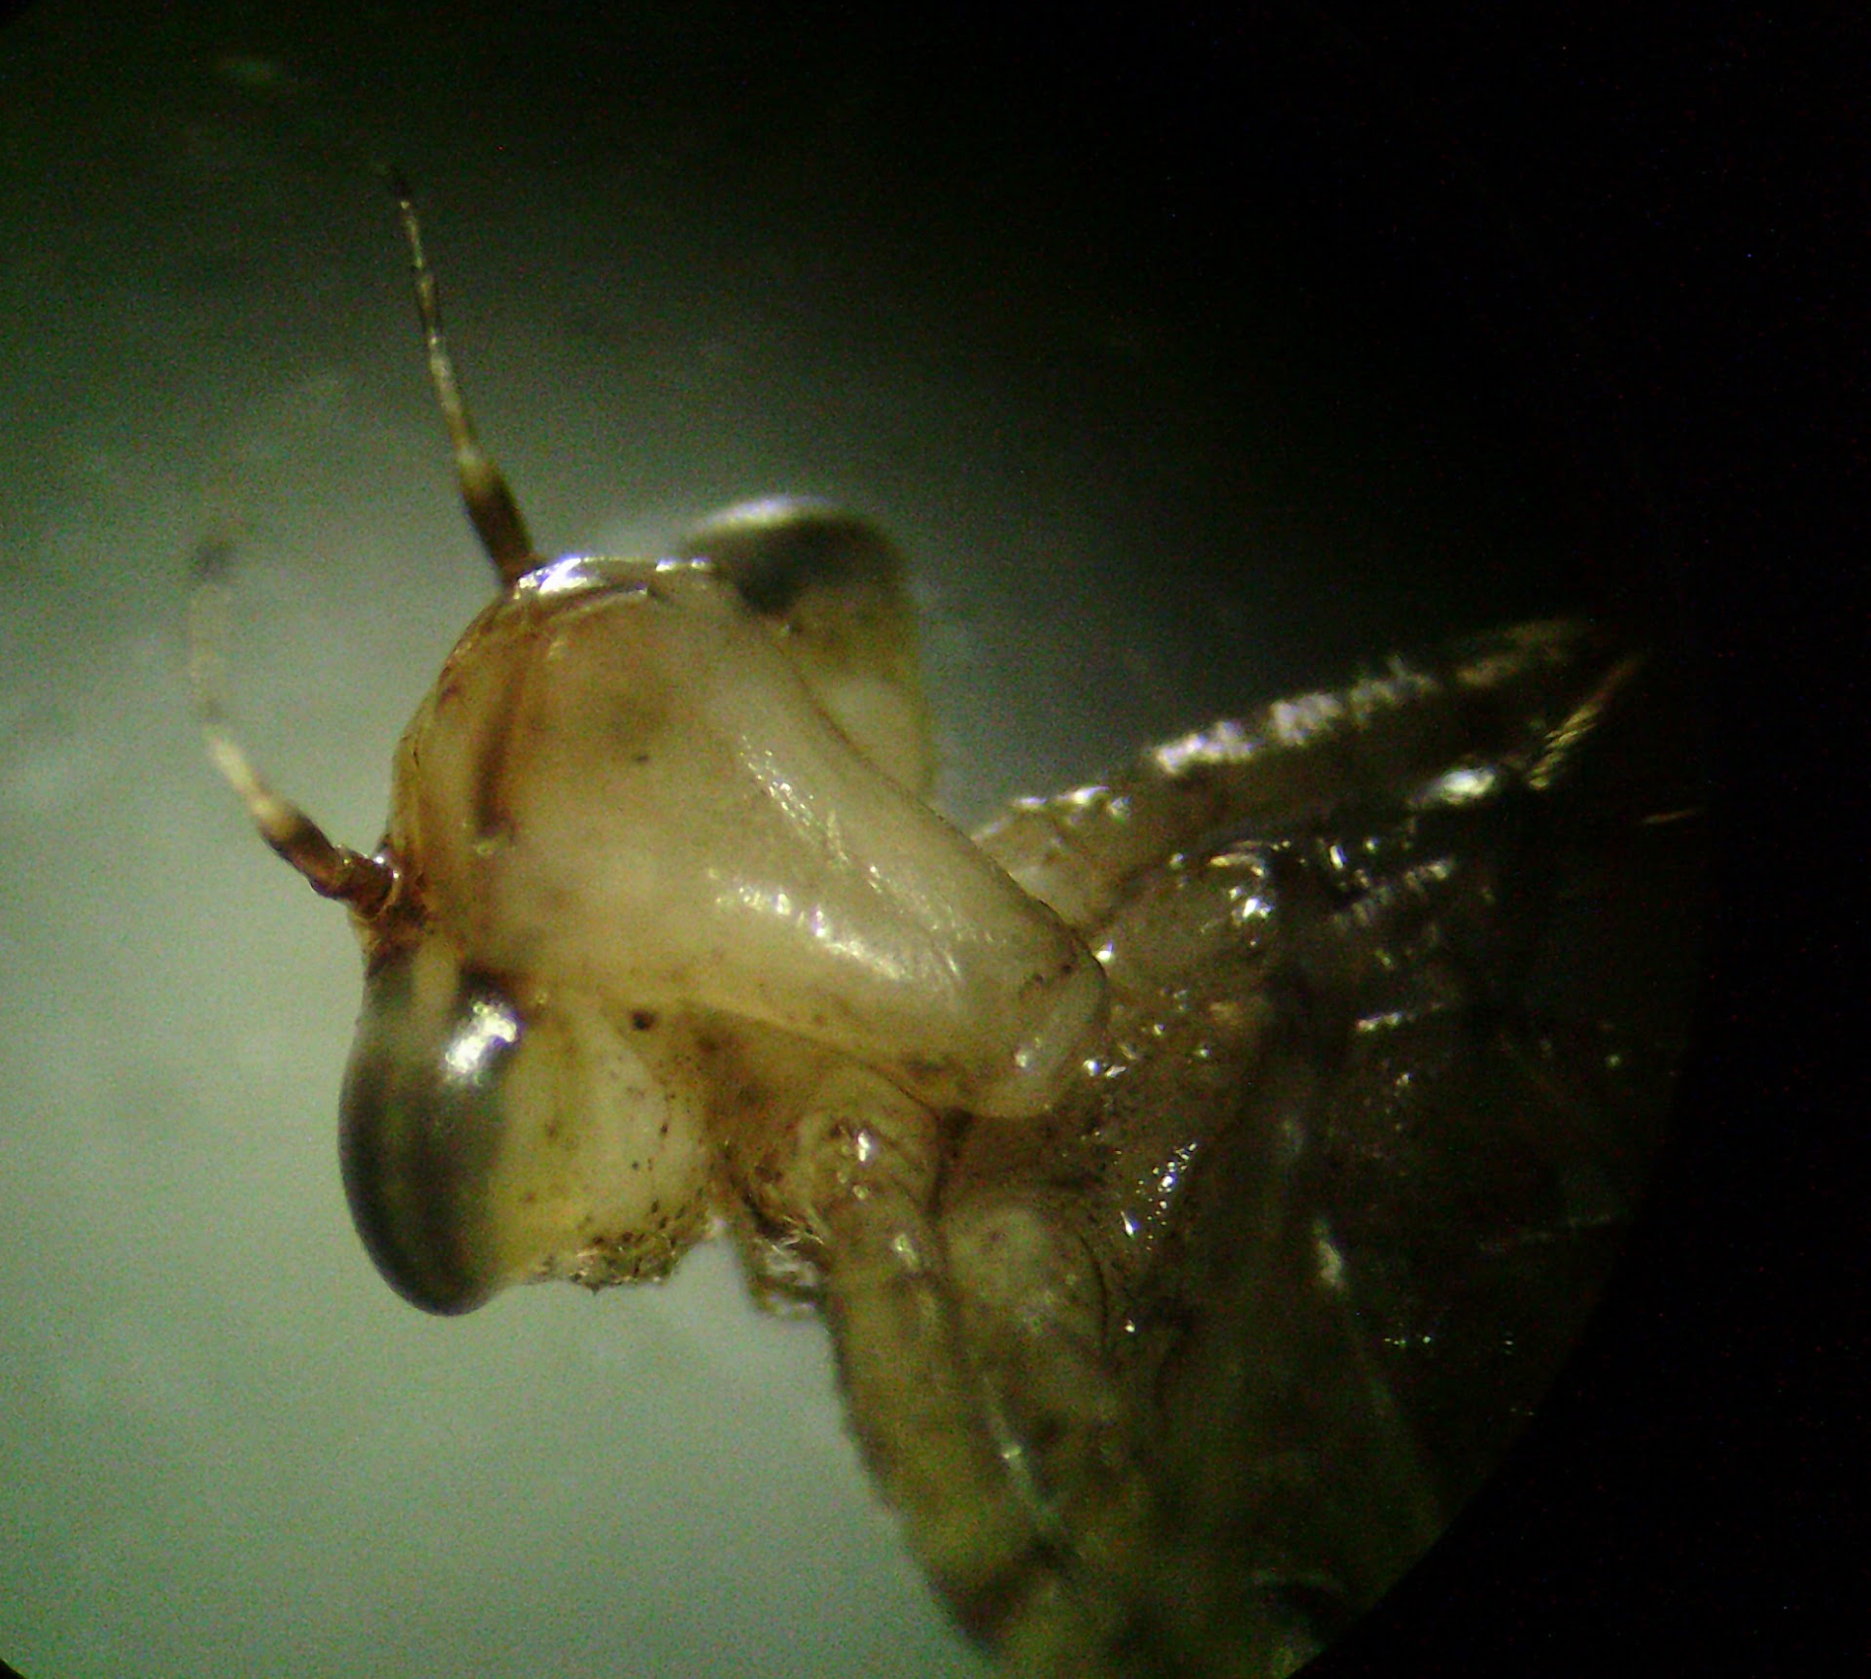





Analyzing Barcode Sequences to Measure
Peconic River Biodiversity
Sabrina Disney and Morrigan Katzenberger
Eastport South Manor Junior-Senior High School
Mentor: Mr. Robert Bolen
Abstract
Results
This project measures the biodiversity of the Peconic River by identifying the species that inhabit the Peconic River. Numerous invertebrate species were identified. Identifying this information will provide us with the data that is necessary to maintain the environment’s health. This project may identify possible invasive species, beneficial species, or species that do not have a DNA sequence that has been identified already. Samples 007, 004, and 011 are identified as an eastern forktail damselfly and sample 005, which had been identified as a two-ridge ram-horn, and sample 003 was identified as the Boreal Bluet (a northern bluet damselfly.) These damselflies are natural predators to mosquitoes and help control pests and possible pathogen transmission.
DNA was taken from 11 samples that were located in the Peconic River in order to measure biodiversity. It was found that some samples had the same DNA while others DNA were not an exact match to any species but close to two different species. Not all of the samples are fully identified just yet as there are other organisms that share the same DNA.
DNA Subway 2.0 multiple sequence comparison by Log-Expectation. This image shows which samples could possibly be related to other already known organisms based off the DNA barcode sequence.
Introduction
DNA barcoding is a highly accurate method used to identify a species by analyzing a short segment of the organism's DNA. The most commonly used gene is a gene from the mitochondria, the cytochrome c oxidase subunit 1, or CO1. The dragonfly larvae and damselfly larvae all have nearly identical appearances as larvae. The organism's physical characteristics cannot be used to identify the species.
The Peconic River is part of the Peconic Estuary and it provides a habitat for many different species. This estuary is being studied to better understand the biodiversity and overall ecological health. Biodiversity in an ecosystem is essential because the higher the biodiversity, the higher stability which increases survival. Unfortunately, the Peconic River faces major issues, including invasive species, nitrogen overloading and chemicals that cause pollution. These eventually leads to algal blooms and decreased oxygen levels, causing reduced biodiversity and destruction of habitats which allows invasive species to outcompete native wildlife.
Materials and Methods
SAMPLE NUMBER | SCIENTIFIC NAME | COMMON NAME
003 | Enallagma boreale | Boreal Bluet Damselfly
004, 007, 011 | Ischnura posita | Eastern Forktail Damselfly*
005 | Planorbella anceps | Two-ridge Rams Horn Snail
The Peconic River, Long Island’s longest, goes from a freshwater stream to an estuary as it flows into the Peconic Bay. Bordering wetlands, it provides habitats for many different species. While collecting at the river, seine nets were used to collect different diverse aquatic macroinvertebrate species. Smaller dip nets were used to collect samples from the docks and the shoreline.
An example of how the sample would like once extracted
Image taken by student researcher
Discussion
The results show a wide range of species that helps identify the biodiversity of the ecosystem. There are many different species that have been identified, such as different damselfly, dragonfly, leeches, and snails. These findings are important because they help us understand and examine the diversity within the environment. Knowing about the biodiversity in this ecosystem is important because the Estuary system is a very crucial environment being that it is home to many important species that contribute to stability.
Four different species of damselfly were identified, which indicate high biodiversity of organisms that prey upon mosquitoes. The Eastern Forktail has not been previously identified in this location. This could improve the overall quality of the ecosystem for the public. The outcome of our project was expected, which is that there are many different species that all contribute to stability within the Peconic River ecosystem.
Samples were separated and transferred into capped vials with 99% ethanol, and placed in the freezer (for storage). DNA was extracted and the CO1 gene was amplified with PCR. Afterwards gel electrophoresis was used to confirm that the COI gene was amplified.
Image source from Barcode Long Island lab manual
What was done in order to complete PCR
DNA Subway was used to determine the identity of each sample by using Nucleotide Basic Local Alignment Search Tool in order to use already identified sequences and compare them to the samples we found. BLAST finds results known to barcodes for verification.
Future Directions
Some important steps that can be taken in order to continue this project is restore habitats in order to keep biodiversity in the river, have people volunteer their time at the Peconic river in order to keep it a safe, clean space for new organisms and document are share findings to influence habitat management and possible biodiversity plans. We can make this project even more accurate by running PCR again to get more accurate results in order to leave no room for error.
DHM- 007 head picture. This sample is most likely the Fragile Forktail damselfly (Ischunra posita)
Image taken by student researcher
References
Acknowledgements
Thank you to the DNA Learning Center Staff for support with proposals, providing laboratory equipment, and supporting sequence analysis. Special thanks to Jeff Petracca for technical support with sequencing.
Notes:
Posters must be no larger than 3 ft wide x 4 ft high in portrait orientation. Posters do not need to follow the exact format laid out in this template but should include all sections and logos. Discussion and future directions can be combined as appropriate. Importantly, posters with descriptive images and figures are preferred over text-heavy posters. Font size throughout should be no smaller than 24 pt.

