Slide 1
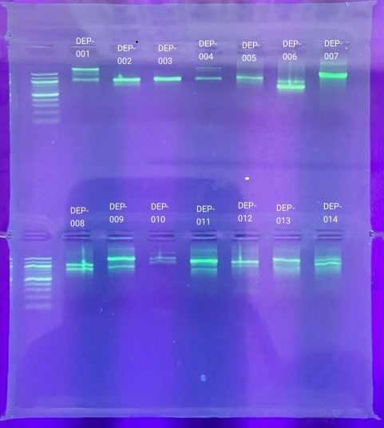
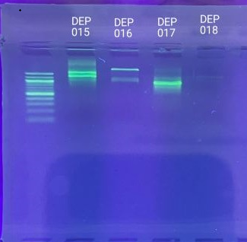
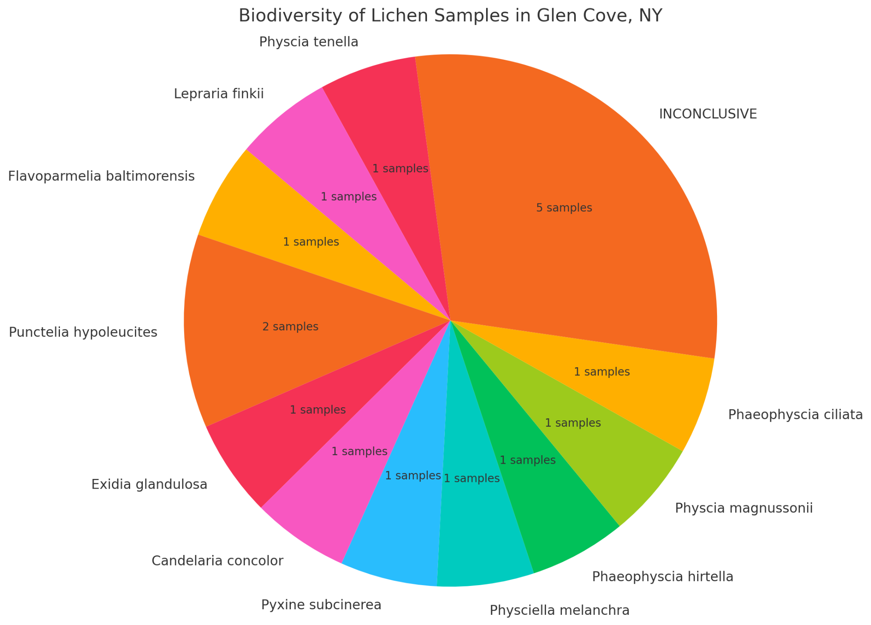
The Biodiversity of Lichen in Glen Cove
Nicole Lee¹ Elif Turan¹ Umut Turan¹ Mentor/Teacher: Kerry Bunyan¹
Glen Cove High School¹ Cold Spring Harbor Laboratory’s DNA Learning Center²
Abstract
Lichen are composite organisms made up of fungi and algae which share a symbiotic relationship. A symbiotic relationship is a close association found between two or more species, in a symbiotic relationship one or more organisms must be benefited (Brusowankin, 2022). Lichen showcase a mutualistic relationship, it is one where both benefit in their relationship (National Park Service, 2018). In this project we are looking to investigate what factors could make a difference in the biodiversity of lichen. For our project we will collect lichen from 3 different locations, one school campus and two backyards, looking at the species of the lichen and determining the biodiversity. Therefore aiding us in finding out what may affect the biodiversity of the lichen. We predict that the school campus will have more biodiversity than the two backyards.
Introduction
In this project we are looking to compare the biodiversity of lichen from three different backyards in Long Island. The organism lichen is made up of algae and fungi. Lichen are commonly found in humid areas near bodies of water and can be found in a variety of places. Lichen play a significant role in the survival of the ecosystem around them. In our project we will compare the species of lichens found at our chosen locations to identify which location is most diverse. The locations are two backyards and one school campus. We hypothesize that there will be more biodiversity on the school campus rather than the two backyards. This is due to the fact that the school campus is larger, which can mean more species of lichen. Additionally, species richness is the total number of different species in an ecosystem. Whereas, species evenness is how balanced the species in an ecosystem are. Species richness will be the greatest on the school campus and evenness will be greatest in backyard A. We believe the species richness will be the greatest at the school campus due to its larger area size, and we believe that species evenness will be the greatest in backyard A due to it being a more uniform environment.
Discussion
The findings showcase that backyard A had the most inconclusive samples due to only one of the samples having a successful sequencing result. This prevented us from knowing the biodiversity of the location. When comparing the school campus and backyard B, backyard B was the most diverse because it had no repeats in samples. The school campus had two repeats of Punctelia Hypoleucites, making it not as diverse as backyard B. When describing the species richness and evenness found in our samples, we cannot conclude whether backyard A had the most evenness due to the inconclusive samples. Given the samples from backyard B, it had the most species richness and evenness due to the samples all being different species.
Materials and Methods
References
For our collection we will look at rocks and trees from 3 different locations: 2 different backyards and the school campus. We will choose the most unique samples from each location and have 5 samples from each backyard and 10 total from the school campus. For DNA barcoding, we will be amplifying the ITS gene for each sample in order to identify the specific species of the Lichen. After PCR, we will use gel electrophoresis to confirm if the gene was successfully amplified. The samples will be sent out for sequencing and we will analyze the sequences using DNA subway to determine the species collected. The DNA barcoding will determine which one of our locations carries more biodiversity.
Brusowankin, Aryeh. “What is Symbiosis? Meaning, 3 Types & Examples.” PBS, 14 July 2022, https://www.pbs.org/articles/what-is-symbiosis. Accessed 15 November 2024.
“Foliose Lichens.” USDA Forest Service, https://www.fs.usda.gov/wildflowers/beauty/lichens/gallery/foliose/index.shtml. Accessed 1 November 2024.
Acknowledgements
Thank you to Cold Spring Harbor Lab for providing the resources necessary, Jeffrey Petracca for the experience at the lab and assisting us, and our teacher Ms. Bunyan for this opportunity.

