Slide 1
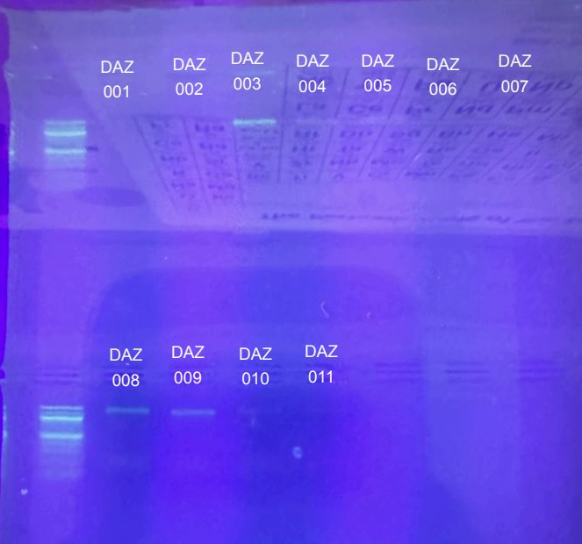
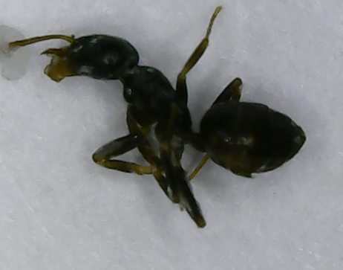
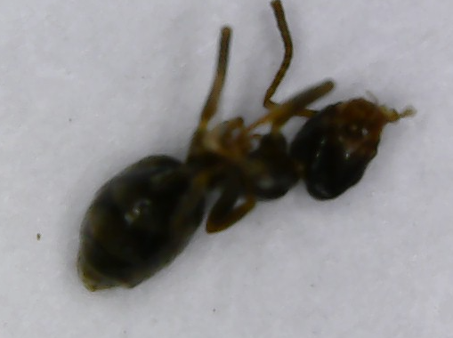
The Effect of Human Activity on Ant Biodiversity
Monica Penafiel, Junior Ramos, Ms. Bunyan
Glen Cove High School
Abstract
Ants play an important part in our ecosystem as they are predators to other insects as well as decomposers of organic waste or other dead animals. For our research project we will be collecting ants from three different environments to assess the biodiversity of ant species in Glen Cove: Morgans Park, Glen Cove High School fields, and Juniors backyard. We believe that if human activity in an ants environment impacts them, then ants present in areas with less human activity will be more biodiverse. We think that ants in Juniors backyard will have more biodiversity than GCHS (Glen Cove High School) fields or Morgan Park because there is less human activity, whereas Morgan Park or GCHS fields will have less diverse ant populations.
Introduction
We will be collecting specimens from three different locations with varying amounts of human activity, we would like to see the effects on the ants biodiversity depending on the amount of human activity in the area. Our three locations are; Morgan’s Park, Glen Cove High School, and Junior’s Backyard. We plan to collect as many different looking ants as possible from each site. We believe that there will be more biodiversity in ants whose environment has less human activity, than those with more human activity. Ants who have increased human activity in their environment will likely have specific characteristics that allow them to survive. Due to natural selection those with the needed characteristics will thrive and continue. Whereas those with less human activity might be more diverse and less cautious but will maintain a bigger colony. Therefore we expect to see more biodiversity in areas of lower human activity. Three types of ants we might find are; Acrobat Ants (Crematogaster ashmeadi Emery), Pavement Ants (Tetramorium Caespitum), and Field Ants (Formica pallidefulva).
Materials & Methods
We can collect ants by using baits based off of foods they are attracted to. Acrobat ants are drawn to sweets and high-protein foods like meat. Field ants mostly consume honeydew. We can use this information to draw these ants in using index cards to place food items matching the description of their likings. We can use peanut butter or tuna fish on an index card to bring in pavement ants, we can put yogurt or a sugar cookie on an index card for acrobat ants, and for field ants we can use honeydew. The samples will be stored in test tubes in the freezer until we are ready for DNA extraction.
Results DAZ 008 - Tapinoma sessile House Ant, 4 mismatches
DAZ 009 - Tapinoma sessile House Ant, 7 mismatches
The other 8/10 samples tested inconclusive in their sequence results.
DAZ 008 - Tapinoma sessile, House Ant
DAZ 009 - Tapinoma sessile House Ant
Discussion
After conducting PCR and Gel electrophoresis, we found that we had successfully amplified DNA from 3 of our samples. The 3 samples were then sent for sequencing, of the 3 samples, 2 came back with conclusive results. It is hard to determine whether ants present in areas with less human activity will be more biodiverse as many test results inconclusive. What we can determine is that both of these House ants (Tapinoma sessile) have less biodiversity. This may be as a result of more human activity in the area which may partly prove our thesis. Sample DAZ-008 had 4 mismatches, sample DAZ-009 had 7 mismatches.
References
“Acrobat Ant Control - How to Get Rid of Acrobat Ants.” PestWorld.org, https://www.pestworld.org/pest-guide/ants/acrobat-ants/. Accessed 25 September 2024.
“Acrobat Ants – Ant Pests.” Ant Pests, https://ant-pests.extension.org/acrobat-ants/. Accessed 25 September 2024.
Acknowledgements
Thank you to; Jeffrey Petracca, and the Cold Spring Harbor DNA Learning Center for an amazing learning experience.

