Slide 1
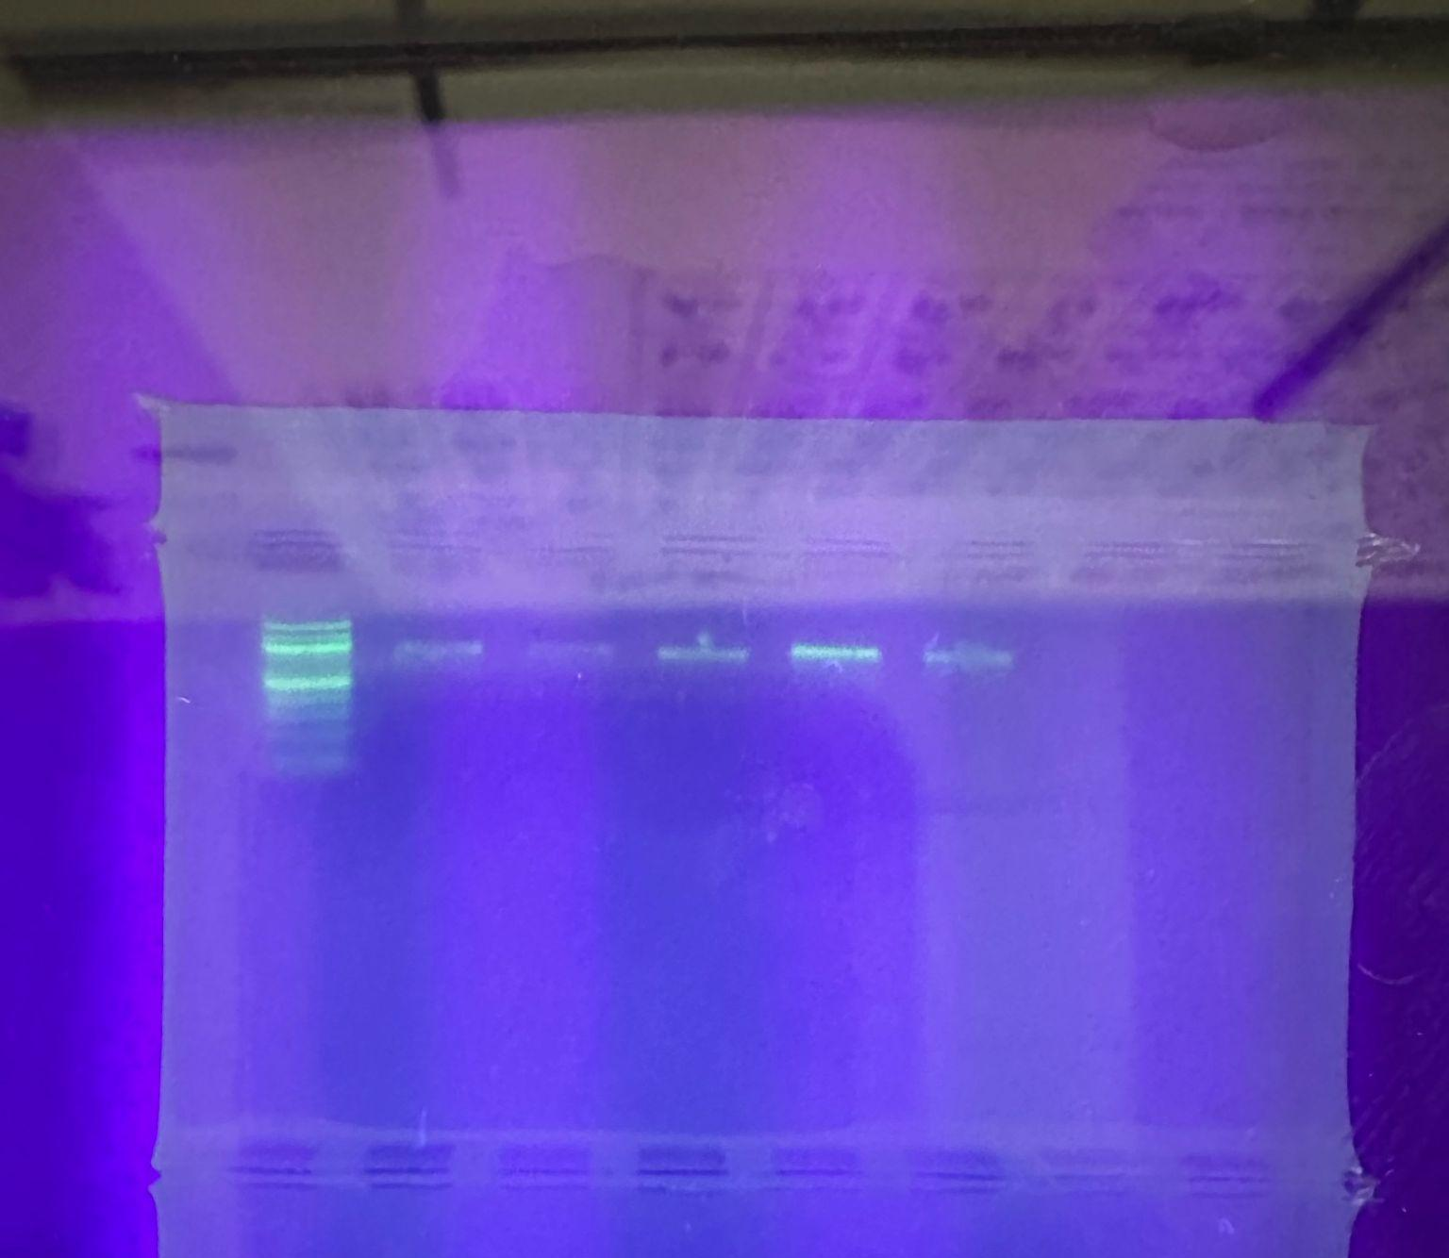
Testing The Biodiversity of Algae in Freshwater Still and Running bodies of water at Dosoris Pond, Glen Cove
Michelle, Rose & Ms. Bunyan
Glen Cove High School
Abstract
In our project we will collect samples of algae in freshwater and compare the biodiversity in still and running water. Dosoris pond in Glen Cove will be where we find one location with both runoff and still water to collect our samples from. There’s multiple examples of freshwater algae we can find like, Blue Green Algae, Brown Algae, and Red Algae. Our hypothesis is the running water location in the fresh body of water will have more diversity since its environment is constantly cycling water from other areas. Our objective is to find the difference in biodiversity in freshwater (Dosoris pond) with a runoff and still location of water. We are also looking to see how each plant affects each environment it is in. The materials we will be using are gloves for protection, ziplocs for storage, and 16s primer for any blue green algae detected and rbcl primer for any brown red algae collected for identification. From each location we are planning to get 10 samples from Dosoris pond in both running and still water locations.We will determine which primer to use based on the phenotype of each algae collected.
Introduction
In our project we will collect samples of algae in freshwater and compare the biodiversity in still and running water. We will do this by going to one freshwater location, Dosoris Pond. There we will find one location with runoff and one with still water to be able to analyze based on the environment.
Materials & Methods
Gloves will be worn for protection and then one sample will be collected for each species of algae, we will base this mostly on phenotype, and try to collect samples that look visibly different. We will put one sample in each ziploc bag and label each one with what site we got it from, and the date. We will take photos of every place we find so that we can compare and contrast later. Algae will be kept in the freezer until DNA barcoding.
Results
In our study, DNA barcoding was used to identify three distinct species of algae: Ulva sp (sea lettuce), Ulva compressa (thread weed), and Ulva prolifera (branched string lettuce). The results were based on the analysis of genetic markers, confirming the presence of these species in the sampled area. DNA barcoding provided precise identification, allowing for the differentiation of these algae based on their genetic sequences
Discussion
Ulva lactuca (Sea Lettuce): This species is commonly found in both still and running water, Cladophora (Thread Weed): Cladophora species often prefer running water, Codium fragile (Branched String Lettuce): Codium fragile is typically found in marine environments, often in areas with moderate water movement. The presence of Ulva lactuca, Cladophora, and Codium fragile indicates moderate biodiversity in the studied area. If these species are part of a larger, diverse ecosystem, it suggests higher biodiversity. However, if these are the only dominant algae present, it could reflect lower biodiversity in that specific region.
References
“Aquatic Invaders of the Sound!” Long Island Sound Study, 23 February 2021, https://longislandsoundstudy.net/2021/02/aquatic-invaders-of-the-sound/. Accessed 6 November 2024.
“Blue-green algae and harmful algal blooms.” Minnesota Pollution Control Agency, https://www.pca.state.mn.us/air-water-land-climate/blue-green-algae-and-harmful-algal-blooms. Accessed 28 October 2024.
Burton, Rebecca. “Sargassum: Seaweed or Brown Algae – Thompson Earth Systems Institute.” Florida Museum, 15 July 2018, https://www.floridamuseum.ufl.edu/earth-systems/blog/sargassum-seaweed-or-brown-algae/. Accessed 28 October 2024.
Acknowledgements
We would like to thank Cold Spring Harbor Learning Center for providing us with all the materials needed for our experiment and thank you to Jeffrey petracca for helping us with our experiments .

