Slide 1
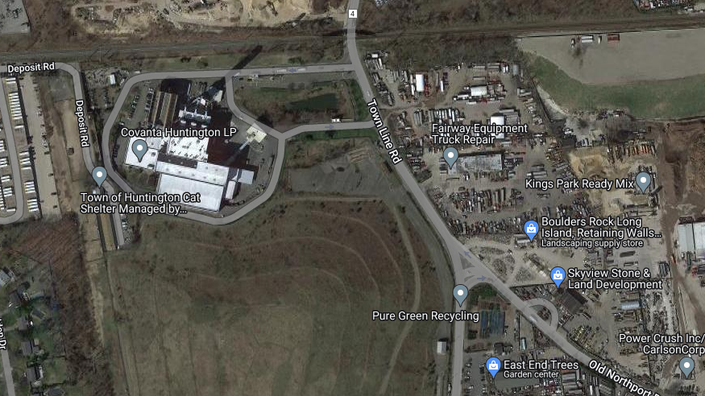
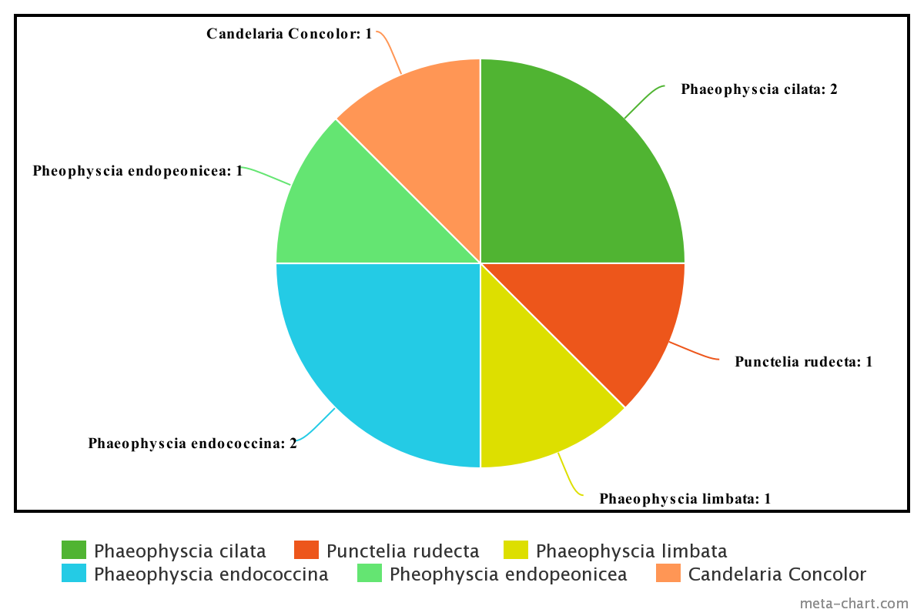
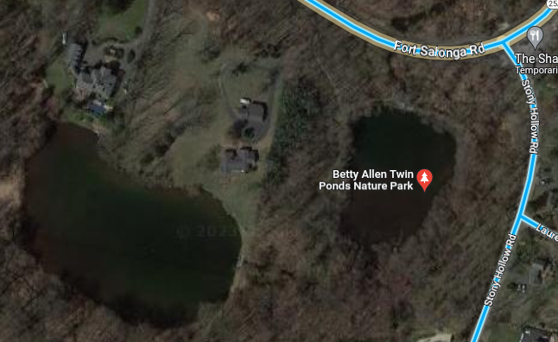
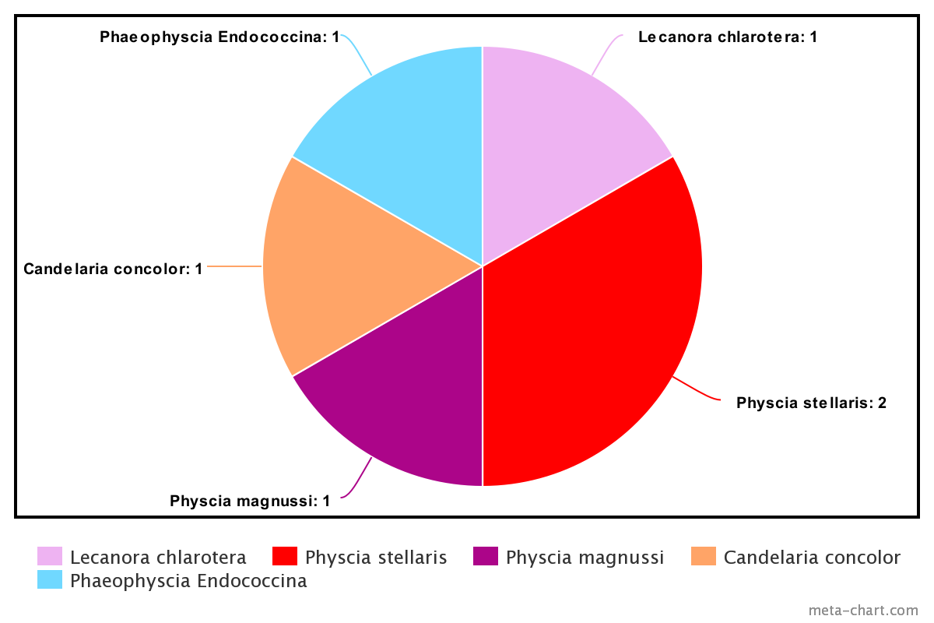
The Effect of Industrialization on Lichen Biodiversity in Northport
Brendan Navas
Northport High School
Abstract
Lichen is a composite organism consisting of a fungus and an algae or cyanobacterium capable of performing photosynthesis. Lichen have an important role in ecosystems as food sources for organisms. Lichen are commonly used to monitor air quality, retain water in soil and prevent erosion (Wolf, 2015). The purpose of this project was to investigate how sources of industrialization affect the biodiversity of lichen in Northport. It was hypothesized that lichen found in the polluted area will be those resistant to air pollution and therefore less biodiverse. To test this, twenty lichen samples were collected. Ten came from a site near three sources of industrialization; a waste to energy incinerator, diesel railroad tracks and a bus yard. The other ten samples served as a control and were collected from Twin Ponds Nature Park (an area not affected by industrialization). Samples were classified according to field guides prior to fungal ITS gene isolation and PCR amplification, according to Cold Spring Harbor’s DNA Barcoding protocol (“Using DNA Barcodes - DNA Learning Center Barcoding 101.”). Successful purification and amplification was determined using gel electrophoresis, resulting in fourteen samples being sent out for sequencing. Samples were then analyzed using DNA Subway’s Blue Line to identify the species of lichen based on the ITS fungal component. Data identified 5 different species of lichen in the experimental (industrialized) collection area, compared with 6 different species identified from the less industrialized control site. This supports the hypothesis, and results suggest a relationship between increased industrialization and a decrease in biodiversity of lichen.
Introduction
Lichen were selected as they are sensitive to air pollution because they receive all their nutrition through the atmosphere. (Wolf, 2015)
Many sources of pollution release nitrogen compounds into the air (NOx) which can kill off many species of lichen by harming the lichen’s chlorophyll that the organism uses to produce sugars for food. (Coffey & Fahrig 2012)
Some lichen, however, are more resistant to many types of pollution which allows me to compare the types of lichen I found at each site and draw conclusions based on if the species present tell how the immediate area and its life is influenced by pollution.
Materials & Methods
20 samples were collected, processed and prepared for the isolation of the ITS and rBCL gene to find the fungal and algal components, run through a PCR and finally a gel electrophoresis run.
Following the Barcode Long Island Blue Line: Determine Sequence Relationship procedure sequences obtained were run through DNA subway and BLASTN results were obtained and used in results.
Results
A greater diversity of lichen by 17.7% was found in samples taken from the less industrialized site
The data suggests that there is a correlation between amount of industrialization and diversity of lichen.
LIRR Tracks
High Concentration
Lightly Industrialized Site
Collection Area
Bus Depot
Garbage Incinerator
Concrete Mixer
Landfill
Main Road
Low Concentration
Heavily Industrialized Site
Collection Area
`1
Discussion
The heavily industrialized site produced less genetic variation in lichen than the control site by about 17.7% or one lichen species.
During the experiment both the ITS and rbcL were ran through DNA subway but the results from the rBCL gene were not reliable due to short sequence length and highly conserved sequences so they were disregarded.
The data in the table comes from only information taken from the ITS gene (fungus) of the lichen.
References
Coffey, Heather M. P., and Lenore Fahrig. "Relative effects of vehicle pollution, moisture and colonization sources on urban lichens." Journal of Applied Ecology, vol. 49, no. 6, Dec. 2012, pp. 1-9. Pdf.
Covanta. www.covanta.com/waste-to-energy-vs-landfill. Accessed 17 Apr. 2023.
Will-Wolf, Susan, et al. "Lichen-based indices to quantify responses to climate and air pollution across northeastern U.S.A." No. 1 Spring 2015 pp. 1-122, 4th ed., American Bryological and Lichenological Society, 2015, pp. 1-122. Vol. 118 of The Bryologist. 122 vols.
Acknowledgements
Thanks to Kimberly Collins, Bryan Horan and Cold Spring Harbor Labs for mentoring, participating in and helping me edit my project throughout the year.

