Slide 1
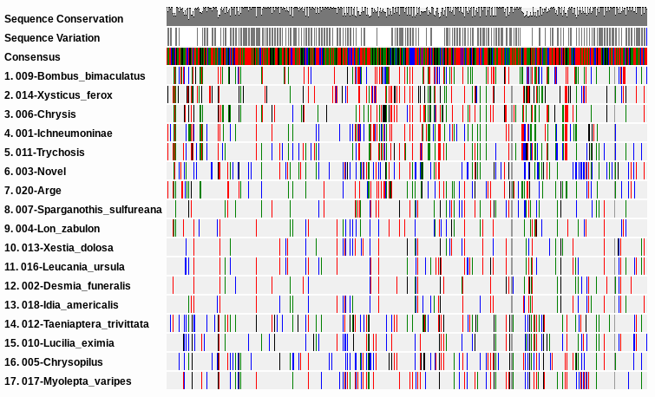
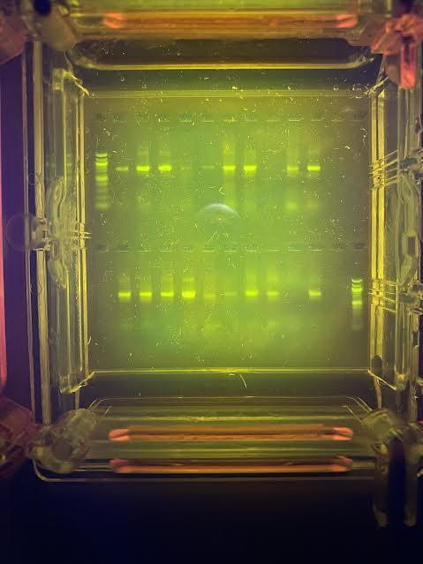
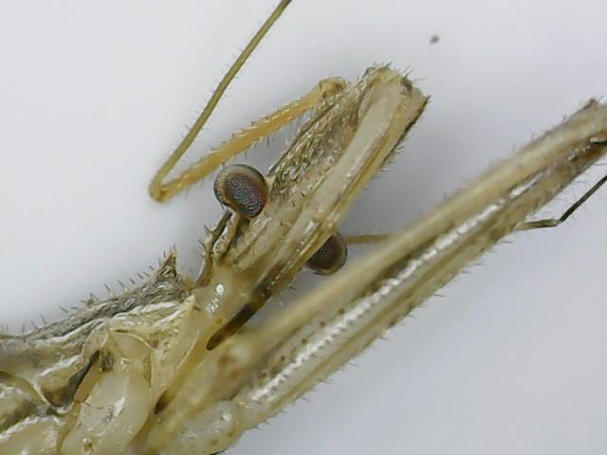
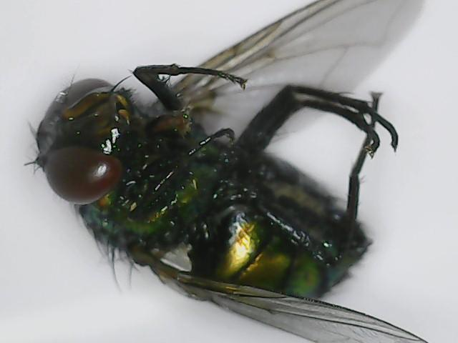
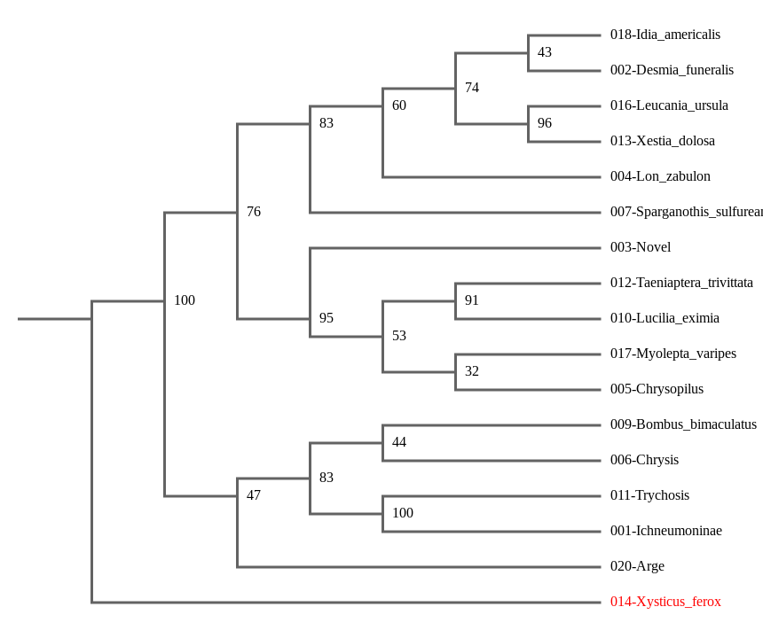
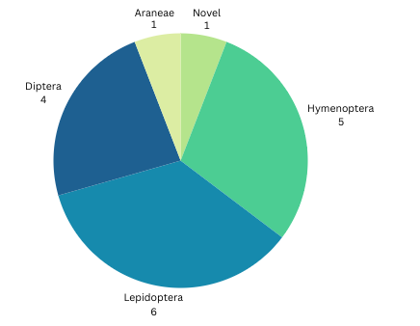
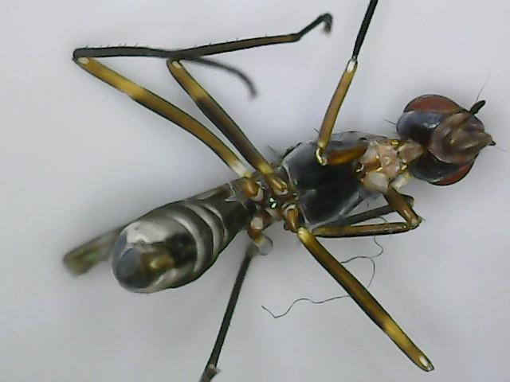
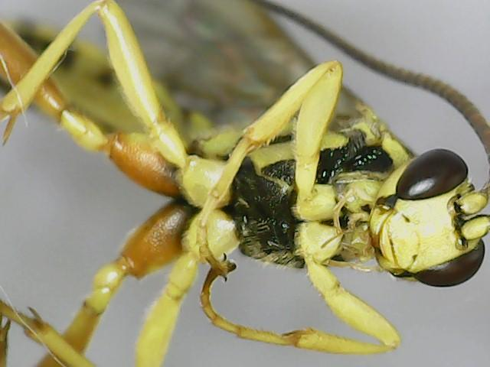
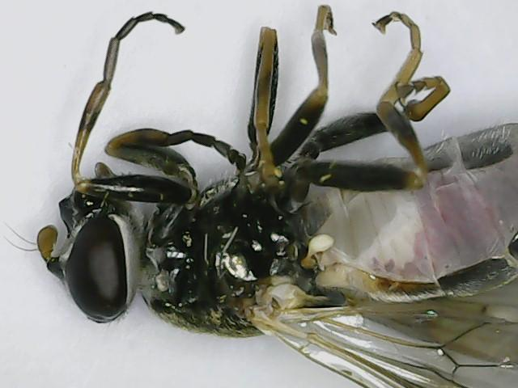
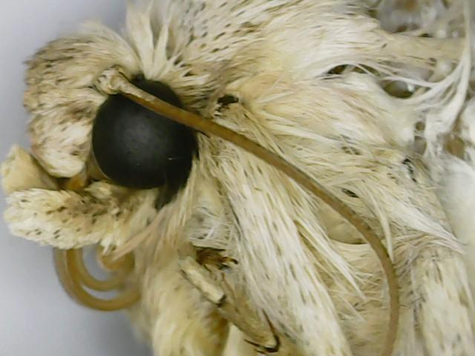
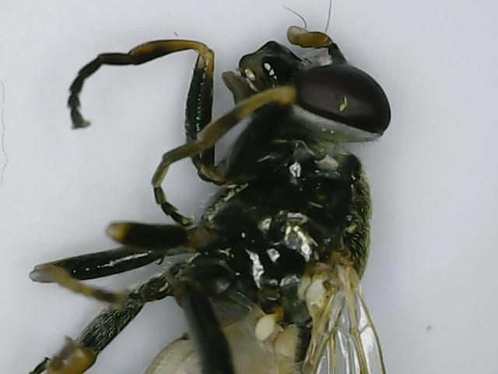
Investigating Biodiversity Using CO1 Markers for Pollinators
at Farmingdale State University
Luis Cabrera, Winter Collinson, Vanessa Maltez, Kayla Piazza
Jeffrey Petracca
Abstract
Methodology
Insect pollinators are crucial to food security and human survival. Pollinators are responsible for the transfer of pollen between different flowers during food search and pollinate over 80% of flowering plants. A high biodiversity of these organisms can improve the quantity and quality of crops produced. A malaise trap is a mesh structure that is very effective at capturing various species of insects. Malaise traps were set during the collection period 06/03/2022- 06/17/2022 by Dr. Carly Tribull, an entomologist and professor at Farmingdale State University. 20 samples of various insect species on Long Island were captured from a field, largely composed of pollinators. In order to identify species, a chelex protocol was carried out. The chelex DNA sequencing targets the COI gene which can identify an insect by species. In order to carry out this protocol, specimens had heads and legs removed for DNA extracted. The Polymerase Chain Reaction (PCR) processes amplified DNA fragments. Gel electrophoresis was used to sequence DNA into fragments and was further used for barcoding specimens. Genetic diversity was analyzed using MUSCLE Sequencing and Gel electrophoresis. Species diversity was analyzed by creating a pie chart and phylogenetic tree. The barcoding process yielded one novel species (CWW-003). A Simpson's index calculation was used to determine biodiversity among the samples which yielded 0.7412 indicating high biodiversity.
Results
Data
Species #` | Scientific Name | Collection Coordinates
CWW-001 | Ichneumoninae | 40.754930, -73.432509
CWW-002 | Desmia funeralis | 40.754930, -73.432509
CWW-003 | Novel | 40.754930, -73.432509
CWW-004 | Lon zabulon | 40.754930, -73.432509
CWW-005 | Chrysopilus | 40.754930, -73.432509
CWW-006 | Chrysis | 40.754930, -73.432509
CWW-007 | Sparganothis sulfureana | 40.754930, -73.432509
CWW-009 | Bombus bimaculatus | 40.754930, -73.432509
CWW-010 | Lucilia eximia | 40.754930, -73.432509
CWW-011 | Trychosis | 40.754930, -73.432509
CWW-012 | Taeniaptera trivittata | 40.754930, -73.432509
CWW-013 | Xestia dolosa | 40.754930, -73.432509
CWW-014 | Xysticus ferox | 40.754930, -73.432509
CWW-016 | Leucania ursula | 40.754930, -73.432509
CWW-017 | Myolepta varipes | 40.754930, -73.432509
CWW-018 | Idia americalis | 40.754930, -73.432509
CWW-020 | Arge | 40.754930, -73.432509
Introduction
Insects, the most diverse animals on Earth, are responsible for a wide array of ecosystem services including seed dispersal, pollination, organic matter processing, nutrient cycling and water filtration. These processes help regulate plant diversity, photosynthesis, soil fertility, ecosystem structure and water quality (Crespo-Peréz et al., 2020)
These functions and services depend on specific species and thus their abundance, but are also often enhanced or stabilized by higher diversity (Dainese, Loreau et al., 2022)
Malaise traps are a widely used trap type in biodiversity surveys and monitoring because they are easy to handle and capture a huge variety of flying insects and also wingless arthropods (Kaczmarek et al., 2022)
In recent years, the COI data of Insecta in GenBank have been increasing rapidly with the emergence of DNA barcoding and the development of high-throughput sequencing techniques (Zhang et al., 2022)
Plant-pollinator interactions are valued mutualisms in agricultural food production and provide indispensable ecosystem functions that support global biodiversity (Ollerton et al., 2017, Katumo et al., 2022)
In agriculture, 87 of the leading global food crops and 35% of global production volumes from crops are dependent upon animal pollination (Klein et al., 2007, Katumo et al., 2022)
Figure 2: Head of novel species (CWW-003)
Figure 1: MUSCLE multiple alignment software embedded in DNA Subway was used to create a visual DNA barcode of all sample specimen (N=17) to compare sequences expressing genetic diversity.
Figure 10: Gel electrophoresis results showing DNA fragments of each of the 20 samples collected.
Organization of Specimen
Based on Order
Figure 3: Lucilia eximia (CWW-010)
Figure 4: Taeniaptera trivittata
(CWW-012)
Simpson's Index
Figure 6: Phylogenetic tree composed of all sample specimen (N=17). Branches connect species with similar genetic makeup identifying closely related species. 014 was used as a control in sample collection
Figure 5: Pie chart categorizing species diversity (N=17) by order.
Figure 9: Ichneumoninae (CWW-001)
Discussion
n (Lepidoptera) = 6
n (Diptera) = 4
n (Araneae) = 1
n (Hymenoptera) = 5
n = the total number of organisms of a particular species
N = the total number of organisms of all species
The value of D ranges between 0 and 1. With this index, 1 represents infinite diversity and 0, no diversity.
N = 16
Six (majority) of the species sequenced belonged to the order Lepidoptera which are composed of butterflies, moths, and caterpillars
Five of the seventeen species samples belonged to the order Hymenoptera which includes bees, wasps, sawflies, and ants
Phylogenetic tree results express species diversity. Trychosis and subfamily Ichneumoninae scored 100 indicating closely related species
MUSCLE multiple alignment software embedded in DNA Subway expresses genetic similarities between all samples collected.
The Malaise trap was located in a field at Farmingdale State University (40.754930 -73.432509) and collected all specimens in one collection period (06/03/2022-06/17/2022)
All samples are classified as pollinators and therefore are essential to food stability on Long Island
Simpson's Index yielded 0.7412, indicating high levels of biodiversity
Acknowledgements & References
Figure 7: Leucania ursula (CWW-016)
Figure 8: Myolepta varipes (CWW-017)
Notes:
Simpson's Diversity Index is a measure of diversity which takes into account the number of species present, as well as the relative abundance of each species. As species richness and evenness increase, so diversity increases.
MUSCLE multiple alignment software embedded in DNA Subway was used to create a visual DNA barcode.

