Slide 1
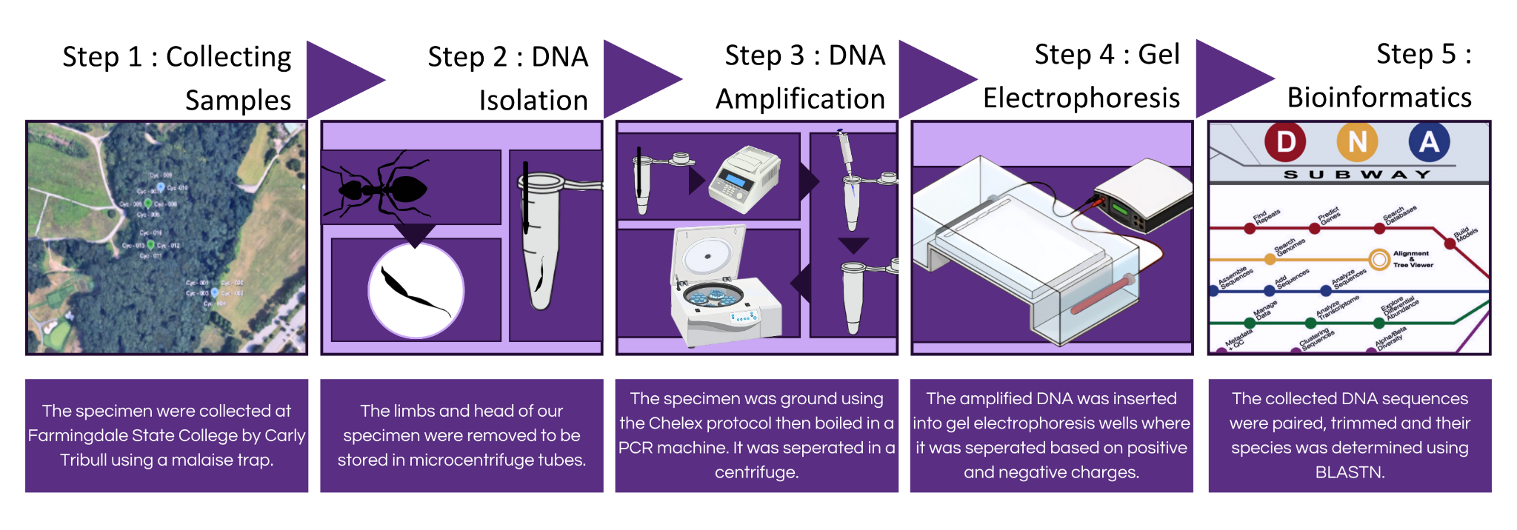
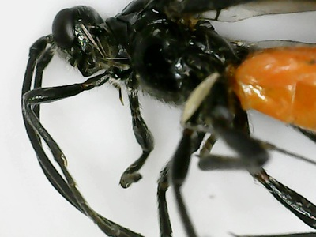
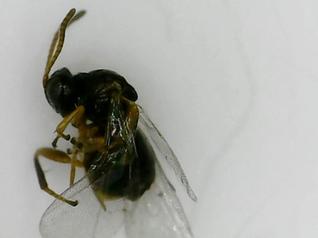
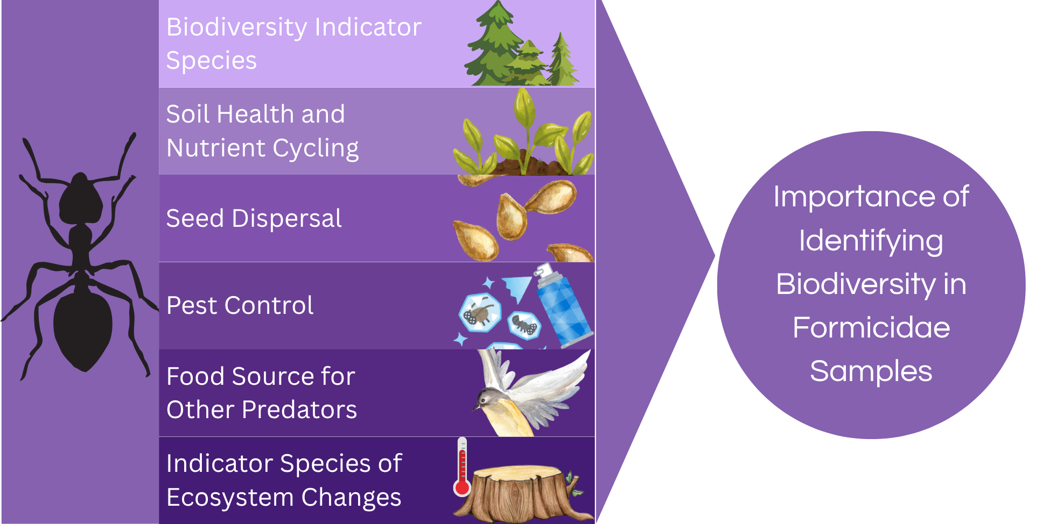
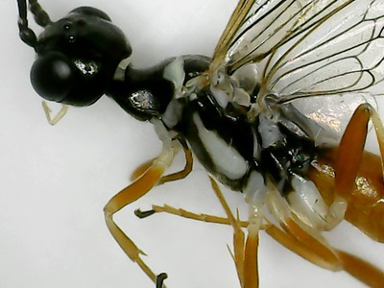
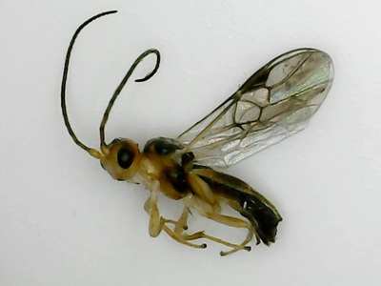
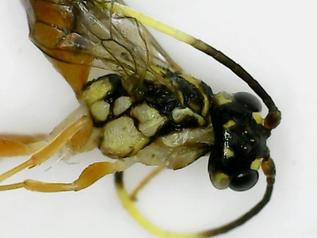
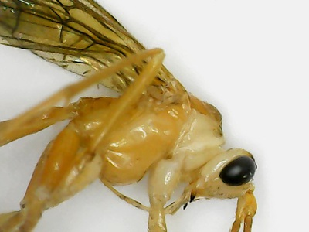
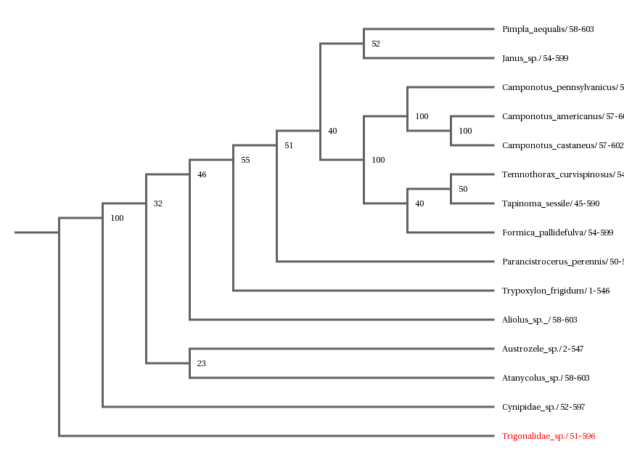
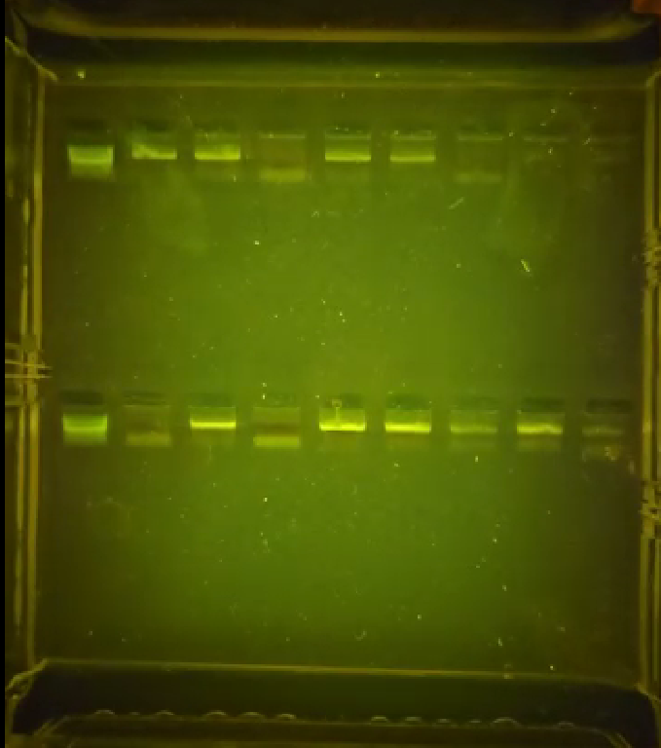
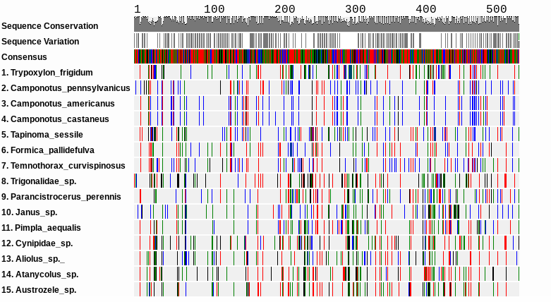
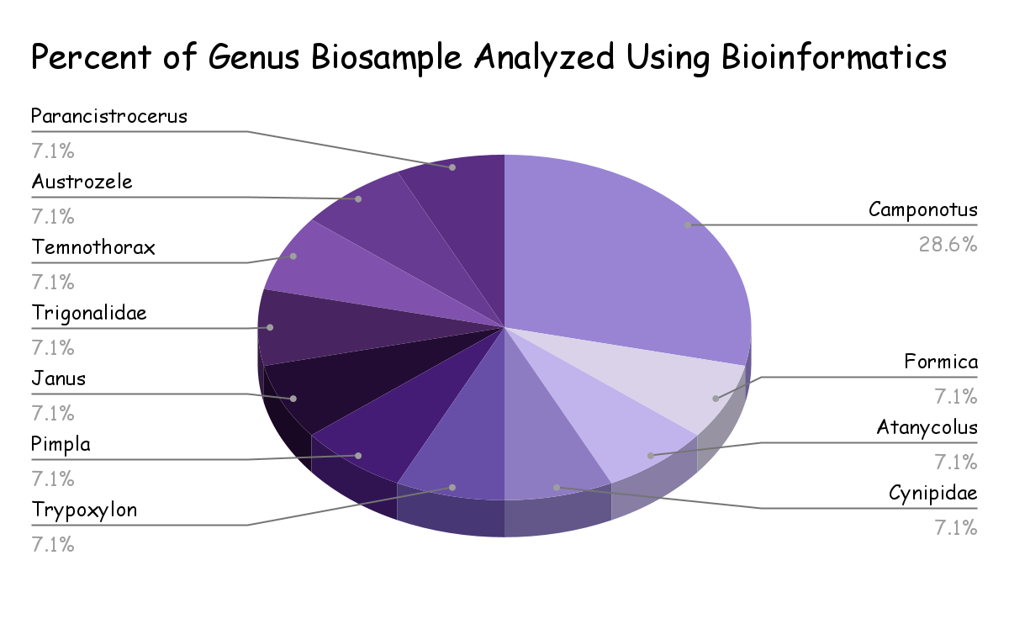
Applying The C01 Gene Biomarker to Identify Biodiversity of Formicidae Samples in a Forest From Farmingdale State University
Researchers: Karina Rios and Rylee Varian
Mentors: Jefrey Petracca and Kristen Conklin
Abstract
Methodology
Biodiversity is crucial for ecosystem stability and can be effectively documented using DNA barcoding. The purpose of this study is to investigate Formicidae biodiversity on Long Island by using DNA barcoding techniques. This study seeks to determine whether the CO1 gene can be effectively utilized to measure and compare Formicidae biodiversity across various forest habitats. To conduct this research, insect samples were photographed and documented after collection from a Malaise trap located in Farmingdale State University Teaching Gardens. DNA was then extracted from the samples using the Chelex protocol. The cytochrome oxidase I (CO1) gene was amplified through polymerase chain reaction (PCR). Confirmation of successful amplification was achieved through gel electrophoresis. The resulting sequences were then analyzed in DNA Subway to identify and compare species. Following the use of DNA Subway. Additionally, the Simpson's Index was employed to quantify biodiversity, yielding a result of 0.99. This value suggests that the study site exhibited an exceptionally high level of biodiversity, as it approaches the maximum possible value of 1. A higher level of biodiversity suggests greater stability in the ecosystem. Future research could explore how soil in different regions of Long Island can impact the biodiversity of Formicidae samples.
Data Collection
Sample ID | Genus | Species | Family | Forest, Field, or Ecotone
DCH-011 | Camponotus | pennsylvanicus | Formicidae | Forest
DCH-012 | Formica | pallidefulva | Formicidae | Forest
DCH-014 | Camponotus | americanus | Formicidae | Forest
DCH-015 | Camponotus | castaneus | Formicidae | Forest
DCH-021 | Camponotus | castaneus | Formicidae | Forest
DCH-022 | Tapinoma | sessile | Formicidae | Forest
DCH-024 | Atanycolus |  |  | Forest
DCH-025 | Cynipidae |  |  | Forest
DCH-026 | Trypoxylon | frigidum | Crabronidae | Forest
DCH-027 | Pimpla | aequalis | Ichneumonidae | Forest
DCH-028 | Janus |  |  | Forest
DCH-030 | Aliolus |  |  | Forest
DCH-032 | Trigonalidae |  |  | Forest
DCH-033 | Temnothorax | curvispinosus | Formicidae | Forest
DCH-034 | Austrozele |  |  | Forest
DCH-035 | Parancistrocerus | perennis | Vespidae | Forest
Introduction
DCH - 024 : Atanycolus
DCH - 025 : Cynipidae
DCH - 028 : Janus
DCH - 030 : Aliolus
Figure 1: A data table for the identification of each species.
SDI = 0.99
Research Question
DCH - 032 : Trigonalidae
DCH - 034 : Austrozele
Can the CO1 gene be used to measure and compare formicidae biodiversity in forest habitats?
Results
Hypothesis
The CO1 gene can be used to effectively measure and compare ant biodiversity, revealing high species diversity in forest habitats.
Key References
Article #1: Using DNA Barcodes to Evaluate Ecosystem Health in the SWRCMS Reserve
JEI. (2018). Using DNA Barcodes to Evaluate Ecosystem Health in the SWRCMS Reserve | Journal of Emerging Investigators. Emerging Investigators.org.
https://emerginginvestigators.org/articles/17-005
Goal: The goal of the article was to determine if the SWRCSMR (Southwestern Riverside County Multi-Species Reserve) is successfully protecting the species within by checking their genetic diversity.
Findings:
The SWRCSMR midges likely came from other areas and settled recently, possibly due to human influence.
Their DNA is less diverse and more unique, suggesting a newer population.
Insects at the college campus have more genetic variation, showing older more mixed origins, likely due to gene flow from nearby populations.
Article #2: The marker choice: Unexpected resolving power of an unexplored CO1 region for layered DNA barcoding approaches
Rach, J., Bergmann, T., Paknia, O., DeSalle, R., Schierwater, B., & Hadrys, H. (2017). The marker choice: Unexpected resolving power of an unexplored CO1 region for layered DNA barcoding approaches. PLOS ONE, 12(4), e0174842. https://doi.org/10.1371/journal.pone.0174842
Goal: Test how well different DNA barcoding methods work for identifying species and understanding species groups, especially using a new CO1 region.
Finding:
The “Folmer region” of the CO1 gene is the most effective DNA marker for identifying closely related species of dragonflies and damselflies. This region showed a high number of useful genetic differences, low error rates, and worked well in lab conditions.
Substitution saturation (when too many changes make comparisons less useful) was a concern in other regions, especially in deer evolutionary comparisons.
Using just one DNA marker can sometimes lead to false positives or missed identifications.
Figure 2: Phylogenetic tree composed of all sample specimen. Branches connect species with similar genetic makeup identifying closely related species
Figure 4: A gel electrophoresis sample of specimens. Gel electrophoresis is a laboratory technique used to separate DNA, RNA, or proteins based on their size and charge.
Figure 3: MUSCLE was used to align DNA or protein sequences from different species. MUSCLE stands for Multiple Uniform Sequence Conservation Logic Engine
Figure 5: A pie chart showing the biodiversity of the species by the family
Discussion
100% of the samples were collected from forest habitats.
Simpson’s diversity index was calculated to determine 0.99 biodiversity. This indicates a high level of biodiversity in the area because 0.99 is close to 1.
The phylogenetic tree yields a score of 100 between Camponotus americanus and Camponotus castaneus indicating common ancestry as shown in Figure 2.
Samples DCH-024, DCH-025, DCH-028, DCH-030, DCH-032, and DCH-034 were unable to be identified through the BOLD or BLAST system and therefore have been determined as novel.
According to the MUSCLE, species americanus and castaneus are most likely related genetically.
The largest percentage of castaneus were from the genus Camponotus and represented 28.6% of the samples.

