Slide 1

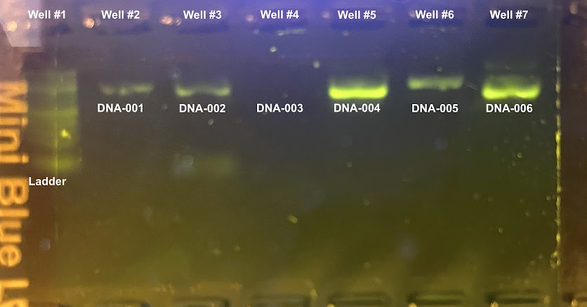



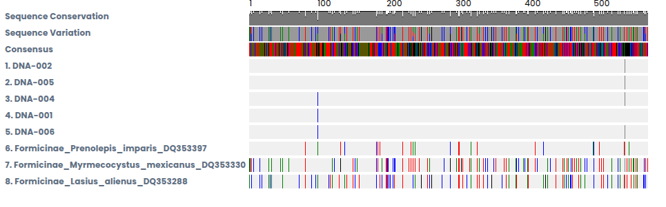
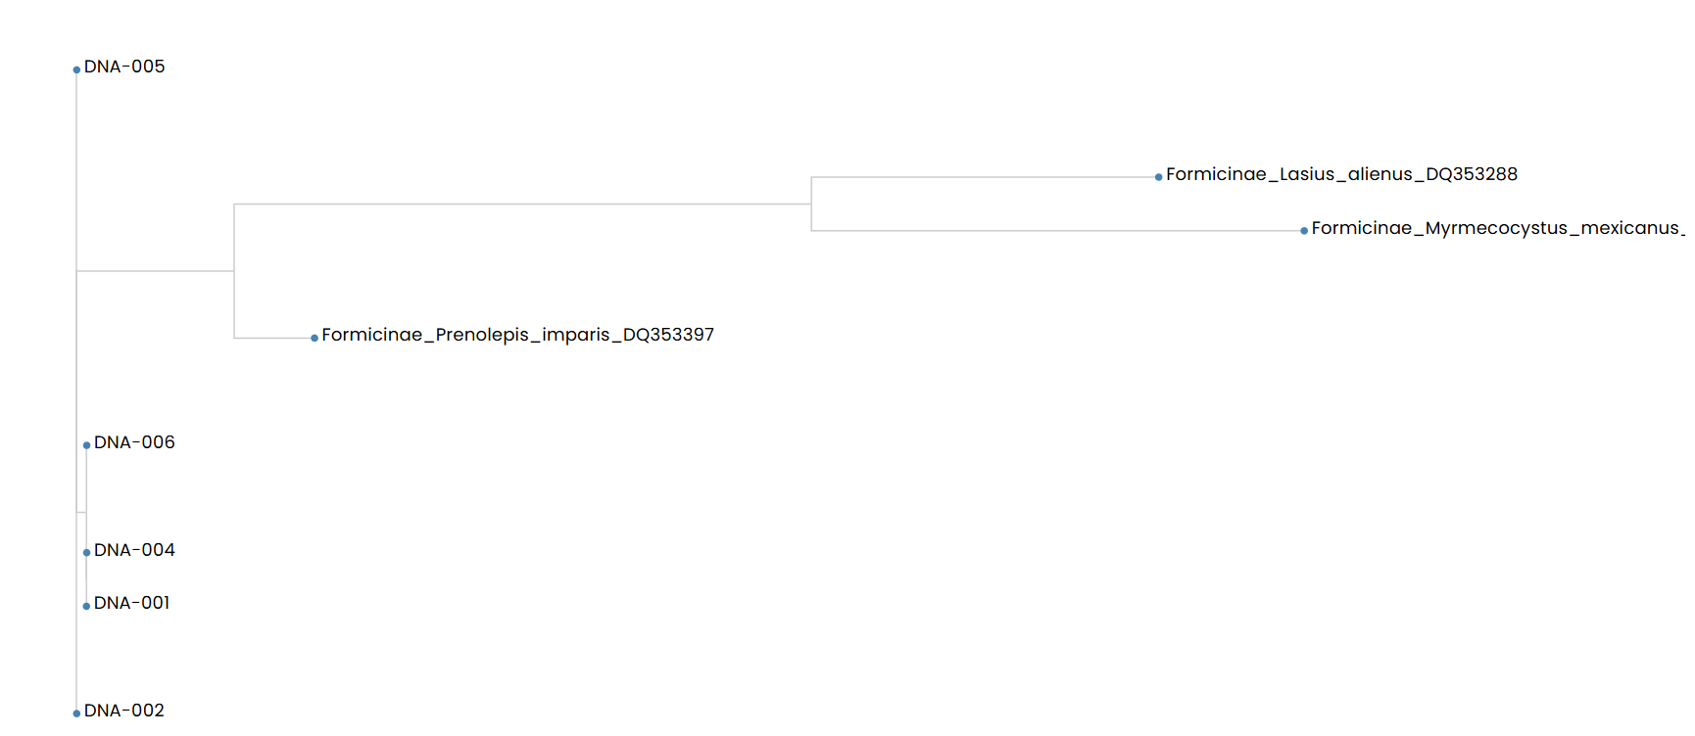
The Use of DNA Barcoding for validation of species of local ants collected at West Babylon Senior High School, Long Island NY
Authors: Amelia Berkey, Lauren Giudice, Jennise Gomez
Mentor: Andrea Durbin
West Babylon Senior High School
Introduction
We need DNA extract and not just looking at the ants because they all look visually alike to the human eye. The types of ants found on Long Island are Odorous House, pavement and carpenter ants.(A&C Pest Management, n.d) There are about 30,000 species of ants that may still be undiscovered (Csosz, 2018). DNA extraction is the process to clean DNA through Chemical or Physical reactions from a sample splitting apart the cell membrane, proteins, and other cellular components from DNA (Gupta, 2019). DNA needs to be purified to make sure it is clean and not contaminated. PCR is a Polymerase Chain Reaction and we need it to make multiple copies of the ants DNA (National Human Genome Research Institute, 2020). Gel electrophoresis is the process that splits up DNA fragments based upon their size (Khan Academy, n.d). We are using this technique to help ourselves be able to distinguish materials in difficult mixtures. To sequence DNA it means to figure out the order the nucleotides go in, to formulate the DNA. BLAST is a Basic Local Alignment Sequence program (National Library of Medicine, n.d). DNA Subway analyzes DNA barcoding (DNA Subway, n.d).
Discussion
Our original hypothesis was rejected because we thought we were going to get carpenter and odorous house ants. Instead we identified Prenolepis imparis voucher for each of our samples. We learned that the scientific process is more time consuming and is not always successful the first time. Our results were important because they showed us what we collected was a native ant. Our study may not have worked because of the type of climate we chose to select our samples of ants. Suggestions for future studies if we had more time is being able to research about different ants to make a better guess for which ant the species may be in our school courtyard.
Abstract
The goal of this project is to find out the different types of ants in our school courtyard. The location of these species is in the West Babylon Senior High School Courtyard. The ants were collected by hand and some by placing a cookie trap down. The motivation for this project is to discover the many different types of ants. The methods used to accomplish this goal is to first take pictures of the ants, then extract the ant’s DNA, clean the DNA, manage PCR on a certain type of gene that will aid in copying the mitochondrial gene, then get gel electrophoresis to see if you got DNA, transfer the samples to Cold Spring Harbor Laboratory to be sequenced and lastly utilize BLAST and DNA Subway to check if we can find a match and distinguish the species. We expect to find different species of ants.
Results
After using BLAST on our sequences, we found our ants were winter ants (Prenolepis imparis voucher) (Figure 2). These are found during the winter and spring seasons on Long Island. These species are very tolerant of cold temperatures. In the gel electrophoresis out of six ants extracted we successfully extracted DNA from five ants producing bands on the gel electrophoresis (Figure 1).
Acknowledgements
We would like to say thank our teacher, Mrs.Durbin! We also like to thank our funders from Cold Spring Harbor Laboratory DNA Learning Center for giving us this great opportunity and experience.
References
A&C Pest Management. (n.d.). Common Ants Found on Long Island. https://www.acpest.com/about/our-blog/top-3-ants-found-long-island
Basic Local Alignment Search Tool. (n.d.). Blast: Basic local alignment search tool. National Center for Biotechnology Information. https://blast.ncbi.nlm.nih.gov/Blast.cgi#:~:text=The%20Basic%20Local%20Alignment%20Search,the%20statistical%20significance%20of%20matches.
Csosz, S. (2018, July 3). How many ant species are there on earth?. Myrmecological News Blog. https://blog.myrmecologicalnews.org/2018/06/15/how-many-ant-species-are-there-on-earth/#:~:text=Sandor%20Cs%C5%91sz,regions%20or%20underexplored%20habitat%20strata?
DNA Barcoding. (n.d.). Fast track to gene annotation and genome analysis - DNA subway. Fast Track to Gene Annotation and Genome Analysis - DNA Subway. https://dnasubway.cyverse.org/#:~:text=DNA%20Subway%20ties%20together%20key,more%20about%20the%20analysis%20steps
Gel electrophoresis. (n.d.). Gel electrophoresis. Khan Academy. https://www.khanacademy.org/science/ap-biology/gene-expression-and-regulation/biotechnology/a/gel-electrophoresis#:~:text=Gel%20electrophoresis%20is%20a%20technique%20used%20to,so%20they%20move%20towards%20the%20positive%20electrode
Gupta, N. (2019). DNA extraction and polymerase chain reaction. Journal of cytology. https://pmc.ncbi.nlm.nih.gov/articles/PMC6425773/#:~:text=DNA%20extraction%20is%20a%20method,proteins%2C%20and%20other%20cellular%20components
National Human Genome Research Institute. (2020). Polymerase chain reaction (PCR) fact sheet. Genome.gov. https://www.genome.gov/about-genomics/fact-sheets/Polymerase-Chain-Reaction-Fact-Sheet#:~:text=and%20so%20on.-,The%20cycle%20of%20denaturing%20and%20synthesizing%20new%20DNA%20is%20repeated,allow%20DNA%20denaturing%20and%20synthesis
Materials & Methods
The area which we used to collect the organisms is in a landscaped courtyard. One of our traps was put under a tree and we hand picked the other ants in moist dirt. We trapped the ants by first hand picking them and then the other ants were caught by using a cookie trap. DNA extraction is the process to clean DNA through Chemical or Physical reactions from a sample splitting apart the cell membrane, proteins, and other cellular components from DNA (Gupta, 2019). DNA needs to be purified to make sure it is clean and not contaminated. PCR is a Polymerase Chain Reaction and we need it to make multiple copies of the ants DNA (National Human Genome Research Institute, 2020). Gel electrophoresis is the process that splits up DNA fragments based upon their size (Khan Academy, n.d). We are using this technique to help ourselves be able to distinguish materials in difficult mixtures. To sequence DNA it means to figure out the order the nucleotides go in, to formulate the DNA. BLAST is a Basic Local Alignment Sequence program (National Library of Medicine, n.d). DNA Subway analyzes DNA barcoding (DNA Subway, n.d).

