Slide 1




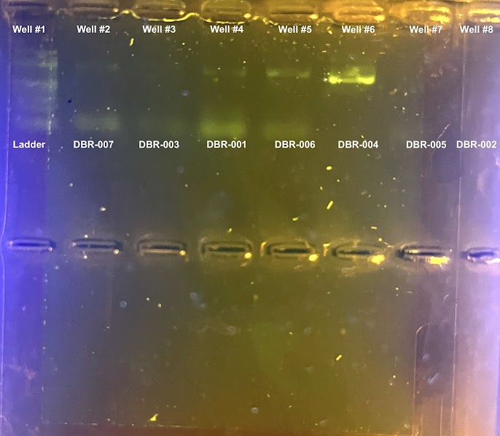
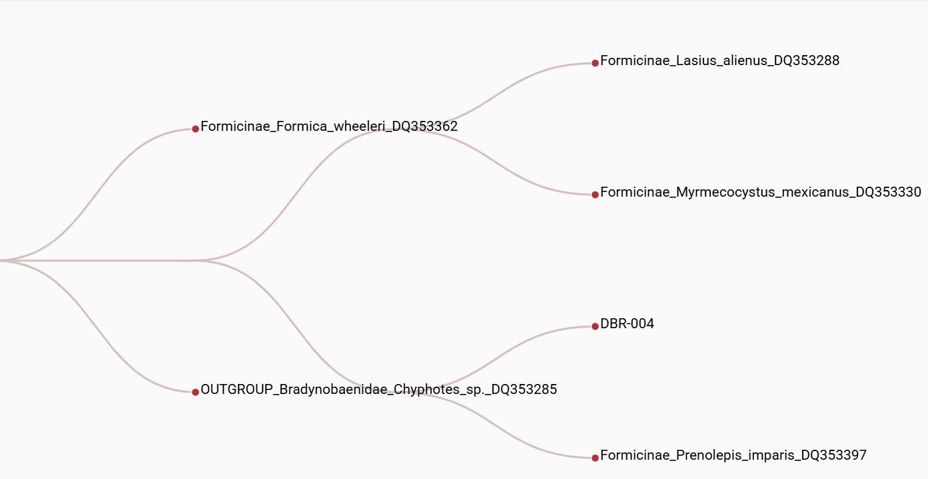
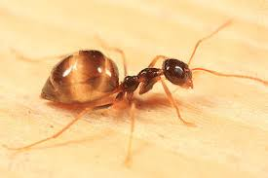
Discovery and Validation of local species of ants collected in West Babylon Senior High School through the use of DNA Barcoding
Jayden Cicero, Simon Inkpen, Kayla Joseph, Jack O’Dougherty Mentor: Mrs. Andrea Durbin
West Babylon Senior High School
Abstract
The main objective was to discover what species of ants reside in our courtyard through physical inspection and DNA extraction to determine whether our original ant identification was correct. It's important to look at the DNA of the ants rather than just looking at them because most appear similar. Long Island species include Carpenter ants, Little black ants, Field ants, and Pavement ants. Scientists estimate 20,000 ant species might be undiscovered. The Chelex, PCR, Gel Electrophoresis, BLAST, and DNA Subway methods were used for this experiment. We expected to find a few different species of ants, not many, as the WB courtyard is small and enclosed. Only one specimen had a complete DNA sequence. Four failed gel electrophoresis, and two didn’t have a complete DNA sequence. The one ant was identified as a Winter Ant. The ant identified wasn’t new, but common.
Introduction
The goal of the experiment was to identify the species of ants based on their DNA. To do this, we collected ants from our school’s courtyard. Our group went into the West Babylon Senior High School's courtyard, putting seven ants into a container. Then, the ants were refrigerated, and frozen, killing them. The reason we collected these ants for DNA extracting, is to figure out what kinds of ants live in our school’s courtyard, such as Carpenter ants, Acrobat ants, Argentine ants, Citronella ants, Little black ants, Pharaoh ants, Thief ants, Field ants, Pavement ants, and Odorous ants (Common Ants on Long Island and How to Prevent Them, n.d.). To find their species, we will be putting the ants into special containers with a substance called Chelex in them. We will then grind it up, and submerge the container in boiling water for ten minutes. After that, we will put it in a centrifuge for thirty seconds. Next, a process called PCR will be done to produce millions of copies of the COI gene for further examination and comparison (PCR, 2025). Then using gel electrophoresis, we will ensure that DNA has been extracted and that enough copies were made to be sequenced. (Gel electrophoresis, 2016). Then, the DNA will be sent to a lab in Cold Spring Harbor Laboratory to be sequenced. Finally, using a database such as BLAST and DNA Subway, we will determine if the DNA matches any known ant species.
Results
Out of the seven ants used in the experiment, all of them successfully went through PCR and purification, but only three samples had visible banding in gel electrophoresis (see figure 1). The other four specimens failed gel electrophoresis, with their DNA being lost in the process. After being sent to Cold Spring Harbor Laboratory, only one specimen had a full sequence. The one ant is most likely the Prenolepis imparis (Winter Ant), as there is a 1224 bit score.
Discussion
Out of the seven specimens, only one had a proper DNA sequence and was able to go through BLAST. During gel electrophoresis, while injecting the DNA, four failed to get into the wells. Only one specimen had enough DNA for sequencing. The results of BLAST indicate that the ant species identified is the Winter Ant (Prenolepis imparis). The Winter Ant is common to Long Island and New York, and is not invasive. It contributes to the ecosystem, spreads seeds, and decomposes nutrients (Winter Ant, False Honey Ant, 2017). If this research were to be repeated, extra care should be used while pipetting the DNA into the wells during electrophoresis, as this is where it's believed the biggest mistake of the experiment was made. The original hypothesis, that the ant species was the Common Odorous Ant (Tapinoma sessile), was rejected.
References
Stroik, Susanna. “Plasmids 101: Choosing an Antibiotic Resistance Gene.” Blog.addgene.org, 10 Oct. 2023, blog.addgene.org/plasmids-101-choosing-an-antibiotic-resistance-gene.
Williams, Jason L., and Andrea Lucky. “Winter Ant, False Honey Ant Prenolepis Imparis (Say) (Insecta: Hymenoptera: Formicidae: Formicinae).” EDIS, vol. 2017, no. 2, 9 May 2017, p. 5, edis.ifas.ufl.edu/publication/IN1168, https://doi.org/10.32473/edis-in1168-2017.
Materials & Methods
The objective was to obtain ants and to extract their DNA. The ants were obtained on October 15, 2025 from a small, enclosed courtyard. Seven samples were both obtained by tubes placed in the ground and handpicked. To find the DNA of these ants, the Chelex method will be used to extract the DNA, this also purifies it so further methods work better. The PCR method will be used to amplify the DNA, then we will use gel electrophoresis to validate that DNA was extracted from the ants and that enough was amplified to be sequenced. Using the sequenced DNA, it was compared to other DNA found in the BLAST database. DNA Subway was used to finalize the results.
Acknowledgements
We would like to thank our mentor, Mrs. Durbin, for helping us throughout this research project. Thank you to the DNALC for lending us the equipment.

