Slide 1






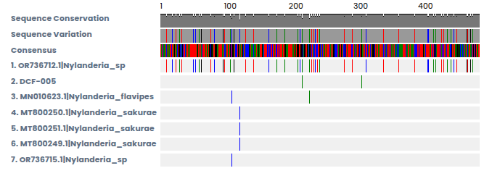
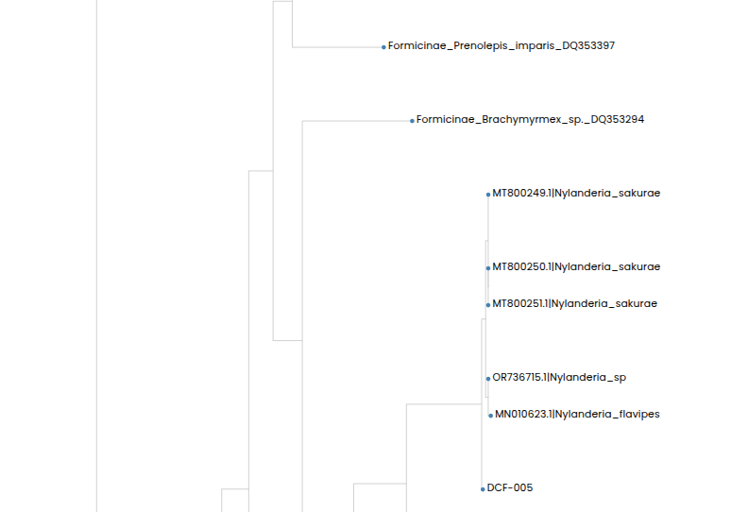

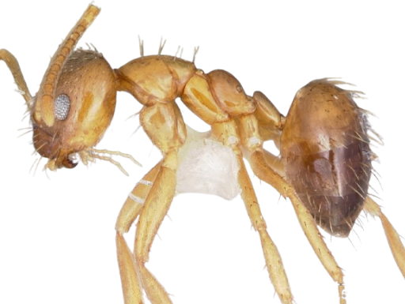
Validation of Species of Local Ants using DNA Barcoding collected in the Courtyard of the West Babylon Senior High School
Authors: Corey Garet, Tyler Hurd, Mason Rosario, Pradhi Singh
Mentor: Mrs. Andrea Durbin
Abstract
Our goal is to identify the ants species living in the courtyard of West Babylon Senior High School. We collected our ant specimens with 2 methods. Some were collected placing ant traps with sugary snacks in the ground. Others were collected digging through dirt, placing them in containers. Our expectation was to validate the species of our ants by extracting and then purifying their DNA followed by using BLAST and DNA Subway. We will use PCR on a specific gene, COI, helping identify the species of ant. The gel electrophoresis will then be run on the DNA, ensuring DNA extraction. Then we will send the DNA to the Cold Spring Harbor Laboratory for sequencing. Once sequenced, we will use BLAST and the DNA subway to find matches to the DNA we sent. We expect to find common ant species native to Long Island, such as carpenter and pavement ants.
Introduction
We must extract the DNA of our ant specimens instead of just looking at them to determine their species because lots of ants look so similar that they are indistinguishable from each other and the fact that there are thousands of species of ants. Ants are highly diverse, comprising more than 15,700 named species and subspecies and possibly as many undescribed ones (Schultheiss, P, 2022). The ants commonly found in our area (Long Island) include carpenter ants, pharaoh ants, and pavement ants. DNA extraction is the process of taking out and purifying the DNA of a species. The DNA needs to be purified to make sure when computers read the DNA they are not discombobulated by other substances. Polymerase chain reaction (abbreviated PCR) is a laboratory technique for rapidly producing (amplifying) millions to billions of copies of a specific segment of DNA, which can then be studied in greater detail (Smith, M, n.d.). PCR must be performed so we can have enough DNA to be sequenced and then analyzed. Gel electrophoresis will follow PCR to ensure that DNA was extracted from the specimens. Gel electrophoresis is a technique commonly used in laboratories to separate charged molecules like DNA, RNA and proteins according to their size (Sanger, n.d.). Once the gels have run, the DNA will be sent out to be sequenced. Sequencing DNA is the process of determining the order of the 4 nitrogen bases in a given genome. This will help identify the specific species of ants collected. Common ways to decode DNA are BLAST and the DNA Subway. DNA Subway is an intuitive interface for analyzing DNA barcodes (DNA Learning Center, n.d.). BLAST (Basic Local Alignment Search Tool) is a program that compares a sequence of DNA to a large database to find similar sequences. BLAST can be described as an internet search engine for DNA.
Materials & Methods
A majority of our ants were hand-caught by digging through soil and uplifting rocks near moisture due to our traps being unsuccessful. But the traps were not totally ineffective, a few ants were caught in that manner. The few traps that did work were filled with pieces of chips-a-hoy chocolate chip cookies. Our method of DNA isolation is the Chelex Method. This includes adding our ant specimens into the special Chelex Solution and crushing up the ant tissue. The remaining solution is placed in boiling water for 10 mins and then allowed to cool off for another 10 mins. After that the solution is placed in a centrifuge for 30 minutes. The ` The remaining solution should then be transferred to a clean test tube and kept at 4 degrees Celsius overnight. After that the test tube should be kept at -20 degrees Celsius.
Results
In the results, we found that out of all the ant samples, DCF-005 was successful. At first, we collected eight samples of ant and then extracted DNA out of all of these samples. After that, The Gel Electrophoresis worked for DCF-005 and DCF-002. This was then sent to be sequenced. Results showed that DCF-002 did not have enough product while DCF-005 did have enough product. The closest relatives to the ant sample DCF-005 are the Nylanderia flavipes and the Nylanderia Sakurae.
Discussion
In our experiment, out of 8 ants only 1 of our ants' DNA was successfully extracted. Ant DCF-005 was our only successful gel electrophoresis. This ant is an invasive ant species named the Nylanderia flavipes. It nests in leaf litter in Japan, known to be winter active. This data is important because it shows that there is an invasive species of ant in the West Babylon Senior High school court yard. Our study didn't work as originally hypothesized, due to human error when performing the gel electrophoresis. This led to successful extraction of only one ant's DNA. For future studies, we could use the DNA and information already extracted form Ant DCF-005 to recognize certain species of ants. We can also learn from our mistakes while performing the gel electrophoresis.
References
DNA Learning Center. (n.d.). Using DNA Barcodes to Identify and Classify Living Things. DNA learning center barcoding 101. https://dnabarcoding101.org/lab/bioinformatics.html
Sanger. (n.d.-a). What is gel electrophoresis?. YourGenome. https://www.yourgenome.org/theme/what-is-gel-electrophoresis/
Schultheiss, P. (2022, September 19). The abundance, biomass, and distribution of ants on earth | PNAS. PNAS. https://www.pnas.org/doi/10.1073/pnas.2201550119
Smith, M. (n.d.). Polymerase chain reaction (PCR). Genome.gov. https://www.genome.gov/genetics-glossary/Polymerase-Chain-Reaction-PCR#:~:text=Polymerase%20chain%20reaction%20(abbreviated%20PCR)%20is%20a,of%20DNA%20synthesis%20to%20amplify%20that%20segment.
Acknowledgements
DNALC for their support in providing the equipment for this project.
Our mentor, Mrs. Durbin.

