Slide 1








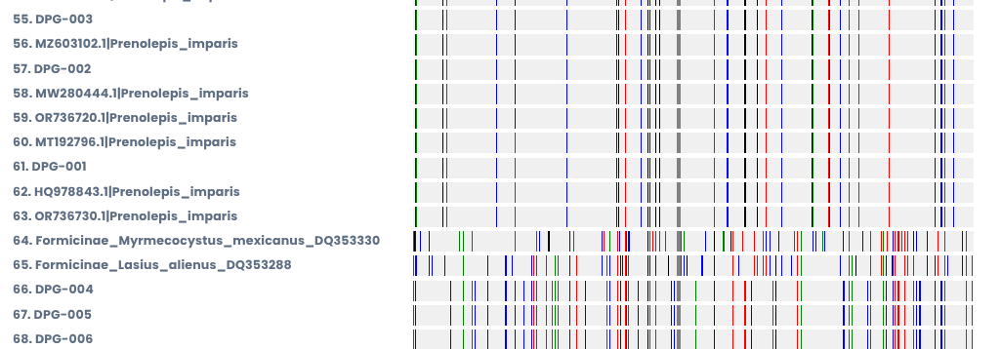
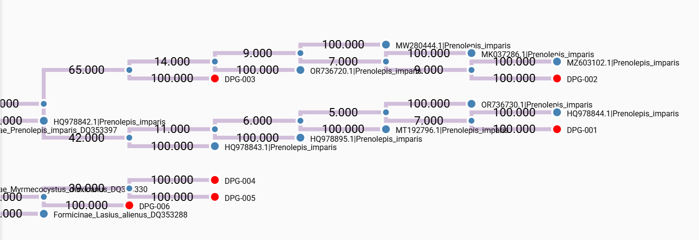
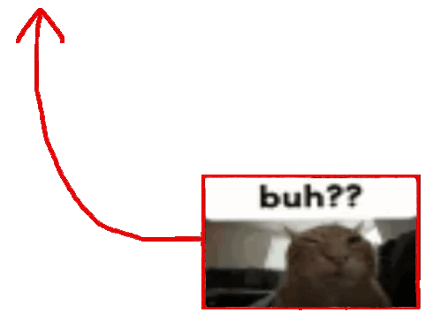
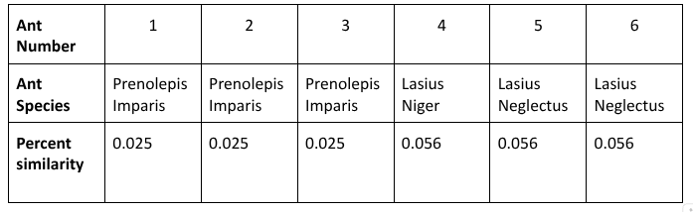


DNA Barcoding in Ant Species to Examine Biodiversity Within West Babylon Senior High’s Courtyard.
Authors: Alec Apostolides, Kieran Flynn, Emily Piotrowski
Mentor: Mrs. Durbin
¹Cold Spring Harbor Research Center, ²West Babylon Senior High - AP Biology
Organisms adapt to their surroundings and evolve to ensure survival.
Ants occupying Long Island commonly consist of Acrobat, Carpenter, Little Black, Pavement, Pharaoh, Winter, and Odorous House ants (AEC, n.d.).
DNA Barcoding can assist in the identification of unknown species by matching purified, extracted DNA from cellular components of a specimen to a database of DNA sequences of known species from BLAST.
DNA Subway can generate phylogenetic analyses and provide simplified annotations and genomic workflows.
When studying biodiversity, genetics is an important method of identification, and the DNA Barcoding process provides reliable and applicable results.
Our Goal: Biodiversity is an essential part of maintaining a healthy ecosystem, ensuring a stable environment. By sequencing the gathered ant samples, use DNA Subway to identify the species within the courtyard to examine biodiversity.
Results
Abstract
Introduction
This laboratory examines biodiversity deduced from conducted sequences of DNA barcoding. It will investigate an ecosystem’s diversity within an enclosed environment; this data directly translates to the course studies for DNA and genetic decoding demonstrated in student studies, meant to understand those biological foundations. When dealing with insects such as ants, their unchanged small stature, minute differences in coloring and features, and multitude of possible species can make it difficult to match a specimen to a species based on purely visual evidence. In this study, students sought out ant samples within the high school courtyard. They were dug out and placed in sealed containers to be frozen; these samples will have DNA extracted and purified. Once extracted, a PCR is conducted and gel electrophoresis is ran. The DNA will be turned over to a laboratory to be sequenced, and the data will be used to identify species. In submitting a variety of different samples, evidence of genetic diversity is an expected result after analysis in DNA Subway.
Methodology
Collection:
Hand collected samples from courtyard and placed into sealable tubes.
Extraction & PCR:
Samples were purified and isolated before being sent to the laboratory for a PCR.
Bioinformatics:
After conducting gel electrophoresis to verify DNA collected, BLAST and DNA Subway were used to identify and analyze sequences.
Acknowledgments
Discussion
References
We would like to thank our teacher, Mrs. Andrea Durbin for her outstanding guidance during this laboratory. We would also like to thank Cold Spring Harbor Laboratories, Stony Brook University, and Brookhaven National Laboratory for their collaboration.
In our school courtyard, the species Prenolepis imparis, Lasius niger, and Lasius neglectus were able to be identified, proving biodiversity in the environment.
The species were identified successfully through the use of chelex DNA isolation and purification, PCR, gel electrophoresis, DNA subway, and the BLAST program.
The species Lasius niger, commonly known as the European black garden ant, was identified as a species not native to the Long Island area.
The species Lasius neglectus, commonly known as the Invasive black garden ant, was identified as highly aggressive and invasive to the Long Island area.

