Slide 1






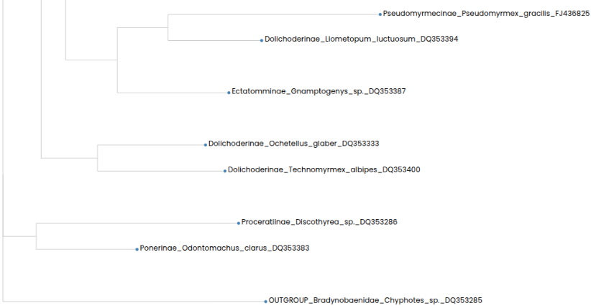
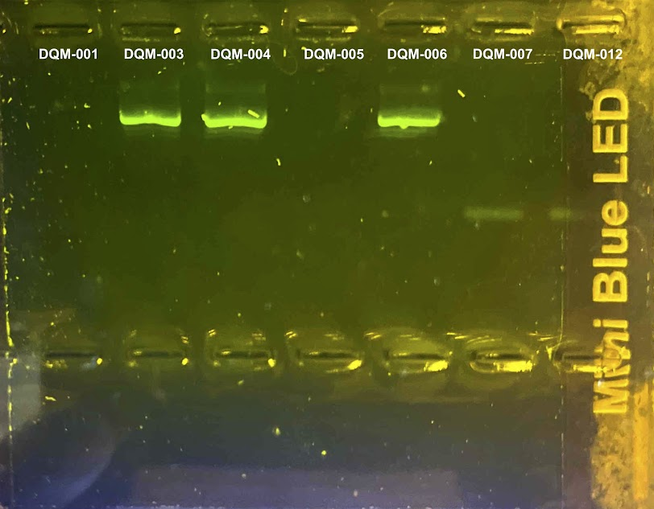

The Use of DNA Barcoding for the Validation of Species of Local Ants Collected at West Babylon Senior High School
Authors: Olyvia Carrasquillo, Hailey Frampton, Sofia Greiner, Paige Tiedemann
Mentor: Mrs. Durbin
West Babylon Senior High School
Abstract
The goal of this project is identifying what species of ants live in our school courtyard. We use a key to identify the ants, but get more information when extracting the DNA. Species that may be found are the acrobat ant and the carpenter ant because these are common ants found on Long Island. We collected the ants by setting up a cookie trap. Our motivation for this project is to determine the ant species in our courtyard and possibly find new species. The methods used to accomplish this goal are extracting the DNA and purifying it. Then conduct PCR on a specific gene to identify the species. Next gel electrophoresis to send the DNA to Cold Spring Harbor Laboratory to sequence. Lastly we'll use BLAST and DNA subway to find a match. At the end of this lab we will hopefully find new species of ants.
Introduction
The types of ants that live on Long Island are Lasius Murphyi, Lasius labtides, and Lasius subglaber ants (AntWiki, 2025). Around 30,000 ant species are still yet to be discovered (Myremecological, 2018). We need to extract DNA and not just look at the ants to determine their species because all ants can look very similar and it can be harder to determine the ants species accurately without looking at its DNA. DNA barcoding is a way to identify a species by its genetic sequence. DNA from an organism is matched to a DNA barcode, which is a short fragment of DNA from a specific gene. (Jennifer Questel, 2024)
Materials & Methods
We trapped the ants by setting up a trap with cookies to attract them to one space and the next day we hand caught the ants that were around the cookies. The DNA isolation method we will be using is the Chelex method. DNA extraction is the process where DNA is separated from proteins, membranes, and other cellular material (Science Direct, 2025). DNA purification is so important because we want to obtain pure DNA, with no proteins, RNA, lipids, and other impurities (Genetic Education, 2025). PCR is a laboratory method used to make many copies of a specific piece of DNA from a sample that contains very tiny amounts of that DNA. We need to do it because PCR allows these pieces of DNA to be amplified so they can be detected and then sequenced (National Cancer Institute, 2025). Gel electrophoresis is a technique commonly used in a lab to separate changed molecules like DNA, RNA, and proteins according to size. We are doing this to ensure that DNA was extracted from the ants and that enough was amplified by PCRT to be sequenced (What is gel electrophoresis?, 2025). Sequencing DNA means determining the order of the four chemical building blocks called "bases" that make up the DNA molecule (What is DNA sequencing?, 2023). BLAST is a program that compares nucleotide or protein sequences and calculates the statistical significance of matches (Berkeley Library, 2024). DNA Subway ties together key bioinformatics tools and databases to assemble gene models, investigate genomes, work with phylogenetic trees and analyze DNA barcodes (DNA Subway, 2025).
Results
The results of this experiment that we got from DNA barcoding showed that all the ants we collected ended up being winter ants. (Prenolepis imparis) The results we obtained from doing gel electrophoresis is that ants 3, 4, and 6 all worked. (refer to figure 1 picture) After doing a phylogenetic tree the species most related to our ants is Prenolepis imparis. (Refer to figure 2 picture) The out group in our phylogenetic tree is Chyphotes matthewsi.
Discussion
These results mean that a common species of ants in our school courtyard, at West Babylon Senior High School is the Winter ant (Prenolepis imparis). The ants we discovered are Winter ants which are native to Long island. These results are important because they combined the use of gel electrophoresis and DNA barcoding to determine what species live in our school courtyard. Some problems that occurred while we were doing this experiment was that the freezer did not completely kill our ants, making it hard to dissect them and get their body parts that we need to construct DNA. A suggestion we have is that students should gather ants from different parts of the area they are searching in so that all of the ants don't turn out to be the same species.
Acknowledgements
We would first like to thank Mrs. Durbin. Her guidance and help was very instrumental in the successful completion of our project. We would also like to thank Stony Brook University for providing us with the opportunities to perform PCR and gel electrophoresis. Finally we would like to Cold Spring Harbor for providing us with the necessary equipment for our project.
References

