Slide 1







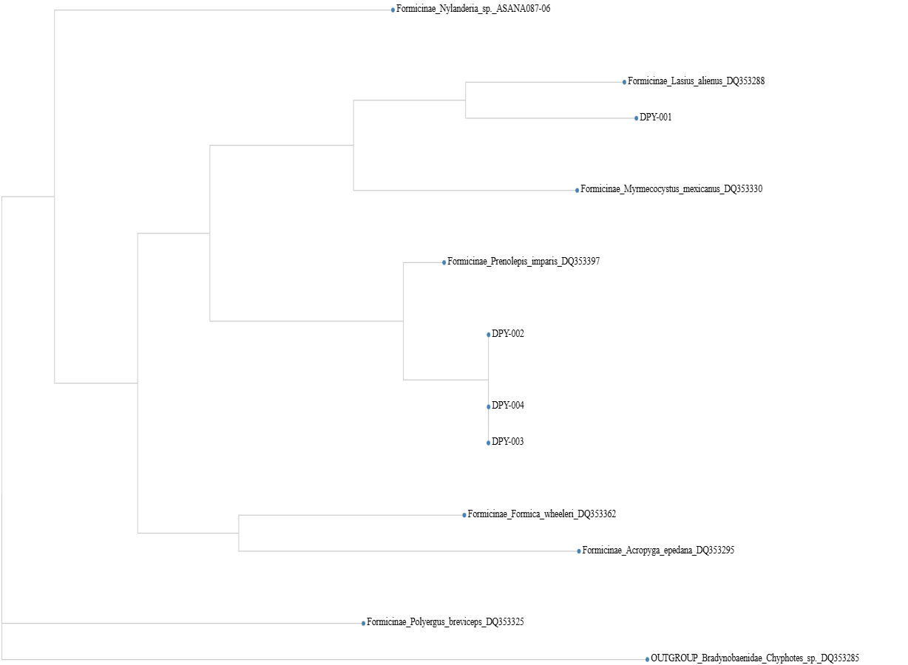
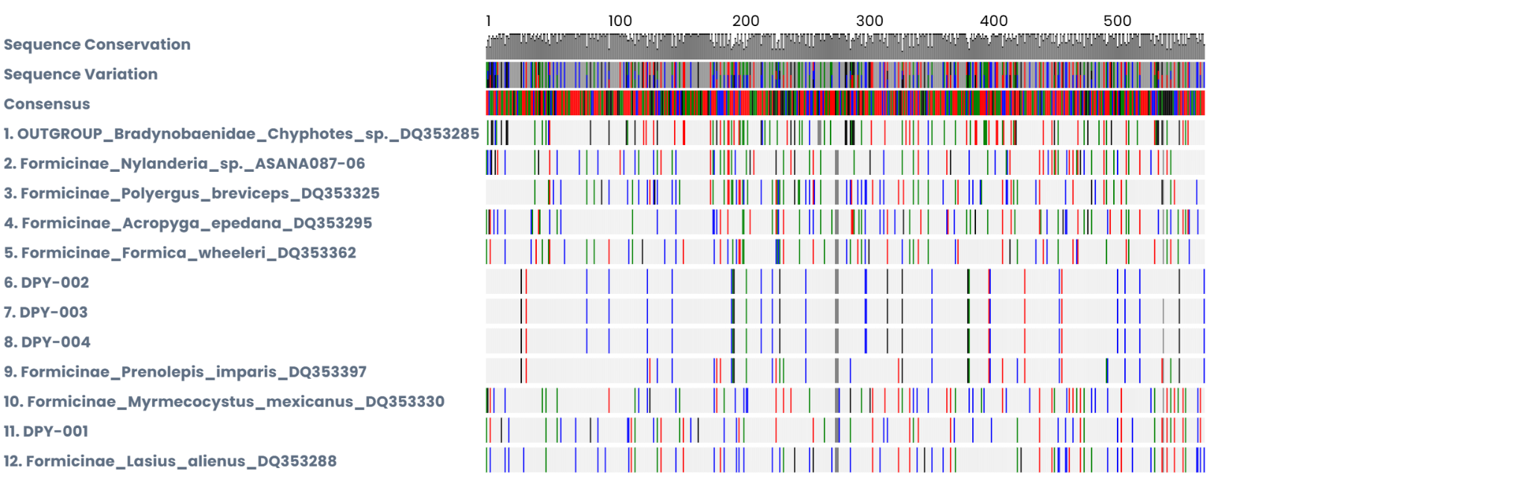
The use of DNA Barcoding for the identification of species of local ants collected in the courtyard of West Babylon Senior High School, Long Island NY
Authors: Talia Acevedo, Lily Boggia
Mentor: Andrea Durbin
West Babylon Senior High School
Abstract
Methodology
Discussion
The purpose of this project was to identify the species of ants that exist in the West Babylon Senior High School’s courtyard and gain a better understanding of the species that inhabit it. The process included collecting ants using traps or manual collection, extracting and isolating ant DNA via the Chelex method, conducting PCR to amplify the mitochondrial COI gene while using gel electrophoresis to check for errors, sending the DNA to Cold Spring Harbor Laboratory for sequencing of the specific gene, and using BLAST and the DNA Subway to identify the ants’ species using the sequenced barcode. The research resulted in a better understanding of the courtyard’s ecosystem and biodiversity.
The experiment was a success and resulted in the identification of two species inhabiting the West Babylon Senior High School courtyard. Since other groups identified different species of ants, this suggests that there may be more unidentified species in the courtyard, and the insect biodiversity may be higher than anticipated. An understanding of the biodiversity of our courtyard will lead to better care of the plants and animals within it. One error in the experiment was the collection of a non-ant specimen, which was discarded and therefore not sequenced. In a repeat of this project or in future studies, it would be beneficial to collect more ant specimens from various areas within the courtyard to potentially identify more species.
Collection
Five ant specimens were manually collected on the ground and on trees, as well as from food traps on the ground left overnight
All specimens were placed into separate tubes for freezing
DNA Extraction
The Chelex Isolation Protocol was used to extract and purify DNA, which reduces the chance of errors when conducting experiments and is necessary for accurate research
After isolation, PCR was conducted to copy the mitochondrial COI gene in the ants’ DNA, allowing for closer study
Gel electrophoresis was used to check that the PCR worked correctly
Bioinformatics
The DNA was sent to Cold Spring Harbor Laboratory for sequencing
Basic Local Alignment Search Tool (BLAST) was used to identify the species by matching the specimen with another in a local database
The DNA Subway was used to create a phylogenetic tree relating the specimens to known ant species
References
Results
Introduction
Long Island is home to many species of ants, including the pharaoh ant, thief ant, carpenter ant, pavement ant, and odorous house ant (Cornell CALS, n.d.). For the identification of species—in this case, ants—it may be possible to use appearance for a general idea. However, the most accurate method of identification would be to sequence the specimen’s DNA. DNA barcoding is a scientific method that involves sequencing a specific region of DNA to identify a species (Antil, S., et al., 2022). For this experiment, DNA barcoding is exceptionally useful, as the result can be cross-referenced with student resources such as the global BLAST database and the DNA Subway.
Acknowledgements
We’d first like to thank our teacher, Mrs. Durbin, as her guidance and help were crucial to the success of our project. We’d also like to thank Cold Spring Harbor Laboratory for providing us with their equipment for the project, as well as the amazing opportunity to showcase our findings.

