Slide 1





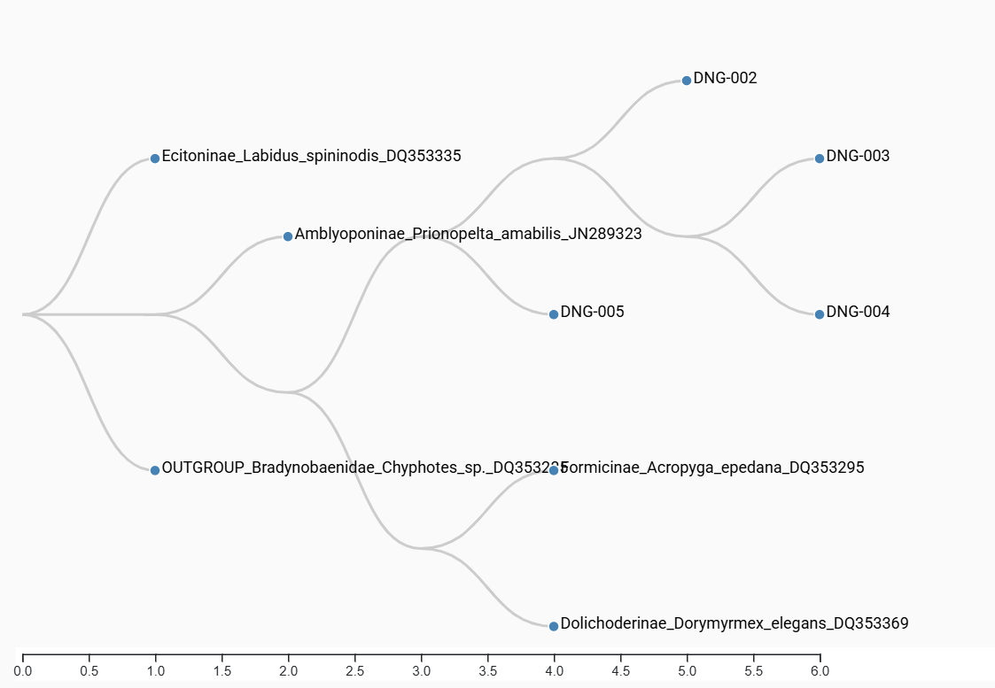


The Identification of Various Species of Ants in the WBSHS Courtyard using DNA Barcoding
Authors: Sienna Cruz, Samantha Dean, Ava Dockery, Lucciana Funes
Mentor: Andrea. Durbin
West Babylon Senior High School
Abstract
Methodology
Discussion
The goal of this project is to determine the ant species that live in the WBSHS courtyard using DNA barcoding. Ant traps were placed so they would either fall into or seek out. We caught these ants in a courtyard with plant and organism diversity. Some species that may be found are Carpenter Ants, Pavement Ants, Cornfield Ants, and Little Black Ants which are common species. The motivation of this investigation is to identify a new species, and determine the ants ecosystem. To achieve this, a specific gene from the ants was analyzed from the purified DNA. From there, PCR amplified the gene, and gel electrophoresis ensured that DNA was extracted and copied to be sequenced. Sequenced DNA is analyzed using BLAST and DNA Subway to determine the species and find a match. It’s expected to find identical species due to selective breeding, but a wide variety is also possible.
We trapped the ants by putting bait in traps that the ants could fall into or traps that we could use to scoop up the ants. We put cookies on index cards or in traps in the ground. We also just scooped up any ants we saw crawling around. We then isolated their DNA through the Chelex method and used the BLAST database. DNA extraction is a method used to purify and isolate DNA from an organism by using physical or chemical methods (DNA Extraction and Polymerase Chain Reaction, 2019). DNA must be purified first to remove anything else that isn’t DNA off of it, to completely isolate it. PCR is a technique used in laboratories to rapidly copy a specific segment of DNA (​Polymerase Chain Reaction (PCR), 2025). This is necessary due to the fact that only having one copy of the needed DNA segment is dangerous, due to the fact that any mistake could be made, so having many copies is the safer option. Gel electrophoresis is a technique used to separate DNA based on size and charge. This technique is needed to see the specific amount of DNA fragments within a sample (Gel electrophoresis, n.d). DNA sequencing means to determine the specific order of each nucleotide base within DNA (DNA Sequencing Fact Sheet, 2023). BLAST, which stands for Basic Local Alignment Search Tool is a tool that will help find areas of similarity between biological sequences (BLAST: Basic Local Alignment Search Tool, 2025). DNA Subway is a bioinformatics platform used to annotate and predict DNA sequences (DNA Subway, 2025)
The results show that although five ants were collected, only four had results. This was due to improperly loading the gel during gel electrophoresis, meaning that one of the ant’s genetic information was unable to be separated, and therefore could not reach PCR. Ant DNG-005 had two possibilities with identical bitscores, leading to the species of ant being still unknown. The species were Lasius Niger, and Lasius neglectus, both of which are invasive species. Due to the area of collection being closed off, these results can imply the existence of other possible invasive species. If we were to determine the ant’s species, the next course of action would be to revisit the area of collection, and attempt to recollect the same species. These results are important because not only do they display the native species of Long Island, which from the gathered results, the Prenolepis imparis, they also show the invasive species and the possible dangers of an invasive species. The study did not match our hypothesis due to the fact that finding invasive species was not predicted, nor was being unable to determine one of the results. For future studies, the possibility of invasive species would be considered.
Introduction
Results
References
DNA Barcoding is a method used through the extraction of DNA to identify a species. DNA Barcoding is being used in this lab in order to identify the species of ants that have been collected. Ants that are commonly found on Long Island include, Carpenter Ants, Pharaoh Ants, Odorous House Ants, Pavement Ants, Little Black Ants, and Acrobat Ants (Common Ants in Long Island, n.d). It’s difficult to truly estimate the amount of ant species left undiscovered, but experts say that there could be thousands. DNA extraction is required for determining an ant’s species due to the fact that often, all ants look extremely similar, and what truly differs one species from another isn’t always visible to the naked eye.
The results of the BLAST show many differences between our hypothesis for the species of ants versus the actual species of ants. For ant DNG_002 we hypothesized that the species was a Tapinoma sessile but the results show the species name is Prenolepis imparis. For and DNG-003 prior to the results we predicted the ant to be Technomyrex albipes but ended up being a Prenolepis imparis. Then, DNG-004 was thought to be Technomyrex albipes but is truly a Prenolepis imparis. It can either be Lasius Niger or a Lasius neglectus. Finally ant DNG-005 was predicted to be Plagiolepis Pallescens but can either be Lasius Niger or a Lasius neglectus. Refer to Figures 1 and 2 for phylogenetic tree and Gel Electrophoresis results.

