Slide 1




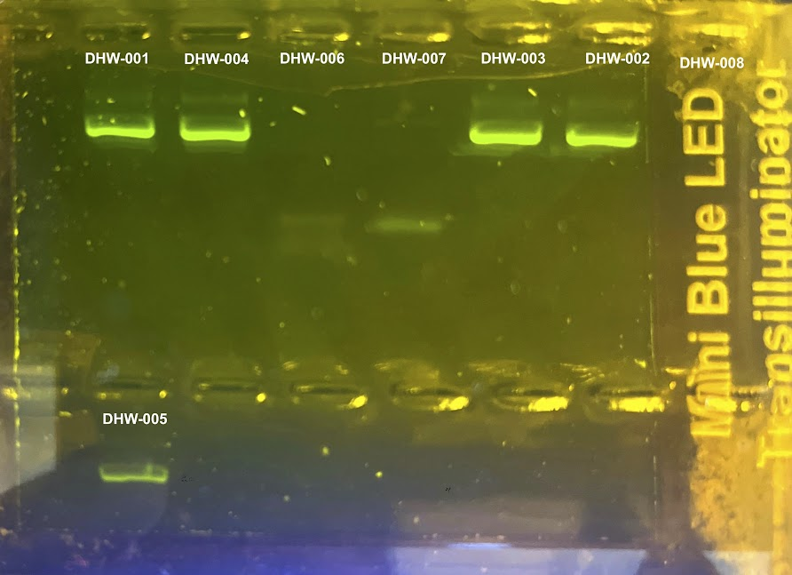
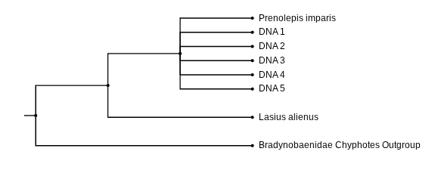


The Investigation of identifying local ants collected at West Babylon Senior High School by using DNA Barcoding
Sophia Chen, Dahiana Horna, Madeline Siena, Janelle Wheeler-Benbadri
Mentor: Andrea Durbin
West Babylon Senior High School
Abstract
We are trying to identify the species of ants that exist in our courtyard. Though we will try to do so just by looking at them and using a key, it is very difficult to identify ants using just your eyes. By extracting the DNA, we will be able to compare their DNA with known ants and see if we can find a match. The reason we are barcoding the DNA of the ants in our courtyard is so we can make an assessment of the inventory of ants that are living in this part of Long Island. In order for us to possibly discover a new type of ant species we need to take the samples of the ants in our courtyard and extract their DNA, purify it and conduct PCR on a specific gene that will help us identify the species of the ant. Once we find the species of the ants we had tested we’ll run gel electrophoresis and send the DNA up to Cold Spring Harbor Laboratory. We will most likely expect to find some of the more common types of ants, but on the off chance that we could discover a new species it could unlock another door in the world of biology.
Introduction
Ants come in many shapes and sizes. According to NPR, “For every human there is on Earth there is estimated to be about 2.5 million ants- or 20 quadrillion in total, now those are just the ants that we have discovered, those are the only species we know exist,”(NPR, 2022). According to “Myrmecological News Blog” Sandor Csosz is asked how many species he thinks are undiscovered, to which he replies “The total number might be between 20,000 and 40,000. So my vote is in the middle 30,000,” (Myrmecological News Blog, 2018). Many known species are similar in their builds, sizes and colors. So how is it possible to know what type of ant is being observed by their appearance? For this, we took the DNA of ants from our courtyard in the high school, which provided the chance of getting many different types to observe; the top three found on Long Island are: Pavement, Odorous House, and Carpenter (A&C Pest Management, n.d.). To determine if our ants are of the common types or a new species, we need to perform DNA extraction, a method to purify DNA by using physical and/or chemical methods from a sample separating DNA from membranes, proteins, and other components (National Library of Medicine, n.d.). To get a good extract, you need to purify your DNA, which helps extract ample amounts of a sample from a limited source to satisfy the requirements of your research, it also reduces an amount of contaminants that compromise the results and shorten the shelf-life (G-Biosciences, n.d.). Another part of DNA extraction is PCR (polymerase chain reaction), a robust technique to selectively amplify a specific segment of DNA (National Library of Medicine). The necessity for it is that DNA produced can be used in many laboratory procedures (National Human Genome Research Institution, n.d.). One of these procedures is gel electrophoresis, a standard laboratory technique used to identify, quantify, and purify DNA fragments. It involves loading samples into the wells of an agarose gel and subjecting it to an electric field (Thermo Fisher Scientific, n.d.). If you have the DNA, you just need to sequence it, which means determining the order of the four chemical building blocks (bases) that make up DNA molecules (National Human Genome Research Institution, n.d.). This may seem complex but there are ways of learning this like DNA subway, an educational bioinformatics platform that bundles research-grade bioinformatics tools, high-performance computing, and databases into genomics workflows, (Cyverse) and BLAST, an algorithm that searches for sequences related to a sequence (Oak Ridge National Laboratory, n.d.).
Materials & Methods
To trap our ants, we used plastic vials for them to walk into and get stuck, one with and without water. With trouble hand picking them, Mrs. Durbin gave us a cookie to draw ants in and collect them the following day. Using the Chelex method, the use of a tissue no larger than a grain of rice, and gently tapping a 10% Chelex solution tube on a hard surface to ensure the solution is at the bottom to isolate the DNA. Then placing it into a tube labeled with a sample ID number. The Chelex will bind with positively charged contaminants that could be inhibitors of DNA amplification, that will bind with magnesium ions, cofactors of DNA nuclei. Using a clean plastic pestle, we grinded the cell walls against the inner surface of the tube for at least 2 minutes to get it as fine as possible. The sample should be liquid afterwards, but there may be some particulate matter remaining. Then fill a mug near the brim with boiling water and cover with aluminum foil, make sure it is secure enough so it won’t open again by putting a capslock. Then punch small holes in the foil for the number of samples, and the heat will help lyse the cell and organelle membranes, releasing DNA. Once boiled, the DNA and Chelex mixture can be stored at 4° C temporarily, frozen at -20° C for long-term storage, or shipped at ambient temperature. After being stored the Chelex will inhibit the DNA from amplifying by PCR (DNA Learning Center Barcoding 101, n.d.).
Tables & Figures
Figure 1
Results
All eight ants that were collected were Winter Ants (Prenolepis imparis). All DNA samples were the same as shown in figure 1 and the phylogenetic tree. Three out of the eight samples failed. One of our ants was a miss well and the other two did not present DNA. So there were five ants successfully sequenced.
Discussion
Our results suggest that the ants could be from the same colony, due to being the same species and all of the ants that we found to have been in a similar area in the West Babylon courtyard. This is important as we did not find any new species in the areas we had collected samples. We originally hypothesized that we could have found the Tetramorium caespitum (Pavement Ant) species or multiple different ant species, along with a new one if possible. It was most likely not pavement ants as it is native to Europe, Morocco and western Asia although we did find a species native to the Americas. In Figure 1, you can see three bands indicating successful amplification of the DNA though we had loaded eight wells. In Figure 2, you can see that all ants that are most related to ours were the Prenolepis imparis (Winter Ant). To get better results we would need to widen the area that we found the ants in, such as finding ants along the property of WB, not just in the courtyard.
Acknowledgements
We would like to thank our Mentor, Mrs. Durbin, for guiding us and helping us throughout the entire experiment.
References

