Slide 1
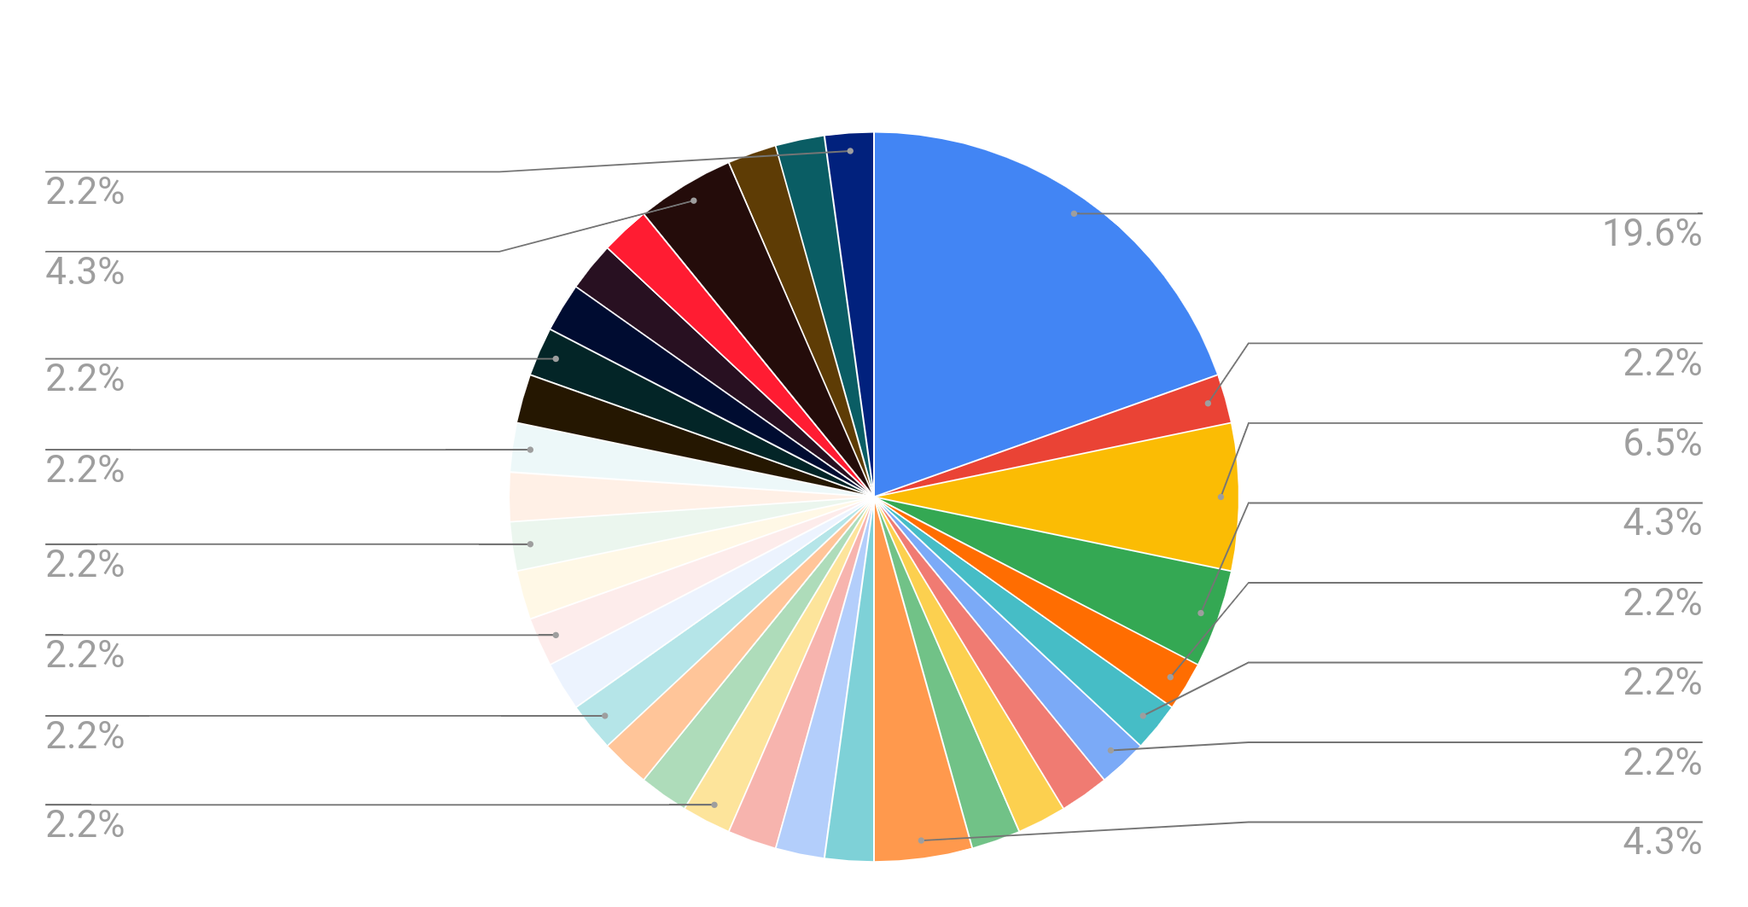
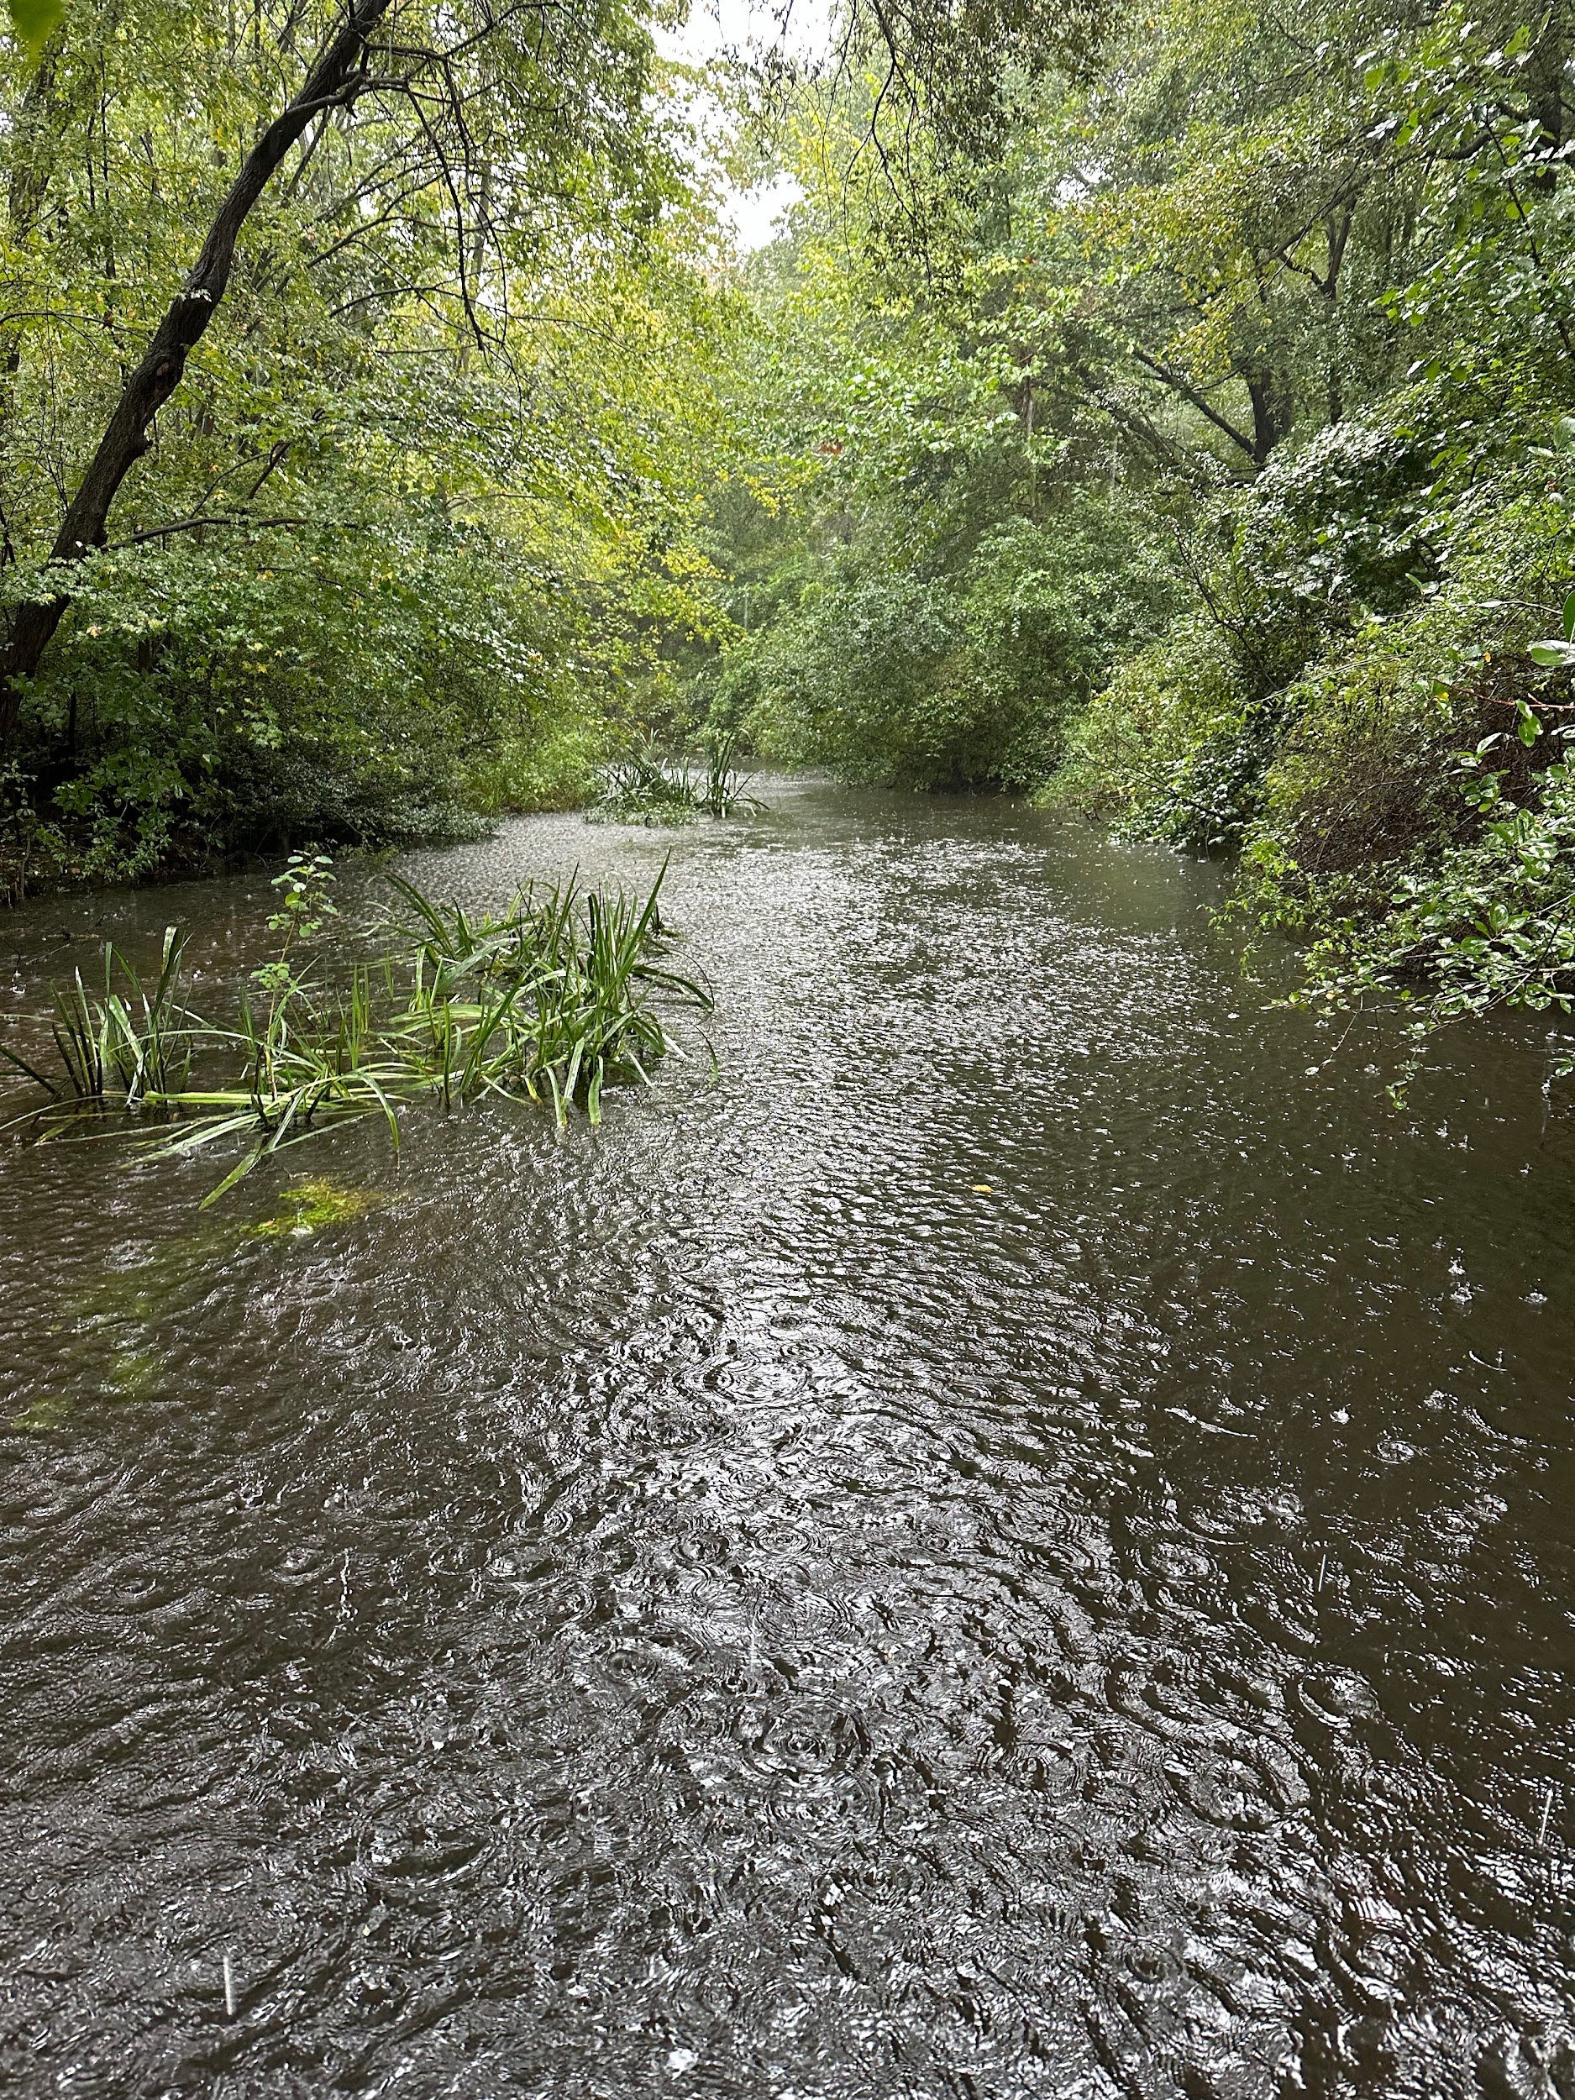
Macroinvertebrate Barcoding
Donald McNeilly IV, Blake Pulley, Nicholas Alini & Devin Vignola
The biodiversity of Massapequa Creek has been a concern for decades due to anthropogenic pollutants threatening its biological integrity. Collecting samples of macroinvertebrates from the Massapequa Preserve is expected to give a scope of the biodiversity in the preserve. The samples will be collected manually and from a streambank in the Massapequa Preserve, and then they will be barcoded with the assistance of Cold Spring Harbor Laboratories. The goal is to be able to gauge differences in the biodiversity of the Massapequa Preserve. Basic gear will be used, such as latex gloves, waders, and sieves. The results gathered showed that 7 of the 9 samples that worked were the same genus, and the other two samples were each different genera. The results suggest that the area is dominated by that one genus or that the genus has a very large population. The other two samples show that other diversity is present, but is not as dominant in that area as the genus that was repeated. Overall, though, the data supports that, while biodiversity is present in the Massapequa Preserve, it is fairly low, especially for a moist riverbank.`
The species that were examined in this collection were sequenced and analyzed to compare to other species in the Genbank database. These species originating from the creek in the Massapequa preserve were high in diversity yet having a high population of a specific species. Proasellus was the dominant genus in this area with us collecting 4 of these in our samples. Our group and the others that completed the extraction in this area acquired many of these isopods as samples, most of which wer due to the excess amount of them collected. The ideal environment for Proasellus consists of a freshwater temperature of 22 degrees celsius and an are of high organic content. The Massapequa preserve satisfied both of these requirements for these isopods to thrive. Even though we collected many of the same genus it is not acceptable to assume that the preserve doesn’t have high biodiversity as all of these specimens were collected in about the same area. It is possible that environmental factors like the rain while we were collecting or the stream of the creek caused the surplus of these creatures in this area. If we were to repeat this experiment we would likely spread out the collections in the massapequa preserve to give a more accurate depiction of the biodiversity in this temperate deciduous forest.
The purpose of this study is to explore biodiversity within the Massapequa Preserve. The location where the macroinvertebrates were gathered was a moist riverbank, and on adjacent tree branches and other flaura. The results that this experiment can yield is how many of the organisms within the preserve may be related to each other, as well as a very small scope of the different organisms within the preserve. The collection was taken by students at the Massapequa Ames Campus, with the help of the mentor, August Eberling. The hypothesis for this experiment is that collecting and analyzing samples from Massapequa Creek will provide a survey of the number of species that represents the expected biodiversity in the area at the time of collection.
We thank Mr. Eberling for helping us and assisting us within this project and also taking us to the preserve to acquire the animals. We all thank the Cold Spring Harbor Labs in giving us the materials needed to conduct this experiment. We also thank Jeff Petracca who helped us majorly in helping with the gel electrophoresis and getting the results that we now have. And finally we would like to thank Brookhaven labs for sponsoring the day in our lives program for massapequa high school.
We entered the massapequa preserve and collected many different bug samples from inside the creek. We ended up collecting nine samples and freezing them in alcohol to preserve them for later barcoding. We did the standard barcoding procedure at cold spring harbor and used the DNA subway database to identify the organisms we had collected.
In this experiment we have found that taxonomic identification has helped us find out what species our insects were. For four of our insects, we found out that they were from the same genus. This showed us that the biodiversity of the Massapequa Preserve Creek was extremely low because of the fact that a large percentage of our sample being the same species. We did not expect these results because since it is a nature preserve usually there are lots of different kinds of insects and animals which was not the case. This data tells us that the environment in massapequa is be severely damaged and many species of insects have been lost and this rate is only increasing with time.
Citations:
Dudgeon D, Arthington AH, Gessner MO, Kawabata Z, Knowler DJ, Lévêque C, Naiman RJ, Prieur-Richard AH, Soto D, Stiassny ML, Sullivan CA. Freshwater biodiversity: importance, threats, status and conservation challenges. Biol Rev Camb Philos Soc. 2006 May;81(2):163-82. doi: 10.1017/S1464793105006950. Epub 2005 Dec 12. PMID: 16336747.
Fenoglio S, Bonada N, Guareschi S, López-Rodríguez MJ, Millán A, Tierno de Figueroa JM. Freshwater ecosystems and aquatic insects: a paradox in biological invasions. Biol Lett. 2016 Apr;12(4):20151075. doi: 10.1098/rsbl.2015.1075. PMID: 27072403; PMCID: PMC4881343.

