Slide 1
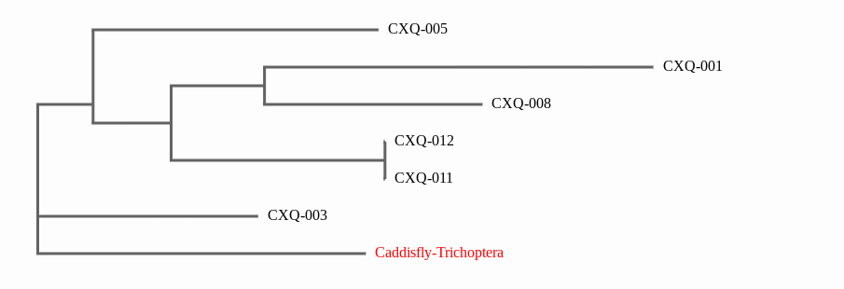
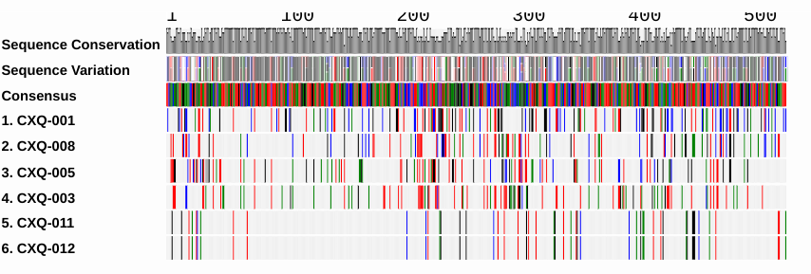
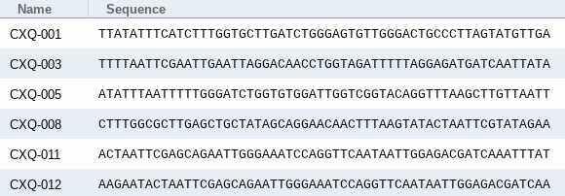
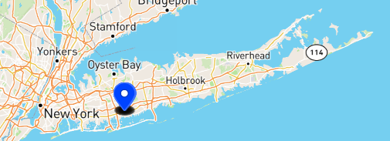
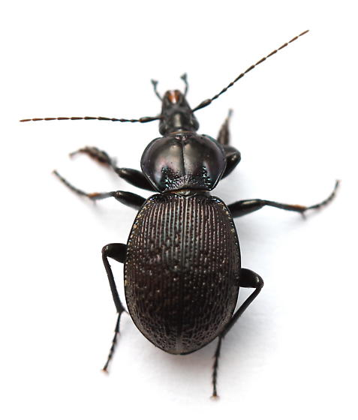
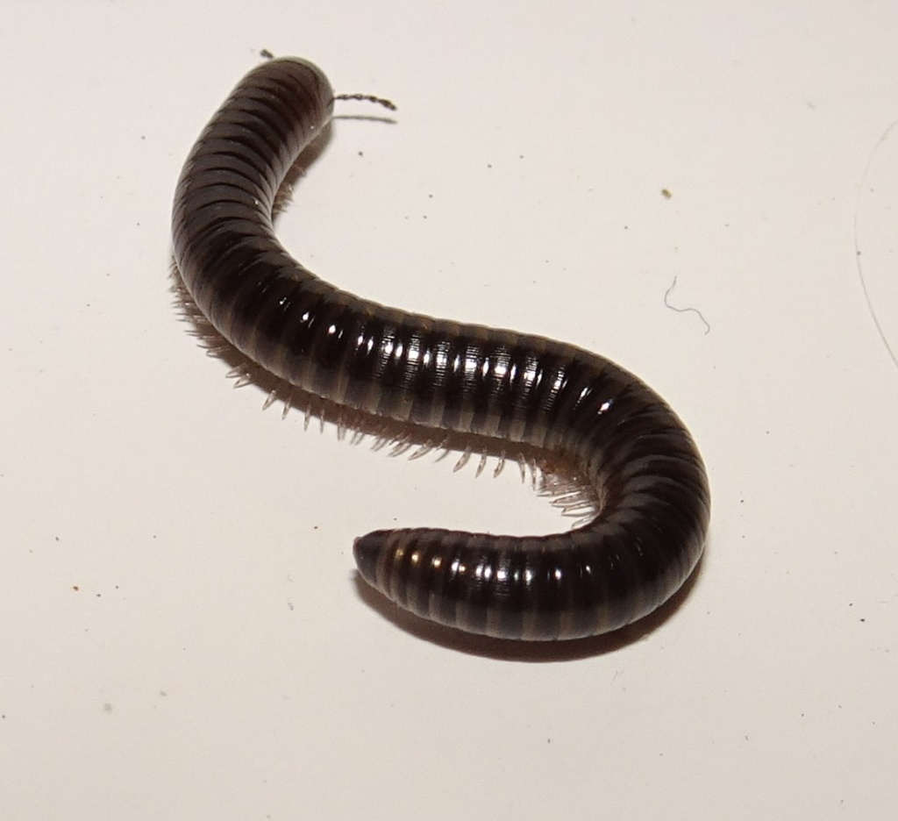
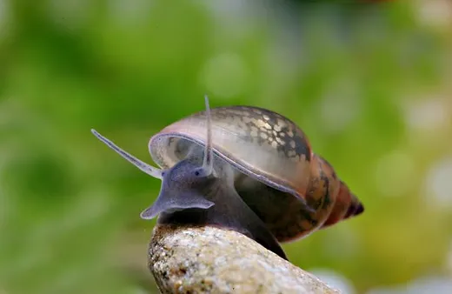
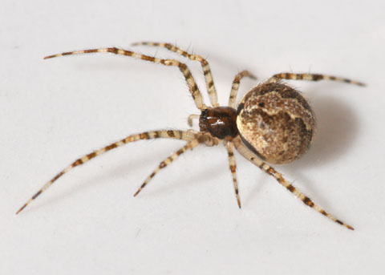
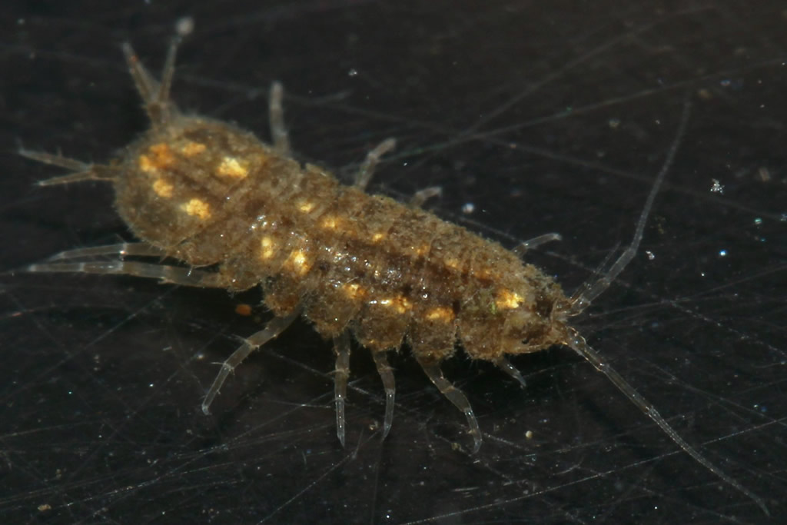
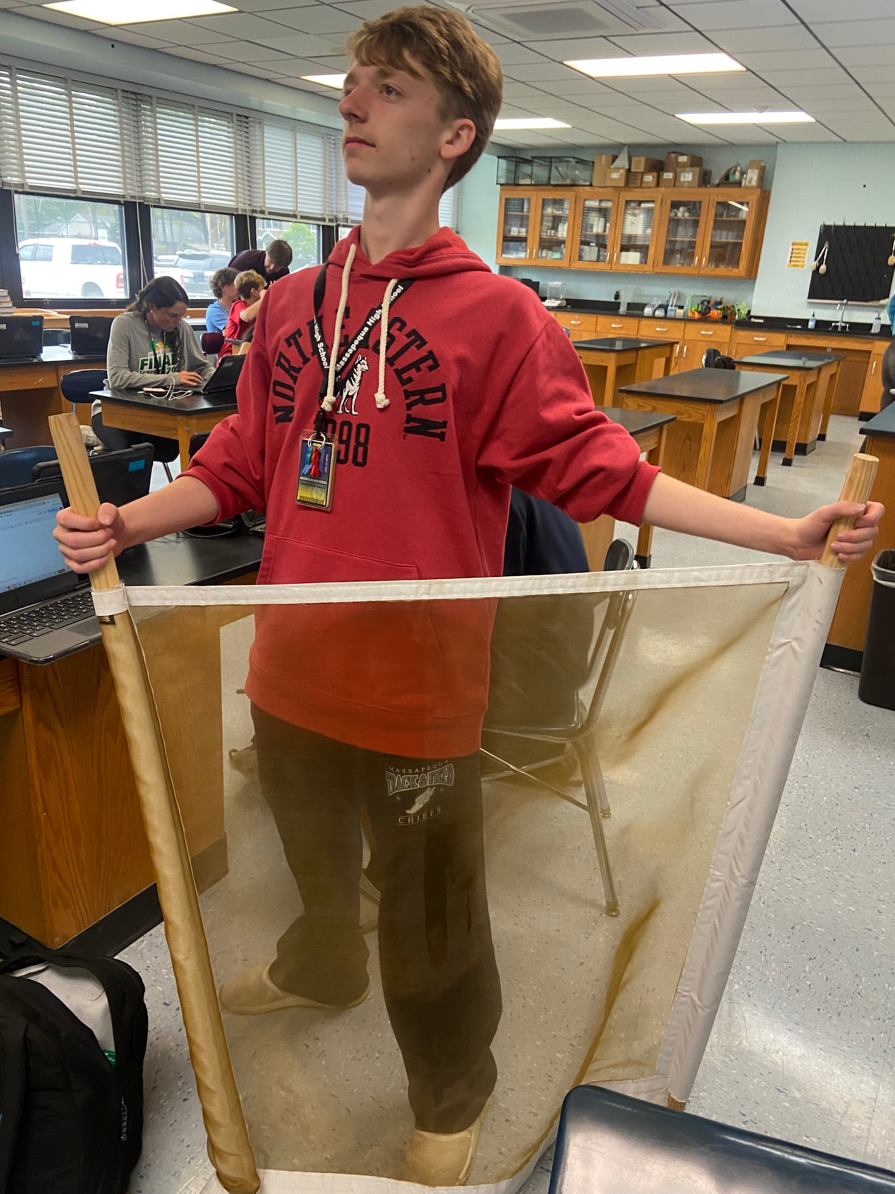
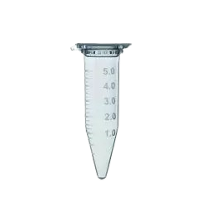
h BIODIVERSITY IN THE MASSAPEQUA PRESERVE
Nikolas Cavallo¹, Liam Chernick¹, Gavin Horigan¹, Dylan Raghubeer¹, August Eberling¹
1 - Massapequa High School Ames Campus
Abstract:
The loss of biodiversity is a major challenge facing humanity. If this continues this could cause a large-scale, irreversible shifting of ecosystems lacking in stability, and sustainability (Mikhail A. Beketov, et al, 2013). It is expected that the group will find a low amount of biodiversity in the Massapequa Creek and its surroundings. A sifter, boots, hip waders, and a kick net will be used when collecting samples. Once collected, the DNA from the samples will be extracted, and barcoded through the use of DNA sequencing and processing, allowing for identification of collected specimens. Of the specimens collected, 5 of the 6 were unique species while two of the samples collected were the same. The results suggest that there is a fair amount of biodiversity within Massapequa Creek since most of the samples collected were unique. However, although the data suggests that there is a decent amount of biodiversity in Massapequa Creek, the sample size collected was very small and is not reliable in determining the amount of biodiversity.
Tables/Graphs
Maps of GPS
Table of BLAST search results
Phylogenetic trees
Table showing sequence similarities
Discussion:
Data obtained from the experiment reveals the biodiversity located throughout the preserve
5 of the 6 specimen samples were classified in differing genus categories
Stated before, CXQ-011 and CXQ-012 had an exact match in genus; Sphaeroderus
Inferred from the collected data (CXQ - 011 and CXQ - 012) the common genus may be dominant and recurring in organisms throughout the preserve; an error may have also been made through the process of transport when sequencing the organism (Steps 2.0-2.4)
The data has provided insight into the significant biodiversity found in the preserve, proving the hypothesis correct (despite limited sample size; 6 samples)
Phylogenetic Tree (ML) depicts the lines of evolutionary descent of different species, organisms, or genes from a common ancestor.
The DNA barcodes illustrates how different the organisms are to each other. For example CXQ-011 & 12 are similar because the bars line up.
Introduction:
Biodiversity, or the variation of life in the world, an ecosystem, or particular habitat, is a massive topic covering scientists, and can be seen in our everyday lives. Biodiversity maintains equilibrium within ecosystems, and conserves stability which is the most necessary item to be considered. Specimens gathered within the Massapequa Creek, located within the Massapequa Preserve, will proceed through DNA sequencing. DNA sequencing allows for the identification of diverse species based on the genetic code found through COI or cytochrome oxidase 1.
Representative DNA Sequences of all the organisms.
Location of where all the organisms found.
References:
Beketov, M. A., Kefford, B. J., Schafer, R. B., & Liess, M. (2013). Pesticides reduce regional biodiversity of stream invertebrates. Proceedings of the National Academy of Sciences, 110(27), 11039–11043. https://doi.org/10.1073/pnas.1305618110
Dudgeon, D., Arthington, A. H., Gessner, M. O., Kawabata, Z.-I., Knowler, D. J., Lévêque, C., … Sullivan, C. A. (2006). Freshwater biodiversity: importance, threats, status and conservation challenges. Biological Reviews, 81(02), 163–182. https://doi.org/10.1017/s1464793105006950
CXQ-11
Sphaeroderus sp
CXQ-008
Cylindroiulus sp
CXQ-005
Physella sp
CXQ-003
Theridion sp
CXQ-001
Proasellus sp
Methods:
Gathering specimens within the Massapequa Preserve
The observed specimens were located with the use of a global positioning system in order to pinpoint and record the exact coordinates of the organisms. Collection of the specimens were achieved by utilizing tools including kicknets and sieves within the body of water, and gathering aquatic invertebrates that are found by overturning and sifting through the rocks and sediments at the bottom of the creek. Soon after, the specimens collected were stored and freezed in a 500 microliter plastic test tube until ready for sequencing.
When ready for sequencing, remove the ethanol from the sample’s storage tube and grind it up using a sterile grinder as to not contaminate it with foreign contaminants. Once grinded up, add chelex to the tube to extract DNA. Use PCR to replicate and amplify the DNA collected. Put the amplified DNA strands into a gel and perform gel electrophoresis to make sure the proper region of DNA was amplified. If the correct region as amplified, sequence the DNA and analyze it in DNA Subway.
Courtesy of Bug Guide
Courtesy of Nature Spot
Courtesy of Oliver’s Aquatic Garden
Courtesy of Nathistoc
Courtesy of BMIG
Sifter <----
----> Kick Net
Results:
Chelex extraction was utilized to isolate the DNA, allowing for gel electrophoresis to confirm the amplification. Following the previous method, the results were sent out for DNA sequencing, later observed by BLASTing the results in Genbank. The results revealed that 5 out of the 6 samples collected were unique, distinct species. Two samples, CXQ-011 and CXQ-012 appeared to belong to the same genus, Sphaeroderus. CXQ - 001 belongs to the Genus, Proasellus, CXQ - 003, Theridion, CXQ - 005 belongs to Physella, and CXQ - 008 categorized in Cylindroiulus.
Acknowledgements:
August Eberling
Jeff Petracca
Test Tube --->

