Slide 1
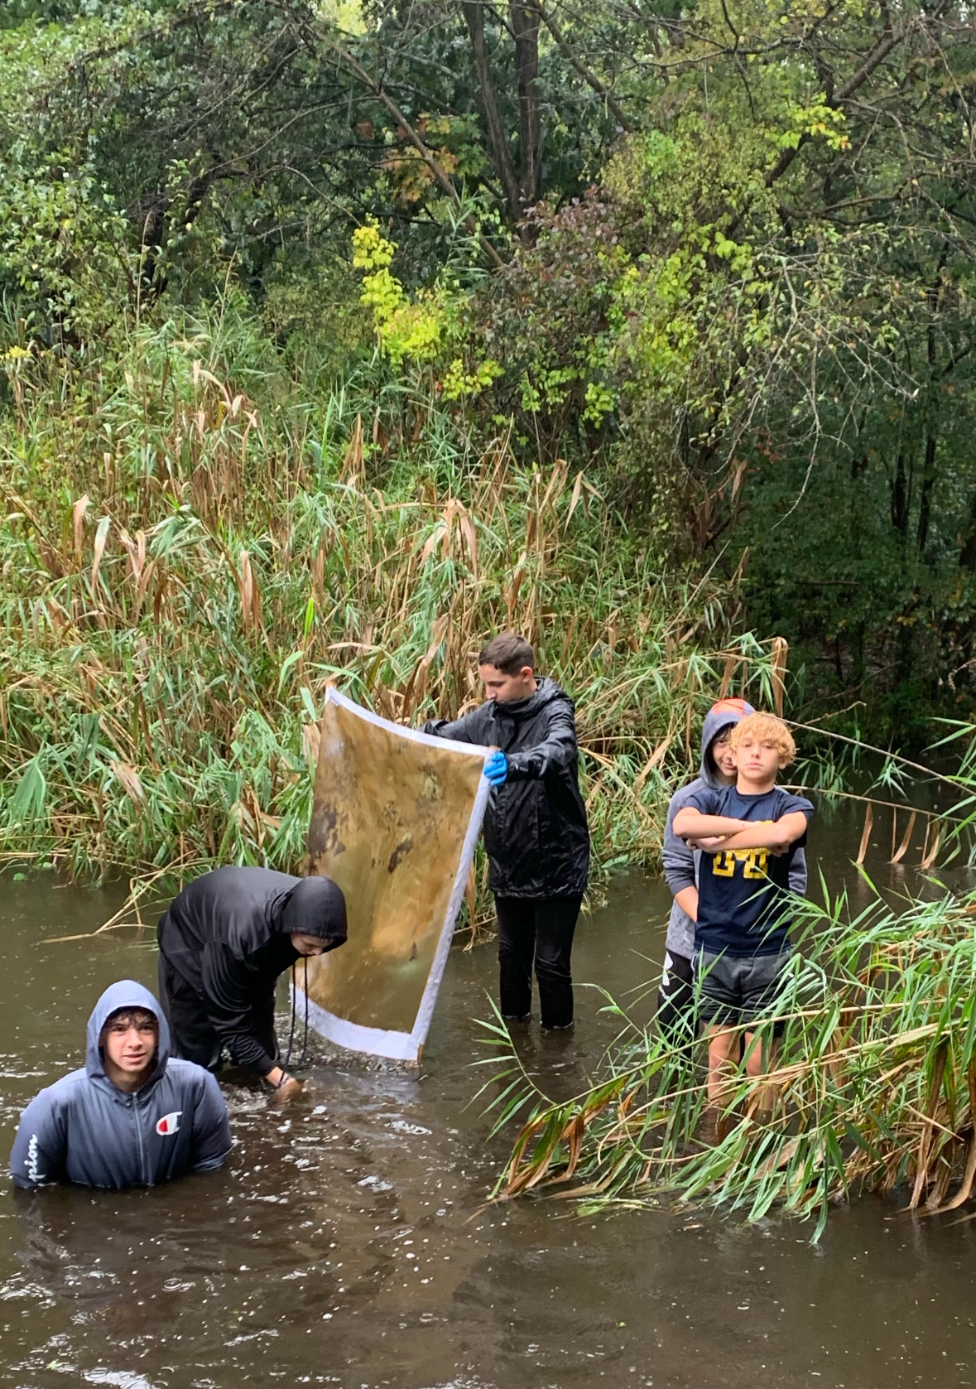
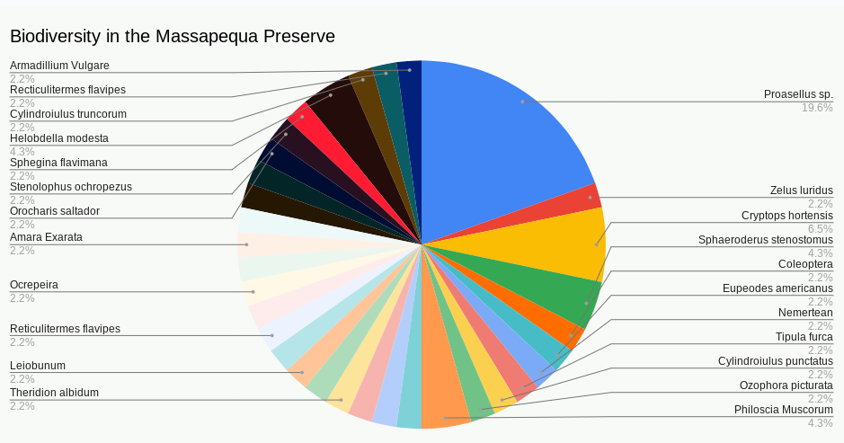
DNA barcoding aquatic macroinvertebrates in the aquatic ecosystem of the Massapequa preserve
By: Alexander Green, Cole Madden, Christopher Maiorino, Lucas Rumberg, and August Eberling
Donald said no
Abstract
Habitats from all over the world are home to a great diversity of organisms. This experiment will determine which aquatic macroinvertebrates are in and around the creek in the Massapequa Preserve, approximately a half a mile away from Ames (Latitude: 40.6994 degrees N, Longitude: -73.4519 degrees W). The Massapequa Preserve has a bike bath that runs through it which fragments the ecosystem. Aquatic macroinvertebrates are animals that live in aquatic environments and lack a backbone. Eleven invertebrates were collected and stored in ethanol in -20°C. Kick nets, shovels, and other tools were used to collect these invertebrates more easily which were found in and and out of the water. Further analysis will be conducted by DNA barcoding the samples to determine the species if possible. The results were that 9 organisms were identified. This could be because DNA was lost in the process of crushing the organism. These results indicate relatively high biodiversity. This is because all of the 8 organisms identified were unique from each other. Overall, there is high biodiversity in the Massapequa Preserve.
Results
8 of the organisms were identified . The reason that all 11 of the samples were not able to be identified was because there was not enough DNA identified to come to a conclusion. It is possible that DNA was lost in the process of crushing the organism. Sample #3 turned out to be a novel sequence which has not been published in any DNA Barcoding Database. These results were found by blasting the CO1 sequence of the insects in GenBank.
Jumping Bush Cricket
Pale Green Assassin Bug
Floodwater Mosquito
Long-Jawed Orb Weaver
: Class results
Identification
8 organisms were identified 8. CRY-003 was a long-jawed orb weaver. CRY-004 was a Proasellus. CRY-005 was a Floodwater Mosquito. CRY-006 was a Tipula Furca. CRY-007 was a Jumping Bush Cricket. CRY- 009 was unidentified CRY-010 was a Pale Green Assassin Bug. CRY-011 was a Proasellus.
Introduction
The aim of this project is to observe, analyze, and discuss the biodiversity in a portion of the Massapequa Preserve. The importance of this experiment is to understand the impact of fragmentation in this ecosystem on the biodiversity. To do this, aquatic macroinvertebrates found near or in a stream along side the bike path in the preserve were collected and identified using gel electrophoresis.
References
Derek PT, et al. A mid-term analysis of progress toward international biodiversity targets. Science 2014 Oct 10;346(6206):241-4. doi: 10.1126/science.1257484. Epub 2014 Oct 2. PMID: 25278504
Dudgeon D, Arthington AH, Gessner MO, Kawabata Z, Knowler DJ, Lévêque C, Naiman RJ, Prieur-Richard AH, Soto D, Stiassny ML, Sullivan CA. Freshwater biodiversity: importance, threats, status and conservation challenges. Biol Rev Camb Philos Soc. 2006 May;81(2):163-82. doi: 10.1017/S1464793105006950. Epub 2005 Dec 12. PMID: 16336747.
Methods
Dirt was scooped up from the streams in the Preserve and transported it into a sifter. From there rocks & dirt was picked through to find aquatic organisms. This process was repeated multiple times with some success. Some of the sediment was scooped up with a small shovel next to the stream on land. This process was repeated as well but with little success. A kick net was also used to get organisms. To use a kick net, walk into the center of the stream and place the kick net at the base or bed of the stream about 2-3 feet below the surface of the water. From there one of the team members kick the sediment from the bed of the stream towards the kick net while facing down stream. This method has a greater success rate since there is more surface area for the aquatic organisms to land on. After collecting the samples, a chelex extraction was followed to get DNA. PCR was used to amplify C01 because it has the most variation for macroinvertebrates. Gel electrophoresis was then used in order to see if PCR was successful. These were sent for sequencing. From there, DNA subway was used to match the DNA sequences with the organisms. For the novel sequence found, bugguide.com was used to help figure out the organism.
DNA Subway sequence alignment
Acknowledgements
We acknowledge and thank Mr. Eberling for helping us and assisting us within this project and also taking us to the preserve to acquire the animals. We also thank Jeff who helped us majorly in helping with the gel electrophoresis and getting the results that we now have. And lastly, We all thank the Cold Spring Harbour Labs in giving us the materials needed to conduct this experiment.
Notes:
Chelex DNA Isolation
PCR used to amplify DNA
CO1 was used because it is very different for each organism
gel electrophoresis is used to verify the DNA is correct
Sanger sequencing.
Know how fragmentation of our ecosystem has impacted the biodiversity in that site.

