Slide 1
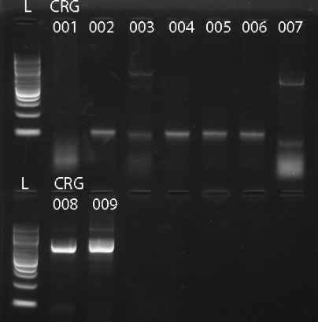
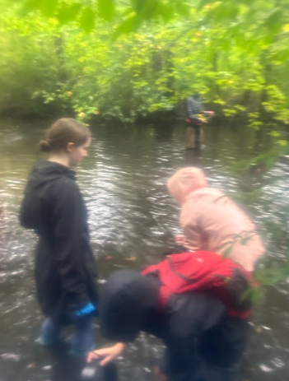
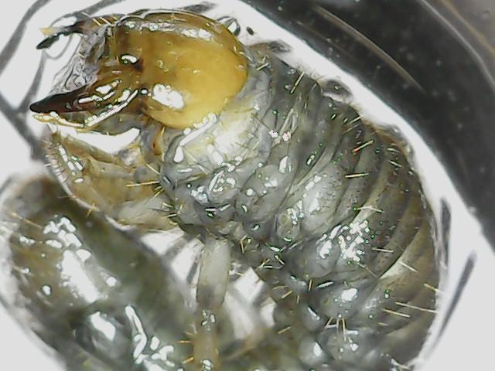
Barcoding Aquatic Specimens Sourced From The Massapequa Preserve In The Early Autumnal Season In Order To Determine Biodiversity
Abigail Matheis, Rhyan O’Leary, Aleyna Saygili, August Eberling
Abstract: Due to pollution and microplastics in water, the biodiversity of many areas worldwide is depleting. Specimen analysis will prove the biodiversity of the Massapequa Preserve. In this experiment, aquatic specimens were collected from the grass and inside the creek sediments and then placed into ethanol alcohol to be DNA barcoded later on using the Cytochrome Oxidase 1 region of DNA. Nine specimens were collected through this experiment, however only 6 were actually able to be barcoded, being Philoscia muscorum, Tomoceridae, Caecidotea racovitzai, Eupeodes americanus, Lumbriculus sp., and Helobdella modesta. By observing the specimens, it was proved that the biodiversity was high due to the vast array of bugs. With a high biodiversity like such, this is an indicator of a healthy environment and stable ecosystem with the area of the Massapequa Preserve and how it has a thriving environment.
Discussion: When analyzing the biodiversity, there was a high biodiversity of organisms within the Massapequa preserve. From the data collected from all of the groups, in total there were 33 different types of organisms. With this, when using the Simpsons as well as Shannons biodiversity index, it was found that there is a biodiversity of 0.3887 with the use of the Simpsons index, and a biodiversity of 1.568 with the Shannon's index. Starting with the Simpson's index, the closer the biodiversity comes out to 0, the higher it is, which indicates that the Massapequa Preserve has high variation of species. Additionally, when comparing the results to the use of the Shannon's index of biodiversity, a number between 1.5 and 3 indicated how the biodiversity is at a relatively equal level that will maintain a decent ecological balance. Addition, though gel electrophoresis and through the process of we were able to find the organisms names and species. The species names were Philoscia muscorum, Tomoceridae, Caecidotea racovitzai, Eupeodes americanus, Lumbriculus sp., and Helobdella modesta, and all help in illustrating the biodiversity of the Massapequa Preserve.
Figure 1: As seen above, the following picture is the sequence alignment of all the organisms that were collected through the conducted study.
Introduction: The reason to conduct this experiment was to observe the biodiversity of the Massapequa Preserve Creek. The importance of finding an understanding the biodiversity to make sure that the ecosystems of a specific area is healthy that people rely to survive. Through the process of searching for insects, 9 specimens were collected. They were then preserved and later put through gel electrophoresis in order to compare their genetic makeup and see if any new species were discovered. To find the identify the species of the samples, DNA barcoding was done. With DNA Barcoding, the CO-1 region, or the Cytochrome Oxidase 1 mitochondrial region, was used in the barcoding process. This study has importance in the process of studying the biodiversity in this location. This helps to create a better understanding of the species of animals at this location. The hypothesis for this experiment is that if comparing the number of different species present, the biodiversity of the area can be determined.
Results: Samples were analyzed using Sanger sequencing followed by alignment and BLASTing against Genbank. It was found that there were a variety of organisms collected. Of the 9 samples collected 6 species were able to be identified. The organisms found were a Philoscia muscorum, Tomoceridae, Caecidotea racovitzai, Eupeodes americanus, Lumbriculus sp., and Helobdella modesta, species that are commonly found in an area like the Massapequa Preserve. These specimens have all been previously found and seen before and recognized in the following area.
Figure 2: Above, is the results from the gel electrophoresis from all the collected organism in our experiment.
Figure 3: From above, it illustrates how the organism were collected in the preserve.
Figure 4: The following image is of organism CRG - 01, one of the more rare organism found.
Acknowledgements: Special thanks to August Eberling and Jeff Petracca for their assistance in the data collection and experimental processes of this project. With their help, access to resources and explanations on the procedures allowed DNA extraction, DNA subway, and gel electrophoresis to be executed efficiently. This project was able to assess biodiversity directly because of their teaching and would not have been the same without their assistance.
Methods:
1.0 Collect specimens from selected area
1.1 DNA Extraction using Chelex method
1.2 PCR
1.3 Gel Electrophoresis
1.4 Sanger sequencing
1.5 Analysis with DNA subway
References:
Beketov MA, Kefford BJ, Schäfer RB, Liess M. Pesticides reduce regional biodiversity of stream invertebrates. Proc Natl Acad Sci U S A. 2013 Jul 2;110(27):11039-43. doi: 10.1073/pnas.1305618110. Epub 2013 Jun 17. PMID: 23776226; PMCID: PMC3704006.
Figure 5: The following image above is the data collected of all the organisms found by all the participants that were a part of the accumulated organism from the Massapequa Preserve

