Slide 1


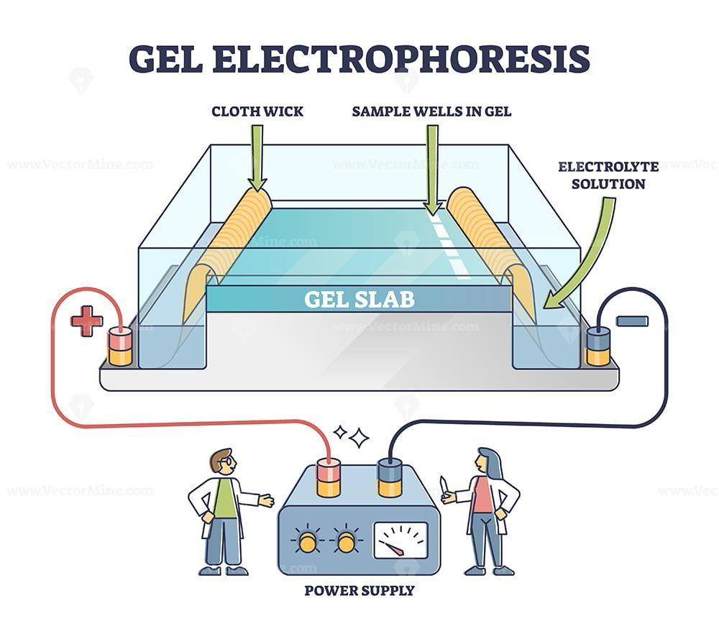
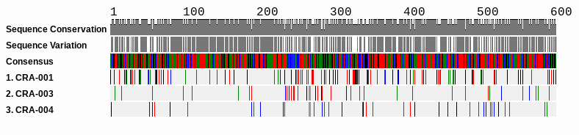
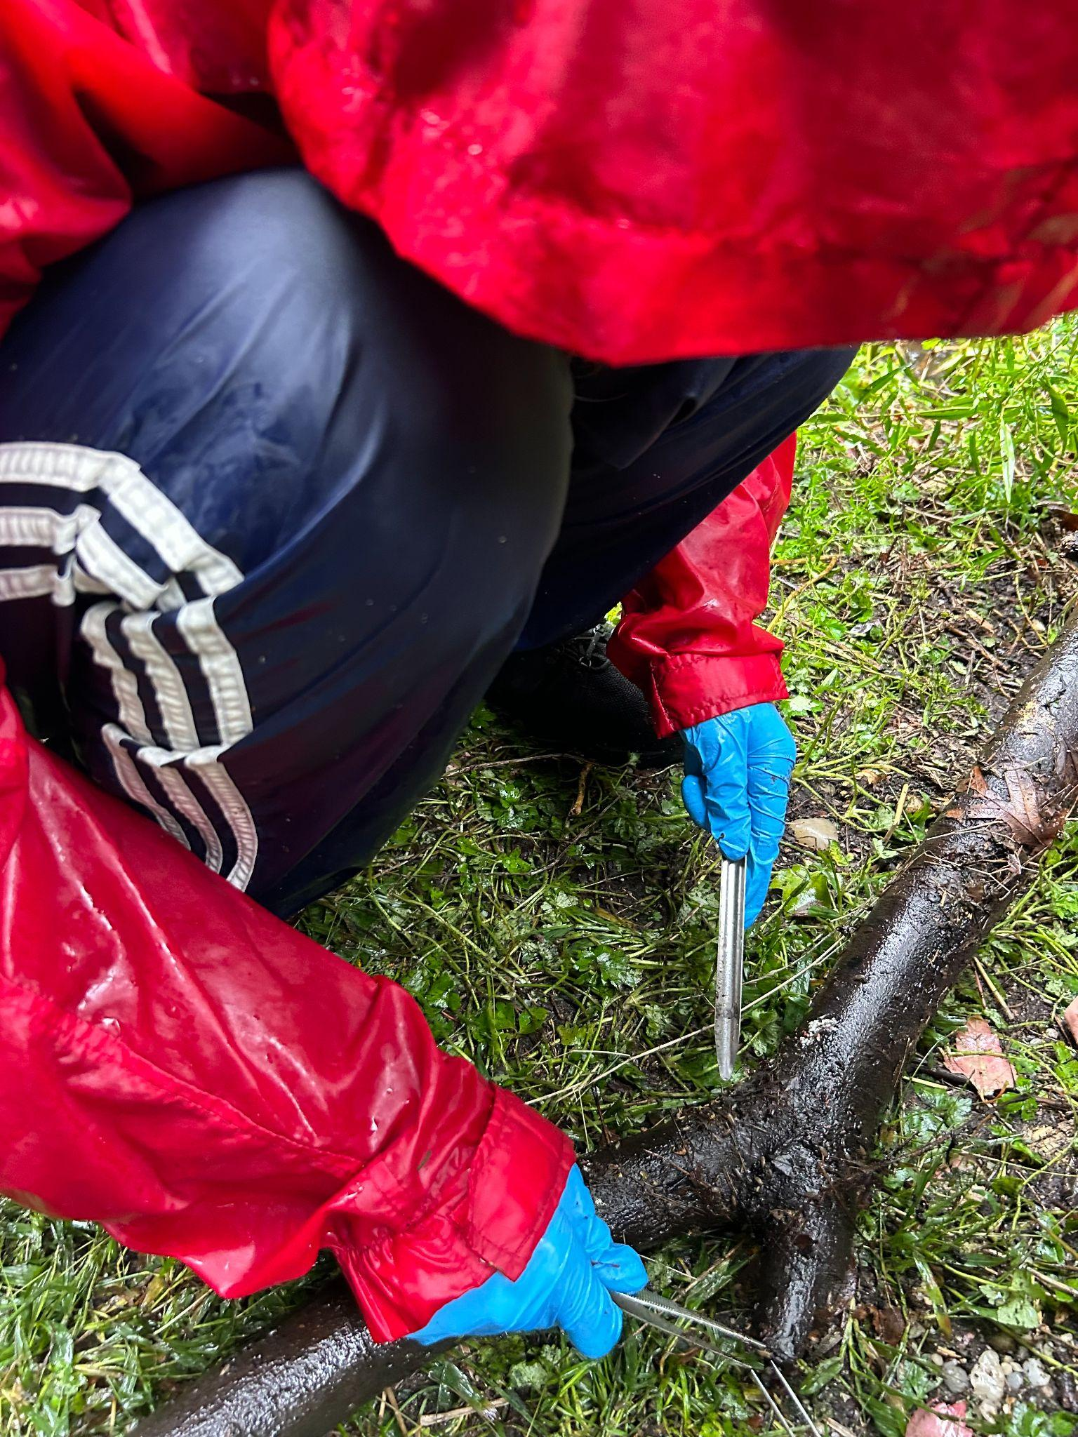
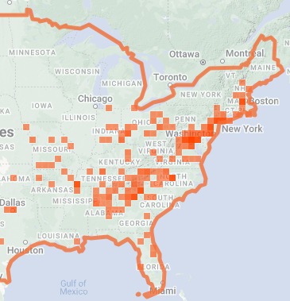
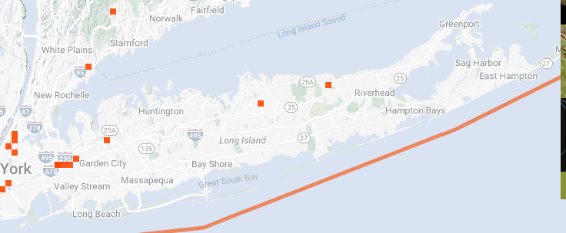
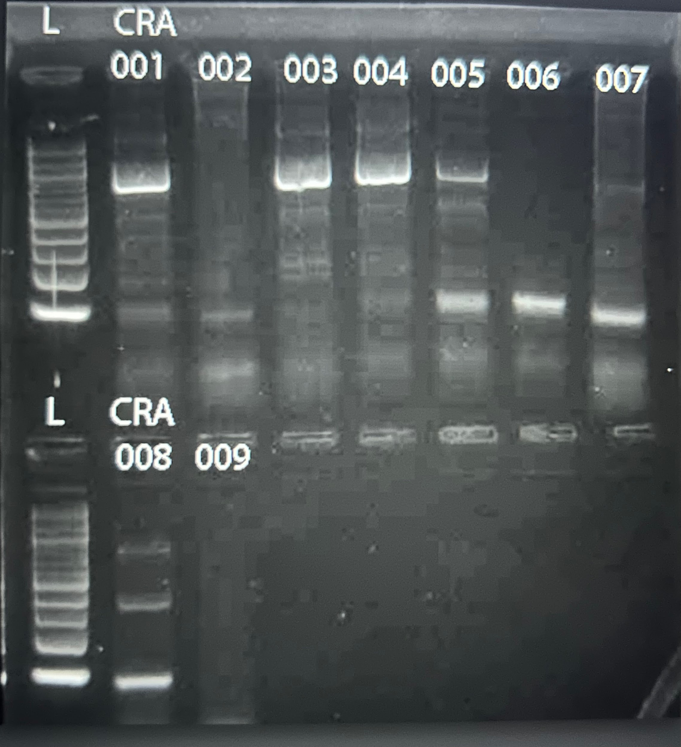
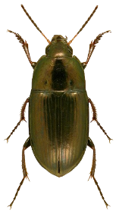
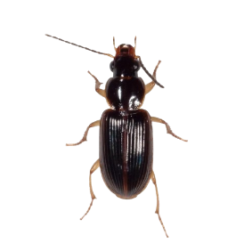
DNA barcoding of aquatic macroinvertebrates in the Massapequa Preserve to determine biodiversity in a temperate deciduous forest
By Anya Mcgrath, Isla Sikinger, August Eberling
Abstract
The investigation was run to determine what aquatic invertebrates live in the local rivers and creeks of Massapequa. Biodiversity continues to decrease in aquatic ecosystems due to changing climates and human interaction. The collected data received during the investigation holds importance as it will be added to the ecological historical data of the area. Biodiversity signifies the sustainability of the ecosystem for the future and is essential to supporting life. Collecting a limited number of samples can help scientists receive a better understanding of biodiversity in the Massapequa Creek. Submerged logs were removed from their aquatic environment and stripped of their bark to collect samples. A DNA barcoding procedure performed at Cold Spring Harbor Laboratories was used to process and analyze the nine samples.Five out of nine samples were unsuccessful in amplifying the DNA and could not be analyzed. CRA-001 is found in the Ocrepeira genus, but the species was unable to be identified. CRA-003 was identified as an Amara aenea and CRA-004 was identified as a Stenolophus ochropezus. Both species are found in the family Carabidae (ground beetles).
Figure 1: Removing bark from wood in Massapequa Preserve
Figure 2: Visualization of how gel electrophoresis works.
Figure 5: Sequence alignment using DNA subway
Results
DNA amplification was not successful for samples 002, 006, 007, 008, and 009.
CRA-001 is found in the Ocrepeira genus, but the species was unable to be identified.
CRA-003 was identified as an Amara aenea - common sun beetle
CRA-004 is a Stenolophus ochropezus - ground beetle
Samples 003 and 004 are both found in the family Carabidae (ground beetles).
Introduction
This study was conducted to discover levels of biodiversity in the Massapequa Preserve, a temperate deciduous forest. A high level of biodiversity indicates a healthy and stable ecosystem that has many different species. However, biodiversity in freshwater areas has been decreasing because of human intervention such as increasing temperatures due to climate change, destruction of habitats, and increasing levels of water pollution (Dudgeon D, et al, 2005). The results will indicate the diversification of species in the ecosystem. A high percentage of relation between species represents a low biodiversity. This study provides information on biodiversity and its importance in the preservation of a stable ecosystem.
Figure 3: The image above shows all the known locations where the genus Ocreperira was found. Zooming in shows the presence of the genus on Long Island, but there has been no species identification.
Discussion
There was a low amount of biodiversity found in the Massapequa Preserve.
User error in the first time performing this procedure resulted in a small number of sequences able to be analyzed.
001 had contrasting results when the sequence was looked up on GenBank and BoldSystems.
Overall, CRA-001 was not able to be identified, which may result in a new emerging species. The genus identified for this sample was Ocrepeira yet the species was not truly identified.
There may be more biodiversity in the Massapequa Preserve than indicated in this experiment.
Procedure
Collect samples in Massapequa Preserve using gloves, hip-waders, boots, etc.
Look for specimens in topsoil, rotting tree bark, and around the area.
Place the specimens in disposable test tubes with ethanol, label with the sample number, and record the coordinates.
Use a Jiusion Digital Microscope to take pictures and record the measurements of the specimens.
Isolate DNA using chelex and amplify the CO1 region using PCR.
Run gel electrophoresis in order to verify that the PCR was successful.
Sequence samples and run through a database to determine the species.
Amara Aenea
Acknowledgements
We would like to thank Mr. Eberling for helping us with our project and providing us with guidance.
Stenolophus ochropezus
Figure 4: The gel electrophoresis results.

