Slide 1
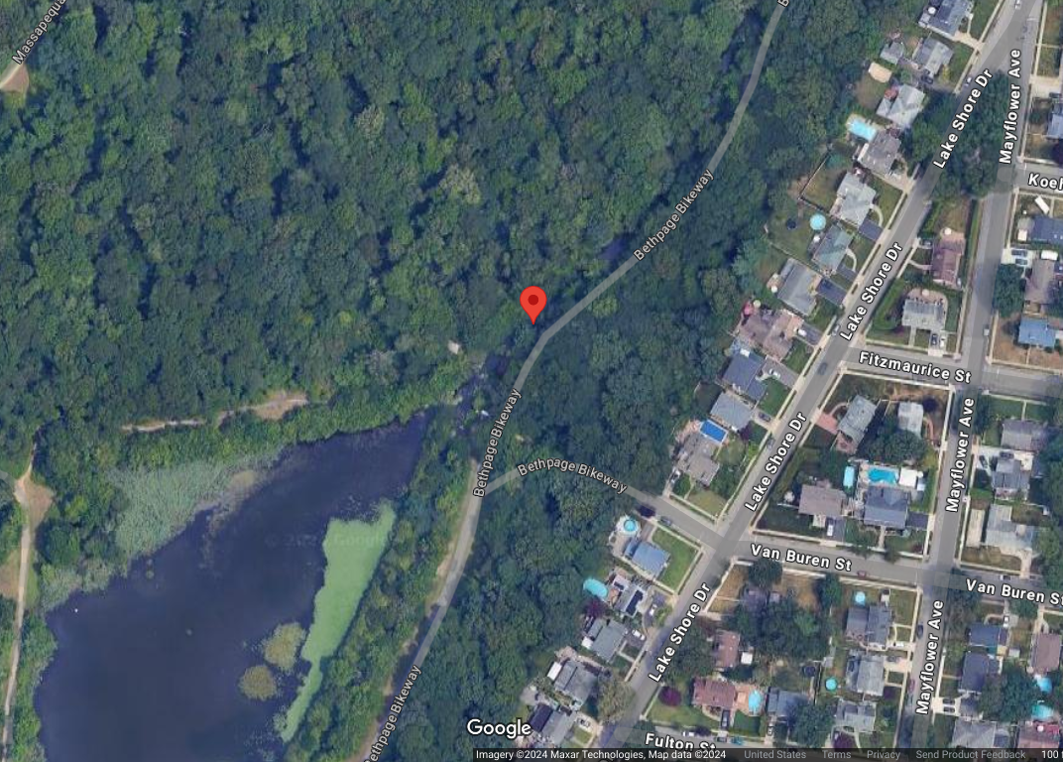
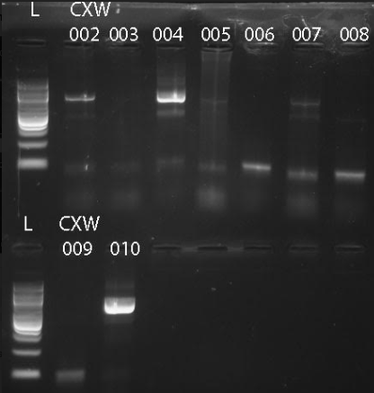
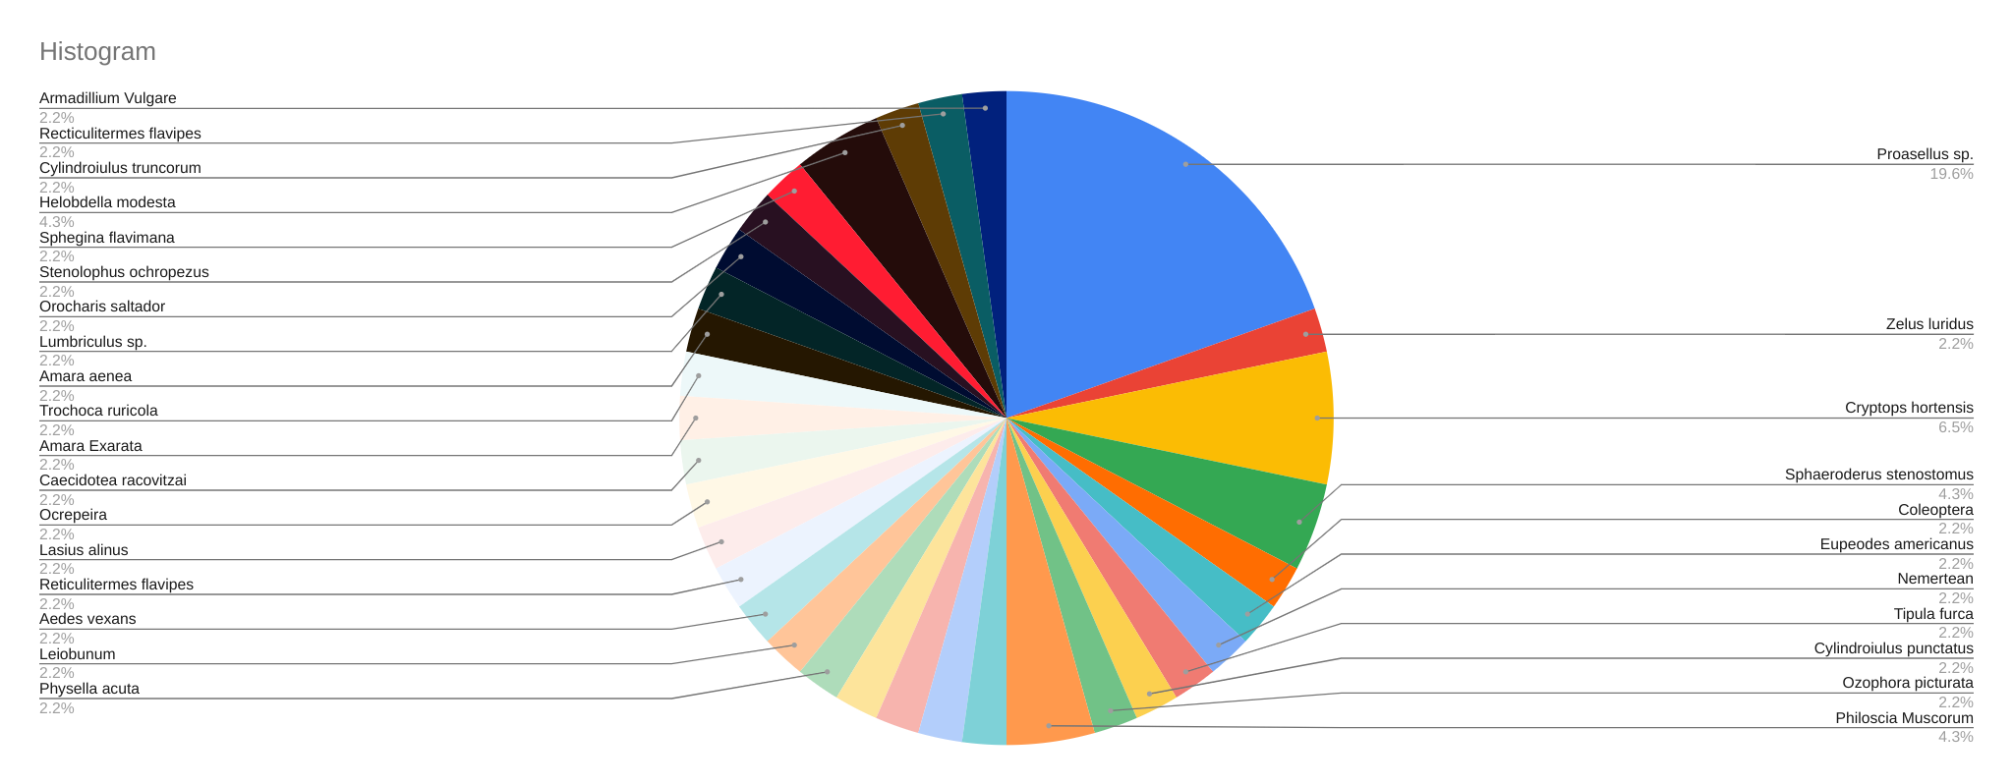
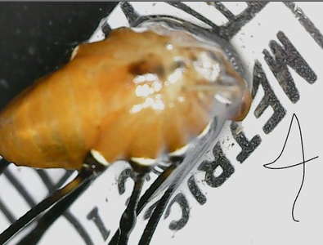
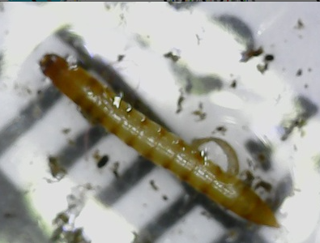
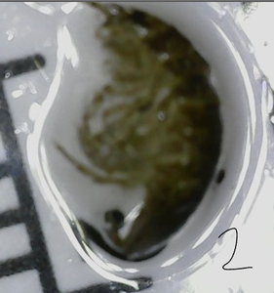
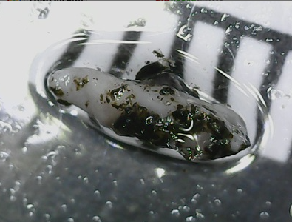
Collection of Invertebrates in and near the creek in the Massapequa Preserve to determine biodiversity through the use of DNA barcoding
By Benjamin VanCura, Lia Ranieri & Ioannis Mastoros
ABSTRACT:In the experiment, macroinvertebrates specimens were collected terrestrially and aquatically in the Massapequa Preserve. The primary intention was to identify the amount of biodiversity in the surrounding environment, in light of this, multiple species were found in each spot when searching for specimens, which overall leads to a more stable environment with more niches, and less competition among them allowing for a better chance to withstand negative environmental changes, Biodiversity will be more accurately measured using DNA barcoding which can be observed from macroinvertebrates that were collected using these methods. Overall, 10 macroinvertebrates were collected and put in 95% ethanol tubes.
Hypothesis
If macroinvertebrates are collected in multiple spots around and in the water, then the chances of finding unique species are increased
The map above demonstrates the global positioning system in which all of the aquatic invertebrates were found
As demonstrated by the phylogenetic tree above, it shows the relationships between all of the organisms, and how similar their cytochrome oxidase 1
As seen throughout data obtained, it is shown that pesticides are killing macroinvertebrate and reducing biodiversity frequently (Hiroshi, et al, 2020). In the Massapequa preserve, biodiversity was tested by obtaining macroinvertebrates near the creek. If macroinvertebrates are collected in multiple spots around and in the water, then the chances of finding unique species are increased. For specimens that were difficult to obtain, tweezers were used to put them out safely and cause them to not be stuck. Logs were turned over for examination in a wooded area that was surrounded by bushes and fallen trees to find macroinvertebrates.
The graph to the left exhibits all the different genus found among the class, the most being Porasellus, showing a significantly large amount of biodiversity among the environment
4
10
Highlighted by the gel electrophoresis, it shows the validity of the PCR results of the specimens, verifying COI amplification.
2
METHODS
7
The hypothesis states that if macroinvertebrates are collected in multiple spots around and in the water, then the chances of finding unique species are increased. Data was checked using DNA subway and their NIH (GENBANK) database. The data that was collected proves this hypothesis correct by proving most species collected were diverse. This is due to the fact that around half of the collected specimen were different Genera. This data leads to the conclusion that there is an increased amount of biodiversity, especially since many specimen that were similar were collected in the same 1 meter quadrant as other specimen. Since the data has proved an increase in biodiversity, this data can support the protection of the Massapequa Preserve.
Collected aquatic and terrestrial macroinvertebrates in Massapequa preserve
Chelex DNA isolation - grinded up specimens, added kelacks agent
Pictures of specimen with DNA sequences
CWX-002:
Genus: Proasellus
CWX-007:
Genus: Nemertean
CWX-004:
Genus: Leiobunum
CWX-010:
Order: Coleoptera
DNA amplification - PCR in the CO1 region located in the mitochondria
Sanger sequencing of DNA - identifies the order of nitrogenous bases in the barcode and allows for disguinguation of specimens
The graph above shows the sequential differences between the corresponding organisms, and their relation to one another.

Slide 2
-Introduction (Worms, crustaceans, ect.) biodiversity, niches, the more organisms that is had, there is more bettering of the environment, if an organism goes extinct, something else can overtake them because it is a stable environment. Insects/aquatic invertebrates are good bio-indicators because they are affected first and are able to tell a lot about an environment. Throughout the past there have been a multitude of ways that this can been brought about, it has been monitored for a couple years from other Massapequa students
Sample group
Methods(brief)
-barcoding, the process, the process does not work for everything, there are certain taxonomic groups that it fails completely. In our area the red and black ants are different but barcode the same for the CO1 region
Sample documentation, entails taking pictures and collecting them, we did tihs because we know for future reference and we can use the barcode to identify the organisms and verify it, if we got a barcode that is a dragonfly we can look at it and say that it is a dragon fly
kelacks DNA isolation, we get the DNA out of the creature, we grinded the specimen up in the kelacks agent, about 2 microliters
DNA amplification - focused in the mitochondria, the region of CO1, or cytochrome oxidase 1, it was utilized because it is different for every species, we want a difference of every sequence so we can distuinguissh every organism from one another. PCR was used, polymerase chain reaction, it makes lots of copies of CO1 and nothing else
Gel electrophoresis - we used it to see the banding pattern so that way we can identify the organism, it was used to make sure that we actually replicated the CO1, it said that the PCR was successful, it is critical and standard practice, the same barcode marker regions are the same size, although they have different sequences, it just says that it is successful,
sequence of DNA (sanger sequencing) it determines the order of ATCG’s in the gel and it allows us to come up with the order of our bases and the type of organism that it is.
data Analysis
DNA subway, the blue line specifically, it was used to trim and prepare the sequence for analysis, we then BLASTIN, genbank is the database that scientists can put their specimens into and see if anyone else knows it (virtural collection of sequences)
Sequence analysis
Species identification (include pictures comparisons, common name)
Species comparison (species similarity/phylogenetic tree
Barcode of life database (BOLD)
Data interpretation
Were you able to identify your species? why or why not? Did taxonomic identification help?
What did you learn about your samples? Were you results what you expected?
What exactly does our project show it shows how fragmented the biodiversity is by the preserve
Ask people if there are any opportunities to conduct research in a couple of years
Things to mention
-barcoding (many forget) -Chelex DNA isolation
-ways/process in which bugs were collected -How Dna subway was used (blasting in the NIAH database) GENBANK
-Companies that helped (Funding)(MAHS)
-evolutionary relationships between parasitic ants

Slide 3
Sample photos
CWX-007
CWX-010

Slide 4
Title
Abstract
Tables/Graphs
Maps of GPS
Table of BLAST search results
Phylogenetic trees
Table showing sequence similarities
Discussion
Intro
References
Materials & Methods
Results
Acknowledgements

