Slide 1
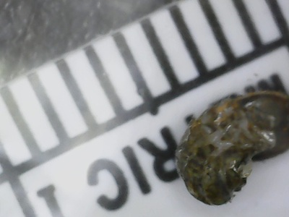
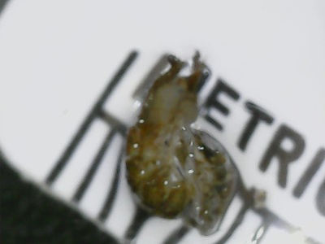
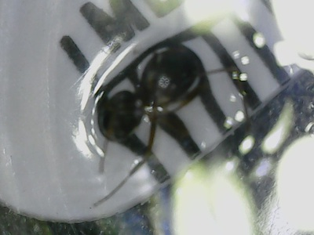
Macroinvertebrate Barcoding
Patrikios Constanti, August Emberling
Abstract An analysis of the local organisms inhabiting the Massapequa Preserve can help to better understand the biodiversity of the nearby region. To more efficiently assess the potential data of the local area. The main objective during the expedition was to gather aquatic and terrestrial macroinvertebrates to help to better understand the biodiversity within the Massapequa Preserve. While work was being done within the creek, various materials and methods were used, such as a kicknet in the deeper waters, as well as a strainer to help find any organisms that may be hiding within the dirt and sand of the creek. They were then stored within ethanol alcohol at low temperatures to better preserve the essential parts of the macroinvertebrates. After the organisms were stored for approximately a month, data was then collected using the process of DNA barcoding. The genus of the organisms collected were CRA-001: Ocrepeira Ectypa, CRA-002: Amara Aenea, CRA-003: Stenolophus Orchopezus. The genus of the fourth organism was indecisive. The data collected shows a lack of biodiversity in the preserve.
ML-Tree
Materials & Methods Materials: kicknet, gloves, a sieve, collection tubes containing ethyl alcohol Method: 1. Locate a body of freshwater with a shallow entry point, using Google maps, obtain the coordinates 2. Enter the water and gather various materials, such as rocks, logs, sticks, soil, and aquatic plants, and sift through them. 3. The discovered macroinvertebrates were photographed, put into collection tubes filled with ethyl alcohol and labeled. The tubes were frozen at -20 degrees celsius. 4. DNA from the procedure was isolated using chelex reagent, amplified using PCR, then did gel electrophoresis, and sequenced using Sanger sequencing.
Alignment Viewer
Introduction The recent changes in the environment and additions of new and foreign pesticides such as, the various pesticides and fertilizers used by local citizens, that may change the stability of a local ecosystem. (Bekerov, et al, 2013,) Therefore, the information of the collected organisms can help to suggest any change or development that may have occurred to the local biodiversity. The specimens were then brought to a lab for more in depth and better analysis of the organisms using the process of DNA barcoding. Based on the data collected via DNA barcoding, the information and awareness of the biodiversity regarding the local and nearby region can be used to better understand the stability of the ecosystem.
Results Samples were analyzed using DNA subway. Samples were also BLASTed using GenBank. Three out of the five samples genus and species was able to be found while one was unable to be read. Sample CSA 001: species was Ocrepiera ectypa, CSA -002 species was Amara aenea and lastly CSA 003: species was Stenolophus ochropezus.
Acknowledgements: Great thanks to August Eberling and Jeff Petracca.
Discussion
The results of this experiment indicate a lack of biodiversity within the Massapequa Preserve. Usually a lack of biodiversity would be a problem to the region that it is correlated with, however, due to my lack of numbers I was only able to collect four samples. This indicates that the overall biodiversity of Massapequa Preserve requires more data and specimens to make a valid claim.Of the four collected only three were able to be identified, as the fourth was unfortunately messed up during the gel electrophoresis stage. If my teams numbers were to increase, and the weather conditions at the time of collection were more optimal I might of been able to get better valued data and a more in depth discussion.
CSA-001 CSA-002 CSA-003

