Slide 1
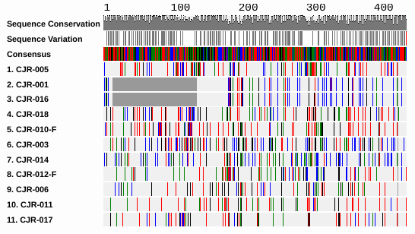
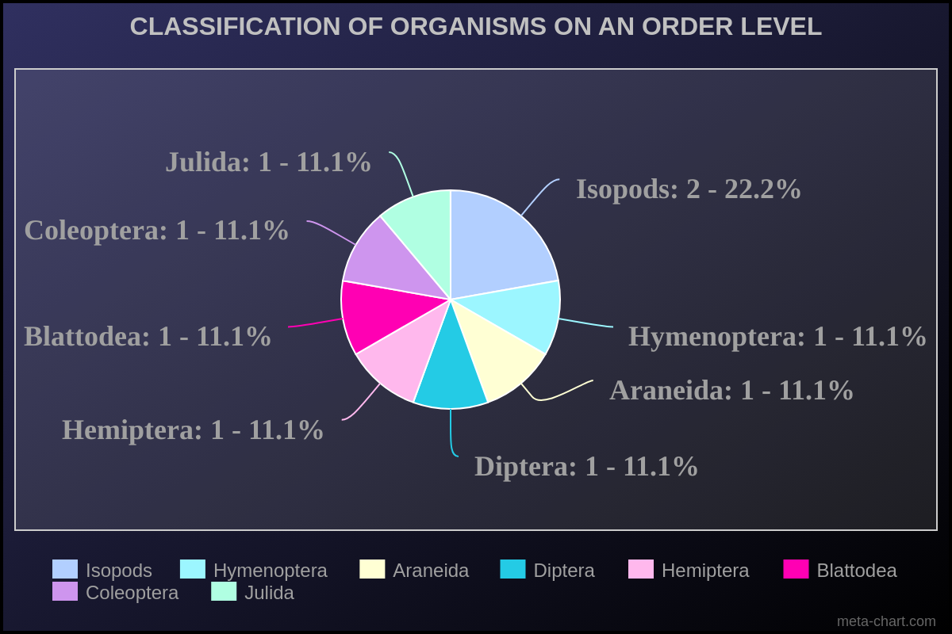
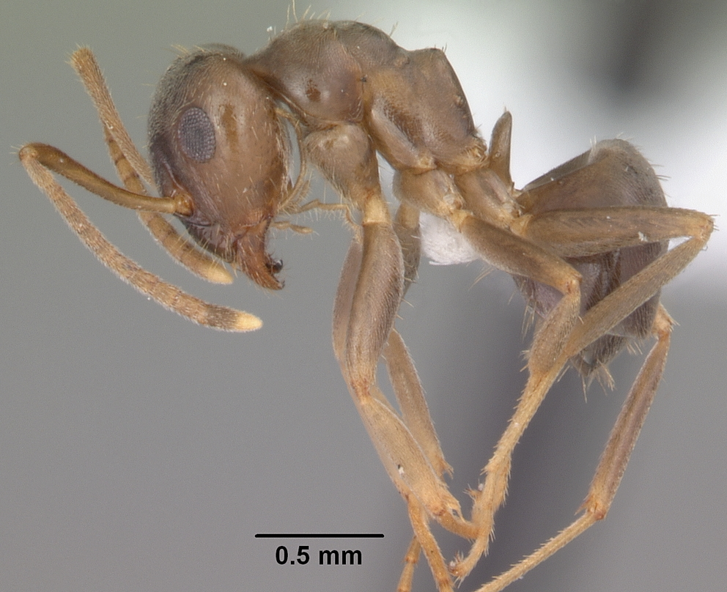
Using DNA Barcoding to Identify the Biodiversity of
the Massapequa Preserve
Chloe Jun, Natalie Byrns, August Eberling
Introduction
The biodiversity of the Massapequa Creek has been a concern for many years due to the increase in pollution threatening the species living there. We collected samples from different locations and studied them with DNA barcoding. This allowed us to identify various species in the preserve from small sections of DNA. Biodiversity is a very important concept when discussing the stability of an environment. It is very important that a ecosystem has a strong biodiversity because it shows what species are endangered and the amount of variety an ecosystem has. Insects, specifically aquatic invertebrates are good to use because not only are there millions of different kinds of them but they are also bioindicators.
Results
Based on the sequences, species CJR-001 and CJR-016 were the same species, Cryptops hortensis isolate. These sequences however, have a big gap in the DNA sequencing which could mean that the DNA sequence have a low quality. However, all the other species were different supporting the idea that the biodiversity in the preserve was strong. CJR-003 species is Proasellus. species CJR-005 is Lasius americanus. CJR-006 species is Armadillidium vulgare. CJR-010 species is Trochosa ruricola. CJR-011 species is Sphegina flavimana voucher. CJR-012 species is Ozophora picturata. CJR-014 species is Reticulitermes flavipes isolate. CJR-017 species is Amara exarata. cytochrome oxidase 1, genbank Lastly, species number CJR-018 was not found in DNA Subway. Boldsystems.org was used to classify the species which matched the species Cylindroiulus truncorum.
Alignment Viewer
Abstract
The importance of researching different specimens is to identify biodiversity. Biodiversity is a crucial part of an ecosystem. If an ecosystem has a high biodiversity it's more stable. Without a wide range of animals, plants and microorganisms, we cannot have the healthy ecosystems that we rely on to provide us with the air we breathe and the food we eat^{₁}. By collecting specimens and identifying their species, the level of biodiversity in the ecosystem can then be determined. When analyzing the data that was collected from DNA barcoding, we assume the biodiversity is going to be similar because many of the specimens were found at the same coordinates. Over 20 samples were collected. Overall, after DNA isolation, DNA amplification, and gel electrophoresis, two of the species were found to be the same. The data collected showed nine out of the eleven species to be different. While this supports the idea that the biodiversity is strong in the Massapequa Preserve, the sample size is way too small to make any further conclusions.
Lasius americanus
Credit : Mississippi state university
Armadillidium vulgare
Trochosa ruricola
Methods
Took samples from the preserve and documented them
Acknowledgements
We would like to thank Jeff Petracca and Cold Spring Harbour Laboratory for their time and resources, we are extremely grateful for this opportunity.
Extracted DNA from specimens using chelax extraction procedure
References
Othman, J., Sahani, M., Mahmud, M. & Sheikh Ahmad, M. K. "Freshwater biodiversity : importance, threats, status and conservation challenges." Wiley Online Library, 15 Mar. 2007, onlinelibrary.wiley.com/doi/abs/10.1017/S1464793105006950. Accessed 8 Nov. 2023.
Discussion
The result of this experiment proved that the biodiversity in the Massapequa Preserve was high. Only two of the eleven species were the same. This data could be seen to supported the hypothesis that the biodiversity in the Massapequa Preserve is very high considering there were 11 different samples taken and only 2 of the species were the same. However 11 samples is not close to the amount of samples that are needed to prove this hypothesis.
Using PCR to replicate and amplify the DNA collected
Use gel electrophoresis to test PCR amplified the correct region
Sequence the DNA obtained, and anaylzed it on DNA Subway

