Slide 1
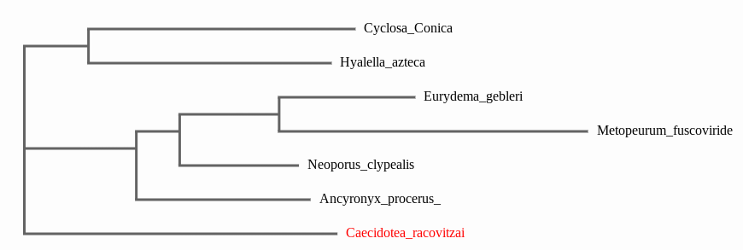
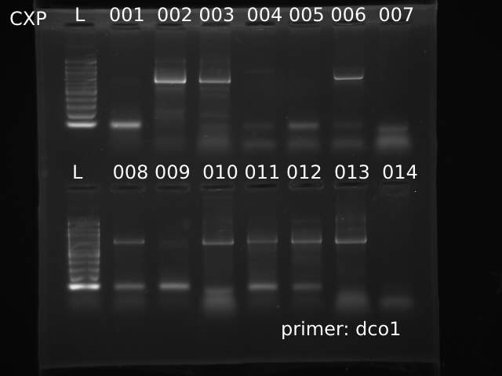
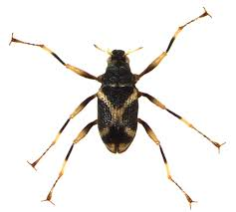
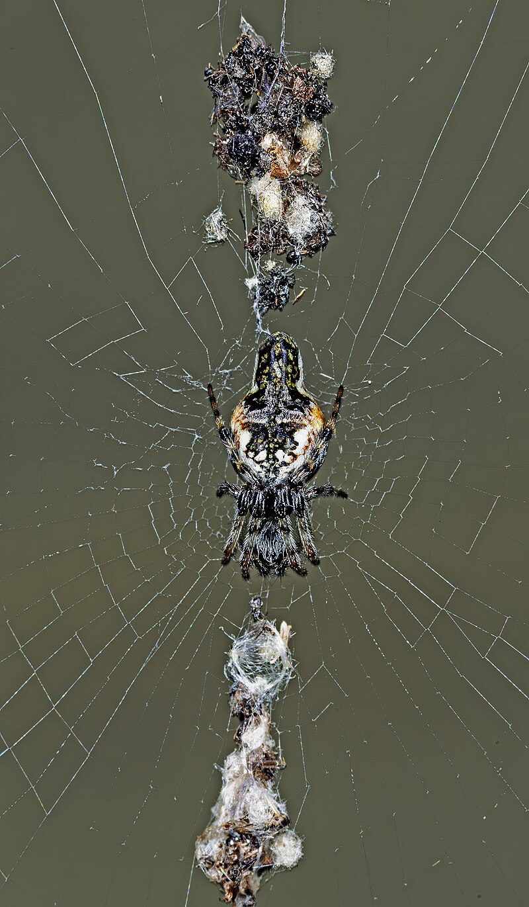
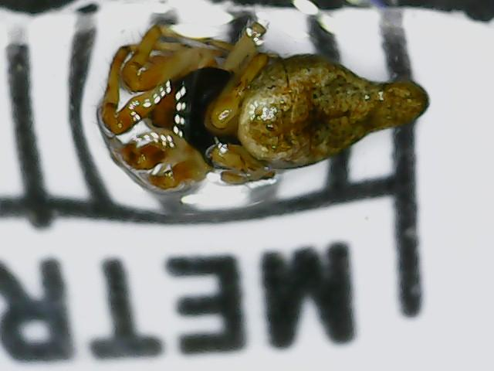
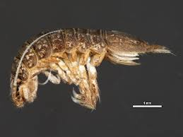
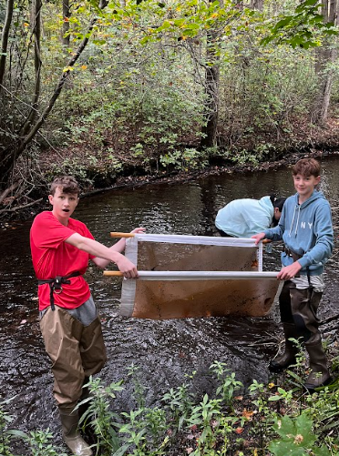
Surveying the Biodiversity of a Freshwater Creek in the Massapequa Preserve
Authors: James Pramataris¹, Dennis Ringel¹, Liam St George¹
Mentors: Jeff Petracca², August Eberling¹ and Sharon Pepenella³
¹Massapequa High School Ames Campus, ²Cold Spring Harbour Laboratory and ³Brookhaven National Laboratory
Abstract
In the environment, biodiversity is very important in the environment. Biodiversity of natural environments can be both positive and negative, with certain physical, mental and social health. Biodiversity is necessary for life in the environment and since the rate of it is declining at a concerning rate, the quality of life of all humans is being threatened. In order to find the biodiversity of the stream, DNA barcoding will be used, which is finding the sizes of DNA in the specimens to find the species of the organisms. The question that is being proposed is how is biodiversity changing on a yearly basis? The objective of this research is to see how the biodiversity changes on a yearly scale and what creatures are abundant in the environment of the massapequa preserve.
Results
The following samples were trimmed and blasted against Genbank. A variety of species were found when looking at the creatures with the least amount of mismatches compared to our creature. The species that were found along with their sample are listed below:
CXP-002-Caecidotea racovitzai
CXP-003-Neoporus clypealis
CXP-006-Hyalella azteca
CXP-008-Ancyronyx procerus
CXP-010-Cyclosa Conica
CXP-011-Metopeurum fuscoviride
CXP-012 No sequence
CXP-013-Eurydema gebleri
Discussion
In conclusion, all of the species collected in the streams of the massapequa preserve were unique. This indicates that there is a high amount of biodiversity in the area, however these results may be inaccurate. This is because some samples collected in the stream weren’t able to be tested, as their DNA sequences were not pure or accurate enough to be able to find the species of the animal collected. Some of these animals collected could have been the same as previous animals, meaning that there would be a lower amount of biodiversity in the massapequa preserve area. One interesting subject collected was CXP-010, or Cyclosa conica, as its behaviour is very interesting. When making a web, Cyclosa conica uses small materials like straw and dead animals as camouflage, to hide from larger predators.
Figure 1: Phylogenetic tree
Introduction
As humans know, there has been a large loss in biodiversity as humans have been doing a lot of deforestation to make room for more cities since urbanization has been greatly increasing. In order to see if biodiversity is changing in certain areas, we collected bug samples in the Massapequa Preserve then did DNA barcoding to see all the different species in the Preserve, to see how the biodiversity has been changing. DNA barcoding is when you look at specific piece of DNA in an organisms which helps to figure out the species of the organism. As the study done by Ben Woodcock, it was proven that as time has been passing on, there has been a loss of biodiversity in areas due to human activities, like pesticide use.
Figure 2: Gel Electrophoresis Results
Figure 3: MUSCLE blast results
/ m
Figure 5 : CXP-008 (Ancyronyx procerus)
Gallery
Figure 7 : Cyclosa conica in a web.
Figure 6 : CXP-010 (Cyclosa conica)
.
Materials/Methods
First, we gathered supplies, including protective waders, kicknets, means of locating latitude and longitude, test tubes filled with ethanol and trowels. Next, we traveled into the Massapequa preserve where samples will be collected. Then, we set up a place to put all your items and samples near water. We then headed to the water with a kicknet and waders. We place a net opposing the current and kick up sediments into the net. Next we took the sediment out of water, and dumped all the sediment on the ground. Then, we sorted through the dirt looking for anything living. Once an organism was located, it was placed inside a test tube with alcohol inside. We continued using kicknets to find samples until satisfactory amounts are found. Then we Gathered our supplies and headed back to the lab. Finally, we analyzed the organisms we collected and took pictures of them. Next, we isolated the DNA. After this we amplified the DNA using PCR. After we used gel electrophoresis to get the final results.
Figure 4
CXP-002: Caecidotea racovitzai
Acknowledgements and references

