Slide 1








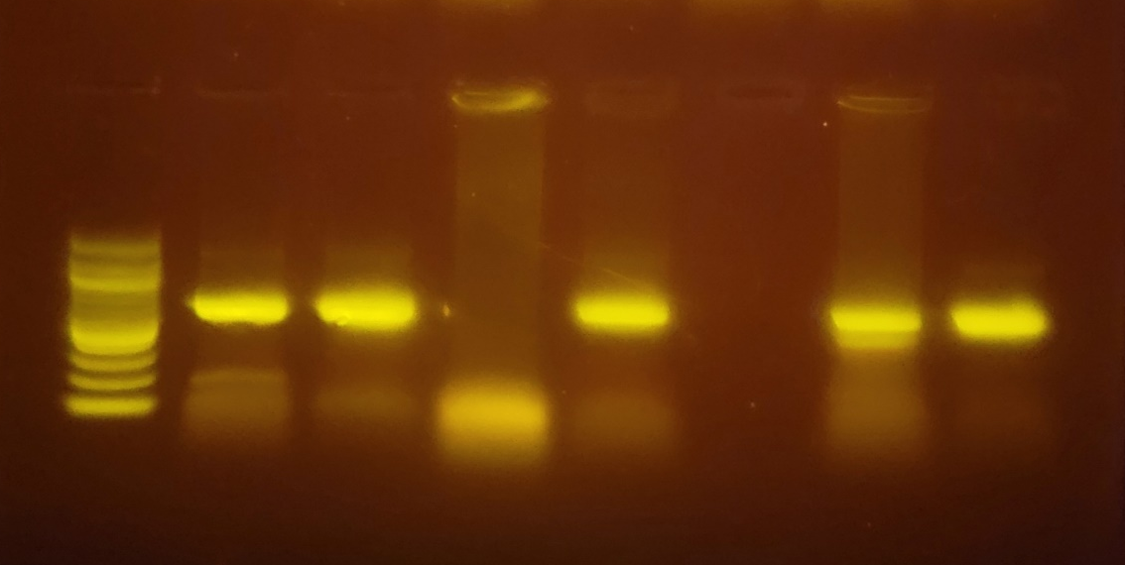
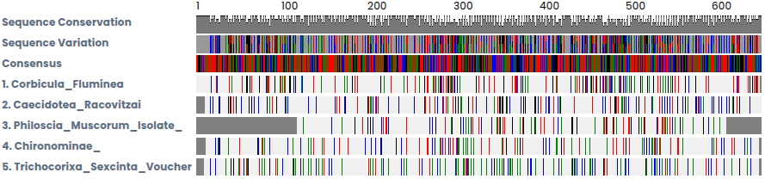
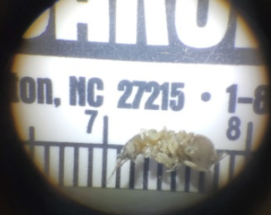
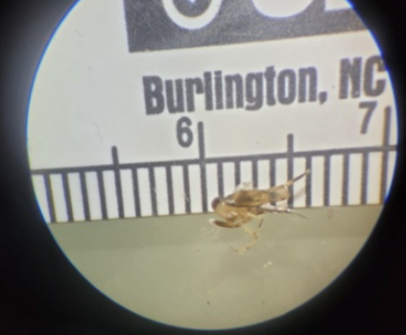
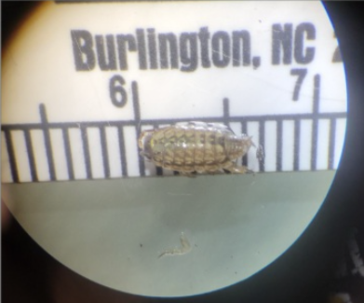
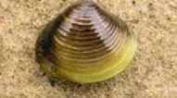
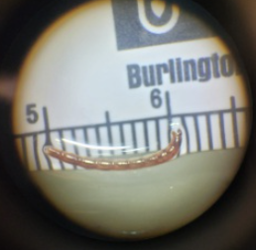
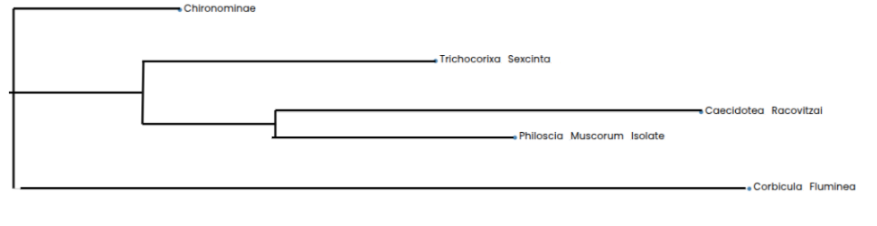
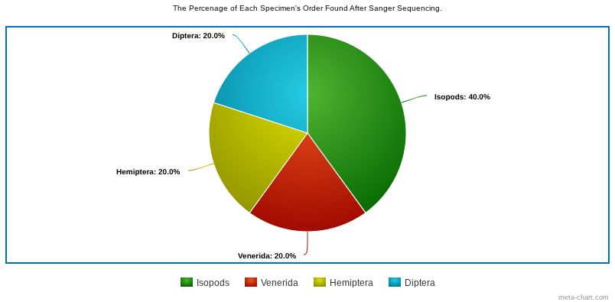
An Investigation of freshwater Aquatic Macroinvertebrates to Learn the biodiversity of Massapequa park through DNA barcoding
Owen Dooher, Cassidy Khrinenko, Brandon Rosso, Emma Klein
Abstract:
References :
Procedure:
The Massapequa park preserve is a public park based in a temperate deciduous forest that aims to protect the wildlife that live in its rivers. Although the Massapequa preserve is aimed at protecting wildlife, the water has been contaminated by human pollution/activities and has threatened the biodiversity of the area. The first step in testing for biodiversity was to take a trip down to the preserve and collect specimens. In the preserve, eight specimens were collected and dropped into an ethanol solution to preserve their bodies and DNA for testing. The specimens were crushed for better access to DNA and a PCR was done in order to make more copies of the CO1 region of DNA for testing. Once the DNA was copied, all the specimen’s DNA were loaded into an electrophoresis chamber where we could see if our PCR was effective. These results were finally sent over to DNA Subway where they were Sanger Sequenced and loaded into the DNA Subway database to get an accurate reading of what organisms were found. The results from the Sanger sequencing showed that specimens DMX-01 was a Caecidotea racovitzai, DMX-02 was a Trichocorixa Sexcinta Voucher, DMX-04 Philoscia Muscorum Isolate, DMX-06 was Corbicula Fluminea, and DMX-07 was Chironomidae. When looking at our final taxonomy of the species we can conclude that there is still a stable amount of biodiversity since none of the specimens resided to the same species classification; none of the specimens were the same species.
MAKE SURE YOU KNOW WHAT WE DID IN CASE SOMEONE ASKS YOU AT SYMPOSIUM!!!!!!
Put yourself out there to bring people to board
THINGS TO ADD:
2014 - 1,358,627 2024 - 1,392,438 (nassau county) (Increase of about 40,000
Sanger Sequencing
Trimming & Blast
L 001 002 003 004 005 006 007
Conclusion:
Collect Specimens
Gel Electrophoresis
Due to the order of all five identified organisms being different besides for two being the same, we can say the hypothesis that stated that there would be less biodiversity due to high amount of pollution, was refuted. As seen on figure 2 below, there was only one repetition of Isopod. There was one Dipteran (DMX - 07), one Hemipteran (DMX - 02) and one Veneroid (DMX - 06). Figure 1 shows similar results, with the two isopods (DMX - 01 and DMX - 04) being the most closely related. It also shows the rest not being closely related. With this data showing the little correlation between the organism, it can be concluded that the biodiversity is relatively high, even though data was limited. As stated before, this causes the hypothesis to be refuted as there is high biodiversity despite the high pollution rates.
Preserve in Ethanol
Separate & Chelex
Centrifuge
PCR (Thermocycler)
CO1 Region
KOD Polymerase Amplification of Gel.
Figure 3: Results from MUSCLE alignment
Blast Results:
DMX-01 Caecidotea Racovitzai
DMX-02 Trichocorixa Sexcinta Voucher DMX-04 Philoscia Muscorum Isolate
DMX-06 Corbicula Fluminea
DMX-07 Chironominae
Introduction:
Chironominae
Long island is getting busier and more urbanized by the day, There was an population increase of about 34,000, an astonishing 2.4% increase in nassau county. “There was a decrease of ecological and phylogenetic richness with the intensity of disturbance” (Cote, 2023). Through the surge in population, biodiversity of aquatic microvertebrates is decreasing from increased pollution of freshwater bodies like rivers and ponds. The biodiversity is thought to be lower and unstable when an ecosystem is exposed to human interaction. To find the biodiversity, the number of species in an area, freshwater aquatic macroinvertebrates will be sampled and identified using blast results from the GenBank database of Macroinvertebrates. Knowing the biodiversity of an area is very important because it will show how stable the ecosystem is. All diversity shows important responses to climate and human disturbances. This experiment tests diversity by looking at the CO1 region of DNA present in all macroinvertebrates. This region of DNA is found in the mitochondria and is responsible for the area of the mitochondria responsible for the electron transport chain. The reason the CO1 region was used was because of its high variability between organisms.
DMX- 01
DMX- 02
DMX- 04
DMX- 06
DMX- 07
Trichocorixa Sexcinta
Results:
Caecidotea Racovitzai
Philoscia Muscorum Isolate
Corbicula Fluminea
After running through the results and analyzing the results from DNA subway, five different species were able to be identified. Due to a mistake labeling, there was no DMX - 05 and DMX - 03 was unable to be identified so the sample is not shown in the results. DMX - 01 was identified as Caecidotea racovitzai, a freshwater isopod typically found where we found it, in North America. DMX - 02 is known as Trichocorixa sexcincta which is part of the water boatman family and is also found in north america. DMX - 04 is known as Philoscia muscorum, originating in europe, it was introduced to new england through transatlantic commerce. DMX - 06 was found to be Corbicula fluminea, a freshwater clam native to Asia and was introduced to North America as a food source. Lastly DMX - 07 is a Chironomidae larvae. Due to most organisms being from different areas and being in different families of insects, it can be concluded that there is biodiversity.
Figure 1: PHYLIP ML of BLI results. Phylogenetic Tree
Figure 2: Pie Chart Showing Percentage of each Order found though the specimens

