Slide 1



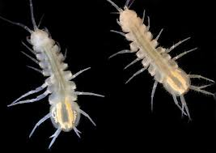
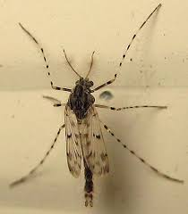
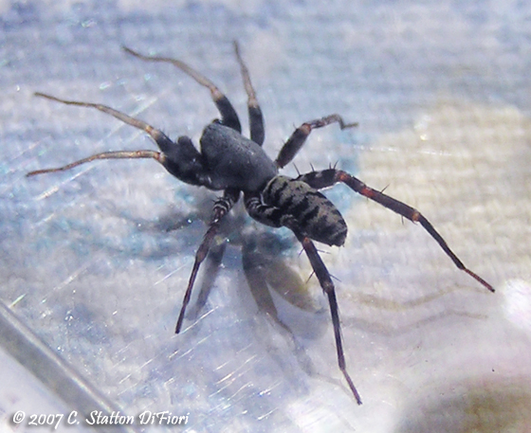
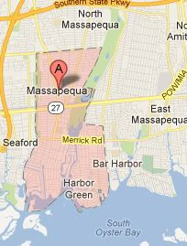
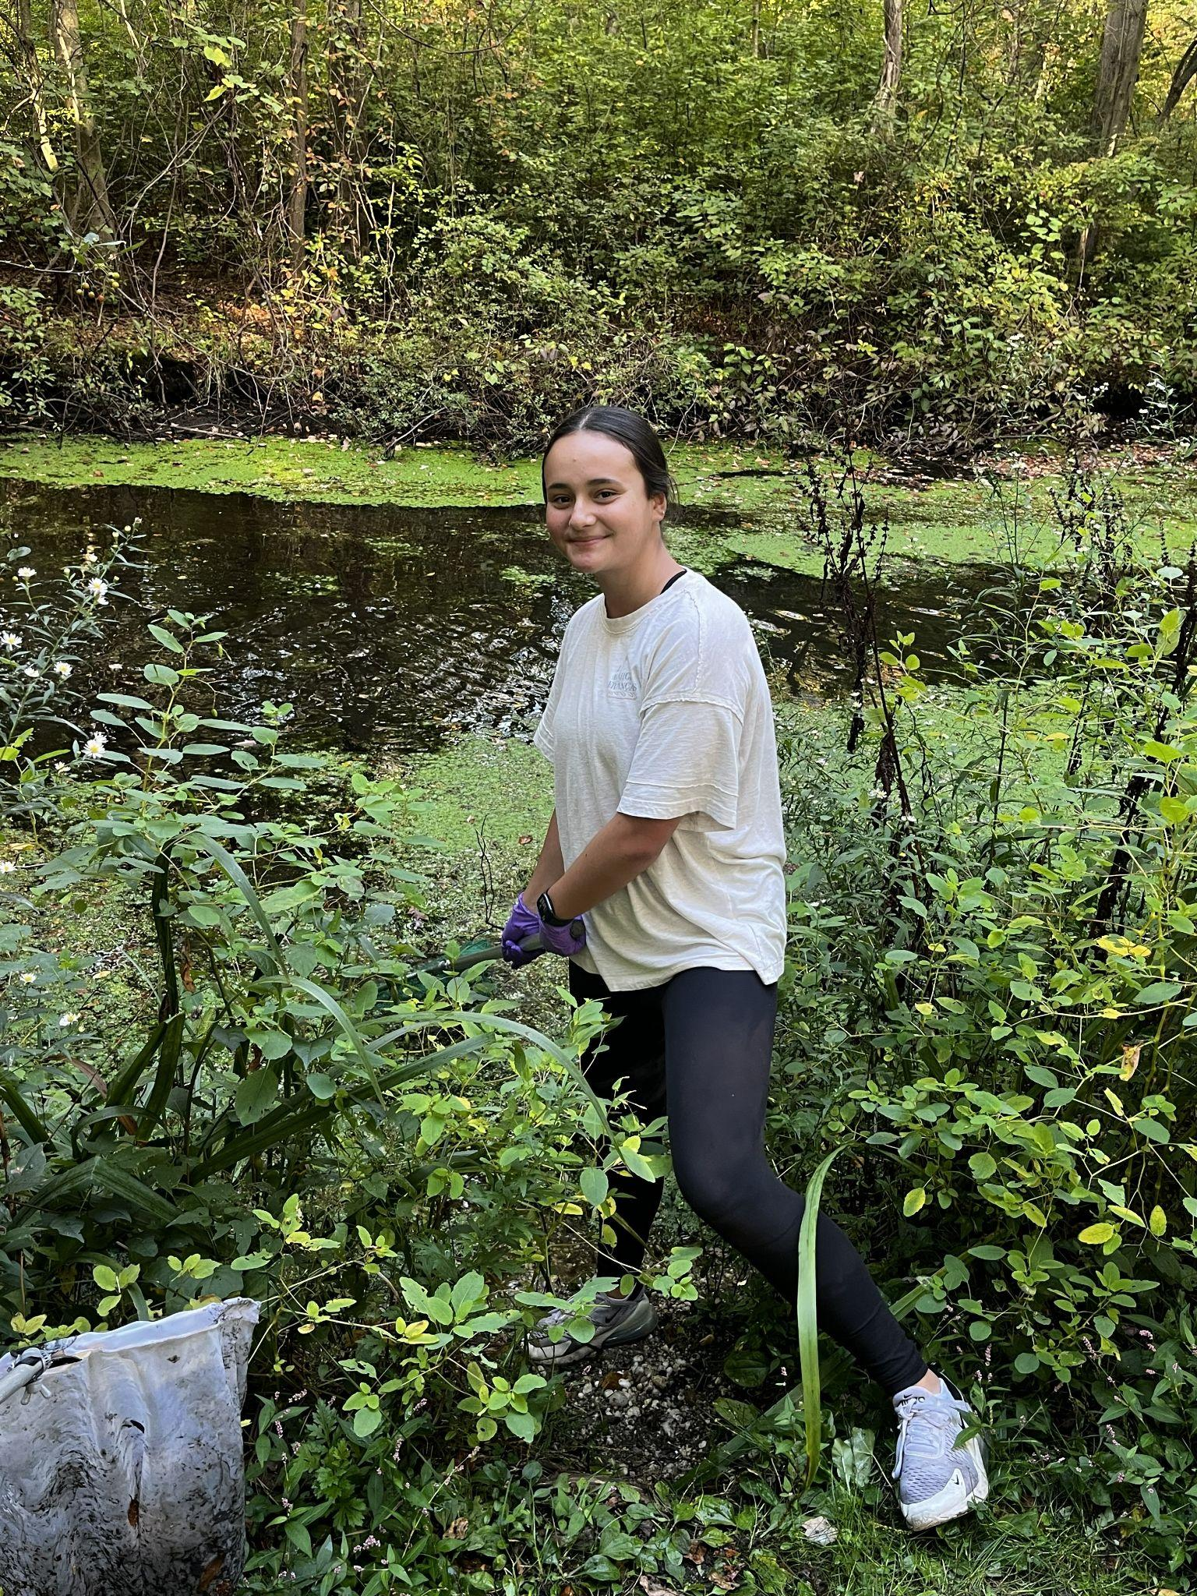
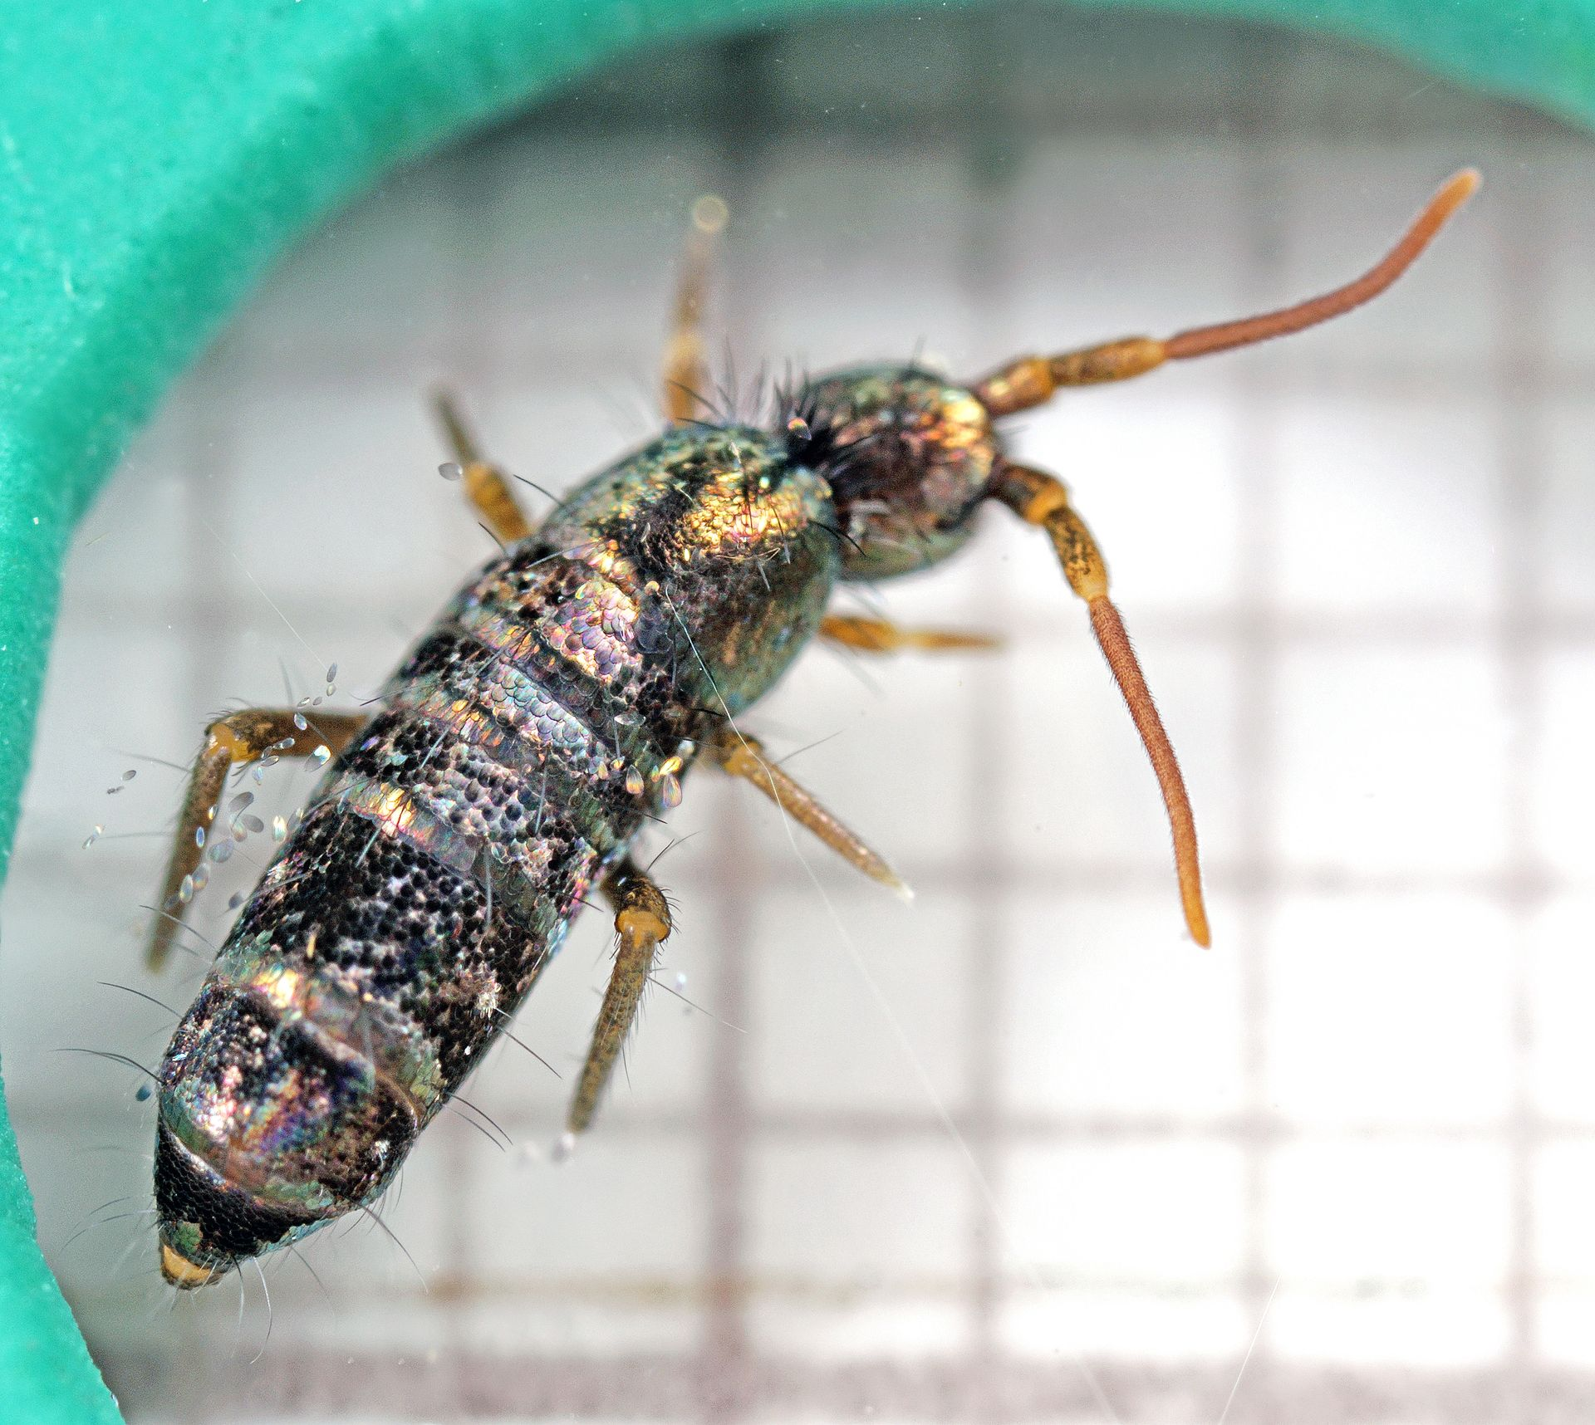
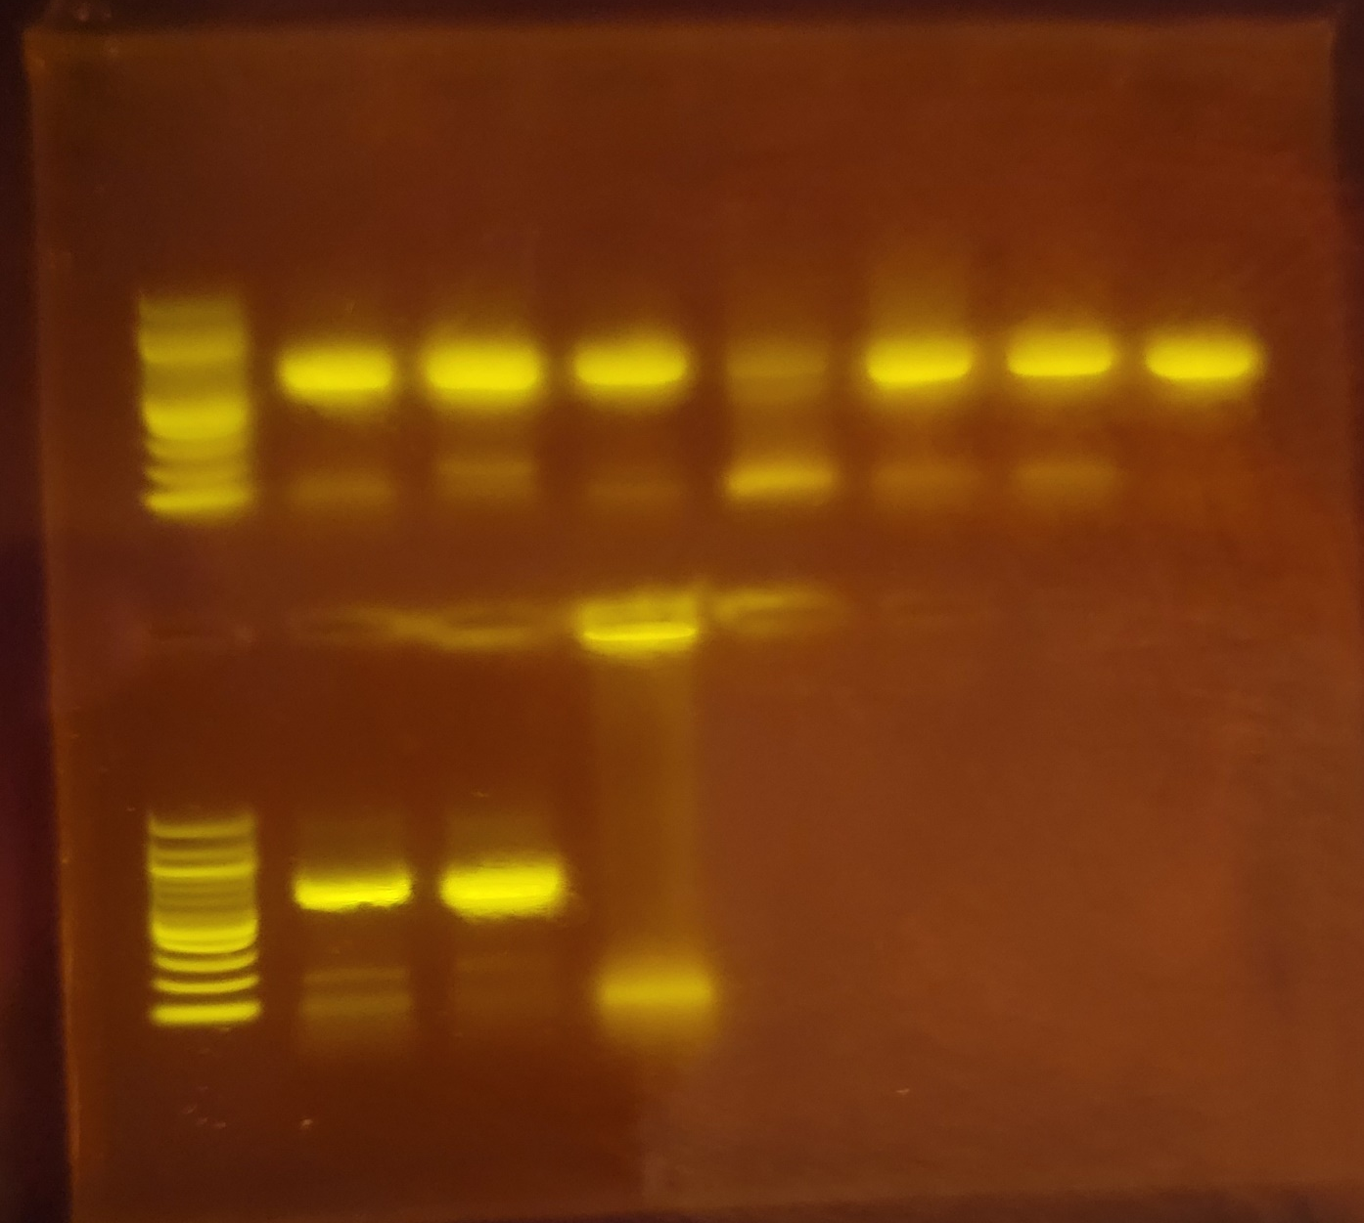
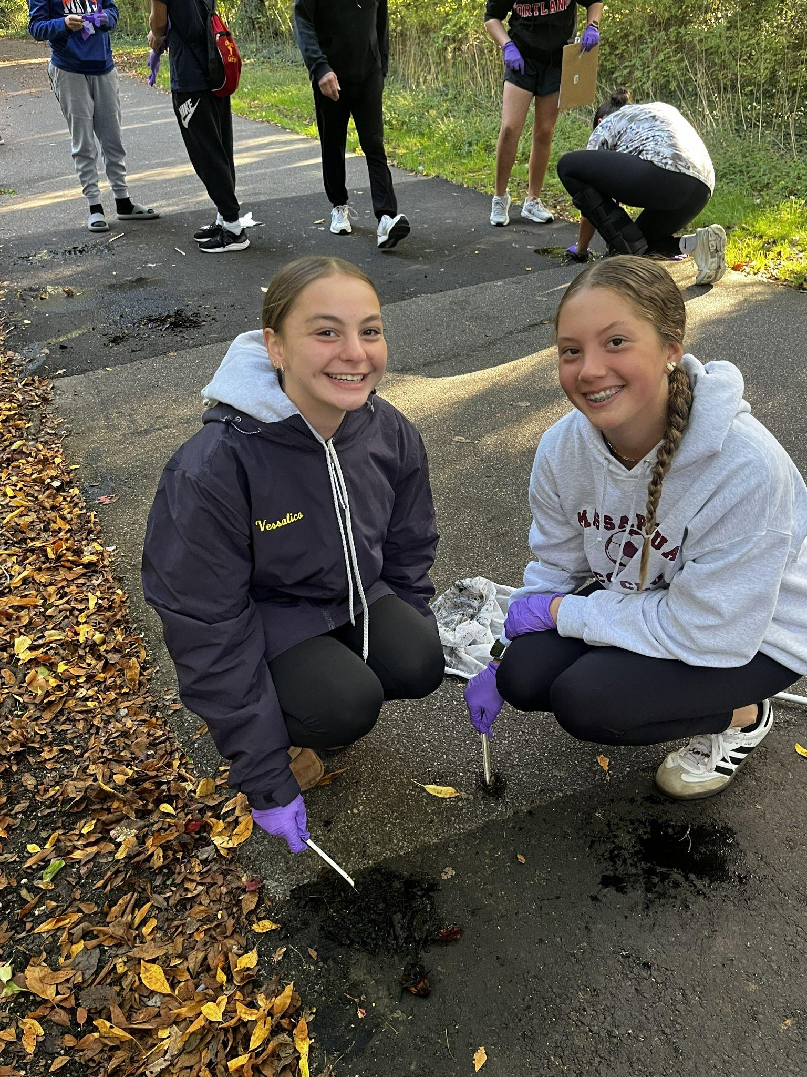
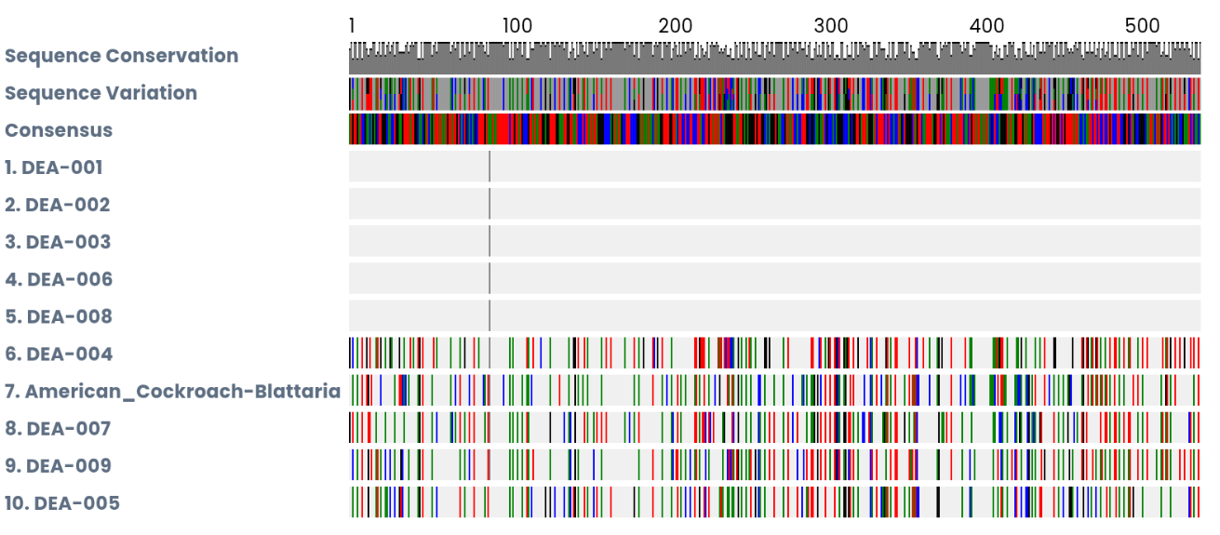
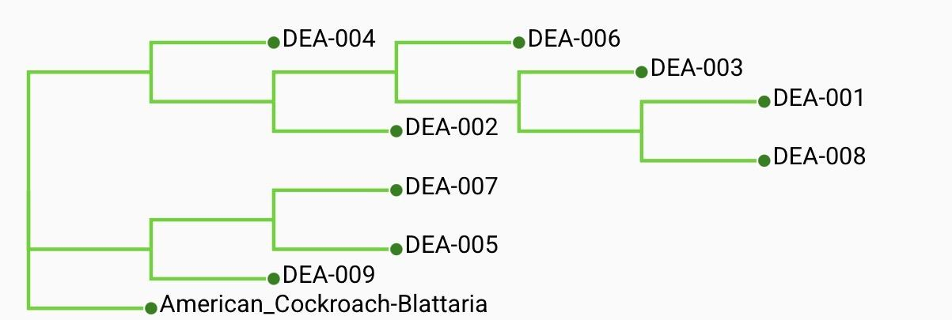

An Investigation in Early Autumn on Macroinvertebrate
Biodiversity in the Massapequa Preserve using DNA Barcoding Technology
Danielle Jacobs, Ashley Justino, Madison Schimkus, Kayla Vessalico
Mentors: Jeffry Petracca and August Eberling
Abstract
This project studies biodiversity in an ecosystem and how human activities can affect it. The Massapequa Preserve, is a temperate deciduous forest, located on Long Island in the suburbs of New York. In the Preserve, there are bodies of freshwater that inhabit different species of macroinvertebrates. The preserve is a public place that is often busy with people, which means there is a high chance the water is polluted with garbage that people leave. This experiment was conducted to figure out if this area was biodiverse, by collecting samples of macroinvertebrates from the sediments in the water. If there is biodiversity in this area, then we know that it is well sustained. Each organism has a different DNA barcode, a region of DNA used to identify species, and it was deciphered at Cold Spring Harbor Laboratory using Sanger sequencing. In the preserve, there is clearly less biodiversity because 50% of of specimens were from the same species.
Results:
The results showed most of the specimens that were found were closely related and some were of the same species. Numbers DEA-001, DEA-002, DEA-003, DEA-006 and DEA-008 were all from the same species but the rest of the samples were all different. Caecidotea burkensis was the name for all of these insects. All of these animals were very similar to each as shown by the phylogenetic tree built using the PHYLIP tool of DNA Subway and a reference American_Cockroach-Blattaria as a outgroup.
Discussion:
In this experiment, the results did not show much biodiversity. Five out of the ten species came from the same genus, some even being the same exact species. The area the species were taken from is also inhabited by humans a lot of the time as it is a public place. This could be the reason as to why our experiment had such a low amount of biodiversity. Humans created bike trails and added pollution which limits the organism's ability to expand and reproduce. The confinement caused by humans can induce inbreeding and a lack of biodiversity. A limitation of this experiment is that there were only nine specimens collected. All of these samples were collected in the relatively same area so many of the same species of samples were collected. This lack of diversity could have been avoided if many more samples could have been collected. Another factor that had a negative effect on the experiment was the location of the body of water was surrounded by human interactions and flooded with human movement. This means that the water has the possibility to be contaminated and driving away some of the native species. This would leave the species that is the fittests for the environment and natural selection would occur and this specific species would dominate the ecosystem.
Ablabesmyia americana DEA-009
Map of Massapequa, the general location of where the sample were collected
Castianeira variata DEA-004
Caecidotea burkensis (most common species. DEA# 1, 2, 3, 6, 8)
DNA electrophoresis
Tomocerus lamelliger DEA-007
Introduction:
The rapid increase in activities that humans conduct can affect the indefinitely changing range of biodiversity (Dopheide,A,2019). Human activity has been ever changing and it is important to note that humans have some of the greatest effects on their environment (Dopheide,A,2019). Urbanization is growing throughout the world and that can affect the increasing amount of biodiversity in the area. One can observe this because when humans do their activities this can lead them to the addition of invasive species. These invasive species significantly amplify the diversity of the different organisms that inhabit those biological areas. Biodiversity can be found through sampling macroinvertebrates from the environment. With the technique of DNA barcoding, the diverse populations of that ecosystem is able to be shown through examining and classifying the specimens. The technique of DNA barcoding will be used to determine the species of the samples found.
001 002 003 004 005 006 007
008 009 010
Ladder Ladder
Muscle alignment of species
Acknowledgments and References:
Thank you August
Eberling and Jeffry
Petracca for guiding
us through this project.
Scan QR code for link
to the References:
Phylogenetic Tree (ML)

