Slide 1


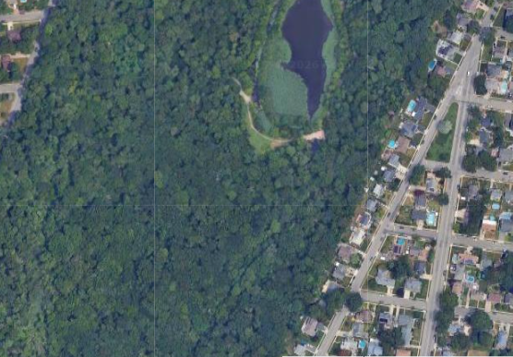
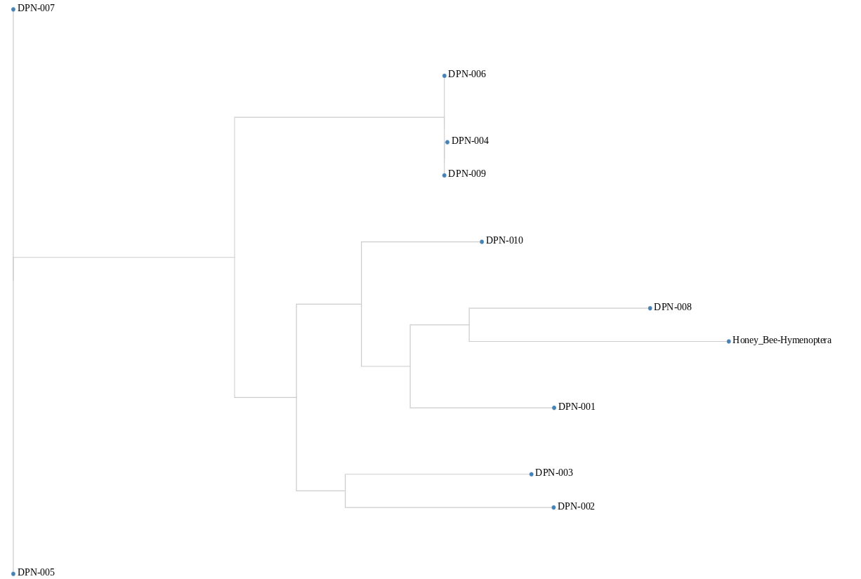
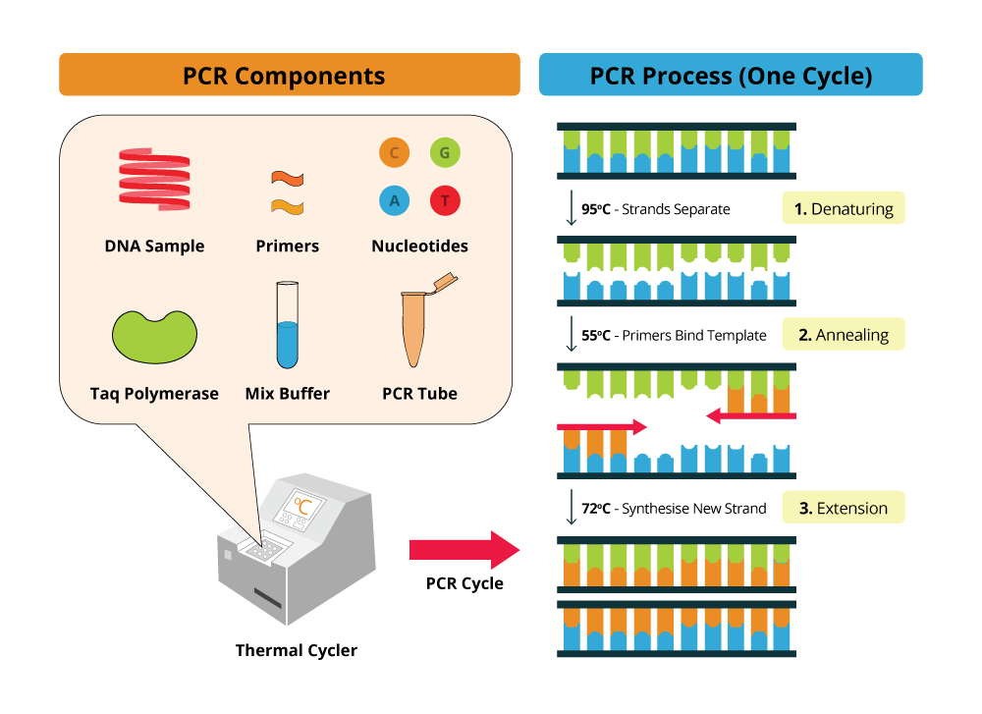
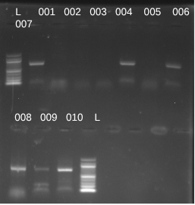
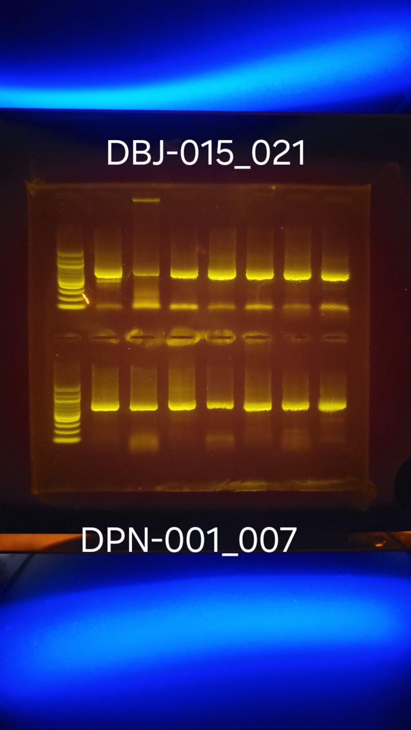
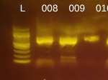
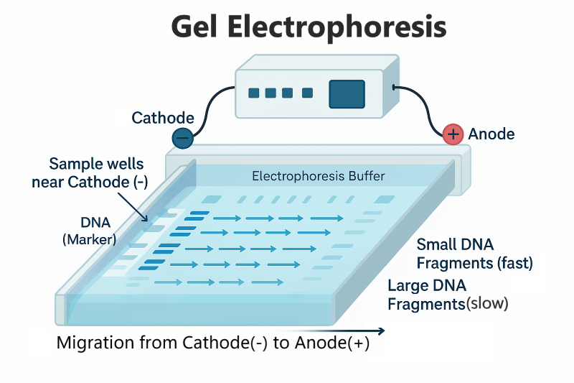
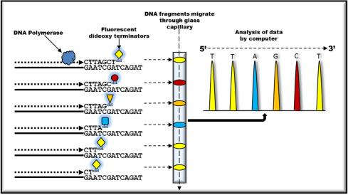
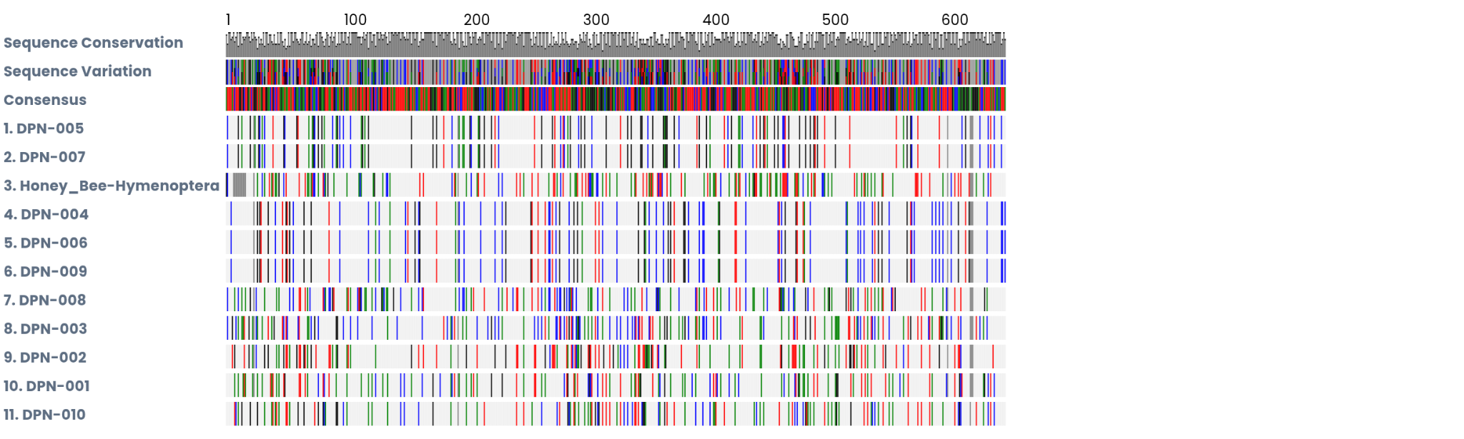

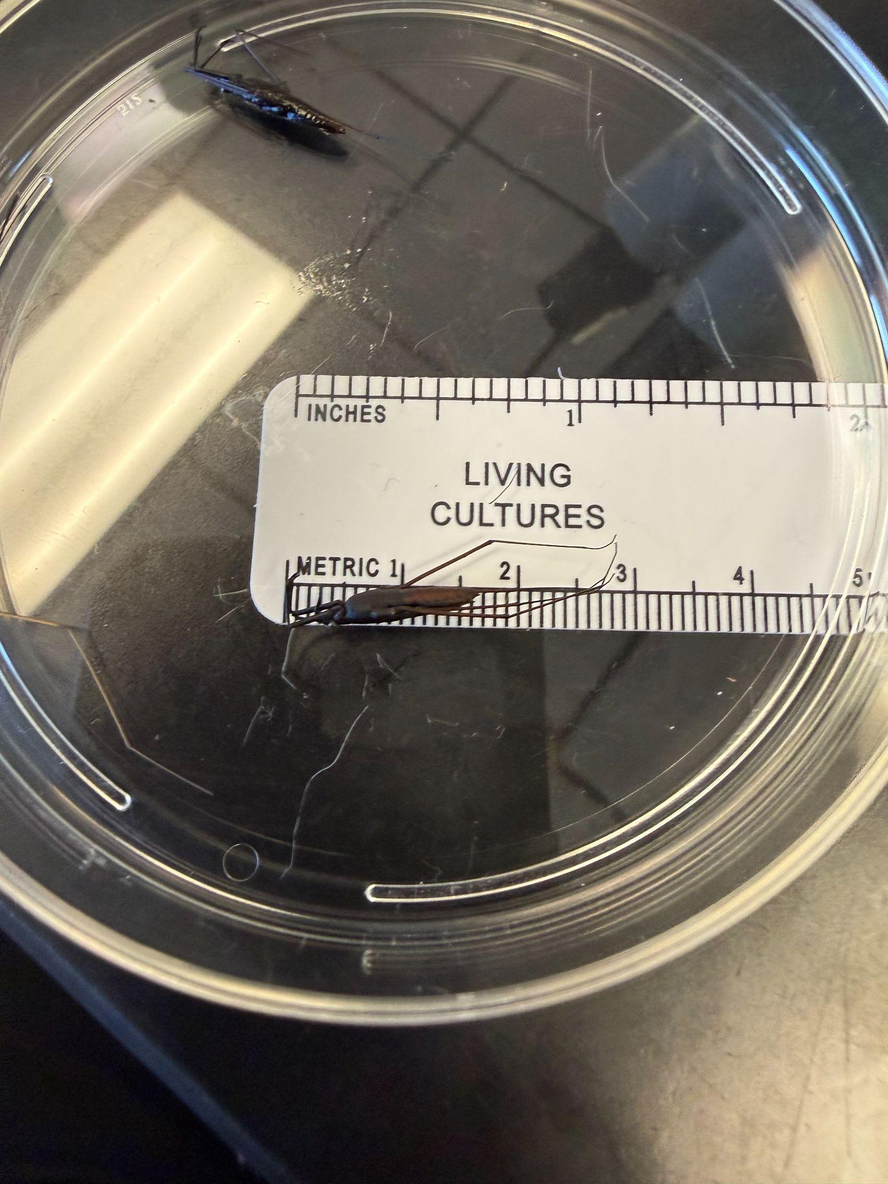
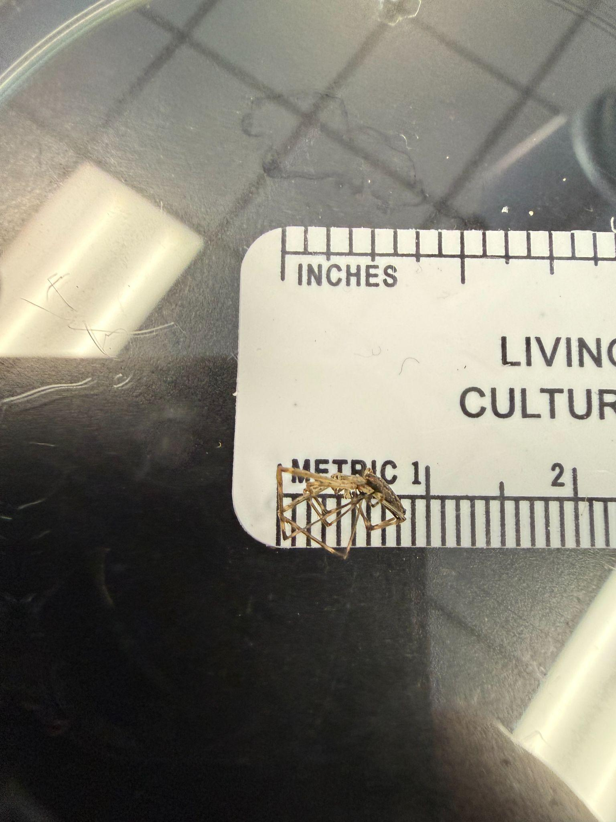
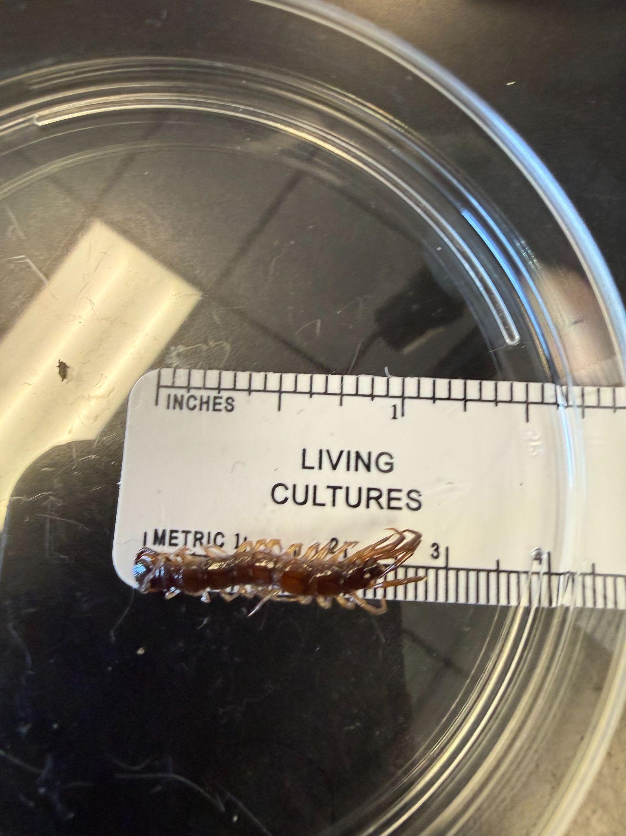
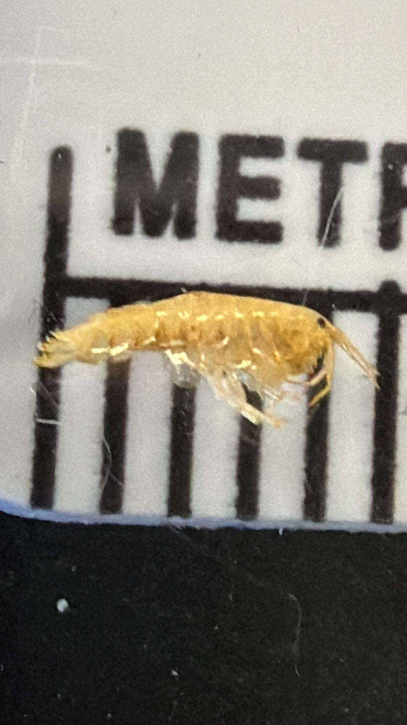
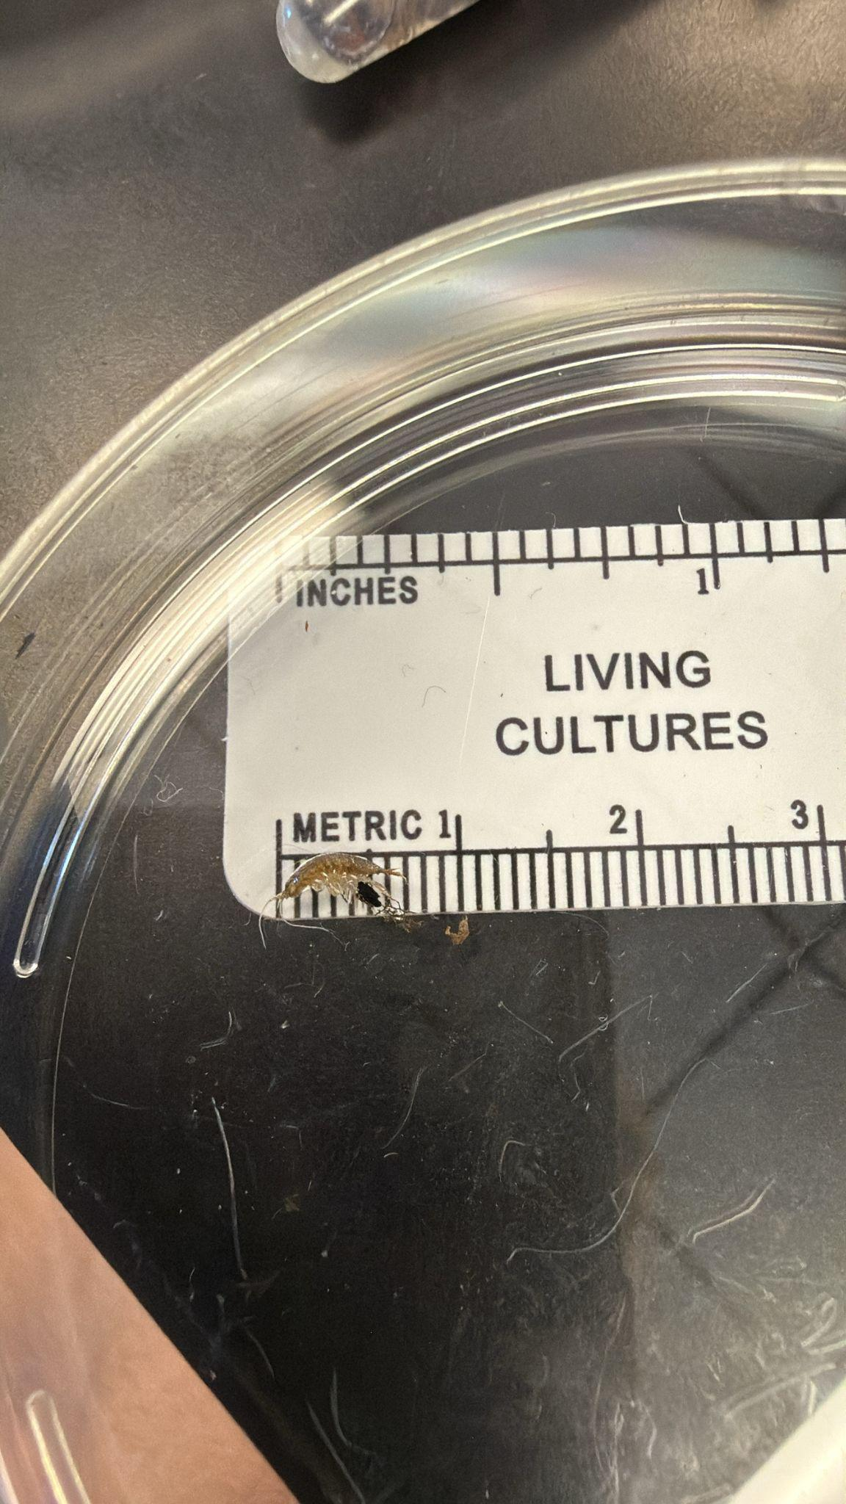
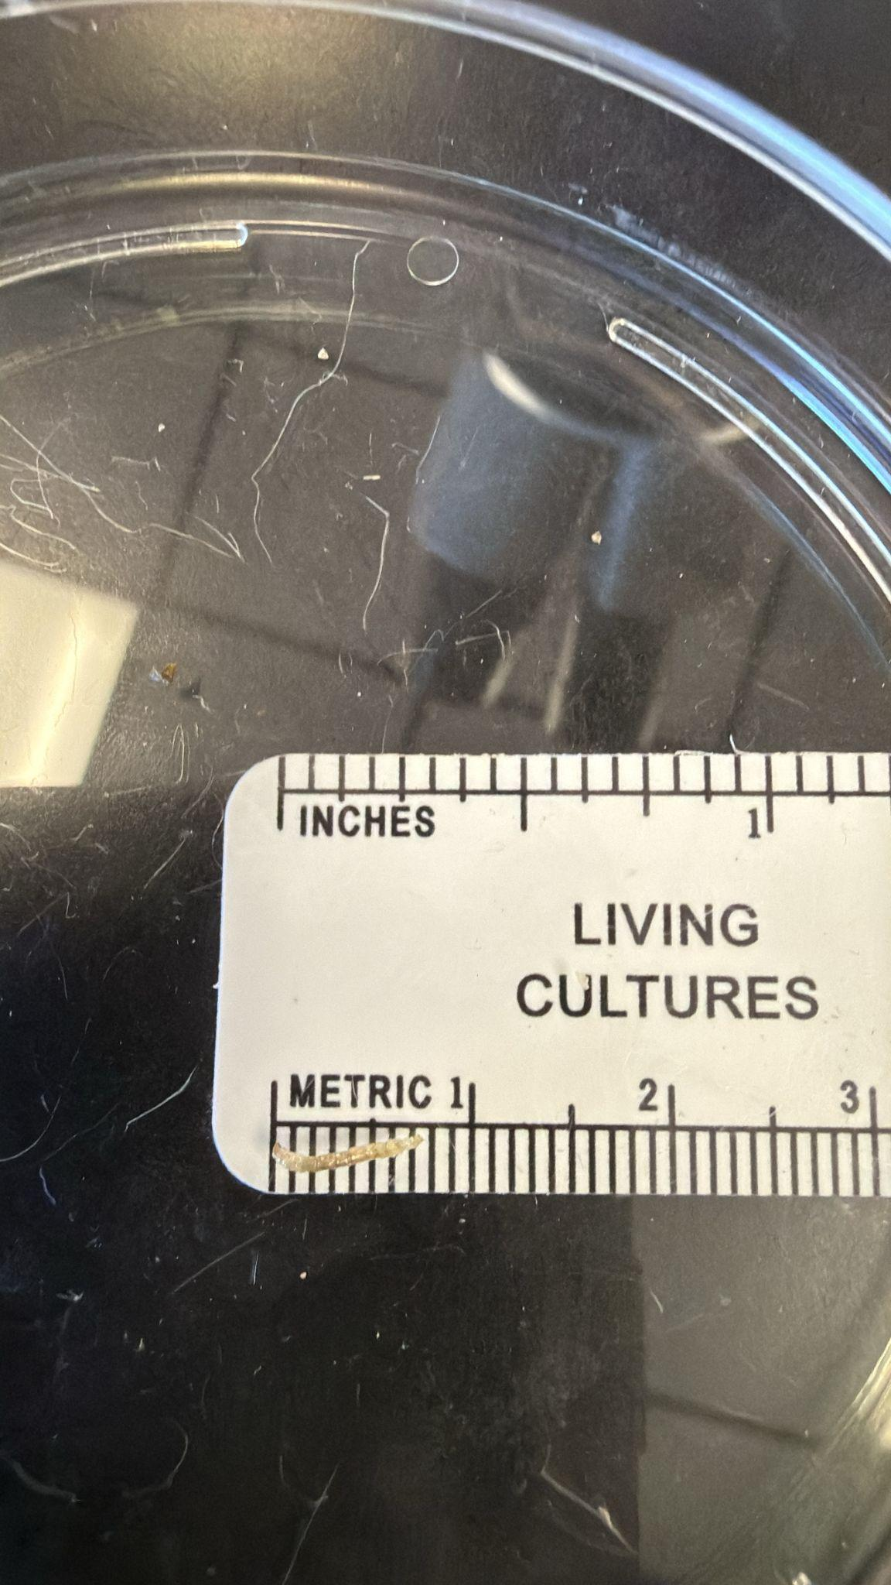
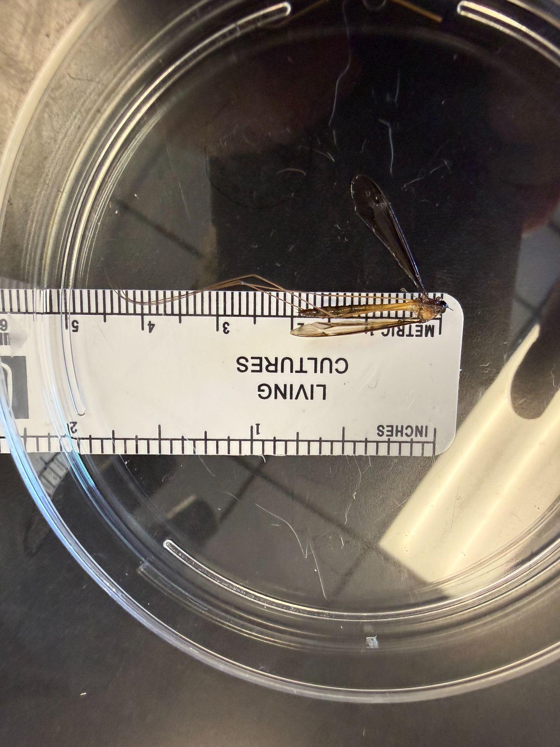


Assessment of DNA Diversity Among Multiple Aquatic Macroinvertebrates Found in the Massapequa Preserve
By Jake Danese, Michael Ehrhardt, Sophia Gentile, Gregory Murano
Abstract
Biodiversity plays a very important role in maintaining the stability, health, and productivity of Earth's ecosystems. Biodiversity is one of the main reasons why ecosystems can be resilient enough to survive extreme events like natural disasters or disease which may lower the population of species. Assessing genetic biodiversity across numerous species from the same habitat provides motivation to carry out this project. Analysis of DNA from a diverse group of aquatic macroinvertebrates from the Massapequa Preserve is valuable in order to achieve this goal. The project entails collecting samples of organisms collected from under rocks,on branches, in the water, and on aquatic plants. DNA from the organisms was extracted by crushing the organisms and chelex was used to remove contaminants. Centrifugation separated the DNA from the chelex. Then, the DNA was mixed with polymerase and primers in a PCR tube. These small tubes were placed in a thermal cycler to create billions of copies of DNA through PCR. The PCR products from all specimens was put through gel electrophoresis to confirm that the PCR worked before being analyzed through Sanger sequencing. Sanger sequencing determined the nucleotide sequence of cytochrome oxidase I (COI), which allowed for identification of species. This was then uploaded to identification databases, which will facilitate identification of organisms for future scientists.
Results
Conclusion
Concluding from this study, the Massapequa Preserve has a moderate amount of biodiversity. This is supported by DNA analysis which identified seven different species of the ten collected. However, there were some limitations during this experiment, such as the number of specimens that were collected, and where they were collected. Additionally, the search area for these organisms was small, some species may have been isolated in one part of the preserve while others species occupied other parts of the preserve, which may affect biodiversity. Furthermore, another constraint during the experiment was that the time to collect the macroinvertebrates was very limited. If this study were to be expanded upon, more specimens could be collected during different times of day, and a wider search area could be observed. This would increase the range and accuracy of this study. Errors that could have occurred during this study include not getting all the DNA inside the gel well during the group DPN gel electrophoresis, which could have caused the DNA to appear as if it wasn't replicated properly, contamination, and misidentifying species. Contamination could have occurred during the phase in which PCR and primer was added to the DNA, as a drop from a different species test tube could have splashed in. Misidentification of a species could have occurred when they were checked through DNA Subway's database, as there may have been a species that was not on there that was collected. The species found include Aquarius remigis (DPN 001), Tetragnatha elongata (DPN 002), Lithobius forficatus (DPN 003), three Caecidotea racovitzai (DPN 004, 006, 009) , two Hyalella azteca (DPN 005, 007), Helobdella modesta (DPN 008), and Tipula tricolor (DPN 010). The organism Hyalella azteca (DPN 005, 007) has a lot of differences in their DNA sequencing from Helobdella modesta (DPN 008), thus showing that there is a moderate amount of biodiversity in the Massapequa Preserve. Due to the variety of macroinvertebrates found despite the limited sample size, it can be concluded that the Massapequa Preserve has a moderate amount of biodiversity. Measuring biodiversity and cataloging organisms is important as it shows which ecosystems need help, and cataloging the organisms in a database can help other scientists identify species or identify new ones. Finding multiple of the same species isn't necessarily bad, as having a high population size can help the species contribute to their ecological niche if a disturbance or event, such as disease or natural disaster, wipes some of the population out.
Materials & Methods
Massapequa Preserve
L 001 002 003 004 005 006 007
Introduction
Aquatic macroinvertebrates are insects that spend part of their lives in water and play a critical role in freshwater ecosystems by recycling nutrients and being a food source for higher trophic levels. Diversity among species in the same ecosystem is critically important to the habitat health and support of the overall food web. So, within this study of aquatic macroinvertebrates, it was hypothesized that the Massapequa preserve has a high amount of biodiversity due to the mass variety of visible organisms. Therefore, study of the biodiversity of the organisms within a particular area is helpful when assessing environmental factors such as pollution, the overall health of that environment (van der Lee, 2024), and whether similarity among the species are present. Further, identification of species in an ecosystem that provide similar roles is meaningful because redundancy provides stability to the ecosystem (Ollard, Showdury, Aldridge 2023).
Collecting insects for DNA barcoding is a multi-step process that starts with collecting specimens, often using traps, which are then preserved in ethanol for later analysis. DNA barcoding helps researchers check the abundance or absence of a species in an environment as shown in the article (van der Plas, 2025). By using specific genes to aid in species identification, the efficiency of assessing the biodiversity of an ecosystem is increased. In this process, scientists use a specific gene, such as the cytochrome c oxidase I (COI) gene, as a "barcode" to identify species by matching its DNA sequence to a reference library, which can differentiate species more accurately than traditional morphology, identify immature stages, and discover new species. This process is crucial for cataloging biodiversity, tracking pests, and monitoring ecosystems, as many of the world's insect species remain unknown.
Acknowledgements
We would like to thank August Eberling, our teacher, and Jeffrey Petracca, an entomologist. They both helped us throughout this project.
References
DPN - 001
Aquarius remigis
DPN - 002
Tetragnatha elongata
DPN - 003
Lithobius forficatus
DPN - 004, 006, 009
Caecidotea racovitzai
DPN - 005, 007
Hyalella azteca
DPN - 008
Helobdella modesta
DPN - 010
Tipula tricolor

Slide 2
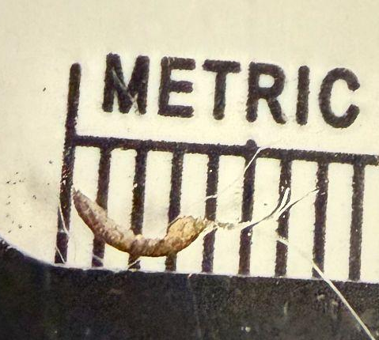
Bug pics (to resize and fit later after writing is done, not all have to be used)

Slide 3
Link to paper (i also shared it with you)
https://docs.google.com/document/d/1JaMm5PuNqBGKs4Y5qS_Se-urcM_cLvTfdkVIMX3F-k4/edit?usp=sharing
We used DNA Subway 2.0 to determine this. To figure out the species that was collected, the CO1 region, through Polymerase Chain Reaction (PCR), in the mitochondria was amplified. This means it is producing copies of the DNA that was collected. Gel electrophoresis was used to check to see if the PCR worked. Sanger Sequencing then reads the specific amplified DNA to determine its exact genetic code. When the code was finalized, it was put into a database, called GenBank, which was used to look up the organisms and give results of the closest species in DNA.-

Slide 4
Materials and Methods
One day in early Fall, science research students from Massapequa High School Ames campus walked to the waterways of the Massapequa preserve to collect an array of aquatic invertebrates for DNA barcoding. The science research students used waders, nets, test tubes filled with an alcohol solution (95% alcohol), and gloves. Once at the preserve, the students entered the water wearing waders to catch aquatic invertebrates using various methods such as shaking branches in the water, scooping mud, running 2mm holded nets through the water, and looking under rocks. To collect specimens off branches, students placed the net closely under the branch and shook it in order to catch specimens falling off the branch. To collect specimens in the water, nets were placed in the middle of the water while touching the mud bottom of the waterway. Sediment was kicked up into the net using the help of the waterway’s current. The latitude of where testing occurs ranges from 40.685 degrees north to 40.690 degrees north. The longitude ranges from -73.4 degrees west to -73.5 degrees west. Photos were taken of the specimens and the information documented on the paper provided. Students record the taxonomic information from Google Lens or I-Naturalist about the organism, including the latitude and longitude.
After the specimens were collected, they were put into the test tubes filled with alcohol. These specimens were then crushed into tiny pieces before being put in test tubes with chelex reagent to remove anything unwanted, then were centrifuged to put the chelex at the bottom. Then, the top layer of liquid that contained the DNA was taken out and put into the polymerase and primer containing solution. The test tubes containing the solution were then put into a thermocycler. An agarose gel is made with a comb to create wells inside the gel. The agarose gel was then placed into a gel chamber and TBE solution was poured into the gel chamber on the sides. The DNA inside the test tubes were then pipetted out into the gel wells. The gel chamber is then hooked up to a power supply that discharges 100 volts. The gel chamber is then left for 30 minutes before turning the power supply off and analyzing the results of the gel electrophoresis. If the gel electrophoresis shows that the DNA was amplified, the DNA is shipped off to Azenta Life Sciences to have Sanger Sequencing performed on it. Afterwards, the results, which are specifically the nucleotide sequences for the DNA segment Cytochrome Oxidase I (COI), are used to figure out what each organism is using DNA Subway's identification database. After identification, they are posted onto DNA Subway for more data on the organisms found.. These sequences are then used to create a MUSCLE chart on DNA Subway for analysis of genetic similarities between the organisms collected.
https://www.bosterbio.com/protocol-and-troubleshooting/pcr-principle?srsltid=AfmBOoo_bW94lhE8xnP6CJ6u-elBjauRt0-XsRF4I6O0Z0IJ-kYmB6kZ
Refrence of PIC of PCR

Slide 5
One day in early Fall, science research students from Massapequa High School Ames campus walked to the waterways of the Massapequa preserve to collect an array of aquatic invertebrates for DNA barcoding. The science research students used waders, nets, test tubes filled with an alcohol solution (95% alcohol), and gloves. Once at the preserve, the students entered the water wearing waders to catch aquatic invertebrates using various methods such as shaking branches in the water, scooping mud, running 2mm holded nets through the water, and looking under rocks. To collect specimens off branches, students placed the net closely under the branch and shook it in order to catch specimens falling off the branch. To collect specimens in the water, nets were placed in the middle of the water while touching the mud bottom of the waterway. Sediment was kicked up into the net using the help of the waterway’s current. The latitude of where testing occurs ranges from 40.685 degrees north to 40.690 degrees north. The longitude ranges from -73.4 degrees west to -73.5 degrees west. Photos were taken of the specimens and the information documented on the paper provided. Students record the taxonomic information from Google Lens or I-Naturalist about the organism, including the latitude and longitude.
After the specimens were collected, they were put into the test tubes filled with alcohol. These specimens were then crushed into tiny pieces before being put in test tubes with chelex reagent to remove anything unwanted, then were centrifuged to put the chelex at the bottom. Then, the top layer of liquid that contained the DNA was taken out and put into the polymerase and primer containing solution. The test tubes containing the solution were then put into a thermocycler. An agarose gel is made with a comb to create wells inside the gel.CLE chart on DNA Subway for analysis of genetic similarities between the organisms collected.
The agarose gel was then placed into a gel chamber and TBE solution was poured into the gel chamber on the sides. The DNA inside the test tubes were then pipetted out into the gel wells. The gel chamber is then hooked up to a power supply that discharges 100 volts. The gel chamber is then left for 30 minutes before turning the power supply off and analyzing the results of the gel electrophoresis. If the gel electrophoresis shows that the DNA was amplified, the DNA is shipped off to Azenta Life Sciences to have Sanger Sequencing performed on it. Afterwards, the results, which are specifically the nucleotide sequences for the DNA segment Cytochrome Oxidase I (COI), are used to figure out what each organism is using DNA Subway's identification database. After identification, they are posted onto DNA Subway for more data on the organisms found.. These sequences are then used to create a MUS
Materials and Methods
One day in early Fall, science research students from Massapequa High School Ames campus walked to the waterways of the Massapequa preserve to collect an array of aquatic invertebrates for DNA barcoding. The science research students used waders, nets, test tubes filled with an alcohol solution (95% alcohol), and gloves. Once at the preserve, the students entered the water wearing waders to catch aquatic invertebrates using various methods such as shaking branches in the water, scooping mud, running 2mm holded nets through the water, and looking under rocks. To collect specimens off branches, students placed the net closely under the branch and shook it in order to catch specimens falling off the branch. To collect specimens in the water, nets were placed in the middle of the water while touching the mud bottom of the waterway. Sediment was kicked up into the net using the help of the waterway’s current. The latitude of where testing occurs ranges from 40.685 degrees north to 40.690 degrees north. The longitude ranges from -73.4 degrees west to -73.5 degrees west. Photos were taken of the specimens and the information documented on the paper provided. Students record the taxonomic information from Google Lens or I-Naturalist about the organism, including the latitude and longitude.
After the specimens were collected, they were put into the test tubes filled with alcohol. These specimens were then crushed into tiny pieces before being put in test tubes with chelex reagent to remove anything unwanted, then were centrifuged to put the chelex at the bottom. Then, the top layer of liquid that contained the DNA was taken out and put into the polymerase and primer containing solution. The test tubes containing the solution were then put into a thermocycler. An agarose gel is made with a comb to create wells inside the gel. The agarose gel was then placed into a gel chamber and TBE solution was poured into the gel chamber on the sides. The DNA inside the test tubes were then pipetted out into the gel wells. The gel chamber is then hooked up to a power supply that discharges 100 volts. The gel chamber is then left for 30 minutes before turning the power supply off and analyzing the results of the gel electrophoresis. If the gel electrophoresis shows that the DNA was amplified, the DNA is shipped off to Azenta Life Sciences to have Sanger Sequencing performed on it. Afterwards, the results, which are specifically the nucleotide sequences for the DNA segment Cytochrome Oxidase I (COI), are used to figure out what each organism is using DNA Subway's identification database. After identification, they are posted onto DNA Subway for more data on the organisms found.. These sequences are then used to create a MUSCLE chart on DNA Subway for analysis of genetic similarities between the organisms collected.
Materials and Methods
One day in early Fall, science research students from Massapequa High School Ames campus walked to the waterways of the Massapequa preserve to collect an array of aquatic invertebrates for DNA barcoding. The science research students used waders, nets, test tubes filled with an alcohol solution (95% alcohol), and gloves. Once at the preserve, the students entered the water wearing waders to catch aquatic invertebrates using various methods such as shaking branches in the water, scooping mud, running 2mm holded nets through the water, and looking under rocks. To collect specimens off branches, students placed the net closely under the branch and shook it in order to catch specimens falling off the branch. To collect specimens in the water, nets were placed in the middle of the water while touching the mud bottom of the waterway. Sediment was kicked up into the net using the help of the waterway’s current. The latitude of where testing occurs ranges from 40.685 degrees north to 40.690 degrees north. The longitude ranges from -73.4 degrees west to -73.5 degrees west. Photos were taken of the specimens and the information documented on the paper provided. Students record the taxonomic information from Google Lens or I-Naturalist about the organism, including the latitude and longitude.
After the specimens were collected, they were put into the test tubes filled with alcohol. These specimens were then crushed into tiny pieces before being put in test tubes with chelex reagent to remove anything unwanted, then w7), Helobdella modesta (DPN 008), and Tipula tricolor (DPN 010). We used DNA Subway 2.0 to determine this. To figure out the species that was collected, the CO1 region, through Polymerase Chain Reaction (PCR), in the mitochondria was amplified. This means it is producing copies of the DNA that was collected. Gel electrophoresis was used to check to see if the PCR worked. After, Sanger Sequencing then reads the specific amplified DNA to determine its exact genetic code. When the code was finalized, it was put into a database, called GenBank, which was used to look up the organisms and give results of the closest species in DNA. ThADD TO PAPER AND NOT POSTER BOARD is what helped prove our hypothesis, that there is a lot of ere centrifuged to put the chelex at the bottom. Then, the top layer of liquid that contained the DNA was taken out and put into the polymerase and primer containing solution. The test tubes containing the solution were then put into a thermocycler. An agarose gel is made with a comb to create wells inside the gel. The agarose gel was then placed into a gel chamber and TBE solution was poured into the gel chamber on the sides. The DNA inside the test tubes were then pipetted out into the gel wells. The gel chamber is then hooked up to a power supply that discharges 100 volts. The gel chamber is then left for 30 minutes before turning the power supply off and analyzing the results of the gel electrophoresis. If the gel electrophoresis shows that the DNA was amplified, the DNA is shipped off to Azenta Life Sciences to have Sanger Sequencing performed on it. Afterwards, the results, which are specifically the nucleotide sequences for the DNA segment Cytochrome Oxidase I (COI), are used to figure out what each organism is using DNA Subway's identification database. After identification, they are posted onto DNA Subway for more data on the organisms found.. These sequences are then used to create a MUSCLE chart on DNA Subway for analysis of genetic similarities between the organisms collected.

Slide 6
Link to References and Acknowldgements
https://docs.google.com/document/d/1aZnG82q0jNyTRkvKuIk8j68OXbws_Yj5AJjndp8e7cI/edit?usp=sharing

Slide 7
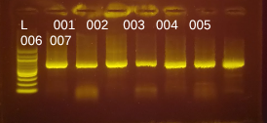
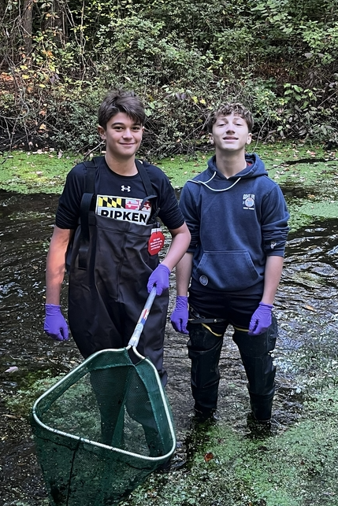
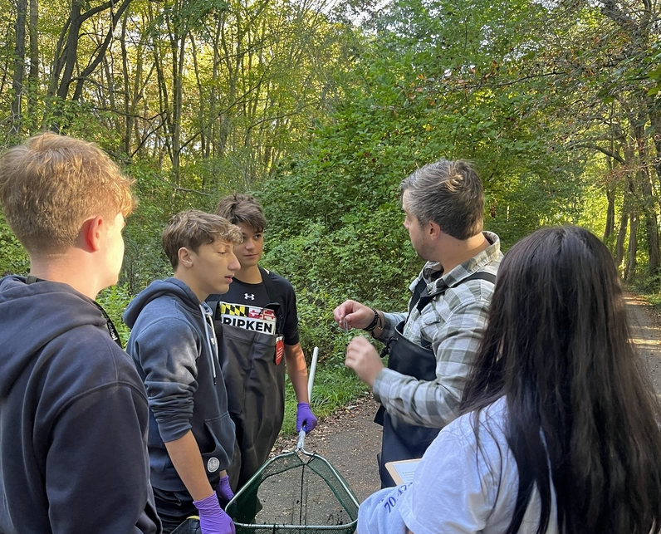
PICTURES TO IMPORT
TO FIRST
SLIDE
Student Version
Jeff Version

