Slide 1

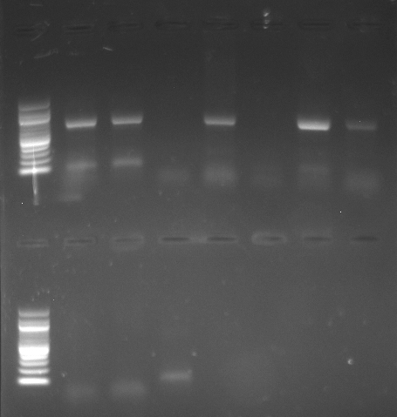
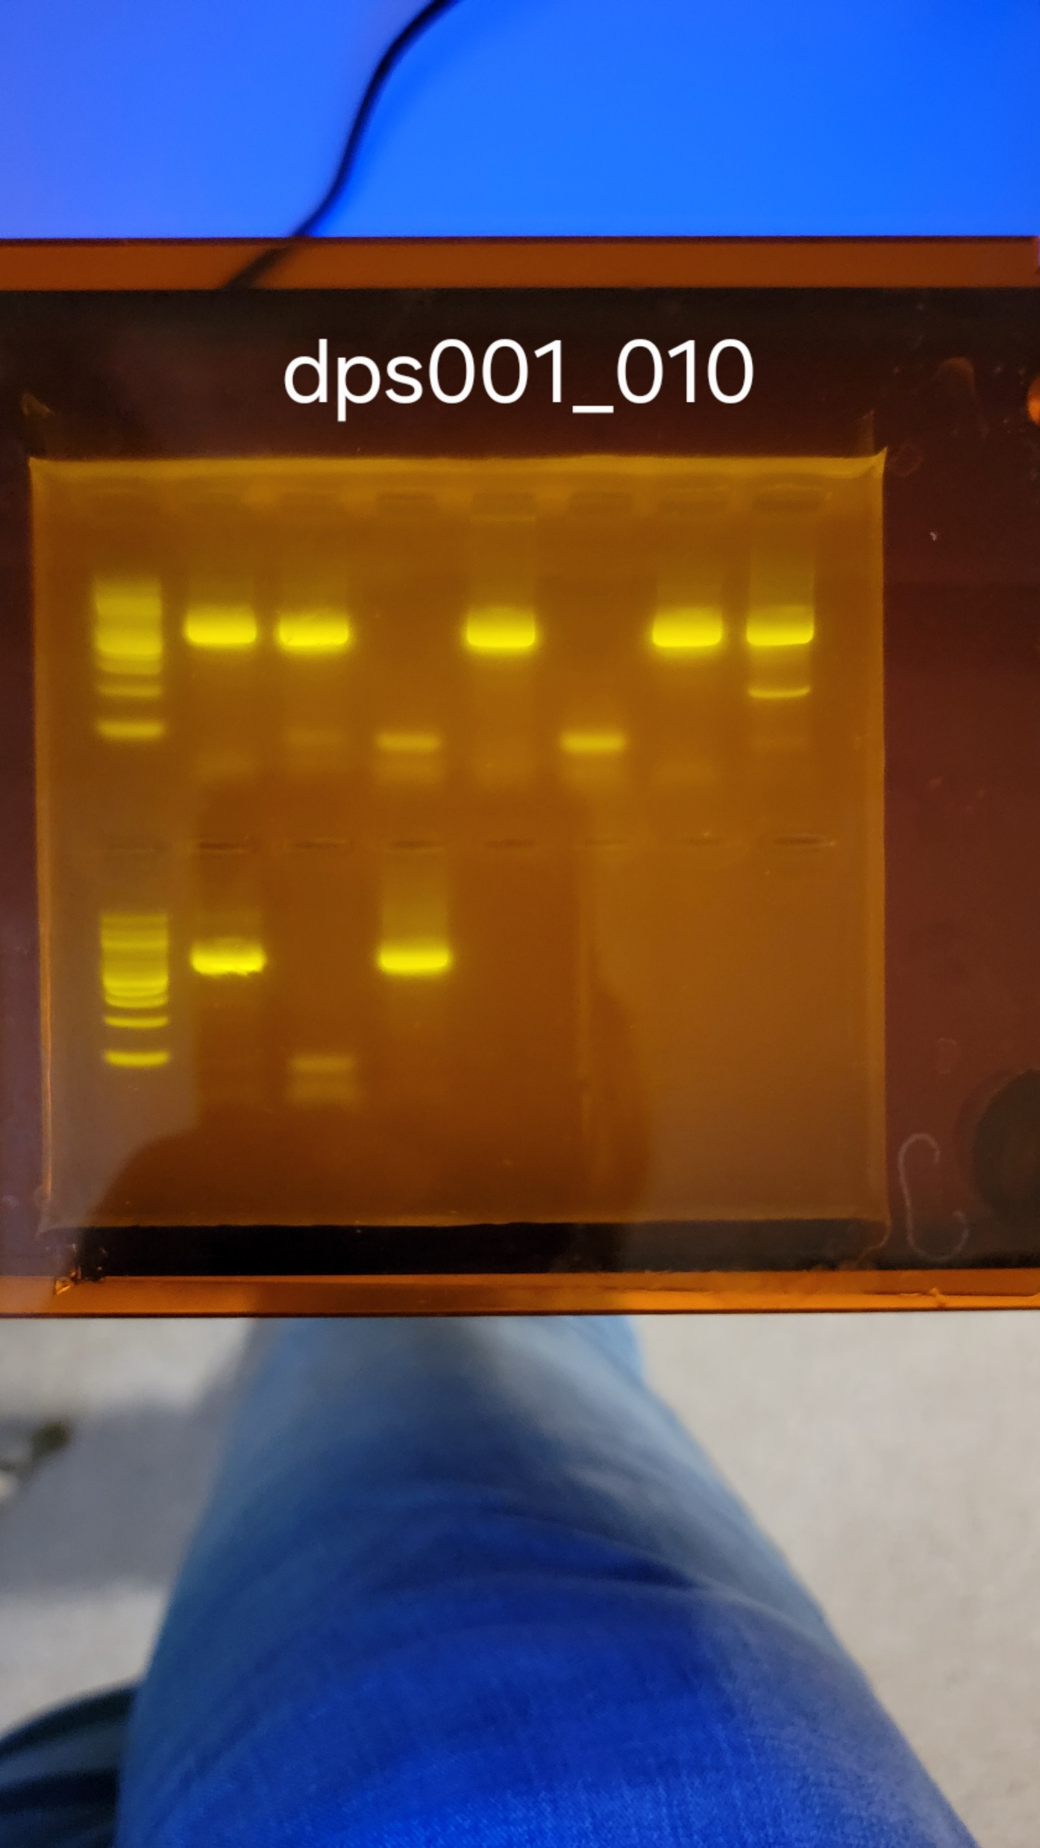
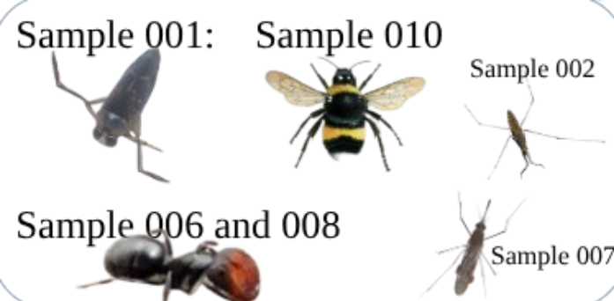
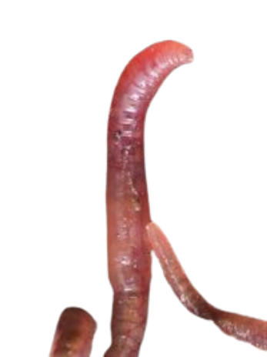
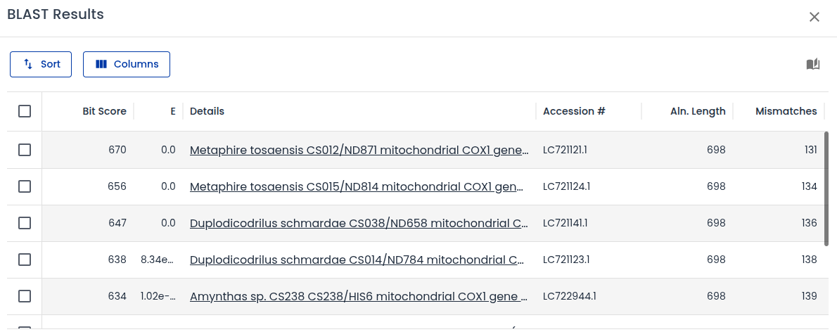
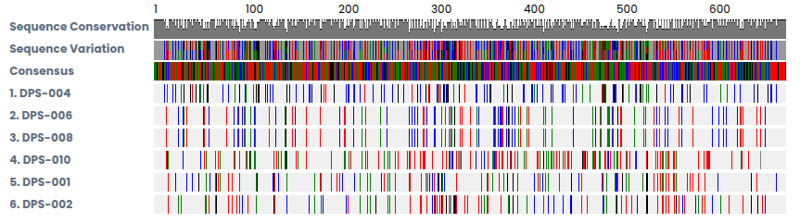
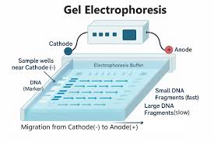
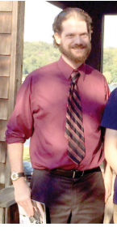
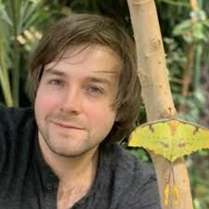
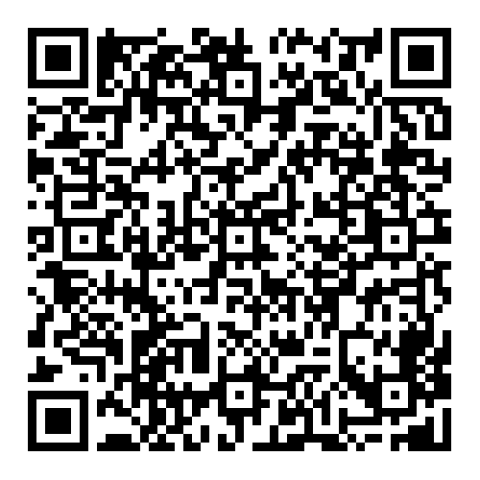
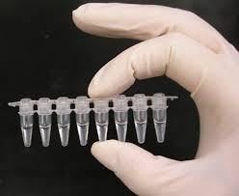
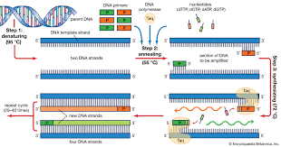
Collecting and DNA barcoding aquatic invertebrates found in Massapequa Preserve during early fall to study biodiversity
Patrick Byrns, Richard Ferrentino, Kyle Madden, Collin Temme
Abstract:The Massapequa Preserve has high biodiversity. Biodiversity is the variety of different species in an ecosystem. It is a very important factor in almost every ecosystem worldwide. Decreasing levels of biodiversity can affect the overall integrity and health of the Massapequa Preserve freshwater creek. Without biodiversity ecosystems would quickly collapse. If an ecosystem contains a higher rate of biodiversity then it is more stable and will have more defence against changes in the outside environment. This experiment was done to dive deeper into the status of the ecosystem and the level of biodiversity of the Massapequa Preserve's fresh water creeks. Invertebrate samples were collected from Massapequa Preserve during early fall. Safety equipment such as waders and gloves were used. Using nets to search through the water, specifically near shallow water and natural debris, invertebrate samples were caught and recorded. Lastly the invertebrates were DNA extracted for barcoding, sequencing, and recording into a database to track the new specimens. After taking closer looks at the DNA sequences it was found that there was one complete match (bumble bee), the others except for one were very close but contain 1-3 mismatches. The one exception had no matching leaving people to believe it is a unknown species. This ecosystem displays high levels of biodiversity shown by the discovery of a possibly unknown species and various species found.
nnnnnnnnnnnnnnnnnnnnnnnnnnnnnnn
KOD Polymerase(Jeff repeat)
L
1
2
4
3
5
6
7
L
1
2
3
4
5
Discussion
Throughout this experiment multiple species of insects were found within the Massapequa Park Preserve. Within this experiment a website called DNA Subway was used in order to identify the species of insects found in the preserve. Sample 001 was classified as invasive species that comes from Europe called a mottled backswimmer. Although, sample four was unable to be identified by DNA Subway, it was able to be identified by Barcode of Life Database (BOLD). It was identified as Eukerrria saltensis according to BOLD. Also to determine whether or not the Massapequa Preserve has high or low biodiversity and can track the changes in biodiversity and species present throughout the years. This unique data represents a small sample of high biodiversity in Massapequa Preserve.
Ready to go beads(Student)
Sample 004
Biodiversity is the variety of life on Earth, encompassing the diversity of species, genes, and ecosystems. This is important because it contributes to the overall well being of the entire ecosystem. This is because biodiversity is crucial for healthy ecosystems, providing essential resources and services for human survival and well being (Shaw,2024 1) To determine the health of the ecosystem by looking closer into the organisms that lives in the ecosystem and how the organism affects the environment . To determine this the researchers collected ten specimens specifically non variety aquatic organisms. After collection the specimens were placed in a test tube with alcohol to preserve the organisms.After these steps the teachers took the specimens back to the lab to conduct experiments. The researchers used an AI-based identifying app to determine the species and the name of the organism. Also to determine the niche of the organism. But after that the bugs will receive a closer look at the cold spring harbor labs to be DNA barcoded and placed on Genbank to be compared to other organisms.
DNA Subway
Boldsystems
We would like to extend our greatest gratitude to Jeffry Petracca, August Eberling, and cold spring harbor laboratory without their help none of this would have been possible.
Sample 001 was a Notonecta irrorata, also known as a mottled backswimmer.
Sample 002 was an Aquarius remigis, also known as a water strider.
Sample 004 was a Lumbricus terrestris, also known as an earth worm
Sample 006 was a Colobopsis truncata, also known as an ant.
Sample 007 was an Anopheles quadrimaculatus, also known as a mosquito.
Sample 008 was a Colobopsis truncata, also known as an ant
Sample 010 was a Bombus impatiens, also known as a Bumble Bee.

