Slide 1


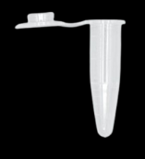
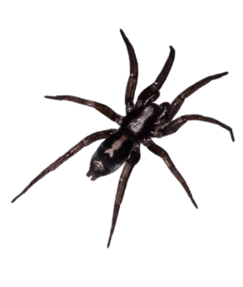
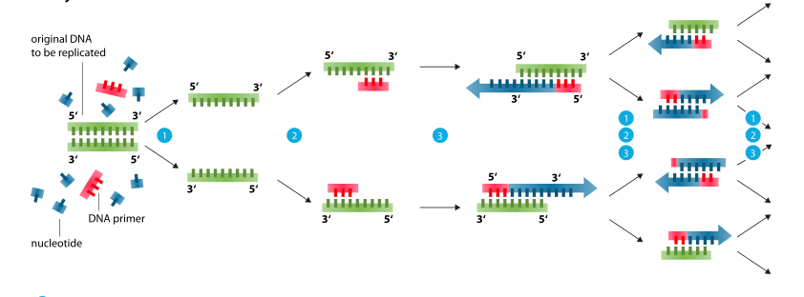
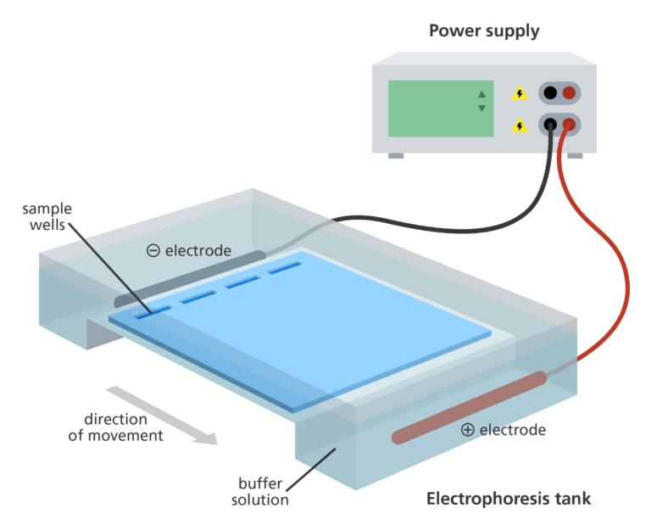
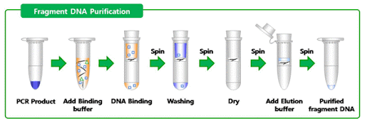


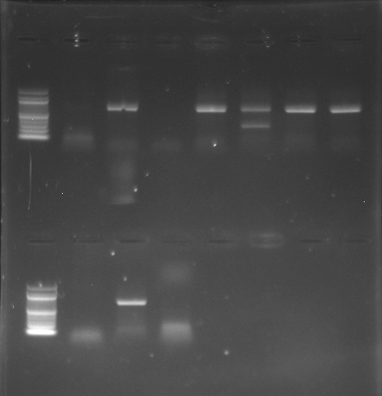
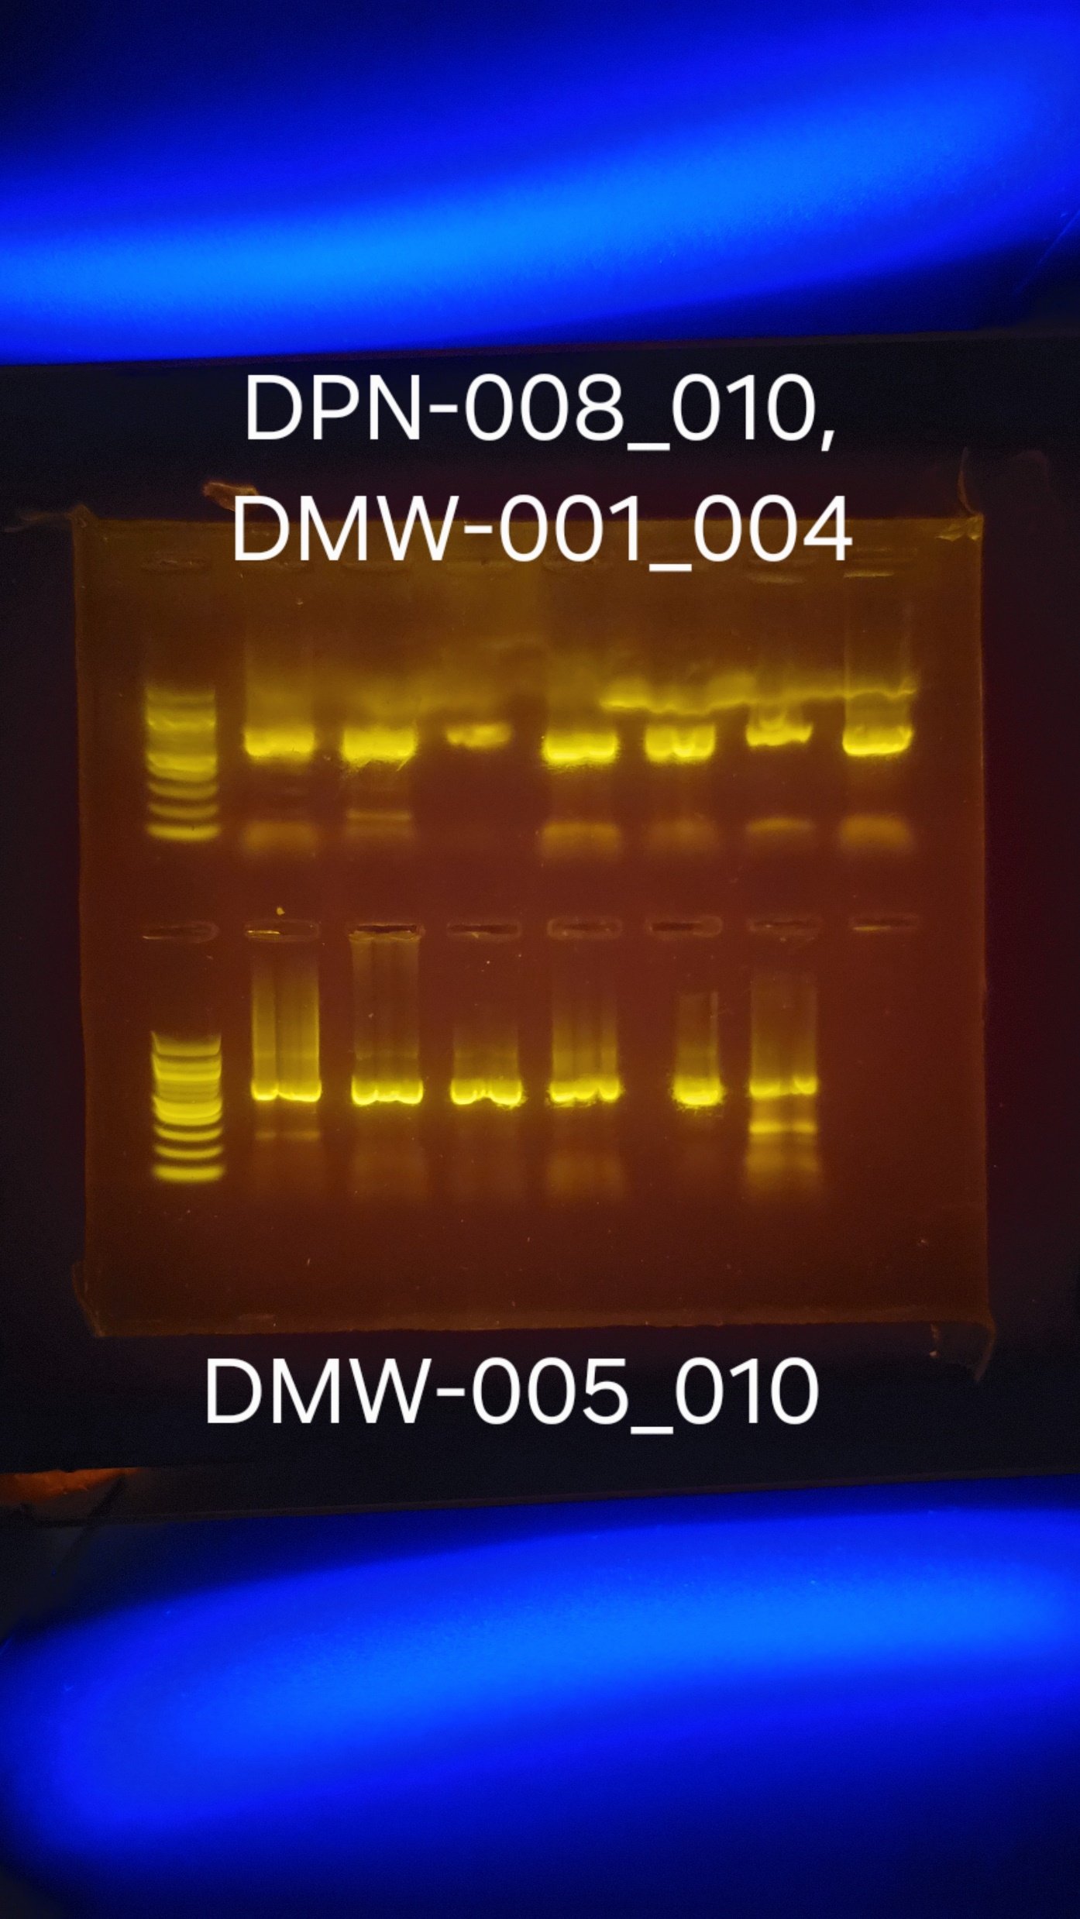
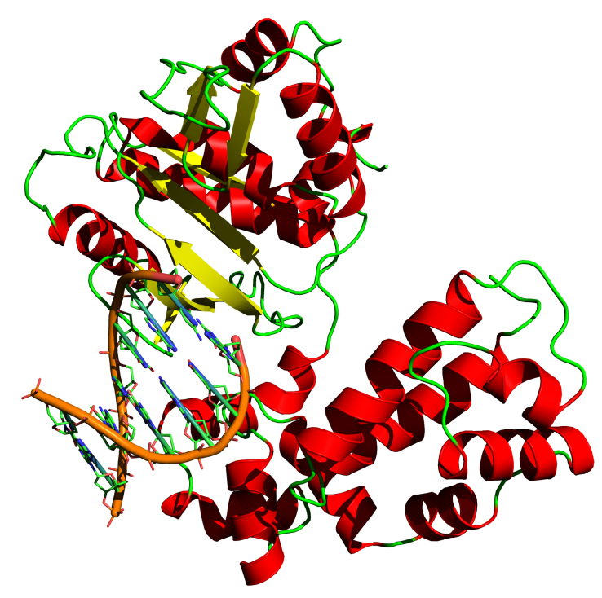
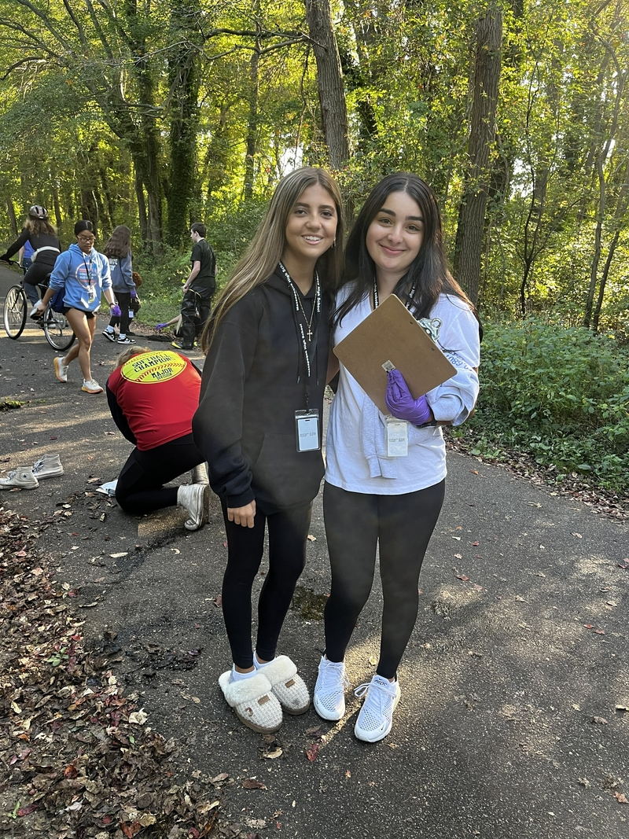
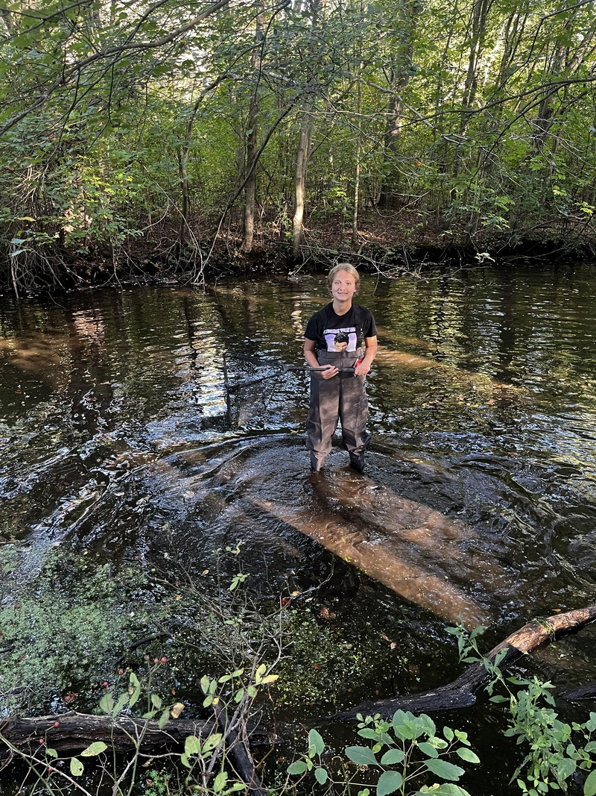
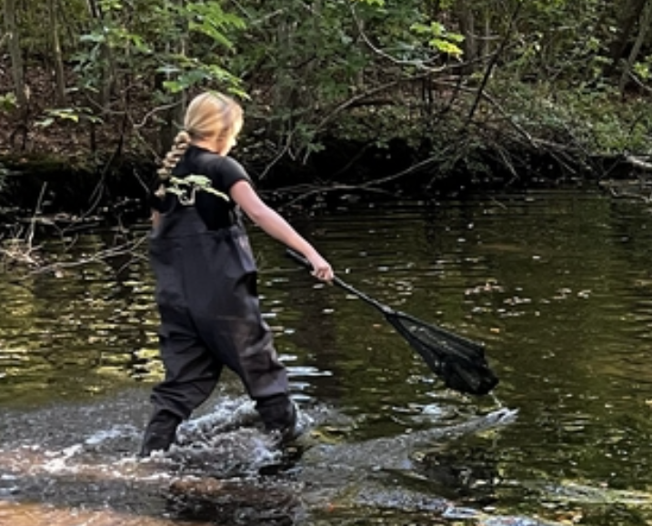
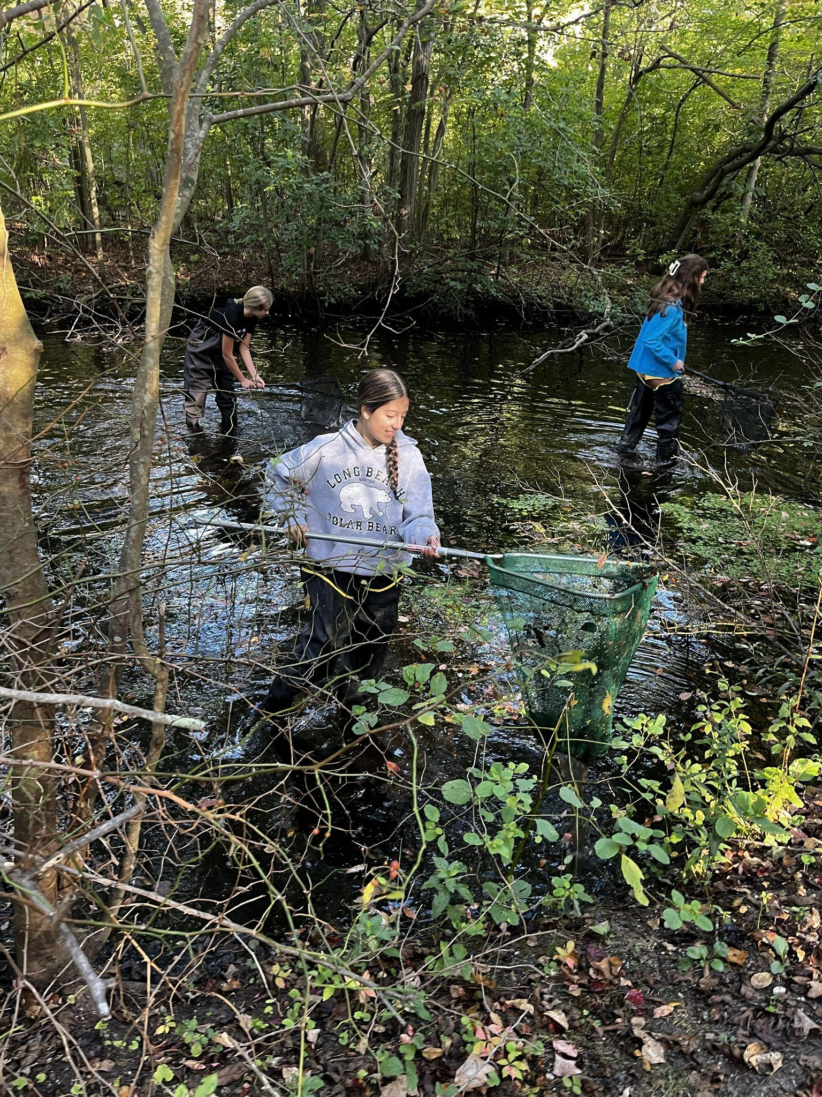
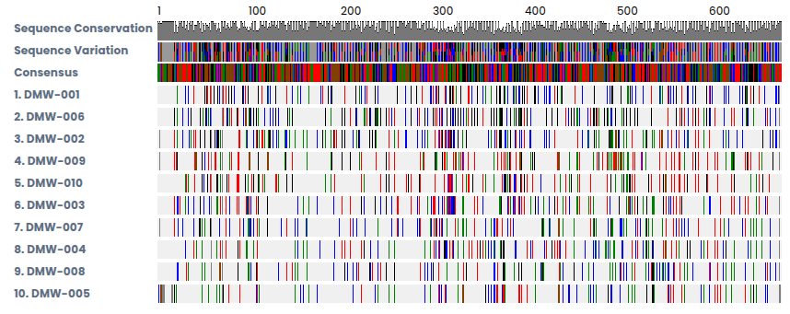

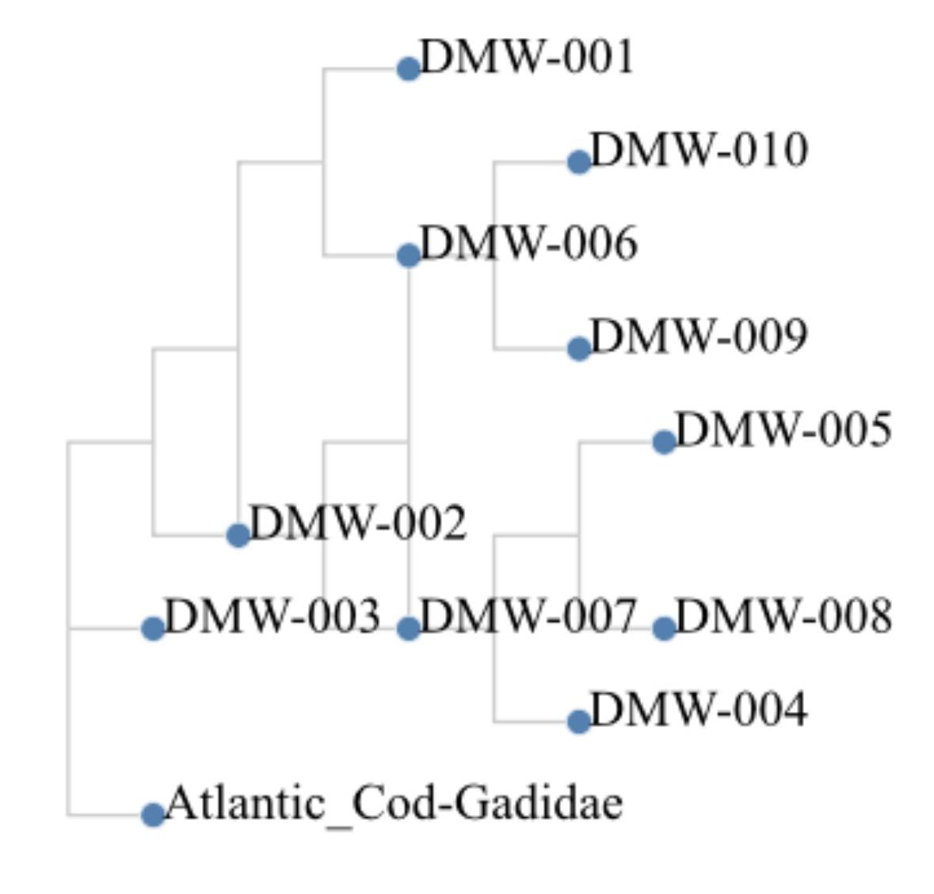
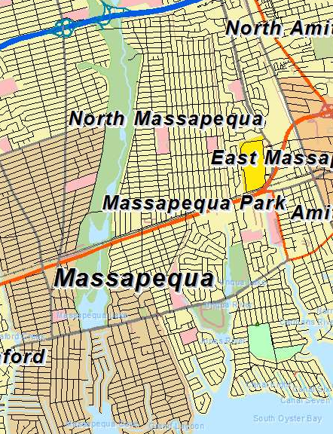
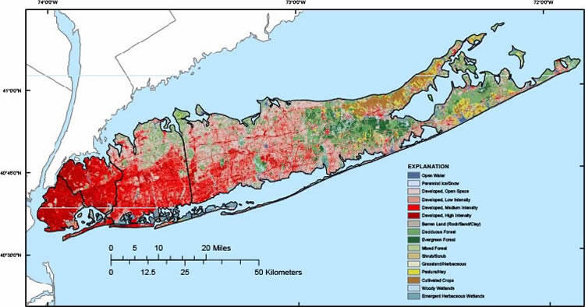
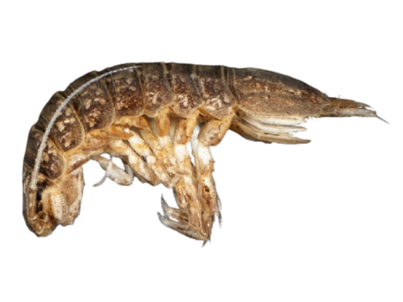
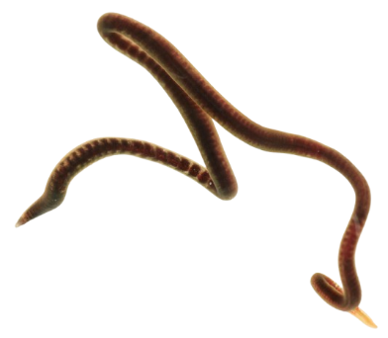
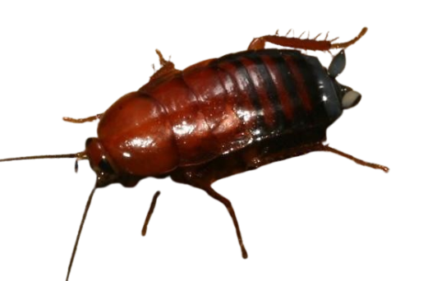
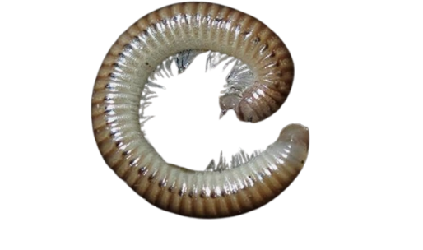
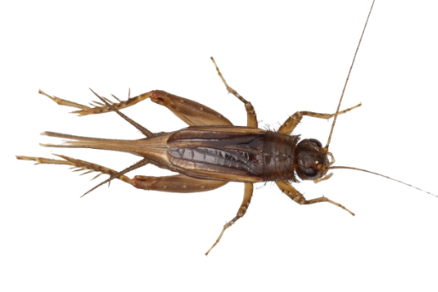

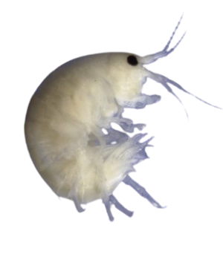
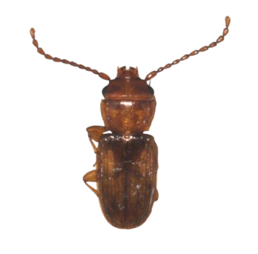
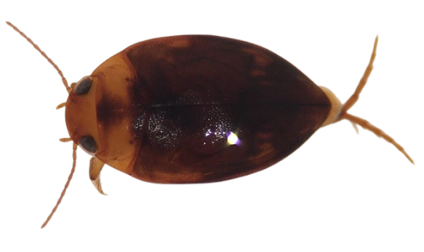
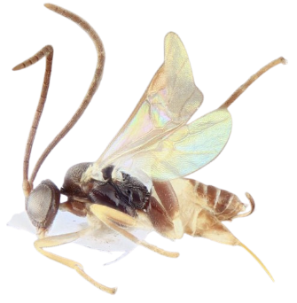
Exploring The Biodiversity of Aquatic and Terrestrial Invertebrates Found In The Massapequa Preserve by Utilizing DNA Barcoding Technology
By: Fiona Ash, Mackenzie DeBello, Madelyn Dejak, Zara Fox
Mentors: Jeffry Petracca, August Eberling, Sharon Pepenella
Methods
L 001 002 003 004 005 006 007
L 001 002 003 004
Discussion
Urbanization is usually seen as something that negatively affects the biodiversity of environments as well as the habitats of organisms. Biodiversity is the variety of organisms in an ecosystem that helps to maintain an environment’s natural balance. A lack of biodiversity can lead to ecosystem instability because it cannot recover and support crucial biological processes. This idea was not supported through the results that were found. As concluded in the experimental investigation, ten out of the ten of the species successfully worked, showing many different variations in the DNA sequences. Furthermore, this is an example of the high levels of biodiversity in the Massapequa Preserve. To reach these results, a Chelex extraction was done. To do the Chelex extraction, the CO1 region was amplified by the polymerase chain reaction. Then, Sanger sequencing was performed to show the nucleotide sequence. Lastly, using DNA Subway, a BLAST search was performed. The results were used to identify the species of the organism that was found. Some limitations involved in this experiment, not a large enough sample size, small locations of species, could have used macroinvertebrates and microinvertebrates to fully ensure that there is a high level of biodiversity.
Abstract
The primary objective of this project was to study the biodiversity of the Massapequa Preserve Creek by examining the macroinvertebrates in the water. Biodiversity is the variety of living things in a particular habitat or ecosystem. Biodiversity is important because the more biodiversity, the more stable the ecosystem will be. To do this, ten samples of macroinvertebrates were collected. To collect these samples, students went into the water using waders and nets, with the nets, students collected samples from the water and sediment and searched through it to find invertebrates. If something was found, students took permanent recordings of the location. After this, students viewed the invertebrates under a microscope to try to determine the specific species of the invertebrate that was collected. To complete this experiment, researchers used DNA barcoding and Sanger sequencing technology to identify the organisms. DNA barcoding is a molecular method for identifying a species using short standardized genetic sequences. Moreover, barcoding acts as a fingerprint to catalog biodiversity. It identifies organisms from small or damaged samples by comparing their DNA to reference libraries. DNA Subway was used to look at the organism's DNA to further identify the species. Out of the ten organisms found, ten of them were able to be identified. The findings collected showed a high variety of organisms, proving that Massapequa Preserve has a high biodiversity.
L 005 006 007 008 009 010
L 008 009 010
Figure 1: The gel electrophoresis results the yellow one is with the KOD polymerase
Figure 2: Muscle alignment of the ten species
Acknowledgments
We would like to thank August Eberling from the Massapequa Ames High School and Jeffry Petracca from Cold Spring Harbor Laboratory DNA Learning Center for their helpful advice and guidance while completing this experiment and project design. Jeffry Petracca helped with using DNA subway to identify our organisms and with the insect extraction. August Eberling helped with our research and the project as a whole.
Introduction
Urbanization is spreading throughout Massapequa, with the spread of urbanization, there is a loss of biodiversity in the environment and habitat of organisms (Bishop, 2022). Human activities play a major role in this loss of biodiversity (Nico, 2021). Humans do this through deforestation and the pollution of the environment and the waters. Due to the loss of biodiversity, surveys show that the population of organisms will start to decrease. The amount of pollution is devastating to all life forms which is the direct effect of human activities. This is a primary reason why human activities may significantly alter the biodiversity of terrestrial and aquatic invertebrates. This study hypothesized that despite surrounding urbanization, the Massapequa Preserve would maintain moderate to high invertebrate biodiversity due to its protected status and freshwater habitat.
Figure 3: Map of urbanization on Long Island
Figure 4: A phylogenetic
tree of the results
Results
Figure 5: A map of the Massapequa Preserve
DMW001 -Caecidotea racovitzai
DMW002- Uktena riparia
DMW003- Parcoblatta sp.
DMW004- Cylindroiulus punctatus
DMW005- Eunemobius Carolinus
DMW006- Hyalella azteca
DMW007- Laemophloeus fervidus
DMW008- Neoporus clypealis
DMW009- Choeras sp.
DMW010- Herpyllus ecclesiasticus
001 002 003 004 005
006 007 008 009 010

