Slide 1



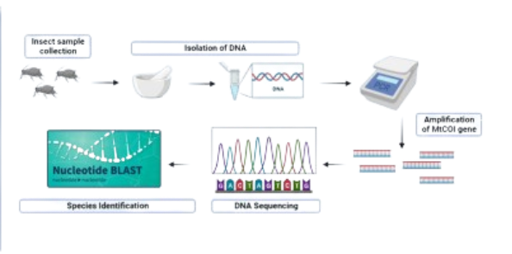
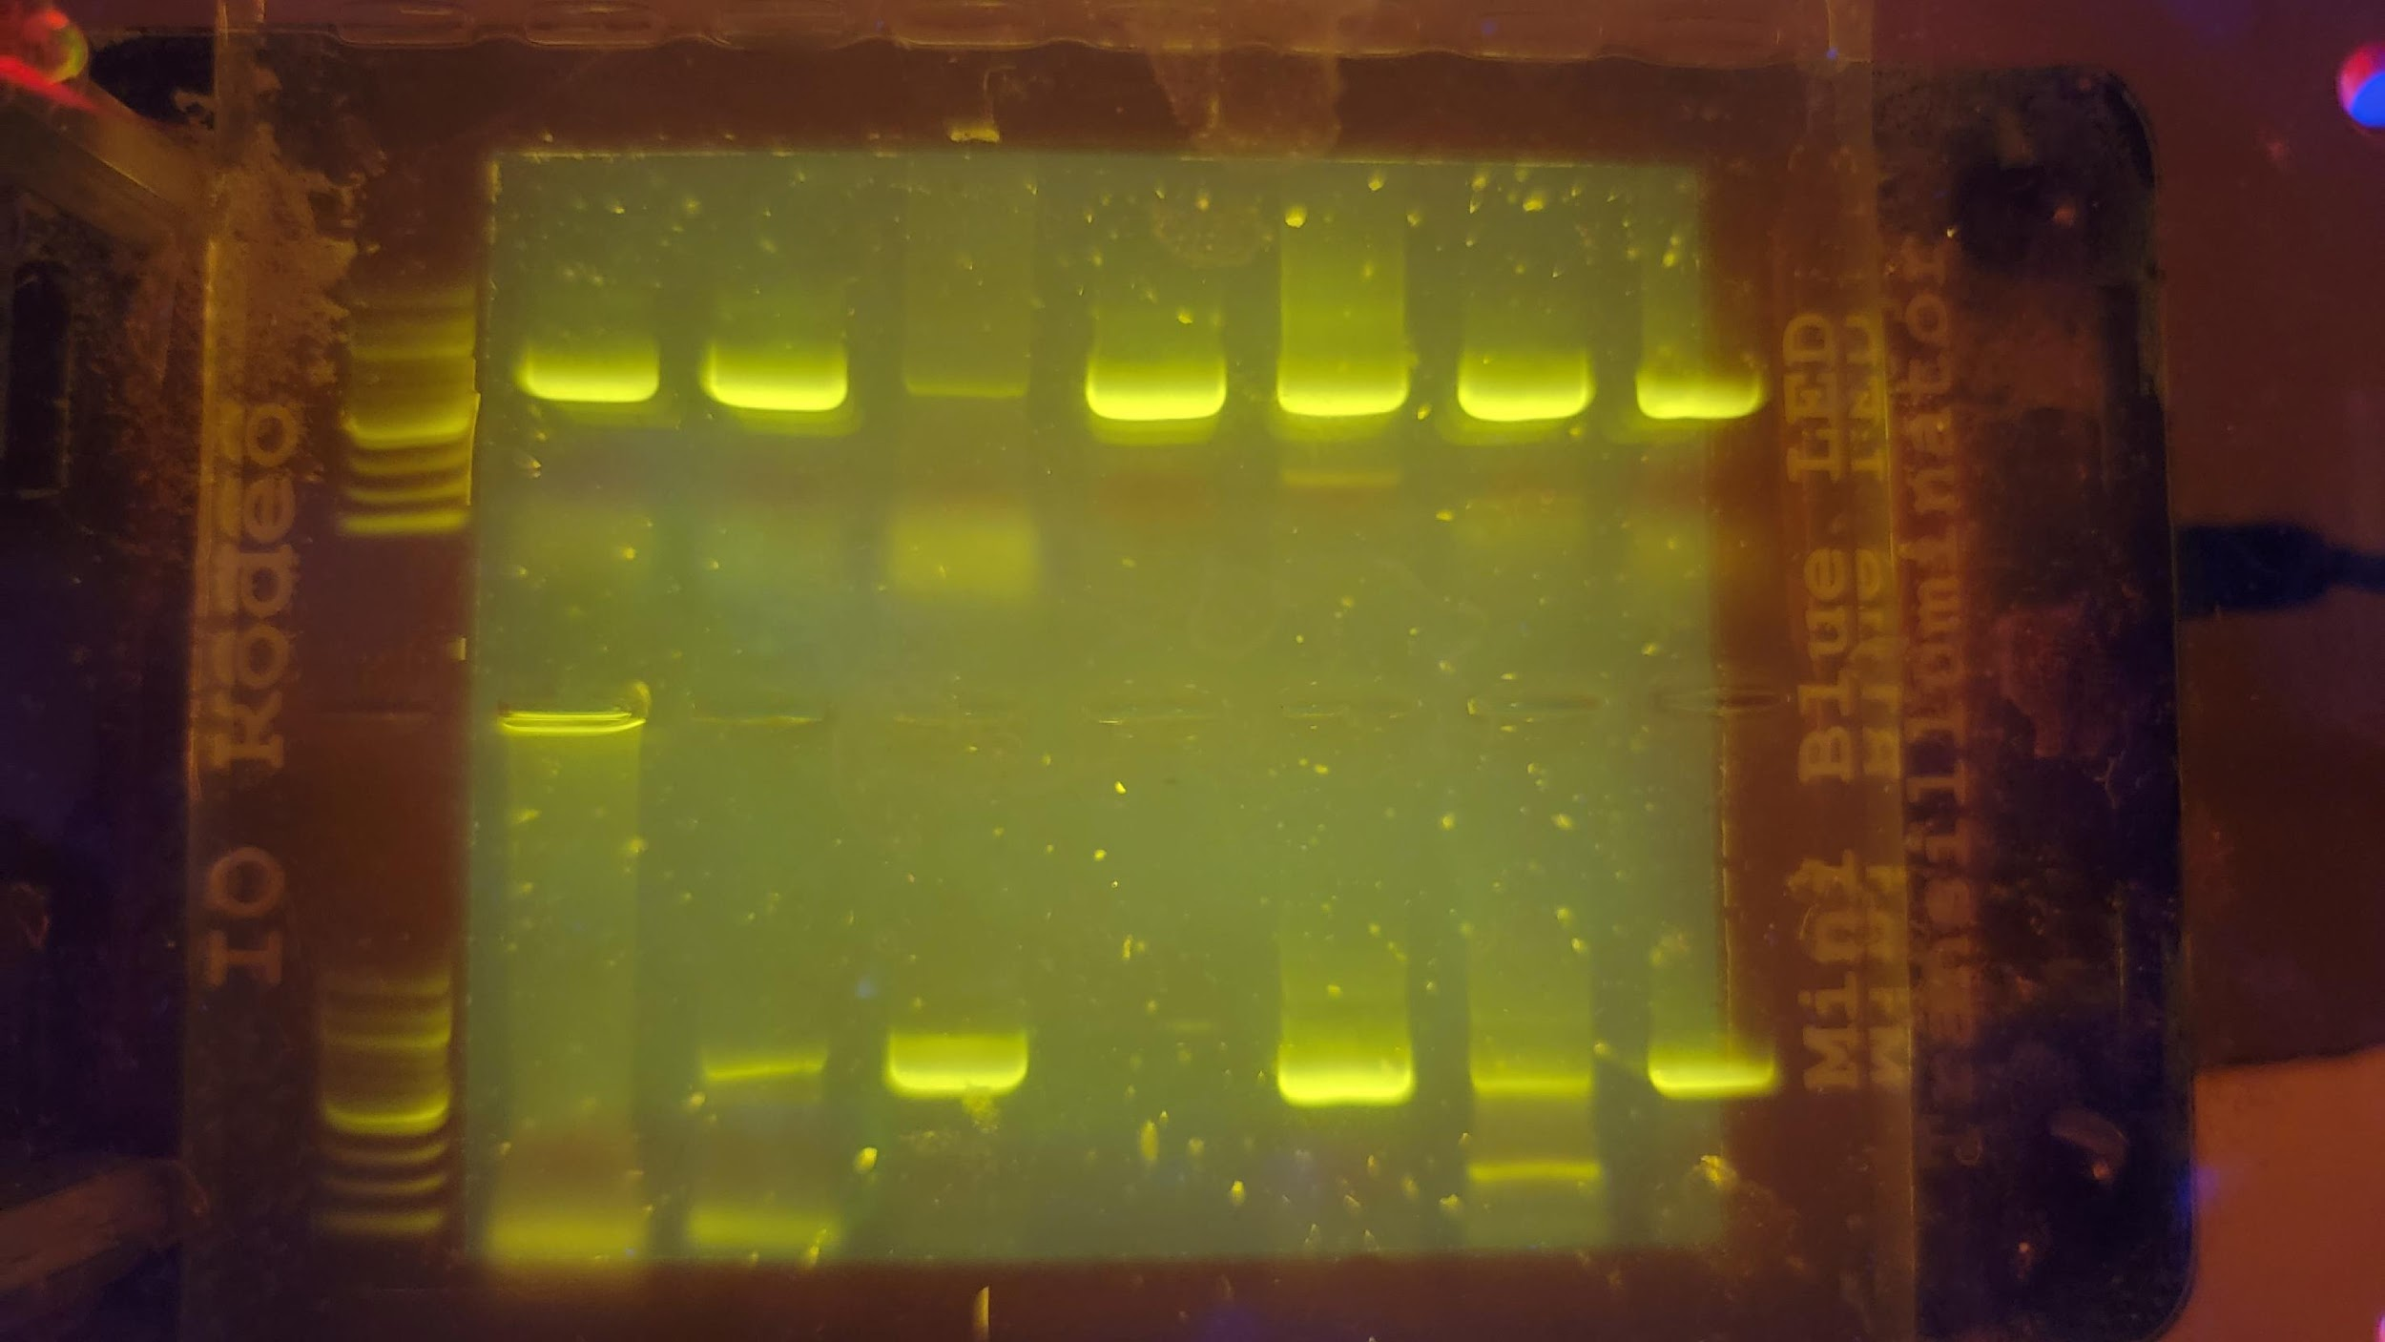
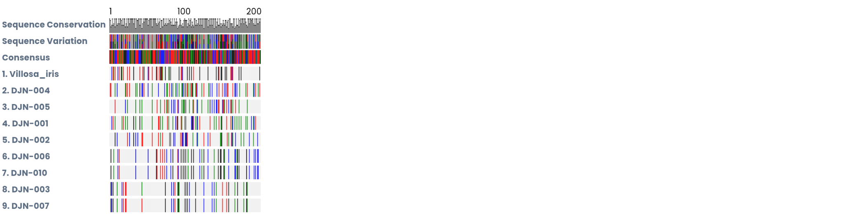
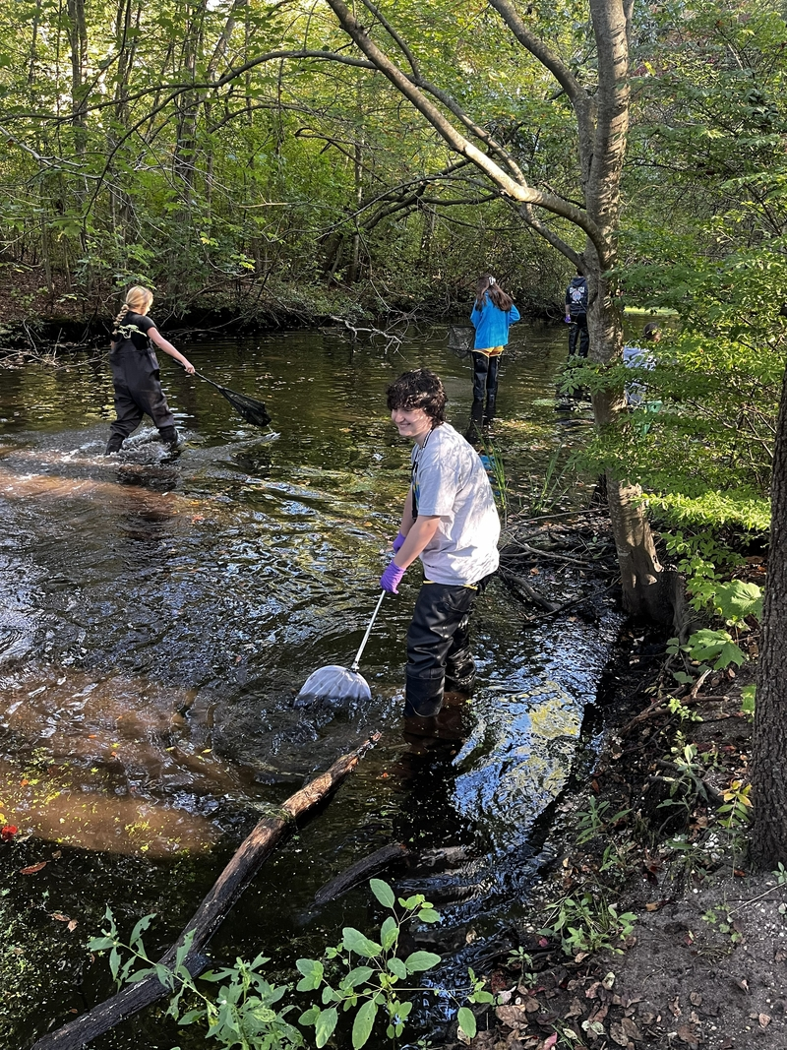
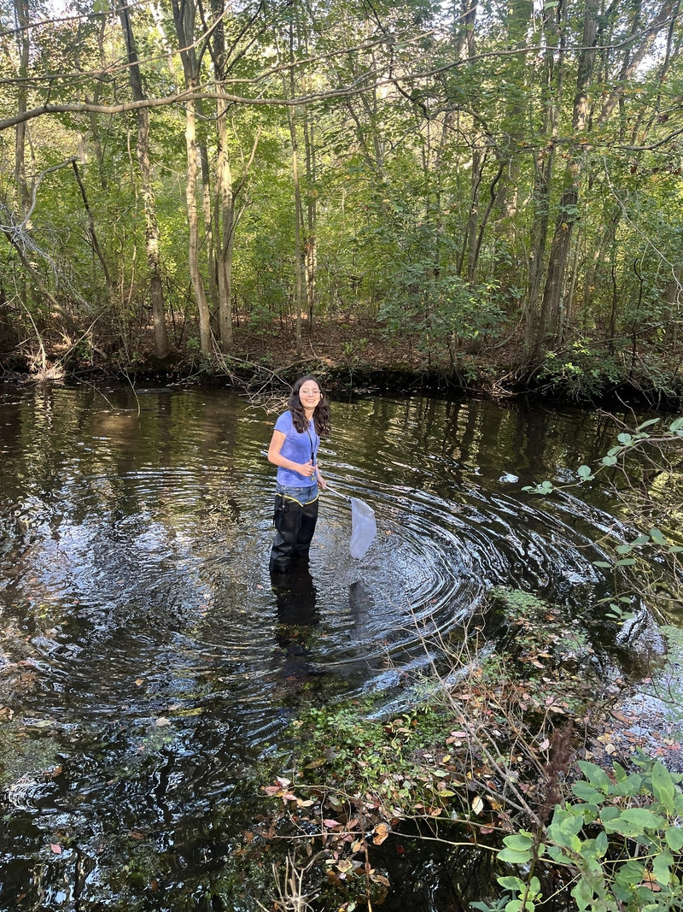

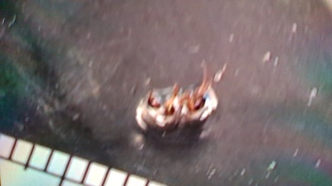
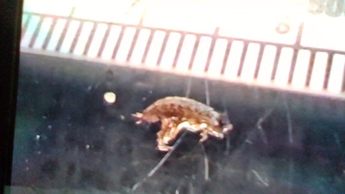
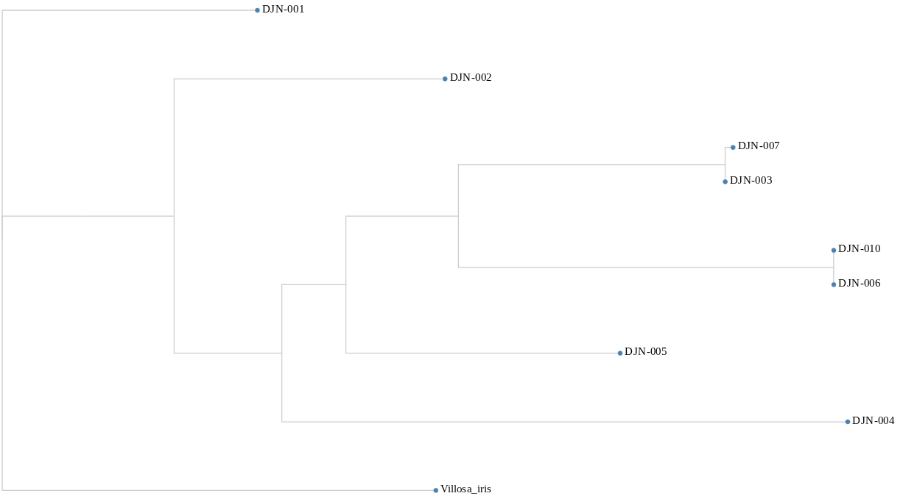
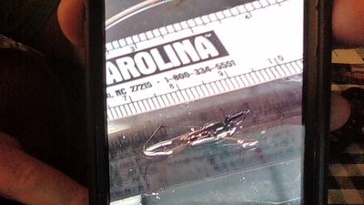
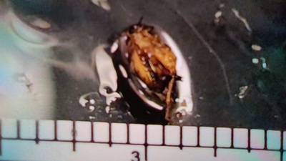
Macroinvertebrates of the Massapequa Preserve
By: Sofia Jackson, Ryan Ma, Brendan D’Agostino & Nia Isaacs-Corr
- Abstract -
- Methods -
- Discussion -
This experiment was conducted to observe the biodiversity of the Massapequa Preserve taking DNA samples from aquatic macroinvertebrates. These organisms are small in size and found throughout the preserve. The hypothesis for this experiment was that around 80% of the samples would be unique species. Samples were collected and stored inside tubes full of ethanol. No more than two of each species were collected in order to examine biodiversity. When the time came to examine the samples, reference images were used as well as gel electrophoresis to identify the organisms. To confirm whether or not these references were correct, each organism was crushed up to extract the DNA using chelex. PCR was used to create multiple copies of DNA strands for observation. Gel electrophoresis was then used to confirm that the PCR amplified the correct strand of DNA. After this, Sanger sequencing was used to determine the nucleotide sequences in the DNA samples. Incorrect bases or those with no matches were cut out before being compared. These sequences were then compared on the GenBank database to identify the species. A total of ten organisms were collected from this experiment. Eight of these samples could be read and identified, and six of these were unique species. The results from this experiment supported the hypothesis, as 75% of the samples were unique species, which is around the 80% the hypothesis predicted. The results also showed that there was a relatively high amount of biodiversity found in the Massapequa Preserve and helped show where certain aquatic macroinvertebrates live inside of the preserve.
In conclusion, eight of the ten macroinvertebrates used in the experiment had successful identification results. DJN-009 and DJN-008 was not able to be identified as there was not an ample amount of DNA to determine the organism’s species. The results of all other samples contained data.. The remaining DNA samples closely matched the original predictions of what the organisms were. Out of the eight samples collected, six unique species were identified. It was found that DJN-006 and DJN-010 contained similar DNA, as both samples were the same species. This was the same case for DJN-003 and DJN-007. Based on this information, the hypothesis was supported as 75% of the samples identified were unique species, which is around the target 80% the predicted. This shows that there was a relatively high amount of biodiversity, even if it was slightly lower than what was projected. While a majority of the collections worked, there were errors made throughout the project. Due to the limited time spent in the preserve as well as the small area of where samples were collected, the macroinvertebrates found most likely do not represent the entire Massapequa Preserve area. Human error is most likely the largest factor in sample data found, as many sample pictures were blurry and DNA may have been unsuccessfully separated from the sample. If this experiment was to be repeated, multiple sample collection trips and different weather conditions could be used, as well as variation in collection sites. A larger sample size could also be beneficial, as this experiment only managed to clearly identify eight samples. In conclusion, the sample results from this experiment highlights that the Massapequa Preserve has a considerably high amount of biodiversity.
- Results -
DNA sample results were collected on DNA Subway using BLAST (Basic Local Alignment Search Tool), which compared the sequences of the samples to the GenBank database. A total of ten organism samples were collected with the team code being DJN. Sample 008’s DNA had inconclusive sequencing, so it was not included in the BLAST search. Sample 009’s BLAST results showed that the best matches had extremely high numbers of mismatches to organisms in the database (80+), so its species could not properly be identified. The remaining organisms listed below all had less than four mismatches.
DJN-001 is a Aquarius remigis voucher, known as common Water Strider
DJN-002 is a Cylindroiulus punctatus voucher, known as blunt-tailed snake millipede
DJN-003 is a Philoscia muscorum isolate, known as common striped woodlouse.
DJN-004 is a Camponotus sp. BBHYN007-10 voucher, known as carpenter ant
DJN-005 is a Eunemobius sp. BOLD-2016 voucher, commonly known as carolina ground-cricket.
DJN-006 is a Caecidotea racovitzai racovitzai voucher, commonly known as asellid isopod
DJN-007 is a Philoscia muscorum isolate, commonly known as common striped woodlouse
DJN-008 and DJN-009 are inconclusive (008 was not scanned as the bases were unclear, and 009 had no accurate matches)
DJN-010 is a Caecidotea racovitzai racovitzai voucher, commonly known as asellid isopod
- Introduction -
Aquatic macroinvertebrates consist of organisms visible to the human eye that lack backbones. These animals spend most of their lives in water. These organisms were collected to view the biodiversity of the Massapequa Preserve, a temperate deciduous forest. The Preserve is a 432 acre section of protected wildlife with hiking trails, making it easy to find and collect organisms. Due to the habitats that these animals live in, most, if not all samples were collected in or around the river. The samples collected were smaller than one inch. When collecting a sample, the coordinates of the location were recorded using Google Maps. DNA was collected from these organisms, and PCR was used to make more copies of the COI strand. PCR, or polymerase chain reaction, is a process using cycles of heating up a DNA sample to make more copies of a DNA strand. Primers are used to bring the polymerase to the target DNA region for replication. To see if the PCR was successful, gel electrophoresis was performed. This is a method used to separate and observe DNA fragments. DNA is placed inside of wells inside of gel. When the current is turned on, the negatively charged DNA fragments will move from the negative to the positive side. DNA is spaced out based on size, with larger fragments being nearer to the wells. A ladder is used to show where the DNA fragments should be. Sanger sequencing is a method used to determine nucleotide sequences. These results were trimmed to get more accurate sequences. Bases that had no matches/had an incorrect match were cut out from the sequence. Using these trimmed sequences, the DNA of an unidentified organism was compared in the GenBank database to see if the DNA matches any previously identified organisms. DNA Subway is the site that was used for observing the sequences, cutting out bases, and looking at the database.
- Citations -
Gel Electrophoresis Results
DNA Sequences (MUSCLE Alignment)
Sample Collectors
L 001 002 003 004 005 006 007
QR Code:
Scan to see citations:
L 008 009 010
Images of Some Organisms Collected
Phylogenetic Tree
DJN-004
DJN-010
- Acknowledgements -
We would like to express our gratitude towards our teacher, Mr. Eberling, for assisting in setting up the process for our sample collection, as well as Jeffry Petracca and the researchers at Cold Spring Harbor Laboratory for aiding us in species identification and the processing of our samples.
DJN-001
DJN-005

