Slide 1



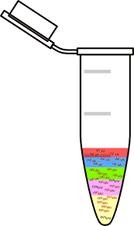

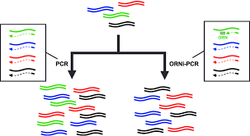
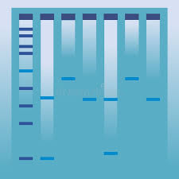

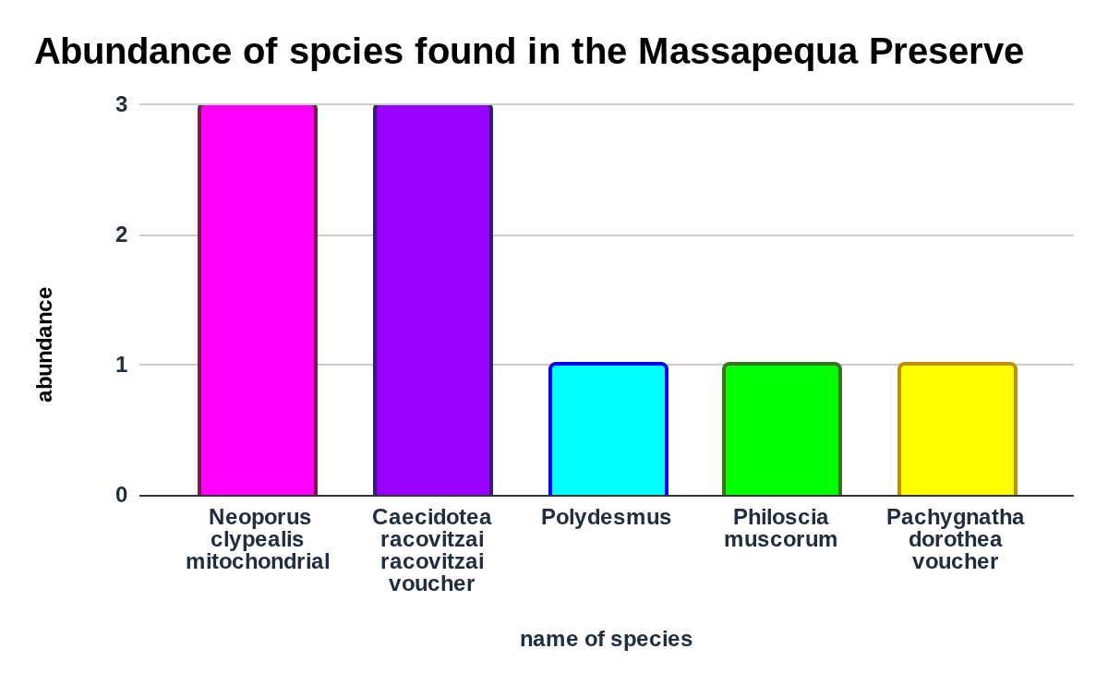
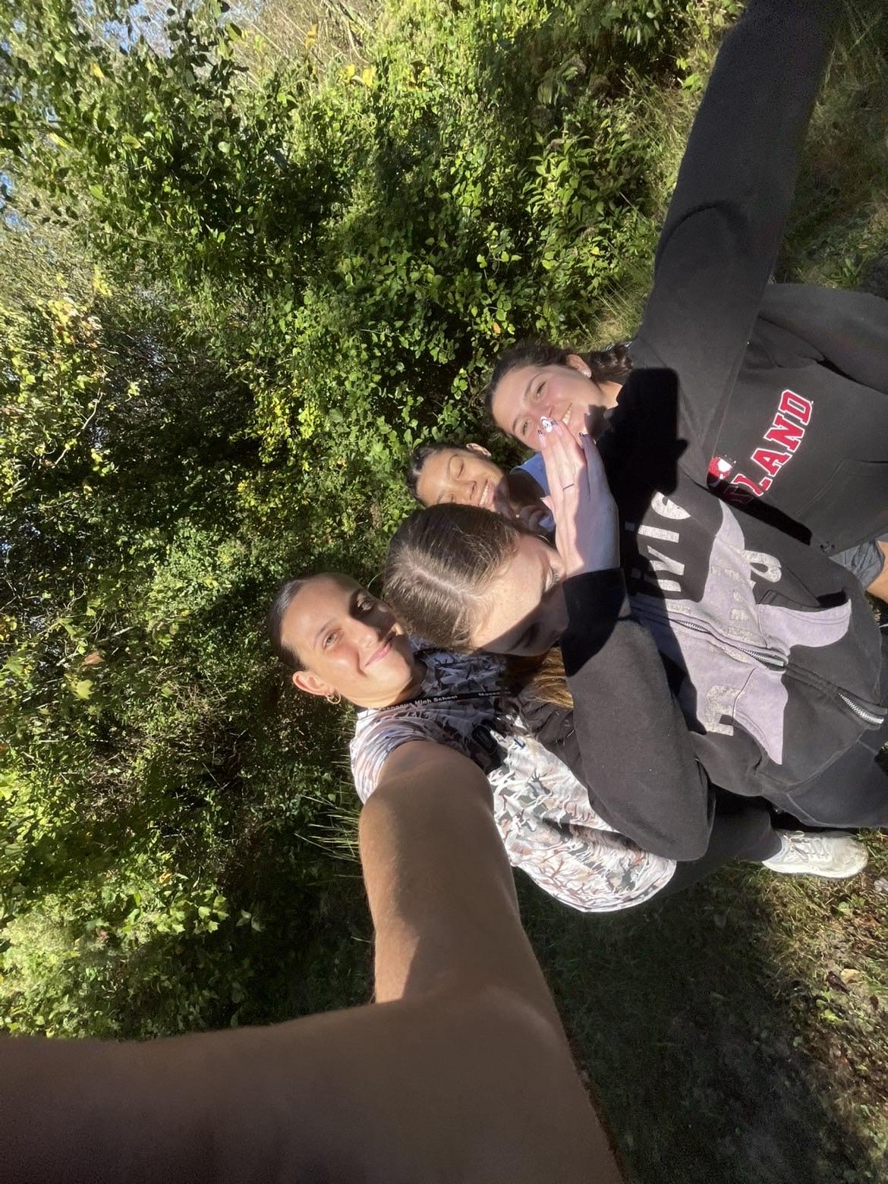
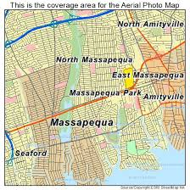
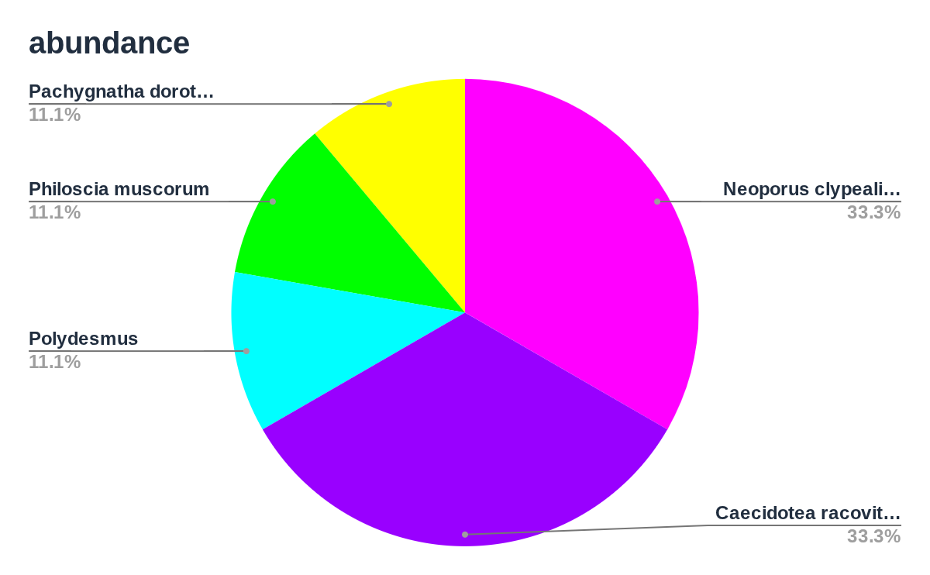
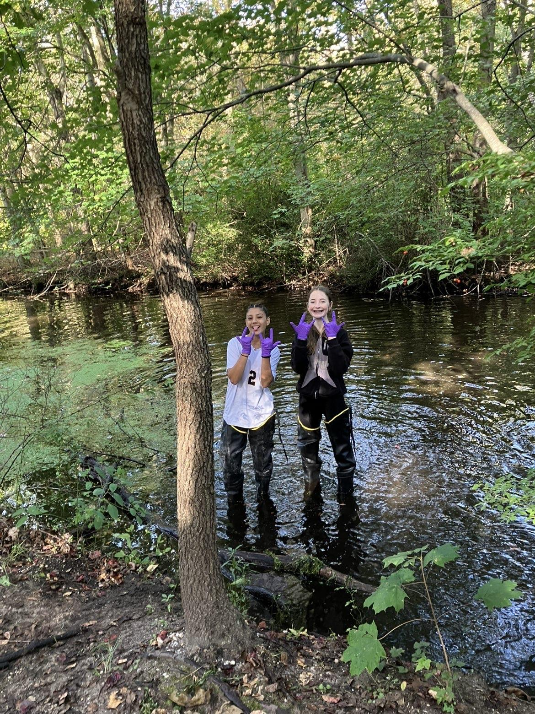
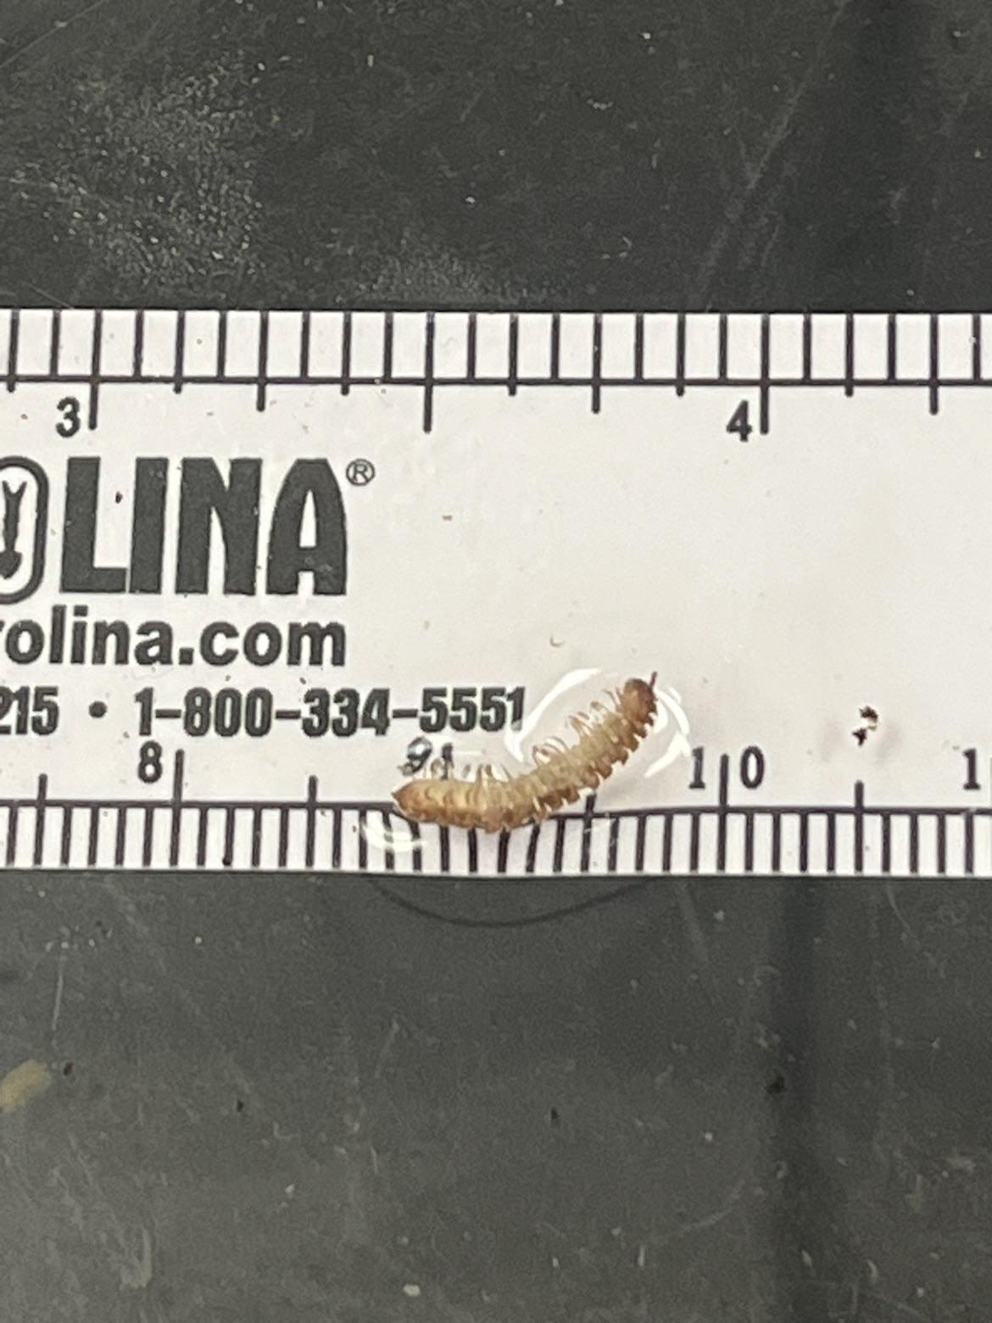
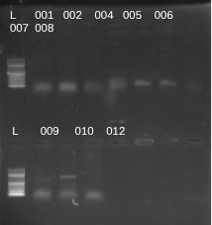
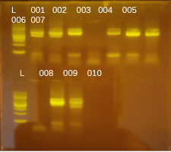
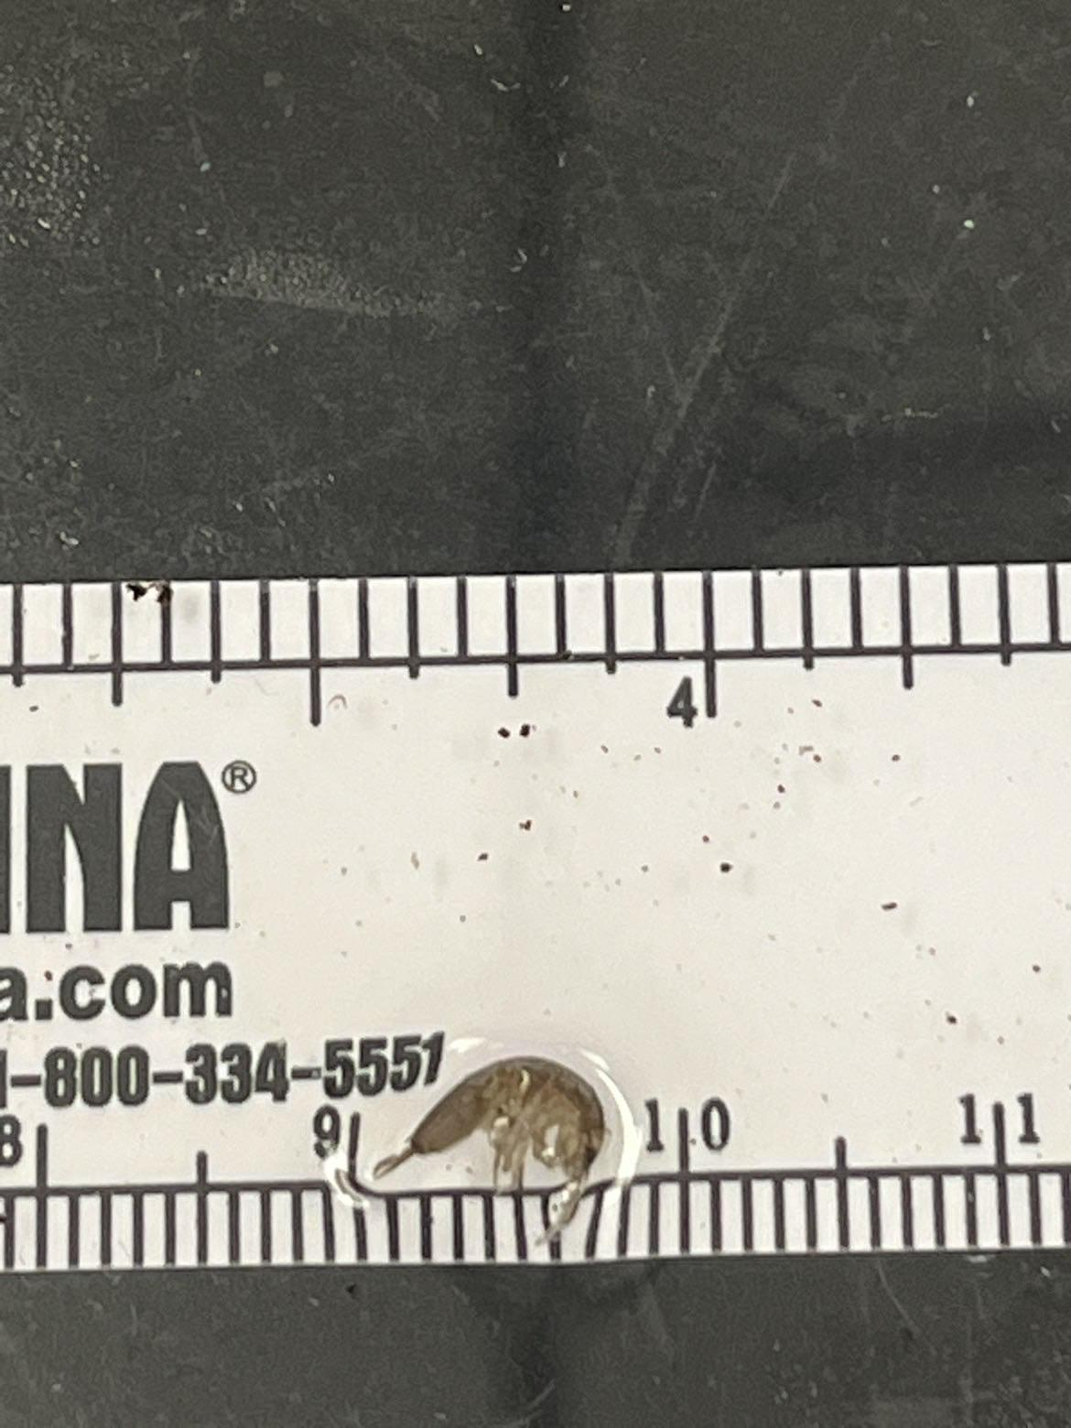

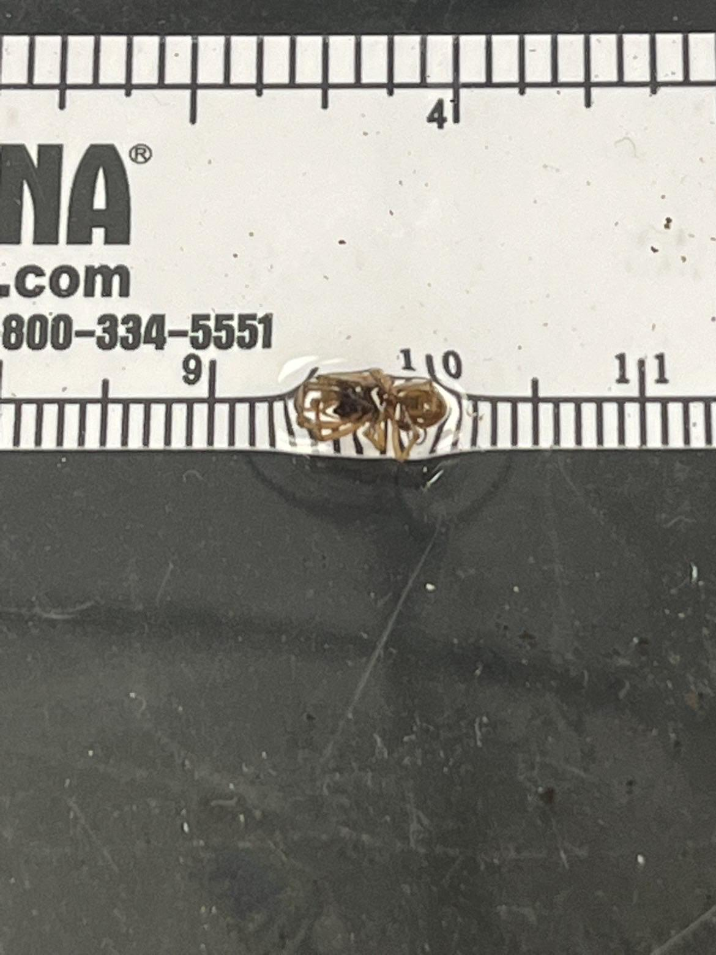
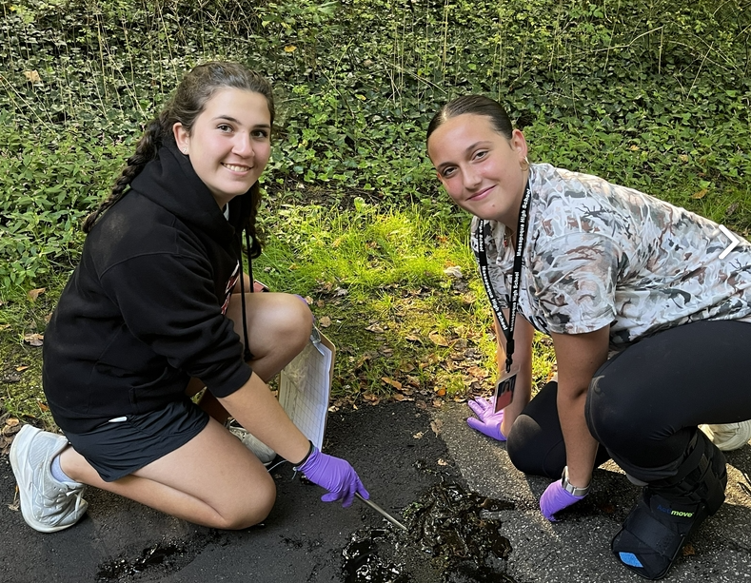
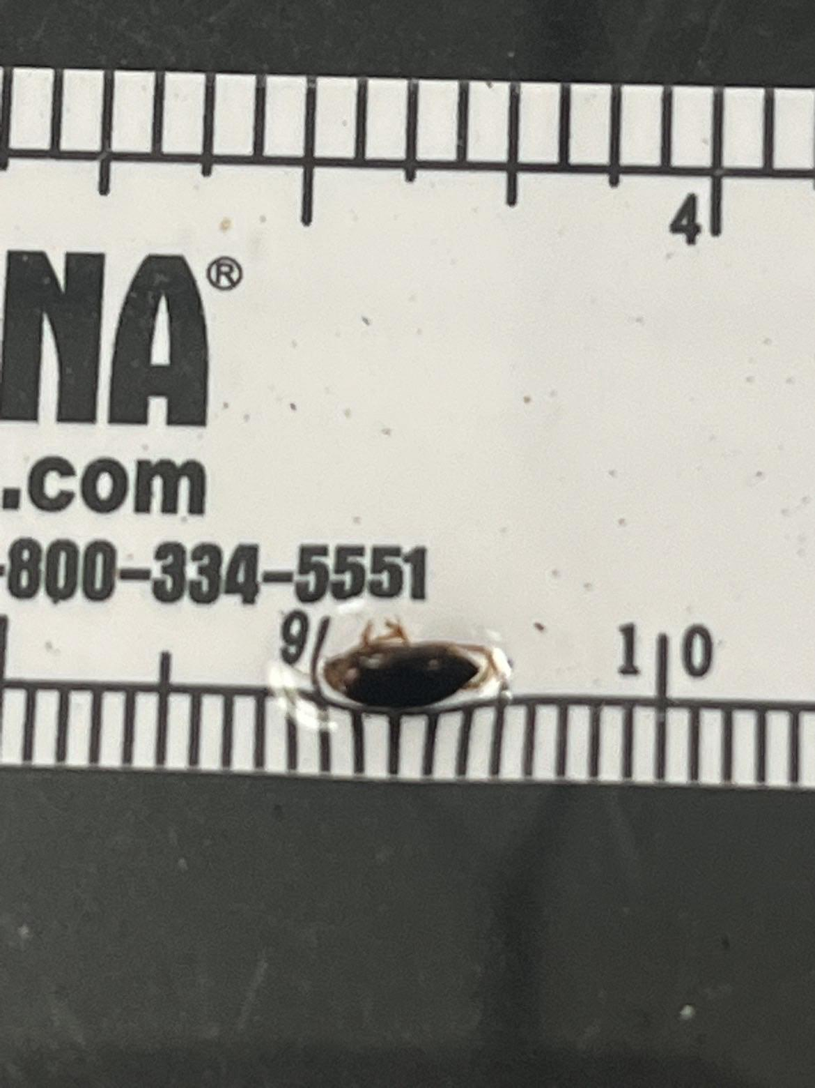
Survey of Seasonal Macroinvertebrates Taken to Be DNA Barcoded to Test The Biodiversity From The Massapequa Preserve
By: Isabella Buonaspina, Mia Cespites, Ryanne Hilt, Angelina Prizzi
Mentors: August Eberling, Jeffry Petracca
Abstract: Biodiversity in a wetland ecosystem like the Massapequa Preserve is important. A rich biodiversity ensures that some organisms will survive environmental pressures in the ecosystem. Samples were collected in the Massapequa Preserve the temperament forest-wetland ecosystem the students found a variety of animals like insects and macroinvertebrates. The students can determine if the Massapequa Preserve is a sustainable wetland ecosystem by determining the biodiversity of macroinvertebrates collected from the Preserve. Students went inside of the water using waders and collected sediments from the pond using a net. Students also collected terrestrial organisms by using tweezers and a shovel-like tool. By using this process we can extract DNA, amplify the CO1 region and barcode it to determine if there is biodiversity in the ecosystem. From the ten species collected only one specimen was shown as a repeat species this shows there is a high level of biodiversity in the Massapequa Preserve.
Figure 1: DNA barcoding workflow
Conclusion: In conclusion the amount of biodiversity is displayed by the vast difference in aquatic organisms found in the Massapequa preserve. Chelex was used to extract the DNA, PCR was used to amplify CO1, and gel electrophoresis was used to verify that PCR worked. Sanger sequencing was used to determine genetic sequence and Genbank was used to compare sequences DNA Subway. When looking at our specimens, after data collection, it was concluded that the aquatic organisms that might have looked very similar, and been from a similar area were completely different. This suggests that there is much biodiversity in the Massapequa Preserve wetland ecosystem. The importance of having high biodiversity in the area is that there are many species to fill its various ecological roles. It is also important that they have different food sources, because this can cause a loss of a species for eating lots of the same foods causing a disruption in the food chain. Figure 4 shows that all the organisms are very diverse and all have different niche that keeps the environment stable. This is very important because if all the aquatic organisms were the same, the effects of disease or resource loss could ultimately lead to the loss of many species and ecosystem collapse. Overall this shows that no two things are the exact same.
Collecting samples - PCR Amplification - DNA Replication & CO1 section of DNA sample - Checks that CO1 in Gel electrophoresis
Figure 2: Column chart and stack chart designed to see the biodiversity of the macroinvertebrates collected in the Massapequa Preserve.
Results: All of the samples that were collected from the Massapequa Preserve were put into Genbank and DNA subway to help find all the different species of macroinvertebrates living in the wetland ecosystem. When using Genbank many different species were found by using the highest number of matches in the symptom. The macroinvertebrates that were found are named and listed below with photos also in figure 4:
001/002- Neoporus clypealis or small predaceous diving beetle
003- Caecidotea racovitzai racovitzai or
“water salter” / pillbug
005- Caecidotea racovitzai racovitzai voucher or North american isopod
007- Philoscia muscorum voucher or Common Striped Woodlouse
009- Neoporus clypealis or predaceous diving beetle
010- Pachygnatha dorothea ot thick-jawed spider
Introduction: Biodiversity has environmental and social value. Where wetlands have healthy biodiversity, they provide essential services to the environment and to our communities. Having biodiversity in an ecosystem it also is relevant to the community where people live for a well rounded ecosystem and world. DNA barcoding is important because it shows what a species is. Humans also have to play their part in helping keep the world biodiverse because humans can not pollute because if humans pollute too much or don't watch close enough we can wipe out certain species keeping our ecosystem alive. Biodiversity is important and needs to be a priority in natural habitats for well-rounded ecosystems. Biodiversity is the link between all organisms on earth, binding each into an interdependent ecosystem, in which all species have their role. It is the web of life. Without biodiversity the way the animals live may die out. Some species may go extinct or not live in areas they used to anymore. All the different animals in a biodiverse ecosystem are benefits in the world and allow different animals to thrive in a habitat they call home. In an effort to analyze biodiversity in the Massapequa Preserve, the students set out to DNA barcode the macroinvertebrates
Figure 3a b : Agarose gel result of macroinvertebrates collected from Massapequa Preserve
Methods and Materials: In our experiment, data was collected by going into the Massapequa Preserve water on 10/3/25. While in the preserve water, nets were used to take scoops of the water or sediment, which then were given to our other partners which then dug through the sediment and found macroinvertebrates. They then placed the macroinvertebrates in tubes filled with 95% alcohol. Then, recorded sample ID and location, location was absolute location, this was done using latitude and longitude. These tubes were then later refrigerated. Upon arrival to the classroom, the macroinvertebrates were placed under a microscope and examined. Pictures were taken of the organisms, then sent to Cold Spring Harbor Laboratory. A few weeks after the insects had been collected, the Ames Campus went to the Cold Spring Harbor Laboratory. At the laboratory, students had collected the macroinvertebrates DNA by using gel electrophoresis. After the gel electrophoresis, the group was able to identify the exact species of the specimen using DNA barcoding.
007 008
007 007
Figure 4: Map of Massapequa Preserve.
007 Philoscia muscorum voucher
003 & 005 Caecidotea racovitza racovitza
Scan for References and acknowledgments!
001 &002 Neoporus clypealis mitochondrial
3a: Our gel using PCR Taq DNA polymerase
3b: Jeffs Gel using PCR KOD DNA polymerase
010 Pachygnatha dorothea

