Slide 1
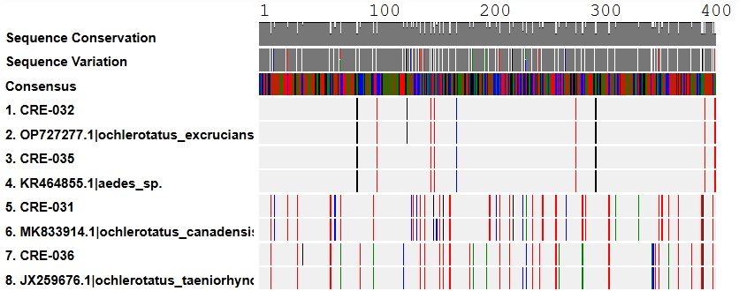
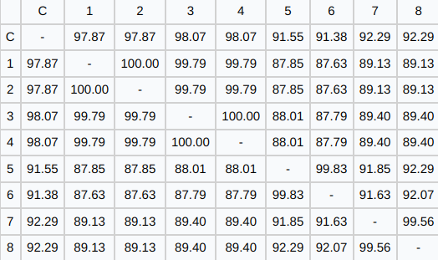
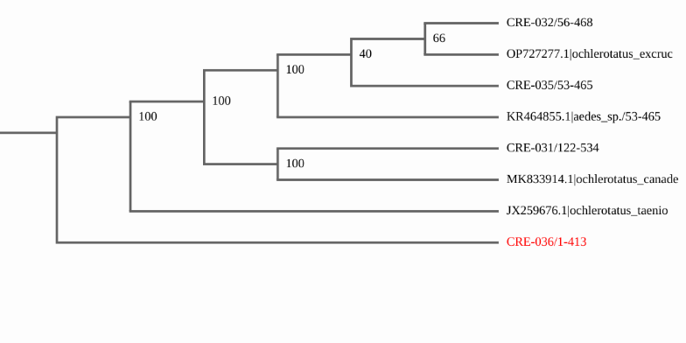
DNA Barcoding the Biting Mysteries: Identifying Various Aedes Populations in New York
Rimsha Abbasi, Ange Guillaume, Carlos Hernandez, Meriannys Moquete, Ms. Bettina Fantal, Mrs. Jessica Ottaviano
Westbury High School, Cold Spring Harbor Laboratory
Abstract
Diagram 1
Materials & Methods
Long Island is home to many mosquito species, including multiple from the Aedes genus, some of which are morphologically indistinguishable. This study investigates genetic variation within and between Aedes populations in New York by analyzing polymorphisms in the cytochrome c oxidase I (COI) gene. We hypothesized that there would be divergence in the COI sequences between various Aedes species within populations in New York State. The mosquitoes were captured with CDC CO₂ traps and identified with the help of iNaturalist. DNA was isolated, amplified using PCR, and sequenced to analyze potential variations within the COI gene of different species within the Aedes genus. The analysis of the COI gene exhibited interspecific variation, with some species pairs showing near-identical sequences, while others displayed marked genetic divergence. Overall, this study highlights the utility of COI barcoding in identifying mosquito biodiversity and reveals genetic structure within Aedes populations across New York.
The Suffolk County Health Department provided us with mosquito samples of the Aedes genus for the experiment. The mosquitoes were collected in 2023 using CDC CO₂ traps across New York. The traps lure mosquitoes using CO₂ as a bait source. We originally used 37 samples of mosquitoes, however only four produced viable DNA which was extracted at the Cold Spring Harbor DNA Learning Center. The DNA was isolated through the Chelex method and the samples were run with a specific primer through PCR to amplify the COI gene. The final step was to utilize gel electrophoresis to ensure the success of amplification. The results were then uploaded to the DNA Subway database, allowing us to analyze the COI sequences.
Diagram 2
Discussion
Introduction
Diagram 3
The Suffolk County Health Department provided us with mosquito samples of the Aedes genus for the experiment. The mosquitoes were collected in 2023 using CDC CO₂ traps across New York. The traps lure mosquitoes using CO₂ as a bait source. We originally used 37 samples of mosquitoes, however only four produced viable DNA which was extracted at the Cold Spring Harbor DNA Learning Center. The DNA was isolated through the Chelex method and the samples were run with a specific primer through PCR to amplify the COI gene. The final step was to utilize gel electrophoresis to ensure the success of amplification. The results were then uploaded to the DNA Subway database, allowing us to analyze the COI sequences.
Mosquitoes are one of the most important vectors for disease transmission, and they are responsible for malaria, dengue, chikungunya, and Zika viruses^{[1]}. Mosquitoes in the Aedes genus, such as Aedes aegypti and Aedes albopictus, are of concern because of their disease potential and urban adaptation^{[2]}. The two species are morphologically identical - thus difficult to distinguish visually - and therefore challenging to survey.
Conventional physical-based identification techniques, such as body color and banding, are unreliable for closely related species. DNA barcoding based on the cytochrome c oxidase subunit I (COI) gene is now a proven technique for the identification and discrimination of insect species, in some cases uncovering cryptic diversity that would have otherwise remained undiscovered by morphological examination alone^{[3]}.
We explore the population genetic structure of Aedes mosquitoes in New York State based on variation in the mitochondrial cytochrome c oxidase I (COI) gene^{[4]}. We consider how much genetic differentiation exists among local populations of Aedes and how well morphological diagnosis predicts actual species diagnosis. We focused on what the range of COI variability is between Aedes populations in New York State and what the variability implies regarding species identification.
Results
Out of 37 mosquito samples, only 4 produced high-quality DNA results due to degradation in older specimens. These samples were identified as Aedes excrucians, Aedes canadensis, and Aedes taeniorhynchus using COI gene sequencing. However, the genetic similarities between some species made identification challenging, highlighting the need for additional genetic markers in future studies.
References
Acknowledgements
Aedes infirmatus, aedes tormentor. JACKSONVILLE.GOV. (n.d.). https://www.jacksonville.gov/departments/neighborhoods/mosquito-control/aedes-infirmatus,-aedes-tormentor.aspx
Powell, J. R., & Tabachnick, W. J. (2013). History of domestication and spread of Aedes aegypti - A Review. Memórias Do Instituto Oswaldo Cruz, 108(suppl 1), 11–17. https://doi.org/10.1590/0074-0276130395
Fang, Y., Zhang, J., Wu, R., Xue, B., Qian, Q., & Gao, B. (2018). Genetic polymorphism study on Aedes albopictus of different geographical regions based on DNA barcoding. BioMed Research International, 2018, 1–10. https://doi.org/10.1155/2018/1501430
Marullo, R., Mercati, F., & Vono, G. (2020). DNA barcoding: A reliable method for the identification of thrips species (Thysanoptera, Thripidae) collected on sticky traps in Onion Fields. Insects, 11(8), 489. https://doi.org/10.3390/insects11080489
Lamichhane, B., Brockway, C., Evasco, K., Nicholson, J., Neville, P. J., Mackenzie, J. S., Smith, D., & Imrie, A. (2024b). dna barcoding for the identification of adult mosquitoes (Diptera: Culicidae) in Western Australia. Ecology and Evolution, 14(11). https://doi.org/10.1002/ece3.70493
We would like to express our sincere gratitude to Westbury High School for providing us with a supportive and encouraging environment. We are especially thankful to the dedicated faculty and staff who mentored us throughout our research journey, offering guidance, feedback, and inspiration that helped us grow both academically and personally.
A special thank you goes to Cold Spring Harbor Laboratory for generously providing the data used in our research and for assisting us in the data collection process. Your collaboration was instrumental in allowing us to carry out meaningful and impactful work.

