Slide 1



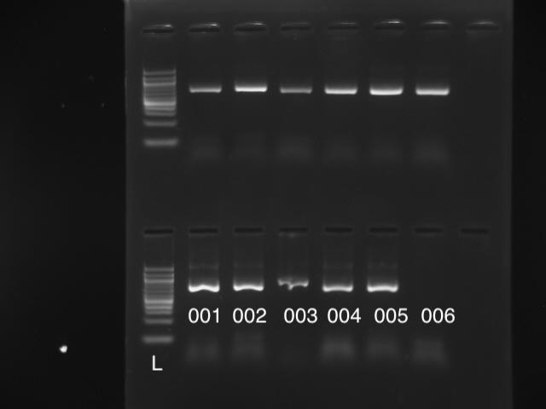
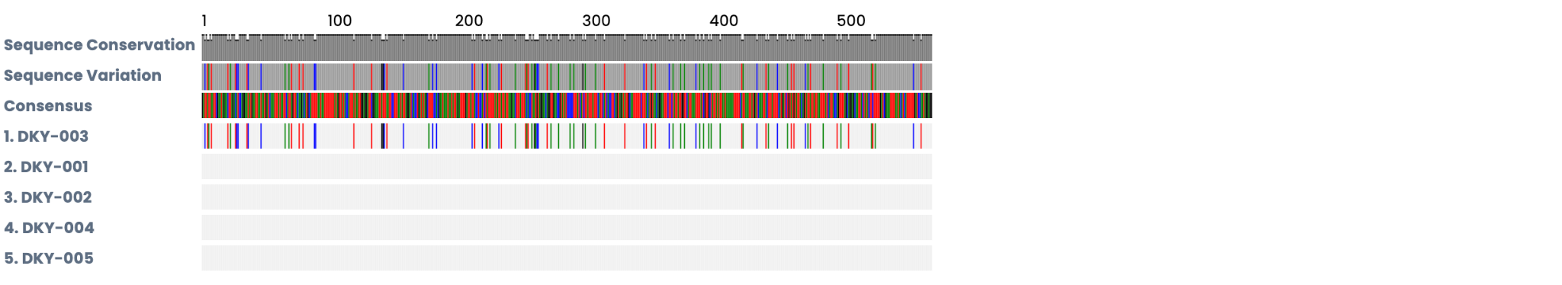
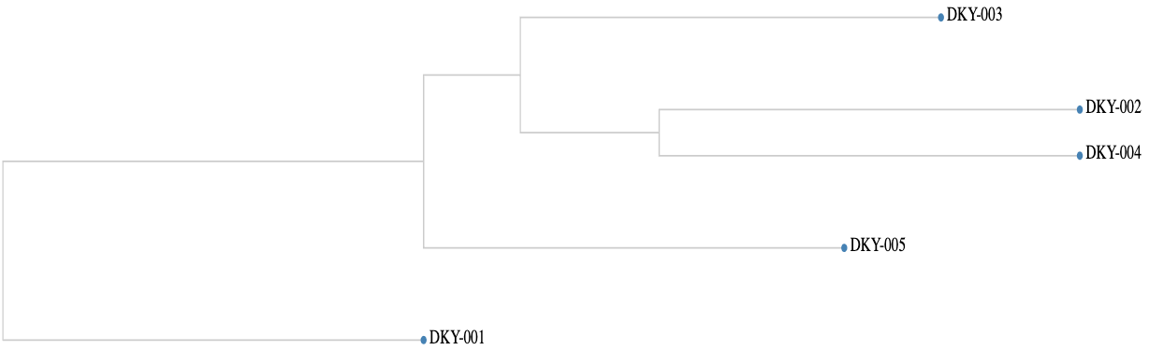
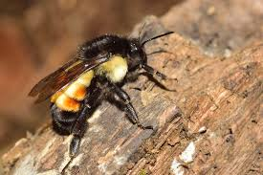
Biodiversity within Bees in Long Island
Gabriela Melgar,Denis Sovjani
Mrs. Bettina Fantal, Mrs. Jessica Ottaviano
Westbury High School/ Cold Spring Harbor Laboratory
Abstract
Long Island is home to many bee species. This study investigates biodiversity within Anthophila populations in New York by analyzing the cytochrome c oxidase I (COI) gene. We hypothesized that there would be a lack of biodiversity within the bee populations between various Anthophila species within populations in Long Island due to environmental pressures. The bees were captured with malaise traps and identified with the help of iNaturalist and Google Lens. DNA was isolated, amplified using PCR, and sequenced to analyze each bee sequence within the COI gene of different species within the Anthophila genus. The analysis of the COI gene confirmed the species that was caught in the trap. Overall, this study highlights the utility of COI barcoding in identifying bee biodiversity and reveals genetic structure within Anthophila populations across New York.
Results
There are about 17 different bee species on Long Island. In our sample, all of the bees, with the exception of one (identified as Apis mellifera), were identified through Sanger Sequencing as Bombus ephippiatus with a sequence alignment between 99.84% and 100%. The one bee identified as Apis mellifera has a sequence similarity of about 84% to the other bees.
Figure 1. Gel Electrophoresis to analyze PCR products.
Figure 2. Shows the sequence alignment of the bees analyzed.
Figure 3. Shows the possibility of shared ancestry among the bee species.
Introduction
Healthy insect populations, especially bees, are vital for our ecosystems and food crops. However, rapid suburban and agricultural growth on Long Island, New York, is threatening local bees, making population monitoring a critical priority.
Nationally, both wild and managed bees are in steep decline due to a variety of environmental pressures (Milman, 2025). On Long Island, the primary driver is habitat loss. Sprawl and farming have fragmented the natural areas and nesting sites bees need to survive and reproduce (New York Bee Sanctuary, n.d.). This report examines the state of bee biodiversity on Long Island to help guide local conservation strategies.
Discussion
There are about 17 different bee species on Long Island. In our sample, all of the bees, with the exception of one (identified as Apis mellifera), were identified through Sanger Sequencing as Bombus ephippiatus with a sequence alignment between 99.84% and 100%. The one bee identified as Apis mellifera has a sequence similarity of about 84% to the other bees. The results revealed that only two different species were captured in the malaise trap, with one species making up the vast majority of the samples. Considering that there are 17 known species present on Long Island, these findings may indicate a concerning decline in biodiversity within the area.
The results of this research suggest that bee populations in Long Island may be experiencing loss of biodiversity because of environmental pressures such as habitat loss, pesticide exposure, and changing local conditions. Bees play an important role in pollination and keeping ecosystems healthy, so changes in their populations can have major effects on plants, crops, and other animals in the food web.
Figure 4. Bombus ephippiatus species
Materials and Methods
Bees were collected using Malaise traps, which are tent-like traps that catch flying insects by guiding them upward into a chamber with preservatives. The bee samples were photographed and identified using iNaturalist.
DNA barcoding was used for more accurate identification by extracting bee DNA, analyzing the COI gene, and comparing the sequences to databases like GenBank to study bee diversity.
Acknowledgements
We would like to acknowledge our mentors for paving the way through this research. We would also like to thank Cold Spring Harbor Laboratory for providing us the materials for our experiment and the opportunity to uncover the surface of biodiversity within bees. We would also like to thank the STEP Old Westbury program for supporting our research endeavors.
References
1. Chan, A., Chiang, L.-P., Hapuarachchi, H. C., Tan, C.-H., Pang, S.-C., Lee, R., ... Lam-Phua, S.-G. (2014). DNA barcoding: complementing morphological identification of mosquito species in Singapore. Parasites & Vectors, 7(1). https://doi.org/10.1186/s13071-014-0569-4
2. Habitat Loss. (n.d.). Retrieved from New York Bee Sanctuary website: https://www.newyorkbeesanctuary.org/habitat-loss
3. Milman, O. (2025, March 25). US honeybee deaths hit record high as scientists scramble to find main cause. Retrieved from the Guardian website: https://www.theguardian.com/us-news/2025/mar/25/honeybees-deaths-record-high
4. White, E. (2024). Species status assessment https://dec.ny.gov/sites/default/files/2024-04/beesstatusassessments.pdf. New York State Department of Environmental Conservation. Retrieved December 10, 2025, from https://dec.ny.gov/sites/default/files/2024-04/beesstatusassessments.pdf
Notes:
IMPORTANT– posters should contain all of the information in this template, but do not need to be organized in this exact format. Posters with descriptive images and figures are preferred over text-heavy posters. Results do not need to be contained to the highlighted “Tables & Figures” box.

