Slide 1
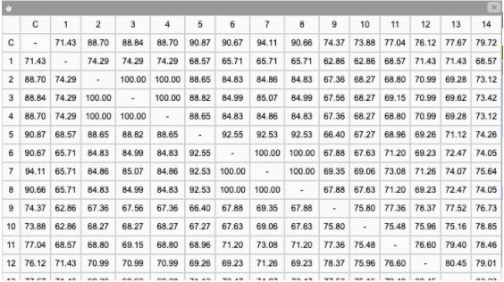
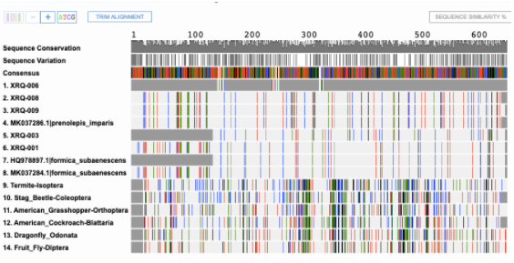
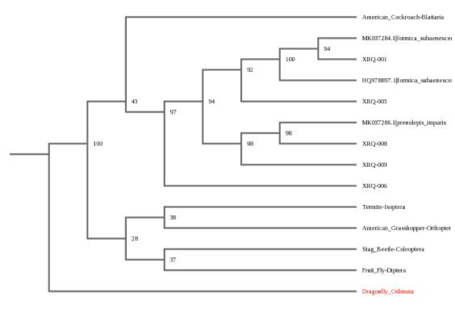
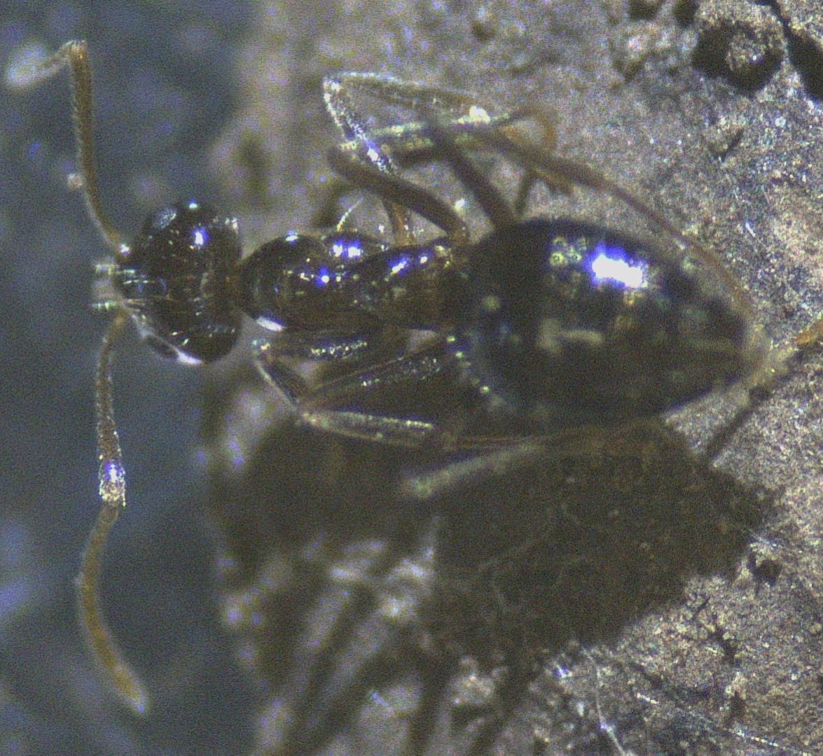
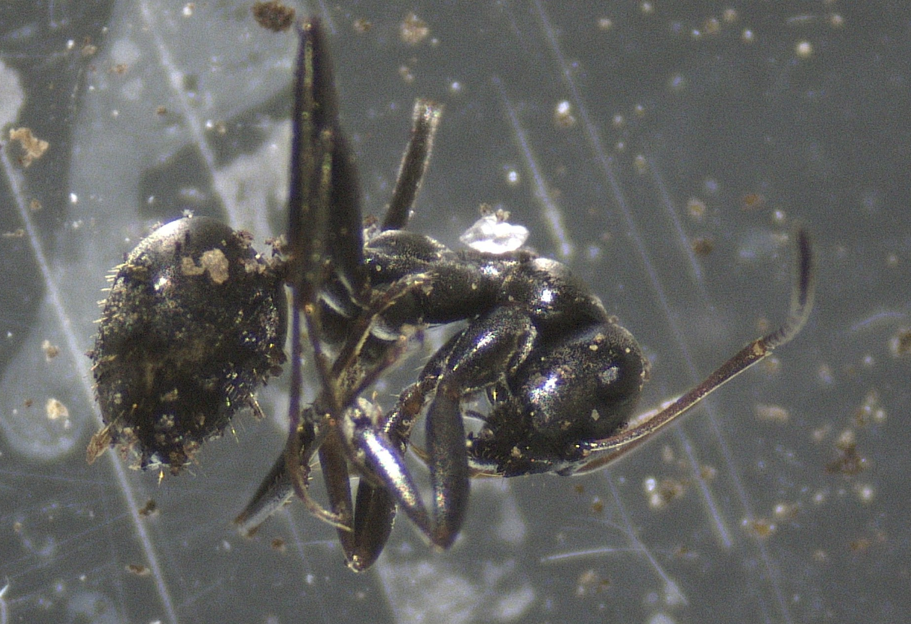
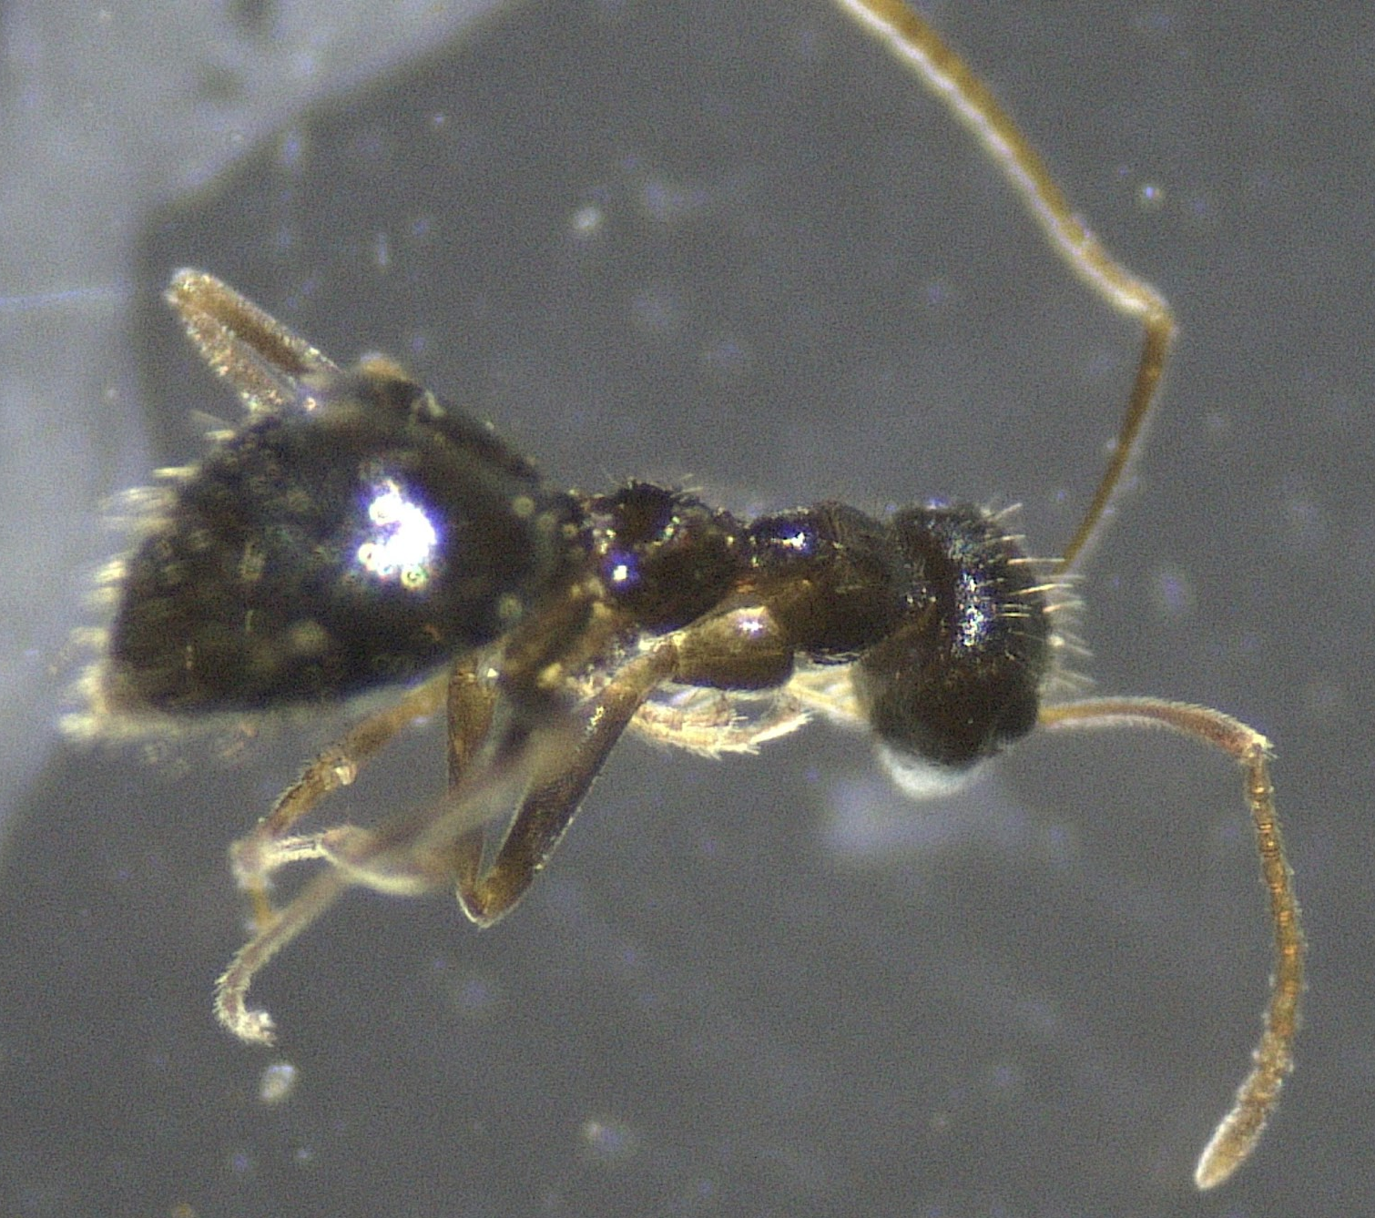
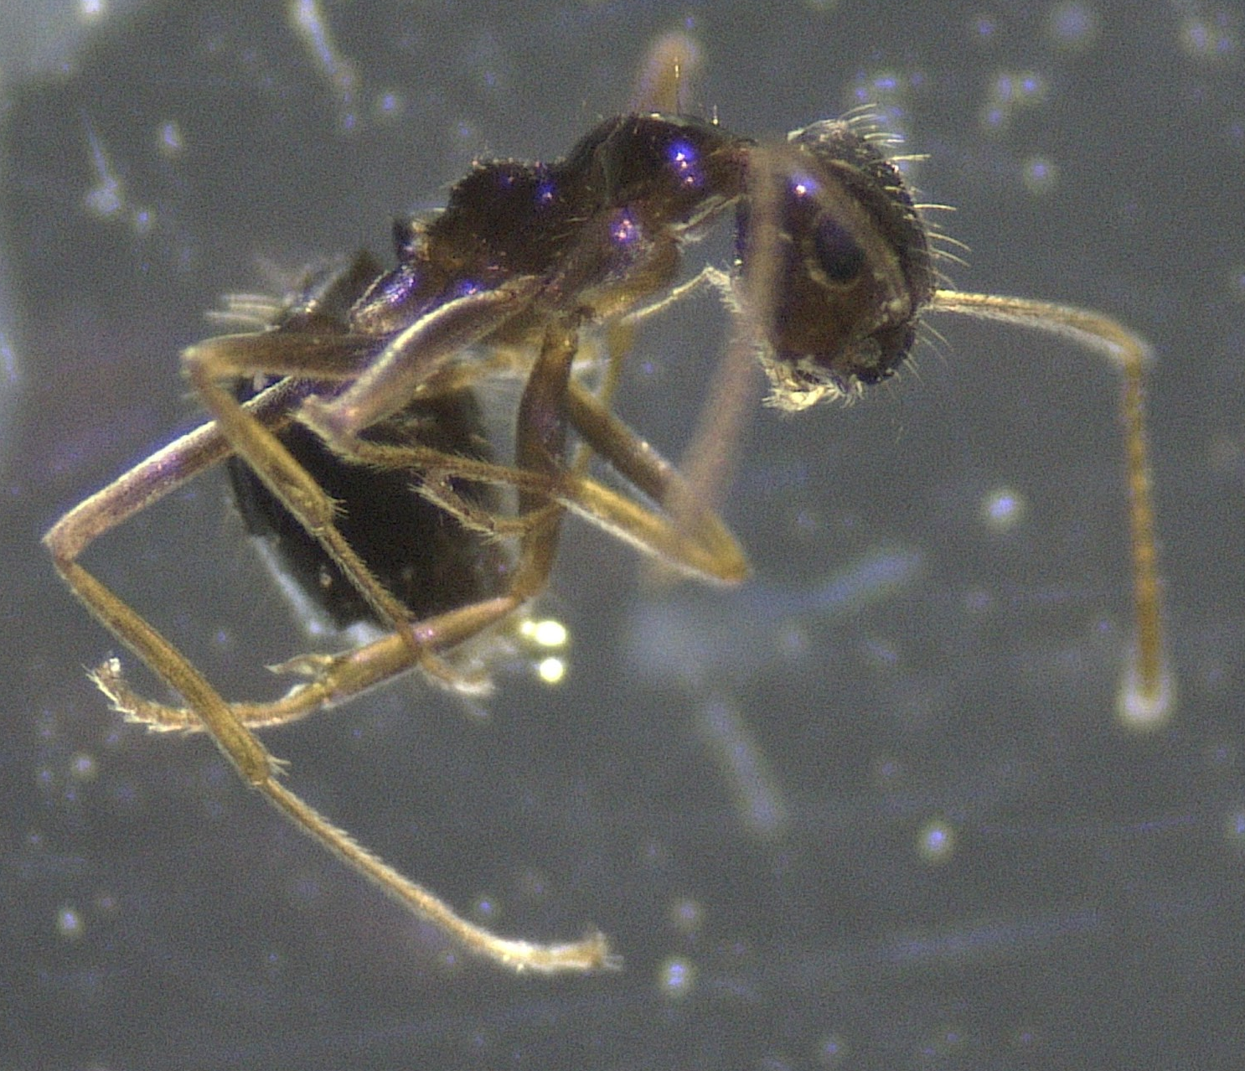
Comparing Levels of Biodiversity Affected & Not Affected by PFAS
Authors: Hannah Saks 1 & Noelle Decker 1
Mentor: Frederick Feraco 1
1 Walt Whitman High School
Abstract
PFAS (per- and polyfluoroalkyl acid) is a group of persistent chemicals used in industrial settings and consumer products. PFAS can travel through the soil and contaminate the groundwater. Communities with PFAS in their drinking water may lead to higher incidences of health effects. The question of whether PFAS limits the level of biodiversity amongst ants was asked. The objective entailed sequencing the DNA of samples from the experimental group and the control group, to compare the ant biodiversity. The DNA was isolated, amplified, and sequenced using barcoding and DNA Subway to identify the species from five samples. Results showed that from the experimental site, two species out of four samples were identified, Formica subaenescens and Prenolepis imparis. Only one sample from the control site was successful, Formica subaenescens. Therefore, results were inconclusive.
Introduction
Maintaining a healthy and balanced diversity of species in an ecosystem is essential to its survival. If threatened species must be able to adapt and evolve. Nonetheless a chemical group known as PFAS may pose a threat to this. PFAS (per- and polyfluoroalkyl acid) is used in industrial settings and consumer products i.e. packaging, non-stick cookware, and fire extinguishers. PFAS can be inhaled through dust particles and is linked to slowing the development of learning, growth and behavior in children and causing various cancers. The Suffolk County Water Authority reported in 2017 that public and private wells of WestHampton had been contaminated with PFOS and were being treated. PFAS, however, is a persistent chemical, lasting in the human body for six to eight years. In Brazil, PFAS has been used in pesticides to kill leaf-eating ants, proving its harmful impact on the ant species. By barcoding the DNA of ant samples, one can hypothesize that if an area is affected by PFAS then it will exhibit lower levels of biodiversity amongst ants. This is because when a population is negatively impacted, the species most adaptive to the environment will survive; survival of the fittest. PFAS has shown to be damaging to the environment and animals. The Ministers of the Environment and of Health stated that PFAS has “an immediate or long-term harmful effect on the environment or its biological diversity”. Nevertheless, the need to bring awareness to and promote its harmful effects is of importance.
Materials & Methods
On November 10th 2019, four ant samples were collected as the control group from the Paumanok Wetlands Preserve with no known PFAS contamination. The following day, seven ant samples were collected as the experimental group from the public areas outside of Francis S. Gabreski Airport, chosen due to its history of using firefighting foam which is a known source of PFAS. The samples of ants were collected using a shovel to dig up the soil and then stored in plastic containers. The eleven samples collected were photographed using a stereo microscope, frozen, and then stored in the freezer of the research room located in the Walt Whitman High School.
The Silica DNA Isolation protocol provided by the Cold Spring Harbor Laboratory (CSHL) was performed to isolate the DNA from each ant sample. Following, seven samples (two from the control group and five from the experimental group) were amplified by PCR using the LCO1490/HC02198 invertebrate primer. The seven samples then underwent gel electrophoresis and the successful five samples (four from the experimental group and one from the control group) were sent to CSHL for sequencing. Finally, DNA subway was used to compare and identify the different species of ants that had been collected.
Results
Following the sequencing, five samples (four from the experimental group and 1 from the control group) were successfully identified. Three samples from the experimental site, XRQ 006, 008, and 009 had strong relations to the ant species, Prenolepis imparis. Upon analysis of the DNA Similarity Percentage Chart which compares the genetic similarities between the sample’s DNA and identified species. Sample XRQ 006 has a 74.29% similarity to the Prenolepis imparis, common name is the false honey ant, and XRQ 008 and 009 have a 100% similarity. An additional sample from the experimental site, XRQ 1, was identified as a different species, the Formica subaenescens and has 100% similarity to it’s DNA sequence. From the control site, Paumanok Wetlands preserve, only one sample was successfully sequenced, XRQ 3 having a 92.53% similarity to Formica subaenescens as well.
Figure 1: DNA Similarity Chart of each of the organisms on the barcode chart.
Figure 2: DNA Barcode Sequencing Chart
XRQ-003
Paumanok
XRQ-001
WestHampton
XRQ-006
WestHampton
XRQ-008
WestHampton
XRQ-009
WestHampton
Figure 3: Phylogenetic Tree using the Neighbor Joining method. Showing how closely related these organisms are based on the barcoding DNA.
Discussion
After analyzing the sequencing samples and origins, the data proved to be inconclusive. With only five samples successfully sequenced, it does not provide a substantial amount of evidence to compare the level of biodiversity in both areas. In addition, only one sample from the control site was able to be sequenced. One control sample cannot represent an entire ant population's biodiversity and without an adequate control sample there is no data to support the hypothesis. However, the results do show that samples collected from the experimental site identified as Prenolepis imparis (false honey ant) are a common native species across the United States nesting outdoors in soil and in cold temperatures. This is relevant due to the ants being collected around fall/winter time. Both an experimental sample and a control sample were identified as the Formica subaenescens which is a part of the largest genus in North America. There is not much information about the individual species being that it is very complex and almost indistinguishable. These specific species are found in cold elevated parts of the woods common to eastern locations.
Acknowledgements
The authors would like to thank Mr. Feraco, our mentor, for guiding us through this process. And to Cold Spring Harbor Labs they would like to thank you for the opportunity and for the supplies and materials provided.
References
N.a (29 Nov. 2018.). . Mfe.govt.nz. Retrieved from https://www.mfe.govt.nz/sites/default/files/media/Land/final-impact-of-pfas-on-ecosystems_0.pdf
N.a (29 Mar. 2019.). . Health.state.mn.us. Retrieved from https://www.health.state.mn.us/communities/environment/risk/docs/guidance/gw/pfosinfo.pdf
Culligan United States & Canada (8 Jun. 2017.). The Effects of PFOS and PFOA in Drinking Water - Culligan. Culligan United States & Canada. Retrieved from https://www.culligannation.com/pfos-and-pfoa-in-drinking-water/
N.a (29 Nov. 2018.). . Mfe.govt.nz. Retrieved from https://www.mfe.govt.nz/sites/default/files/media/Land/final-impact-of-pfas-on-ecosystems_0.pdf
Darlington, R., Barth, E., & McKernan, J. (2018, January 1). The Challenges of PFAS Remediation. Retrieved from https://www.ncbi.nlm.nih.gov/pmc/articles/PMC5954436/
The State of Long Island's Water. (2019, November 26). Retrieved June 01, 2020, from http://nyc.sierraclub.org/9968-2/
SCWA. (2017). Suffolk COunty Water Authority 2017 Drinking Water Quality Report. Retrieved from http://s1091480.instanturl.net/dwqr2017/AWQR2017_FINAL_052517.pdf
Sharon Lerner (29 Apr. 2019.). Brazil’s Pesticide Industry Is Creating Massive PFOS Contamination. The Intercept. Retrieved from https://theintercept.com/2019/04/29/brazil-pfos-sulfluramid-pesticide/
N.a (n.d.). False Honey Ant or Small Honey Ant - NYC Pest Control. Magicexterminating.com. Retrieved from https://www.magicexterminating.com/articles-detail.asp?nid=68
Mrilovetheants (30 May 2020.). Identification and Distribution of Formica. Biodiversegardens.com. Retrieved from http://www.biodiversegardens.com/2011/07/identification-and-distribution-of_3157.html
Per- and polyfluoroalkyl substances (9 Jan. 2018.). Westhampton, Suffolk County, NY. Per- and polyfluoroalkyl substances. Retrieved from https://pfasproject.com/gabreski-air-national-guard-base-and-airport/

