Slide 1


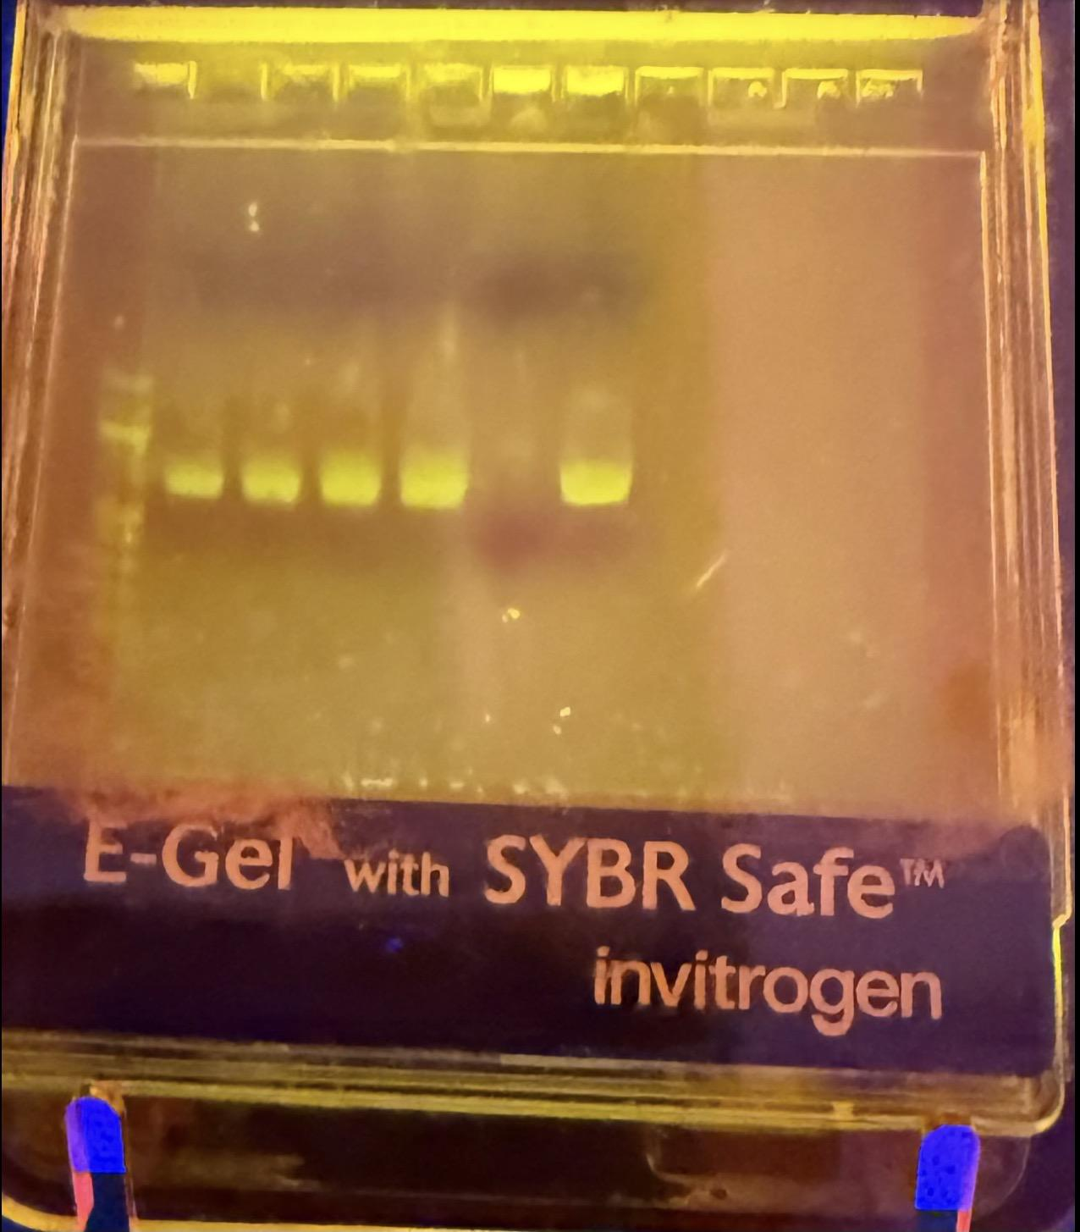
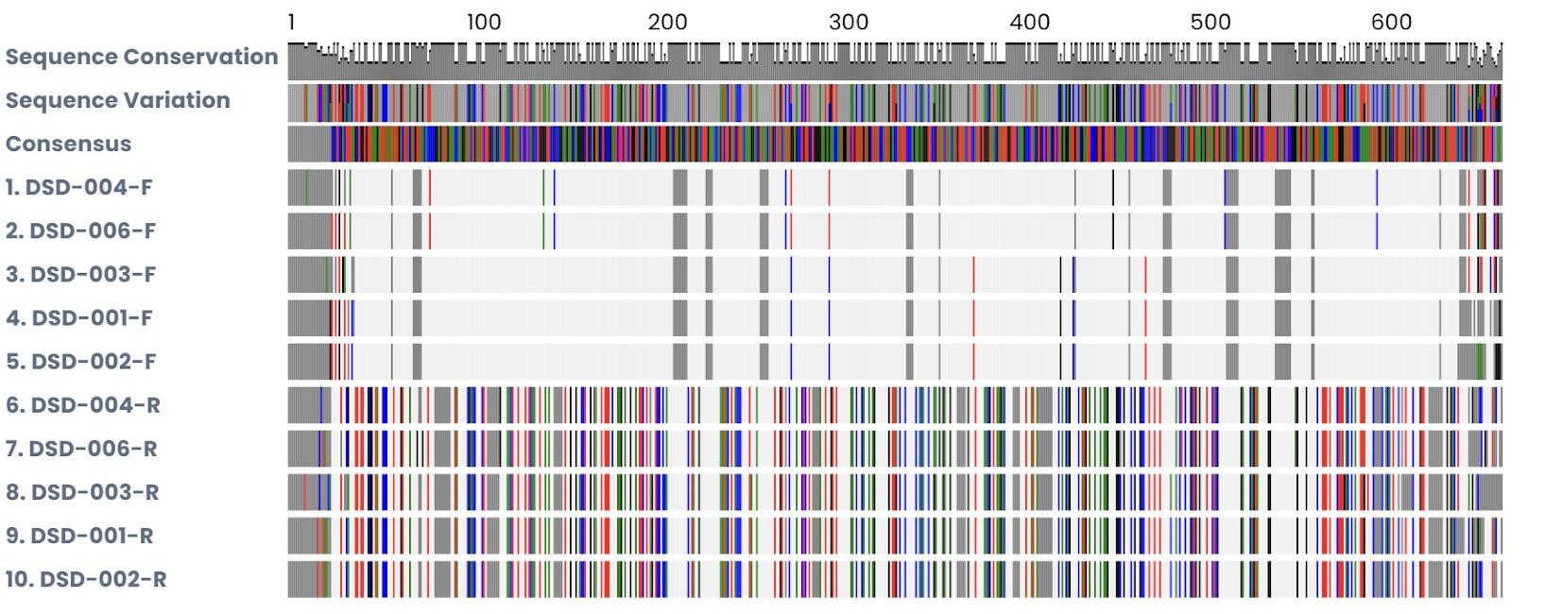
Can you extract more DNA from new or old grass?
Ava Oppedisano, Georgia Kall, Kylie O’Leary & Steven Gordon
Abstract
This experiment tested whether more DNA could be extracted from fresh grass or dried grass. Equal samples of both were tested using the same DNA extraction process. The PCR and DNA purification worked for 5 out of 6 samples. Fresh grass produced stronger PCR results, meaning it contained more DNA. The results supported our hypothesis
Introduction
Topic: Comparing the amount of DNA extracted from dried grass and fresh grass
Hypothesis: If DNA is extracted from both dried grass and fresh grass, then fresh grass will produce more DNA because it’s cells are moisture
Independent Variable= Type of grass used (dried grass vs fresh grass)
Dependent Variable= Amount of DNA extracted
Controls(Constants)= Same type of species of grass, mass of grass, DNA extracted procedure, temperatures conditions, equipment, and same extraction time.
Materials & Methods
Equal amount of fresh grass and dry grass are collected and cut into small pieces. Each sample was placed in a separate container with DNA extraction solution. The grass was crushed to break up to break open the cells. The amount of visible DNA from the fresh grass and dry grass samples was compared to determined in which produced more DNA.
Results
The PCR process was successful for 5 out of 6 samples. Fresh grass showed stronger PCR results than dried grass, indicating that more DNA was extracted from fresh grass.
Discussion
The results confirmed our hypothesis that fresh grass produces more DNA than dried grass. Fresh grass likely worked better because its cells still contained moisture and less damaged DNA. One sample did not work, possibly due to experimental error or contamination.
Acknowledgements
We would like to thank our teacher and Cold Spring Harbor Laboratory DNA Learning Center for providing materials, guidance, and support throughout this experiment. We also thank our group members for working together on the project.
Summary
Our experiment compared old and new grass samples to see which produced more detectable DNA. The new grass showed a stronger PCR result, meaning it had more extractable DNA than the old grass. We also discovered that the samples were different species, Poa annua and Lolium arundinaceum, which may have also affected the DNA results.
Notes:
IMPORTANT– posters should contain all of the information in this template, but do not need to be organized in this exact format. Posters with descriptive images and figures are preferred over text-heavy posters. Results do not need to be contained to the highlighted “Tables & Figures” box.

