Slide 1
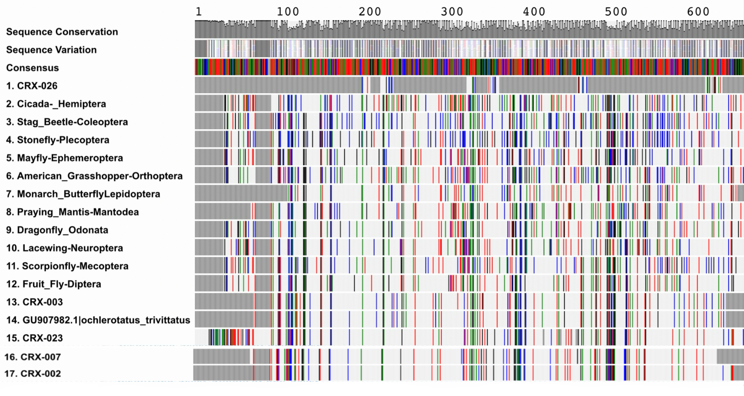
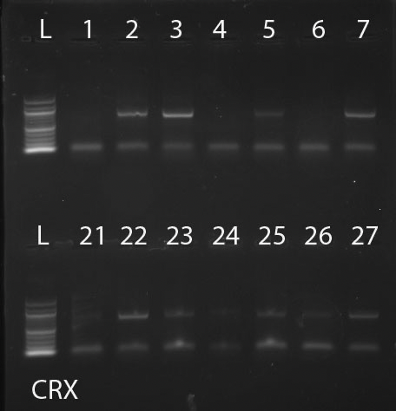
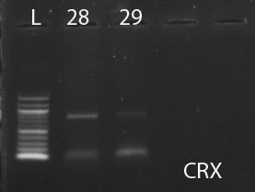
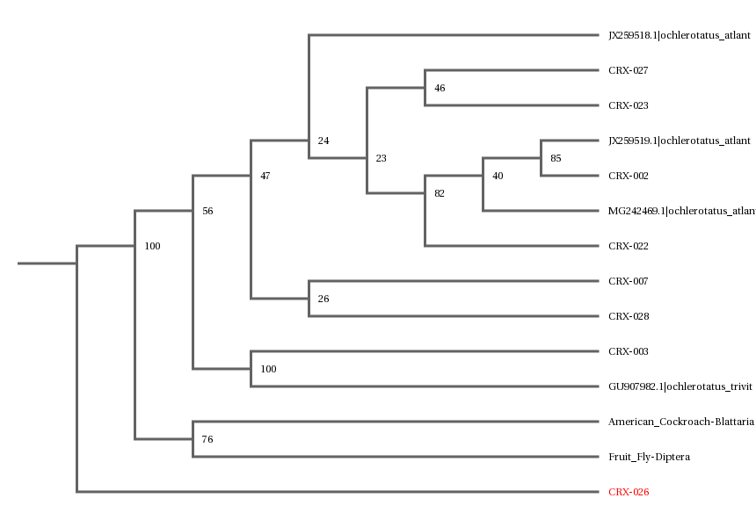
Identifying Aedes atlanticus and Aedes tormentor through DNA Barcoding
Evan Fernandez & Yosef Naser
Mentor: Todor Cvetanovic
Abstract
DNA Barcoding is a taxonomical process that assigns each species a barcode based on the unique pattern of its DNA. This method can identify and differentiate Aedes atlanticus (A. atlanticus) and Aedes tormentor (A. tormentor. Specifically, we can identify the differences in the two species by isolating the Cytochrome c oxidase I (COI). We used DNA barcoding kits to identify these genetic differences, including tools like chemical lysis reagents, PCR reagents, PCR machine, DNA sequencing services, and the mosquito specimens. Using the DNA analyzing application, DNA Subway, we identified the mosquito species by comparing them with one another genetically.
Introduction
We plan to identify the mosquitoes through an initial visual analysis to determine if there are any noticeable differences to the naked eye between Aedes atlanticus and Aedes tormentor. To ensure accuracy beyond morphological traits, we will subsequently use DNA barcoding to further differentiate and discern the two. DNA barcoding using Cytochrome c oxidase I (COI) sequences will accurately differentiate and identify Aedes atlanticus and Aedes tormentor.
Materials & Methods
Our study focuses on Aedes atlanticus and Aedes tormentor due to their presence in the Long Island region and their highly similar appearance, making genetic identification useful for future ecological studies. An initial visual identification of the mosquitoes was done with our eyes and the aid of iNaturalist. iNaturalist is an app that helps users identify and record wildlife such as plants, animals, and fungi through photos taken with a smartphone camera. Users can contribute to a global database to further support scientific research and biodiversity tracking. We used 20 samples provided by Barcoding Long Island, which were collected in September of 2014 from various sites across Long Island. These samples were chosen for their relevance to our study’s focus on distinguishing among visually similar species within the same habitat. The DNA barcoding analyzes a short region of the mosquito's DNA, the Cytochrome c oxidase. The DNA is first isolated using chemical lysis to break the cells apart and purify the DNA. Next, the DNA region of interest is amplified using the Polymerase Chain Reaction to create many copies for analysis. Finally, the amplified DNA is sequenced through Cold Spring Harbor Laboratory, which can determine the exact sequence of nucleotides. These sequences are then compared to identify the species.
Results
Using the phylogenetic tree system on DNA Subway, we determined a genetic difference between the two species and our samples. Sample 26 was on its own branch while samples 2, 3, 7, 22, 27, and 28 were connected on a similar branch.
Fig 1. PCR Results
Table 1. MUSCLE
Fig 2. PCR Results
Fig 3. Phylogenetic Tree
Discussion
Using the findings from DNA Subway, we determined that sample 26 was a different species from the other 6 samples processed. In addition, we used the physical characteristics we attributed to the mosquitoes to determine that sample 26 was an Aedes atlanticus while the other samples were Aedes tormentors.
References
DNA Learning Center Barcoding 101. (2024). Dnabarcoding101.org. https://dnabarcoding101.org/search/#q:Mosquito
CDC. (2024, May 14). Potential Range of Aedes Mosquitoes. Mosquitoes. https://www.cdc.gov/mosquitoes/php/toolkit/potential-range-of-aedes.html
Lindsay, S. W., Wilson, A., Golding, N., Scott, T. W., & Takken, W. (2017). Improving the built environment in urban areas to control Aedes aegypti-borne diseases. Bulletin of the World Health Organization, 95(8), 607–608. https://doi.org/10.2471/BLT.16.189688
Acknowledgements
Thank you to the staff at Cold Spring Harbor who helped us throughout this project!
Notes:
IMPORTANT– posters should contain all of the information in this template, but do not need to be organized in this exact format. Posters with descriptive images and figures are preferred over text-heavy posters. Results do not need to be contained to the highlighted “Tables & Figures” box.

