Slide 1
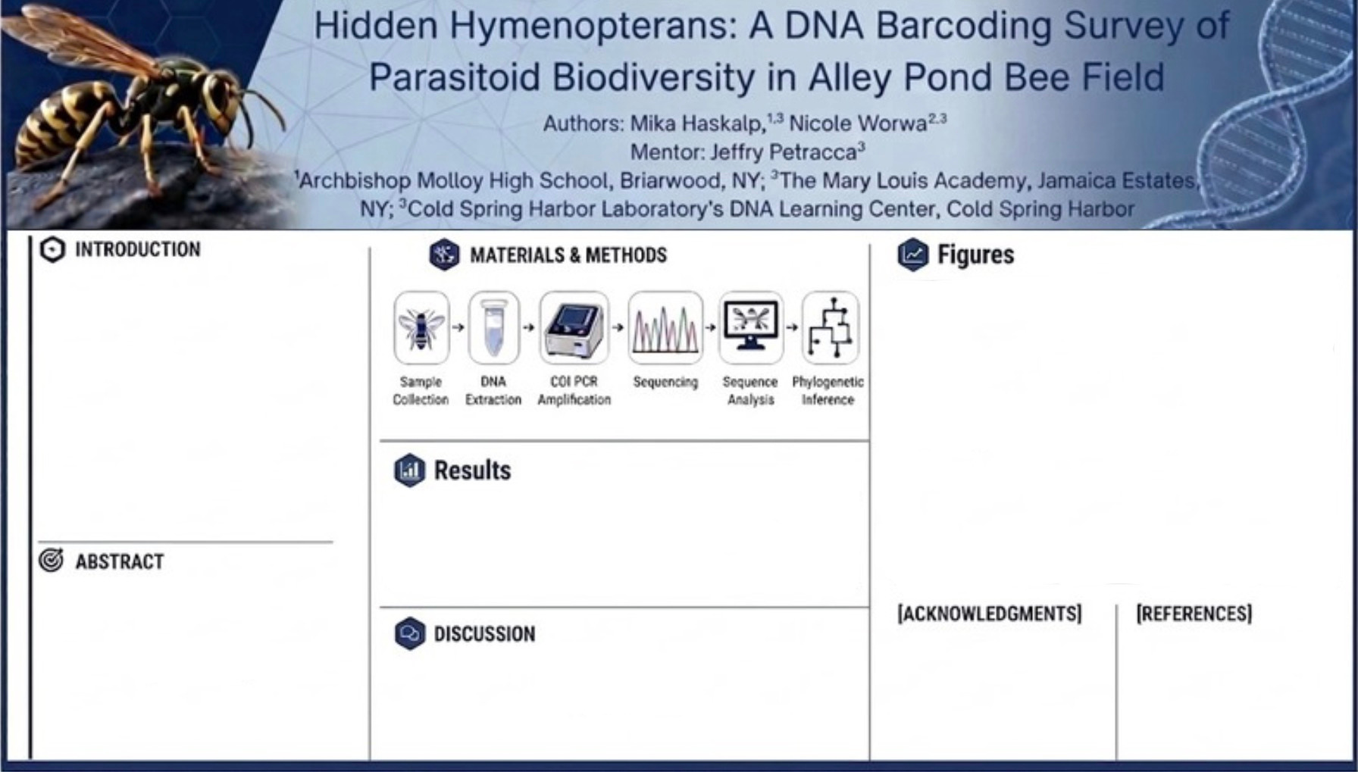

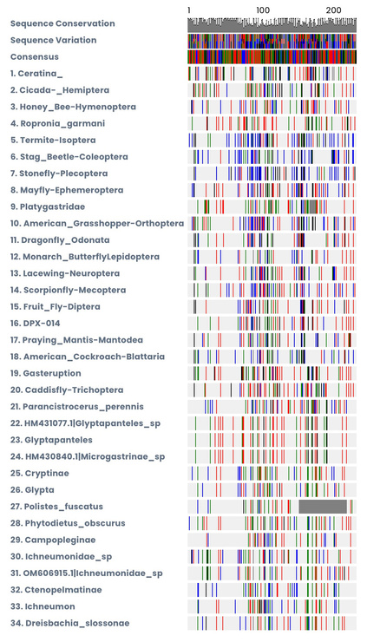
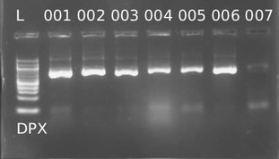
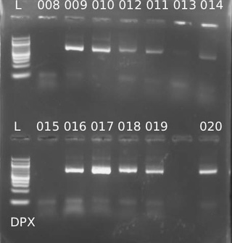

This study used DNA barcoding to identify parasitoid wasps collected in Queens, NY, and evaluate hidden diversity. Specimens were processed through DNA extraction, PCR amplification, and sequencing, then analyzed using DNA Subway and BLAST. Multiple taxa were identified, including both common and rare species. A high proportion of family-level matches suggests significant cryptic diversity and gaps in reference databases.
Most samples successfully amplified and were identified across a range of taxa. However, about half matched only at the family level, suggesting unknown species or gaps in reference databases.
Figures 1&2. PCR amplification of extracted DNA from 20 wasp samples from Alley Pond Bee Field.
Figure 3. DNA Subway barcode alignment showing sequence conservation and variation across identified taxa.
Parasitoid wasps are important for regulating insect populations but are difficult to identify due to their similar morphology. DNA barcoding using the COI gene helps distinguish cryptic species and improve identification accuracy. This study applies barcoding to assess parasitoid diversity in an under-studied urban environment.
Thank you to Dr. Petracca and Ms. Mallia for their support and guidance that made this research possible. We would also like to thank Cold Spring Harbor Laboratory for all materials .
Broad GR. 2010. Ichneumonid Wasps: Evolution, Diversity, and Taxonomy.
Godfray HCJ. 1994. Parasitoids: Behavioral and Evolutionary Ecology. Princeton University Press.
McIntyre NE. 2000. Ecology of urban arthropods: a review and a call to action. Annals of the Entomological Society of America. 93(4):825–835.
Quicke DLJ. 2015. The Braconid and Ichneumonid Parasitoid Wasps. Wiley-Blackwell.
Russo L, Stehouwer R, Keller K, Mortensen D. 2021. Urban green spaces support diverse Hymenoptera communities. Urban Ecosystems. 24:445–458.
Smith MA, Woodley NE, Janzen DH, Hallwachs W, Hebert PDN. 2008. DNA barcodes reveal cryptic host-specificity within the presumed polyphagous members of a genus of parasitoid flies (Diptera: Tachinidae). Proceedings of the National Academy of Sciences. 103(10):3657–3662.
DNA barcoding effectively revealed greater parasitoid diversity than morphology alone. The findings highlight both hidden urban biodiversity and the need for more complete genetic reference data.
Broad GR. 2010. Ichneumonid Wasps: Evolution, Diversity, and Taxonomy.
Godfray HCJ. 1994. Parasitoids: Behavioral and Evolutionary Ecology. Princeton University Press.
McIntyre NE. 2000. Ecology of urban arthropods: a review and a call to action. Annals of the Entomological Society of America. 93(4):825–835.
Quicke DLJ. 2015. The Braconid and Ichneumonid Parasitoid Wasps. Wiley-Blackwell.
Russo L, Stehouwer R, Keller K, Mortensen D. 2021. Urban green spaces support diverse Hymenoptera communities. Urban Ecosystems. 24:445–458.
Smith MA, Woodley NE, Janzen DH, Hallwachs W, Hebert PDN. 2008. DNA barcodes reveal cryptic host-specificity within the presumed polyphagous members of a genus of parasitoid flies (Diptera: Tachinidae). Proceedings of the National Academy of Sciences. 103(10):3657–3662.

