Slide 1
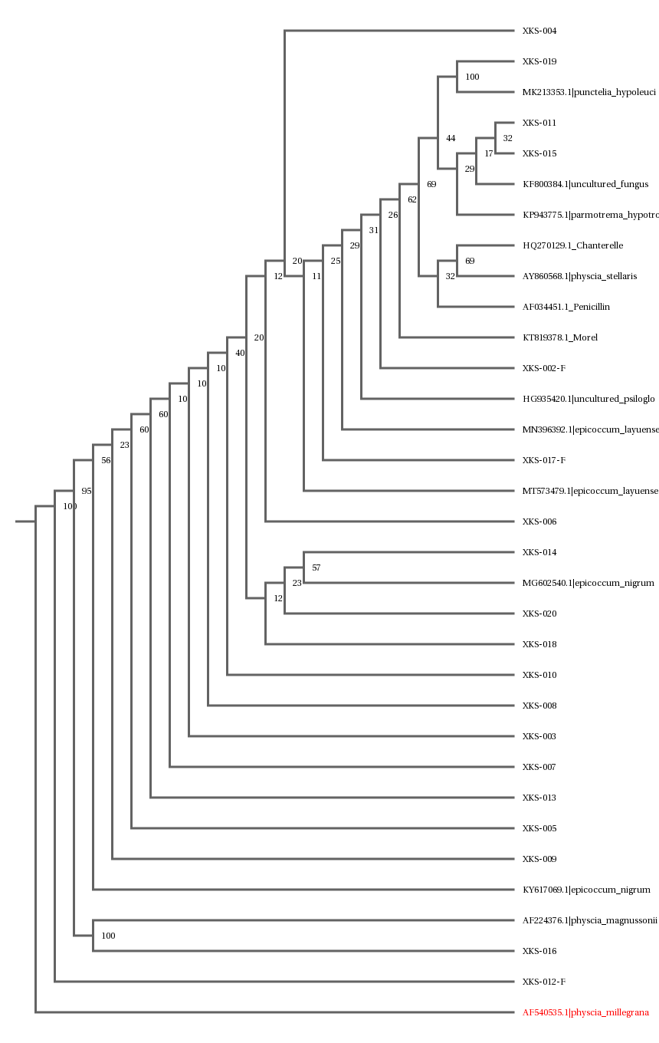
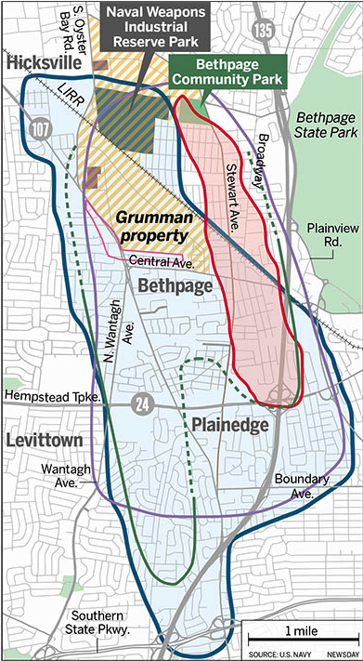
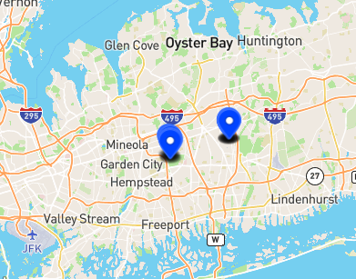
Lichens as Bioindicators for Radioactive Materials in the Grumman Plume
Nicholas Condoleo, Harry Hargreaves, Riley Fowler, Liam Schorr & Kathleen McAuley (mentor)
Lynbrook Senior High School
Abstract
In 1976, the United States and New York State government discovered that a plume of radioactive groundwater contamination had migrated off the Bethpage Naval Weapons Station in Long Island, New York (Schwartz & LaRocco, 2020). This groundwater plume, known as the Bethpage Plume, is contaminated with several hazardous and radioactive chemicals (Schwartz & LaRocco, 2020). The Bethpage Plume is currently considered to be one of the largest groundwater contamination sites in the US (Schwartz & LaRocco, 2020). Additionally, the Central Boulevard Elementary School has conducted tests in past years and detected radium in the groundwater above allowable standards of 3.0 pCi/L (Nannini, 2020); however, in 2021, it was found that radium levels were below 3.0 pCi/L (Nannini, 2021). Lichens are composite organisms and are known to be sensitive to environmental changes (Breeze, 2021). Given the sensitivity to environmental conditions, they could likely be used to monitor the Bethpage Plume.
Code | Genus and Species | Bit Score | # mismatches | Inside or outside of plume
XKS-001 | Physcia stellaris | 218 | 17 | Inside
XKS-002 | Uncultured Psiloglonium | 521 | 42 | Inside
XKS-003 | Epicoccum layuense | 933 | 0 | Inside
XKS-004 | Epicoccum layuense | 940 | 0 | Inside
XKS-005 | Epicoccum layuense | 935 | 0 | Inside
XKS-006 | Epicoccum layuense | 939 | 0 | Inside
XKS-007 | Epicoccum layuense | 933 | 0 | Inside
XKS-008 | Epicoccum layuense | 933 | 0 | Inside
XKS-009 | Epicoccum layuense | 935 | 0 | Inside
XKS-010 | Epicoccum layuense | 937 | 0 | Inside
XKS-011 | Uncultured Fungus Clone CMH293 | 949 | 1 | Outside
XKS-012 | Physcia millegrana | 126 | 3 | Outside
XKS-013 | Epicoccum layuense | 933 | 0 | Outside
XKS-014 | Epicoccum nigrum | 906 | 4 | Outside
XKS-015 | Parmotrema hypotropum | 260 | 3 | Outside
XKS-016 | Physcia magnussonii | 279 | 41 | Outside
XKS-017 | Epicoccum layuense | 993 | 0 | Outside
XKS-018 | Epicoccum layuense | 933 | 0 | Outside
XKS-019 | Punctelia hypoleucites | 961 | 11 | Outside
XKS-020 | Epicoccum layuense | 930 | 0 | Outside
Introduction
Lichens were used as bioindicators in the Chernobyl disaster in Ukraine (Kirchner & Daillant, 2002).
Lichen species Parmelia sulcata was found in Chernobyl to be a bioindicator of radioactivity, therefore it may also be in Bethpage Community Park, showcasing that a dangerous plume may still exist (Kirchner & Daillant, 2002).
We hypothesized that Parmelia sulcata will be found and will indicate radioactivity.
Figure 1. Plume Map
Figure 4. Blast Results
Discussion
Our results showed that the Lichens found in Bethpage Community Park may indicate the presence of radioactivity.
Our hypothesis was not supported, but there was a difference in some of the Lichens found at the different parks within and out of the plume.
The lichens that are able to inhabit the plume area might not be common elsewhere since it is a potentially radioactive area.
More research is needed to show that lichens can be used as bioindicators for radioactivity.
Our findings may have important implications for monitoring the Bethpage Plume; lichens could potentially be used as a cost-effective and non-invasive method to monitor the presence of radioactivity in the area.
This research could help inform future remediation efforts and ensure the safety of the local community.
Our study has several limitations; We only collected a small number of samples.
Future research could collect more samples and test for a wider range of lichen species to provide a more comprehensive understanding of the use of lichens as bioindicators.
In conclusion, our study provides preliminary evidence that lichens may be used as bioindicators for radioactivity in the Bethpage Plume.
Further research is needed to confirm these findings and to explore the potential use of lichens as a monitoring tool for radioactivity.
References
Breeze. (2021, December 3). breeze-technologies. Retrieved November 21, 2022, from https://www.breeze-technologies.de/blog/lichens-as-an-indicator-of-air-quality/#:~:text=Lichens%20have%20also%20been%20used,heavy%20metals%20and%20photo%20oxidants.
Hayward, G. C. (1979). COLLECTING AND CURATING LICHENS. Tane 25. https://www.thebookshelf.auckland.ac.nz/docs/Tane/Tane-25/19%20Collecting%20and%20Curating%20Lichens.pdf
Kirchner, G., & Daillant, O. (2002). The potential of lichens as long-term biomonitors of natural and artificial radionuclides. Environmental Pollution, 120(1), 145-150. https://doi.org/10.1016/S0269-7491(02)00139-2
Nannini, J. V. (2020, September). Central Blvd. Elementary School Groundwater Sampling Report - September 2020 (S. Muller, Ed.). J.C. BRODERICK & ASSOCIATES, INC. https://core-docs.s3.amazonaws.com/documents/asset/uploaded_file/3175/BUFSD/2344515/Central_Blvd._Elementary_School_Groundwater_Sampling_Report_-_September_2020.pdf
Nannini, J. V. (2021, September). Central Boulevard Elementary School Groundwater Sampling Report - September 2021 (S. Muller, Ed.). J.C. BRODERICK & ASSOCIATES, INC. https://core-docs.s3.amazonaws.com/documents/asset/uploaded_file/3175/BUFSD/2344507/Central_Boulevard_Elementary_School_Groundwater_Sampling_Report.pdf
Schwartz, D. M., & LaRocco, P. (2020, February 18). Newsday. Retrieved November 21, 2022, from https://projects.newsday.com/long-island/grumman-plume-evidence-discovery/
Figure 5. Phylogenetic Tree
Materials and Methods
We removed a small portion of tree bark from a tree to collect lichens; to prevent the bark from breaking, we wet the lichen for a few minutes before removing it (Hayward, 1979).
Specimens were 6cm in diameter and undamaged (Hayward, 1979).
We wore gloves to protect our hands. We used a knife to remove the specimen (Hayward, 1979).
We packaged the lichen samples in paper bags to preserve them
We left enough of the species to allow it to regenerate (Hayward, 1979).
We collected lichens from trees in both Bethpage Community Park and Eisenhower Park since both are mid island, and one not closer to the water than the other.
Both are public parks with daily visitors with the similar amount of sunlight reaching the trees. Eisenhower Park is the closest option that is a reasonable distance from the plume.
Bethpage Community Park falls in the area from the Grumman Plume (Experimental Group) and Eisenhower Park does not (control group).
Figure 2. Collection Locations

